Slide 1
Design Technology Co-Optimization for In-Memory Search
Speaker: B11901027 王仁軒

Slide 2
Outline
Introduction to few-shot learning
Traditional computer architecture vs In-memory searching
Choices of memory
Volatile vs Non-volatile
Searching methods
Exact-Match vs Best-Match
Distance metrics and its realization
L-infinity norm
L-1 norm
Difficulties of Best-Match searching method
Methods to tackle analog non-idealities

Slide 3
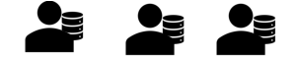




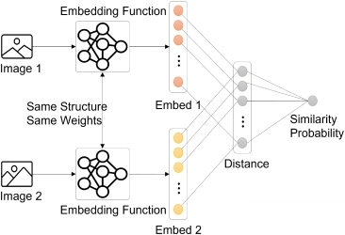
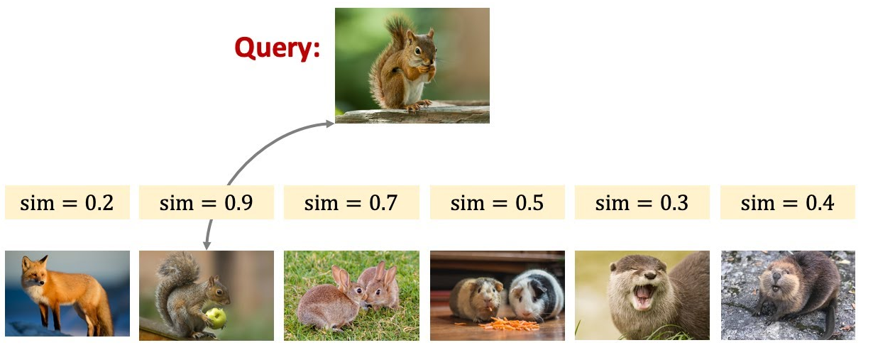
Few/One Shot Learning
Traditional classification models suffers from catastrophic forgetting when learning new domains
Tackle the forgetting issue
Search ALL data stored in the memory
Classfier
Forgets about cats
Cosine similarity!

Slide 4
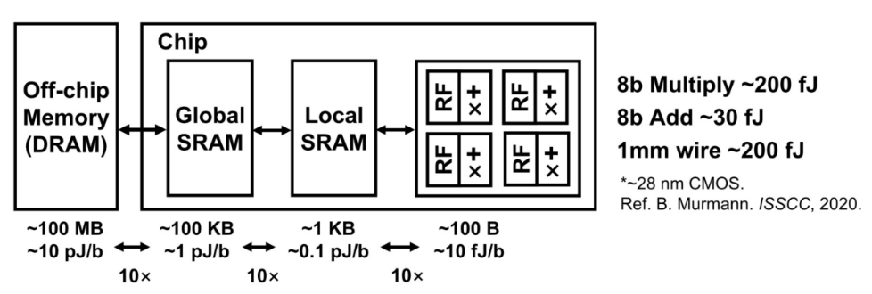

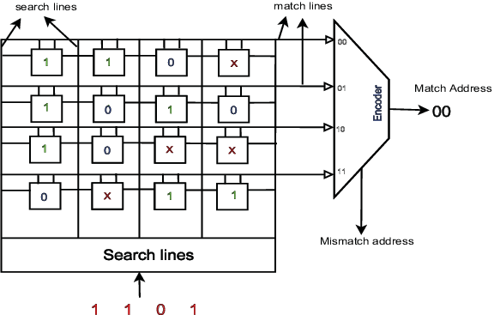
Traditional computer architecture
Traditional computer requires frequent data transfer between CPU and RAM for ML tasks
In memory search structure
60%↑power
von Neumann bottleneck
1
Parallel !
0
Scalable !
0
The array structure of memory allows us to lower the complexity of computing
0

Slide 5
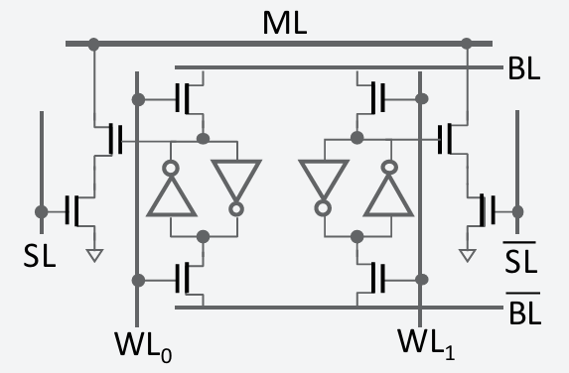
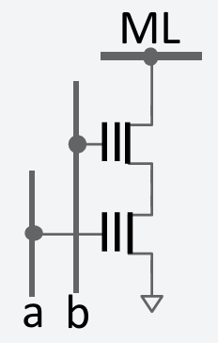
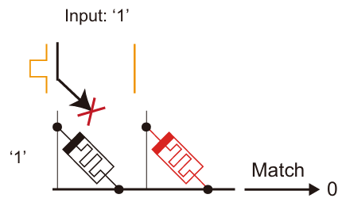
Types of Memory
Volatile vs Non-Volatile
16T CMOS
2T Flash/FeFET
2T RRAM Crossbar
Cannot cut off power
LEAKAGE!!!
Low power
Low leakage
Low power
Acceptable leakage

Slide 6
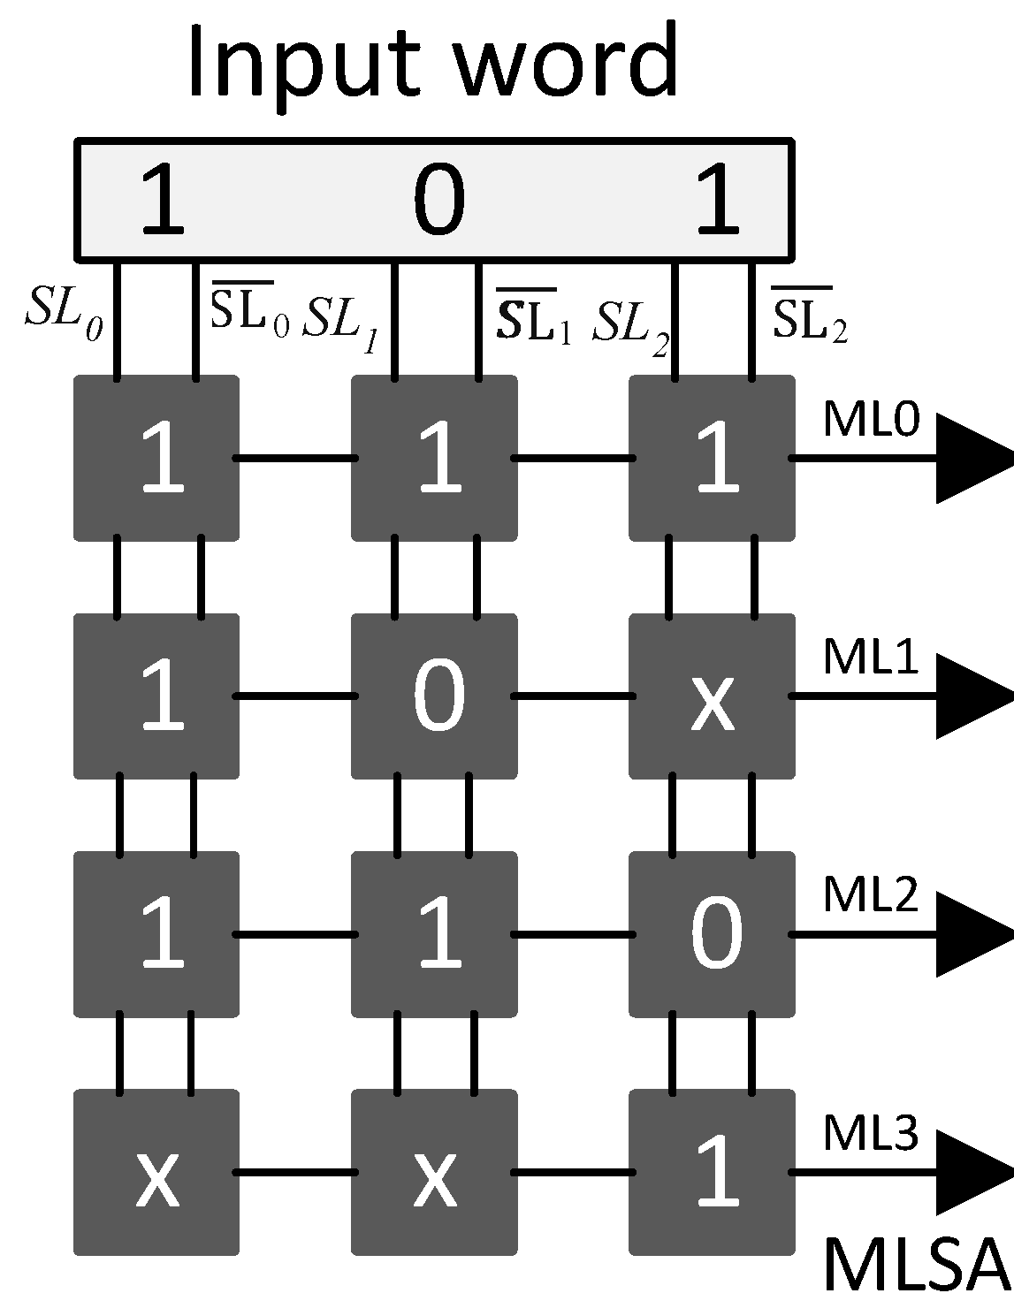

Types of Searching
Exact-match vs Best-match TCAM
Difference
0
1
1
HIT !
0
HIT !
0
2
1
0
Don’t require complex circuit for post processing | Require other analog circuit (Winner Take All ckt, ADC…)
Can scale up to MB/GB | Scale is limited to kB due to analog non-idealities and area
Functionality is restricted (need Special Encoding) | Finds the most similar entry (hamming distance)

Slide 7

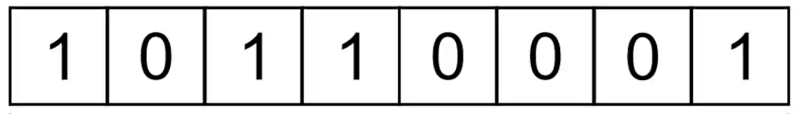

Distance metric
Cosine similarity
$$θ$$
Not friendly for direct hardware implementation
Need some distance metric that can be easily computed with binary data

Slide 8

Distance metric
L-infinity norm
Find the smallest square containing the query
Encode ranges into ternary vector $V={\left\{0, 1, x\right\}}^{2}$
If query is in the range: HIT !
Query
Hit!
Gray code
000
001
011
010
110
111
101
100
00
01
11
10
0*
1*
query
query
query
*0
*1
*0
More space
Short time
Less space
Long time
Less space Short time
But require range-to-range encoding
Good for encoding ranges

Slide 9
Distance metric
L-1 norm ( Hamming distance)
Finds the difference of bit data
High Vt Sence Amp
Can binary bits represent integer L-1 norm well?
Query
1 0 1 1 0 0 1 1
1 1 0 0 0 0 1 1
B
Data
V
15-11=4 but 1111–1011 = 1
A
1
2
0
0
Thermometer code
Low Vt Sence Amp
0 -> 00000000
3 -> 00000111
5 -> 00011111
+
AB = 00 / 10 / 11
Diff = 0 1 2
3

Slide 10
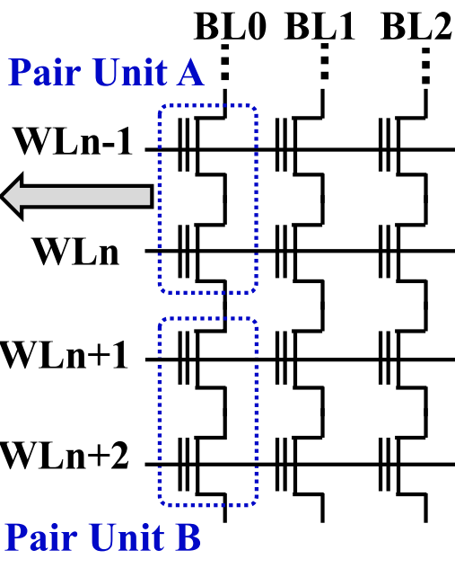
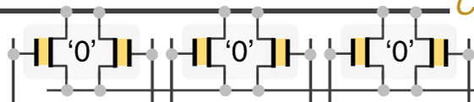
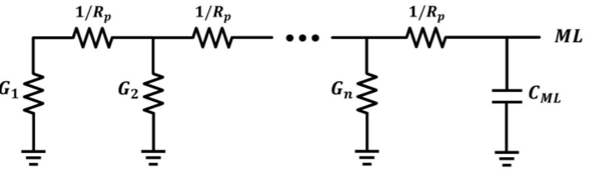
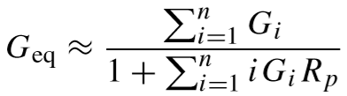
Problems of Best-Match TCAM
Analog non-idealities
Noise of storage elements accumulates
Parasitic effects of Match-Line
RAM array
noise
noise
Eq. ckt model
noise
noise
Position affects discharge rate

Slide 11

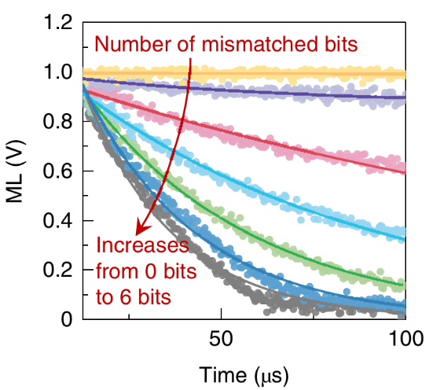
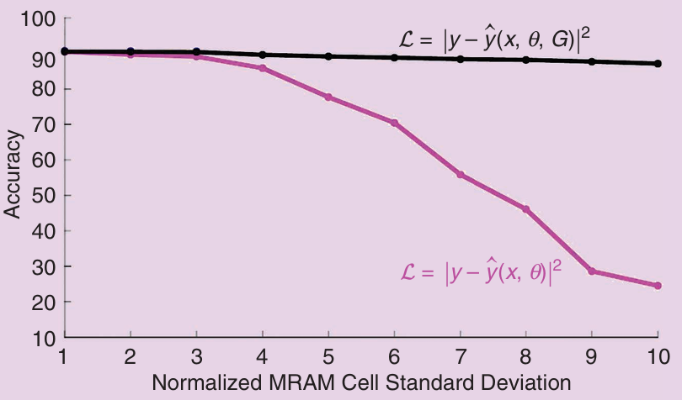
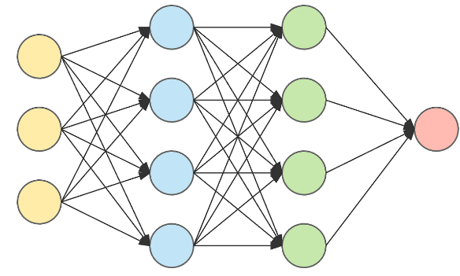
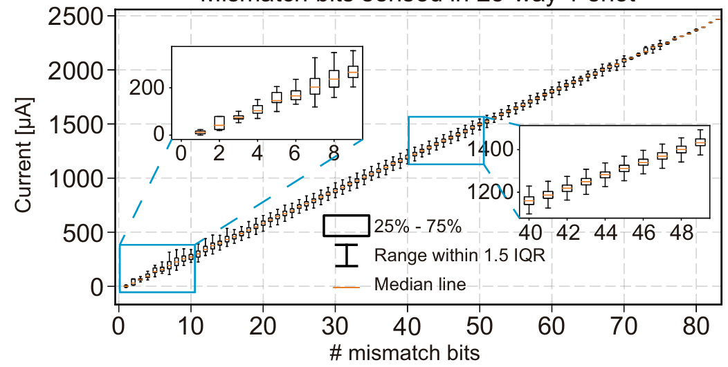

Problems of Best-Match TCAM
Analog non-idealities
Noise-aware training
Noise of analog circuits could hazard our performance
Inject noise into model to make it noise-resistant
w/ noise
injection
w/o noise injection
Noisy!
$$f\left(θ\right) \sim Gaussian\left(0,σ\right)$$
or more complicated
device noise model (costly)

