Slide 1
Segmented Angular Pre-Processing for Accurate and Efficient In-Memory VSS
Speaker : Oniontow
Mentor : Rick Huang
Advisor: Prof. An-Yeu (Andy) Wu / Dr. Hsiang-Yun Cheng
Date : 2026/03/09

Slide 2
Outline
Hamming Distance & Cosine Distance
Estimation of Weights
Preprocessing for Encoding
Codeword Generation
Experiment Results

Slide 3






Observation of Hamming Distance
Gap between Hamming distance and cosine distance narrowed when dimension of embeddings increases
Hamming distance (spatial metric) & Cosine distance (angular metric)
There must be some relation between these two metric
Discrepancy (Segment vs. Vector)
$$D$$
worse
Number of Segments
$$L_{1}$$
$$L_{∞}$$
Discrepancy Saturation Region

Slide 4



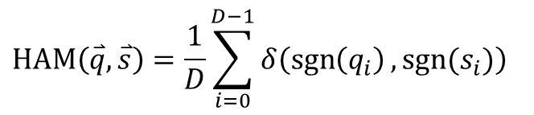




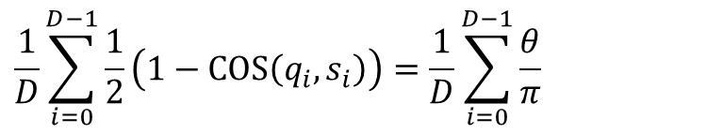











Hamming Distance & Cosine Distance
Relation between Hamming distance & cosine distance
Re-interpretation of Hamming distance
Rewrite the formula of Hamming distance using cosine function
$$HAM\left(\overset{⃑}{q}, \overset{⃑}{s}\right)=\frac{1}{D}\sum_{i=0}^{D−1}{δ\left(\operatorname{sgn}\left(q_{i}\right),sgn⁡(s_{i})\right)}$$
Same sign = 0 Opposite sign = 1
$$\frac{1}{D}\sum_{i=0}^{D−1}{\frac{1}{2}\left(1−COS\left(q_{i}, s_{i}\right)\right)}=\frac{1}{D}\sum_{i=0}^{D−1}{\frac{θ}{π}}$$
Same dir. = 0 Opposite dir. = 1
$$1−cos\left(θ\right)=0$$
$$1−\cos\left(θ\right)=2$$
$$\overset{⃑}{s}$$
$$\overset{⃑}{q}$$
$$\overset{⃑}{s}$$
$$\overset{⃑}{q}$$
$$q_{i}$$
$${sgn⁡(q}_{i})$$
$$q_{i}$$
$${sgn⁡(q}_{i})$$
$$δ$$
$$δ$$
3
1
3
-2
1
1
-1
1
3
1
3
-2
1
1
-1
1
$$θ=0$$
$$θ=π$$
$$s_{i}$$
$$\operatorname{sgn}\left(s_{i}\right)$$
0
0
1
1
$$s_{i}$$
$$\operatorname{sgn}\left(s_{i}\right)$$
0
0
1
1
2
5
-2
9
1
1
1
-1
2
5
-2
9
1
1
1
-1

Slide 5






Hamming Distance & Cosine Distance
Relation between Hamming distance & cosine distance
Re-interpretation of Hamming distance
Rewrite the formula of Hamming distance using cosine function
$$HAM\left(\overset{⃑}{q}, \overset{⃑}{s}\right)=\frac{1}{D}\sum_{i=0}^{D−1}{δ\left(\operatorname{sgn}\left(q_{i}\right),sgn⁡(s_{i})\right)}$$
Same sign = 0 Opposite sign = 1
$$\frac{1}{D}\sum_{i=0}^{D−1}{\frac{1}{2}\left(1−COS\left(q_{i}, s_{i}\right)\right)}=\frac{1}{D}\sum_{i=0}^{D−1}{\frac{θ}{π}}$$
3
1
3
-2
$$θ$$
0
0
1
1
$$q_{i}$$
$$θ$$
$$q_{i}$$
$${sgn⁡(q}_{i})$$
$$δ$$
$$δ$$
$$θ$$
3
1
3
-2
1
1
-1
1
$$s_{i}$$
$$\operatorname{sgn}\left(s_{i}\right)$$
0
0
1
1
$$θ$$
2
5
-2
9
1
1
1
-1
2
5
-2
9
$$s_{i}$$

Slide 6


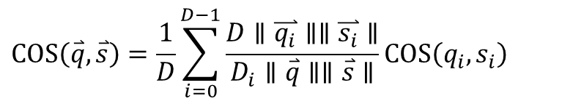
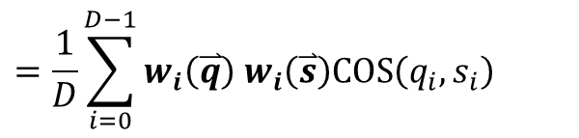
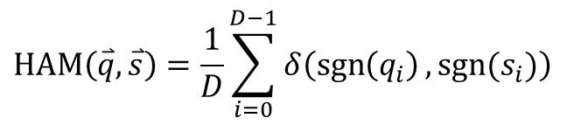
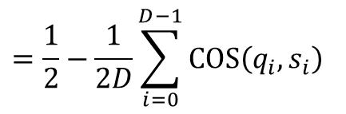

Hamming Distance & Cosine Distance
Difference between Hamming distance & cosine distance
What if we can roughly estimate the weight?
Make Hamming distance more similar to cosine distance
Weights are multiplier in summation
Use logarithmic function to separate weights from $COS\left(q_{i}, s_{i}\right)$
$=δ$ when $D_{i}=1$
$$HAM\left(\overset{⃑}{q}, \overset{⃑}{s}\right)=\frac{1}{D}\sum_{i=0}^{D−1}{δ\left(\operatorname{sgn}\left(q_{i}\right),sgn⁡(s_{i})\right)}$$
$$COS\left(\overset{⃑}{q}, \overset{⃑}{s}\right)=\frac{1}{D}\sum_{i=0}^{D−1}{\frac{D∥\overset{⃑}{q_{i}}∥∥\overset{⃑}{s_{i}}∥}{D_{i}∥\overset{⃑}{q}∥∥\overset{⃑}{s}∥}}COS\left(q_{i}, s_{i}\right)$$
$$=\frac{1}{2}−\frac{1}{2D}\sum_{i=0}^{D−1}{COS\left(q_{i}, s_{i}\right)}$$
$$=\frac{1}{D}\sum_{i=0}^{D−1}{w_{i}\left(\overset{⃑}{q}\right) w_{i}\left(\overset{⃑}{s}\right)COS\left(q_{i}, s_{i}\right)}$$
$$w_{i}\left(\overset{⃑}{v}\right)=\frac{\sqrt{D}}{\sqrt{D_{seg}}}\frac{\left|v_{i}\right|}{\left|\overset{⃑}{v}\right|}$$
Unweighted vs Weighted

Slide 7


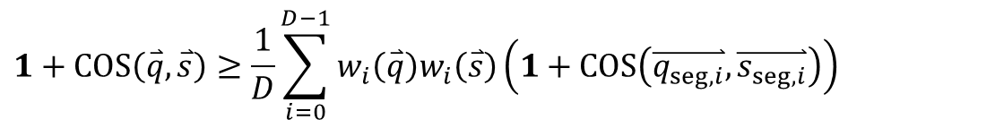
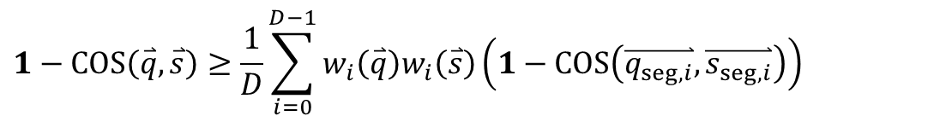
Estimation of Weights
$$w_{i}\left(\overset{⃑}{v}\right)=\frac{\sqrt{D}}{\sqrt{D_{seg}}}\frac{\left|v_{i}\right|}{\left|\overset{⃑}{v}\right|}$$
First using Cauchy-Schwarz ineq.
We get
$$\frac{1}{D}\sum_{i=0}^{D−1}{w_{i}\left(\overset{⃑}{q}\right)w_{i}\left(\overset{⃑}{s}\right)}≤1$$
$$1−COS\left(\overset{⃑}{q}, \overset{⃑}{s}\right)≥\frac{1}{D}\sum_{i=0}^{D−1}{w_{i}\left(\overset{⃑}{q}\right)w_{i}\left(\overset{⃑}{s}\right)\left(1−COS\left(\overset{⃑}{q_{seg,i}},\overset{⃑}{s_{seg,i}}\right)\right)}$$
$$1+COS\left(\overset{⃑}{q}, \overset{⃑}{s}\right)≥\frac{1}{D}\sum_{i=0}^{D−1}{w_{i}\left(\overset{⃑}{q}\right)w_{i}\left(\overset{⃑}{s}\right)\left(1+COS\left(\overset{⃑}{q_{seg,i}},\overset{⃑}{s_{seg,i}}\right)\right)}$$

Slide 8

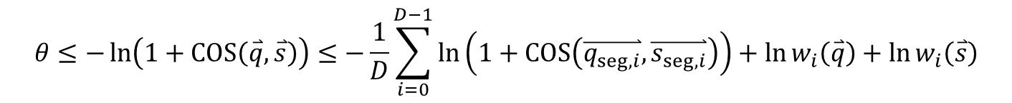
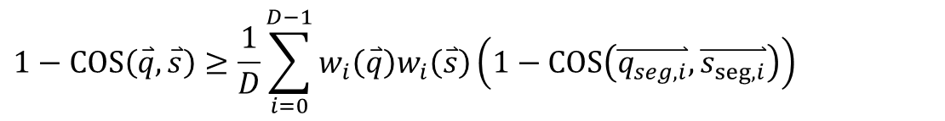
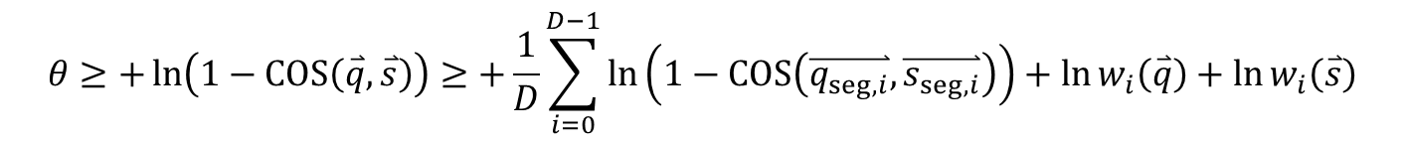
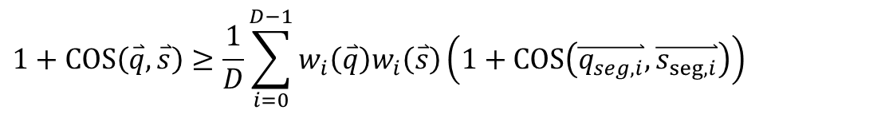
Estimation of Weights
$$w_{i}\left(\overset{⃑}{v}\right)=\frac{\sqrt{D}}{\sqrt{D_{seg}}}\frac{\left|v_{i}\right|}{\left|\overset{⃑}{v}\right|}$$
Using Jensen’s ineq. & log-cosine ineq
We get
$$−ln\left(1+cos θ\right)≥θ≥ln\left(1−cos θ\right)$$
$$1−COS\left(\overset{⃑}{q}, \overset{⃑}{s}\right)≥\frac{1}{D}\sum_{i=0}^{D−1}{w_{i}\left(\overset{⃑}{q}\right)w_{i}\left(\overset{⃑}{s}\right)\left(1−COS\left(\overset{⃑}{q_{seg,i}},\overset{⃑}{s_{seg,i}}\right)\right)}$$
$$1+COS\left(\overset{⃑}{q}, \overset{⃑}{s}\right)≥\frac{1}{D}\sum_{i=0}^{D−1}{w_{i}\left(\overset{⃑}{q}\right)w_{i}\left(\overset{⃑}{s}\right)\left(1+COS\left(\overset{⃑}{q_{seg,i}},\overset{⃑}{s_{seg,i}}\right)\right)}$$
$$θ≥+\ln\left(1−COS\left(\overset{⃑}{q}, \overset{⃑}{s}\right)\right)≥+\frac{1}{D}\sum_{i=0}^{D−1}{\ln\left(1−COS\left(\overset{⃑}{q_{seg,i}},\overset{⃑}{s_{seg,i}}\right)\right)}+\ln{w_{i}\left(\overset{⃑}{q}\right)}+\ln{w_{i}\left(\overset{⃑}{s}\right)}$$
$$θ≤−\ln\left(1+COS\left(\overset{⃑}{q}, \overset{⃑}{s}\right)\right)≤−\frac{1}{D}\sum_{i=0}^{D−1}{\ln\left(1+COS\left(\overset{⃑}{q_{seg,i}},\overset{⃑}{s_{seg,i}}\right)\right)}+\ln{w_{i}\left(\overset{⃑}{q}\right)}+\ln{w_{i}\left(\overset{⃑}{s}\right)}$$

Slide 9
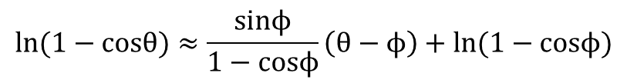

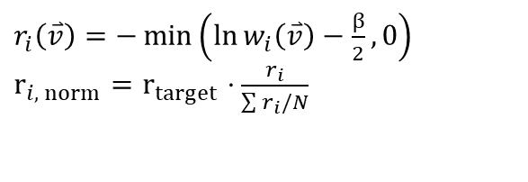
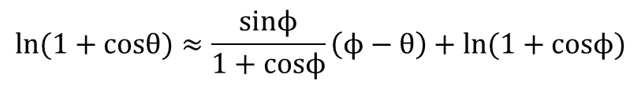


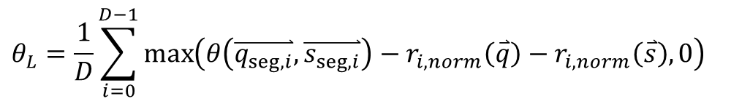


Estimation of Weights
$$−\frac{1}{D}\sum_{i=0}^{D−1}{\ln\left(1+COS\left(\overset{⃑}{q_{seg,i}},\overset{⃑}{s_{seg,i}}\right)\right)}+\ln{w_{i}\left(\overset{⃑}{q}\right)}+\ln{w_{i}\left(\overset{⃑}{s}\right)}≥θ≥\frac{1}{D}\sum_{i=0}^{D−1}{\ln\left(1−COS\left(\overset{⃑}{q_{seg,i}},\overset{⃑}{s_{seg,i}}\right)\right)}+\ln{w_{i}\left(\overset{⃑}{q}\right)}+\ln{w_{i}\left(\overset{⃑}{s}\right)}$$
Non-linear relation between $\overset{⃑}{q}$ and $\overset{⃑}{s}$
Apply Taylor Expansion
Loose bound due to logarithmic function
$$ln⁡(1+cosθ)≈\frac{sinϕ}{1+cosϕ}\left(ϕ−θ\right)+ln⁡(1+cosϕ)$$
$$−ln\left(1+cos θ\right)$$
$$θ−\frac{π}{2}$$
$$ln\left(1−cos θ\right)$$
$$ln⁡(1−cosθ)≈\frac{sinϕ}{1−cosϕ}\left(θ−ϕ\right)+ln⁡(1−cosϕ)$$
$r_{i}\left(\overset{⃑}{v}\right)=−\min\left(\ln{w_{i}\left(\overset{⃑}{v}\right)}−\frac{β}{2},0\right)$ $r_{i, norm}=r_{target}⋅\frac{r_{i}}{\sum{r_{i}/N}}$
Clamping & Normalize
$$\frac{β}{2}$$
$$θ_{L}=\frac{1}{D}\sum_{i=0}^{D−1}{\max\left(θ\left(\overset{⃑}{q_{seg,i}},\overset{⃑}{s_{seg,i}}\right)−r_{i, norm}\left(\overset{⃑}{q}\right)−r_{i, norm}\left(\overset{⃑}{s}\right),0\right)}$$

Slide 10
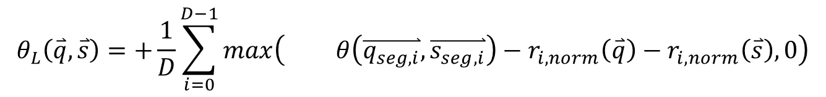
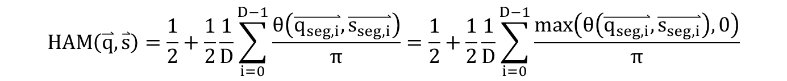
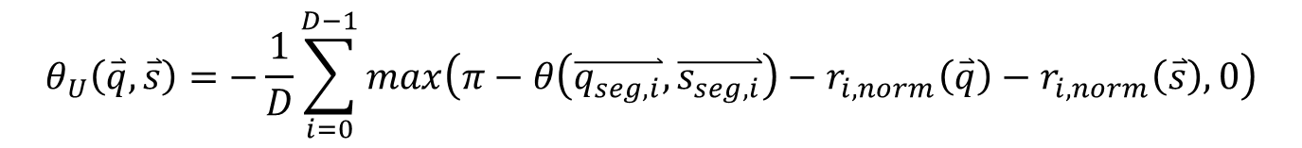
Estimation of Weights
Hamming Distance
Segmented Cosine
$→$ Sum of Low-Dimensional Angles
$$HAM\left(\overset{⃑}{q}, \overset{⃑}{s}\right)=\frac{1}{2}+\frac{1}{2}\frac{1}{D}\sum_{i=0}^{D−1}{\frac{θ\left(\overset{⃑}{q_{seg,i}},\overset{⃑}{s_{seg,i}}\right)}{π}}=\frac{1}{2}+\frac{1}{2}\frac{1}{D}\sum_{i=0}^{D−1}{\frac{max\left(θ\left(\overset{⃑}{q_{seg,i}},\overset{⃑}{s_{seg,i}}\right),0\right)}{π}}$$
$→$ Hamming Distance + Low-Dimensional Magnitudes
$$θ_{L}\left(\overset{⃑}{q}, \overset{⃑}{s}\right)=+\frac{1}{D}\sum_{i=0}^{D−1}{\max\left( θ\left(\overset{⃑}{q_{seg,i}},\overset{⃑}{s_{seg,i}}\right)−r_{i, norm}\left(\overset{⃑}{q}\right)−r_{i, norm}\left(\overset{⃑}{s}\right),0\right)}$$
$$θ_{U}\left(\overset{⃑}{q}, \overset{⃑}{s}\right)=−\frac{1}{D}\sum_{i=0}^{D−1}{\max\left(π−θ\left(\overset{⃑}{q_{seg,i}},\overset{⃑}{s_{seg,i}}\right)−r_{i, norm}\left(\overset{⃑}{q}\right)−r_{i, norm}\left(\overset{⃑}{s}\right),0\right)}$$

Slide 11



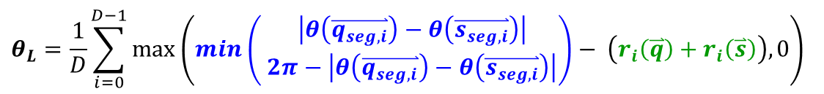







Preprocessing with Angle & Range
Obtained estimation
$$θ_{L}=\frac{1}{D}\sum_{i=0}^{D−1}{\max\left(\min\left( \begin{aligned}\left|θ\left(\overset{⃑}{q_{seg,i}}\right)−θ\left(\overset{⃑}{s_{seg,i}}\right)\right| \\ 2π−\left|θ\left(\overset{⃑}{q_{seg,i}}\right)−θ\left(\overset{⃑}{s_{seg,i}}\right)\right|\end{aligned}\right)− \left(r_{i}\left(\overset{⃑}{q}\right)+r_{i}\left(\overset{⃑}{s}\right)\right),0\right)}$$
$$θ\left(\overset{⃑}{q_{seg,i}}, \overset{⃑}{s_{seg,i}}\right)$$
$$2π−θ$$
Angle
Magnitude
$$[0, 2]=[1−1, 1+1]=[c_{1}−r_{1},c_{1}+r_{1}]$$
0
1
2
3
4
5
$$\left[1, 5\right]=\left[3−2, 3+2\right]=[c_{2}−r_{2},c_{2}+r_{2}]$$
$$c_{1}$$
$$[0, 2]$$
$$d\left(\left[0,2\right], \left[1,5\right]\right)=\min_{m∈\left\{0,1,2\right\}, n∈\{1,2,3,4,5\}}{|m−n|}=0$$
$$c_{2}$$
$$=\max{(\left|c_{1}−c_{2}\right|−(r_{1}+r_{2}),0)}$$
$$r_{1}$$
$$[1, 5]$$
Angle terms : centers of ranges
$$r_{2}$$
Magnitude terms : half-lengths of ranges

Slide 12


Codeword Generation
X
0
0
X
0
X
X
1
1
0
0
0
0
1
1
1
Möbius Encoding (Codeword length: $\frac{N}{2}$)
0
1
2
3
00
01
11
10
3
1
[0,2]: XX
2-bit Difference
[2,3]: 1X
3
1
3
-2
1
3
1-bit Difference
Limitation: Range < $\frac{N}{2}$
3
-2
-2
3
Discretize
Range
Vector
Segment
Codeword

Slide 13

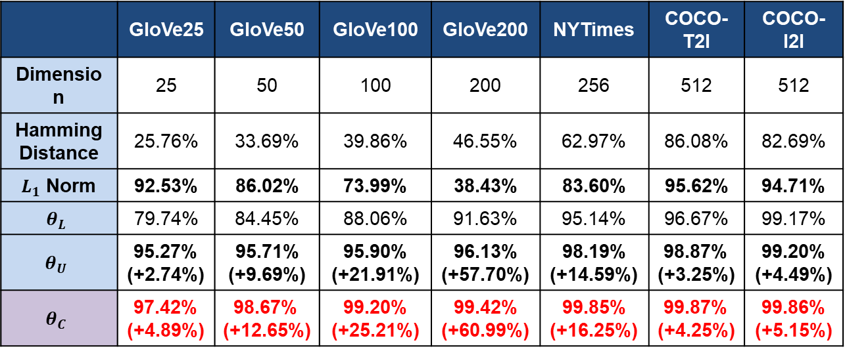
Results
Recall of hamming distance / segmented cosine increases as dimension grows
Complementary estimates perform better recall rate than individual estimates
 | GloVe25 | GloVe50 | GloVe100 | GloVe200 | NYTimes | COCO-T2I | COCO-I2I
Dimension | 25 | 50 | 100 | 200 | 256 | 512 | 512
Hamming Distance | 25.76% | 33.69% | 39.86% | 46.55% | 62.97% | 86.08% | 82.69%
$L_{1}$ Norm | 92.53% | 86.02% | 73.99% | 38.43% | 83.60% | 95.62% | 94.71%
$$θ_{L}$$ | 79.74% | 84.45% | 88.06% | 91.63% | 95.14% | 96.67% | 99.17%
$$θ_{U}$$ | 95.27% (+2.74%) | 95.71% (+9.69%) | 95.90% (+21.91%) | 96.13% (+57.70%) | 98.19% (+14.59%) | 98.87% (+3.25%) | 99.20% (+4.49%)
$$θ_{C}$$ | 97.42% (+4.89%) | 98.67% (+12.65%) | 99.20% (+25.21%) | 99.42% (+60.99%) | 99.85% (+16.25%) | 99.87% (+4.25%) | 99.86% (+5.15%)
Extension of
Ham. Dist.
$$θ_{L}+θ_{U}$$
(Complementary)

Slide 14
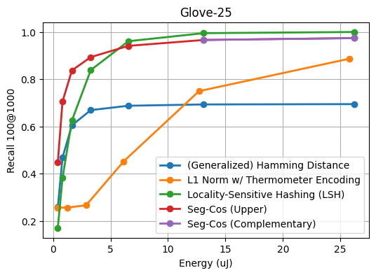
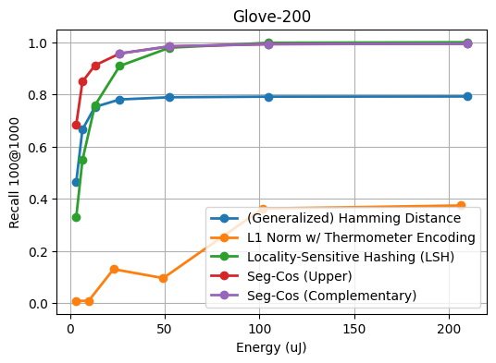
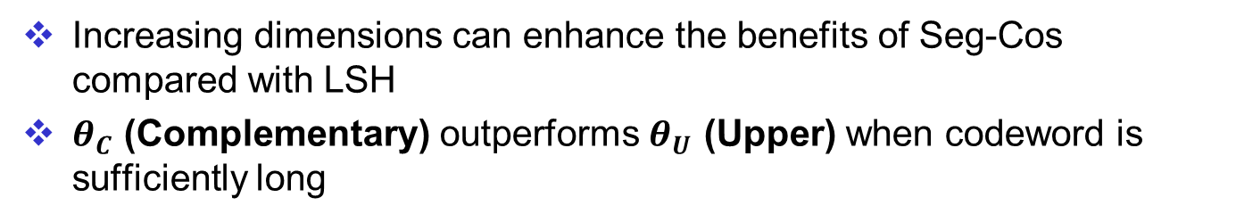
Results (GloVe)
Increasing dimensions can enhance the benefits of Seg-Cos compared with LSH
$θ_{C}$ (Complementary) outperforms $θ_{U}$ (Upper) when codeword is sufficiently long
Discretization Error
Dominate
Metric Error Dominate
Discretization Error
Dominate
Metric Error Dominate

Slide 15
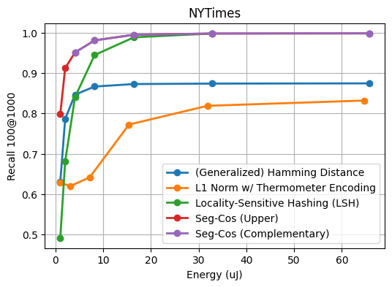
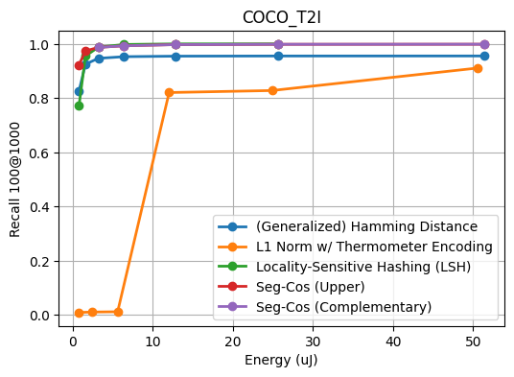
Results (NYTimes & COCO-T2I)
Seg-Cos can preserve higher recall rates in the short-codeword length scenarios
Approx. 100% recall rates in the high-dimensional vector database
Discretization Error
Dominate
Metric Error Dominate
Discretization Error
Dominate
Metric Error Dominate

Slide 16
Conclusion
Hamming Distance & Cosine Distance
Hamming distance can be viewed as an unweighted cosine distance
As long as we can estimate the weight, we can be closer to cosine distance
Estimation of Weights
Using logarithmic functions to form upper/lower bound
Apply Taylor Expansion and clamping skill to simplify computation
Preprocessing for Encoding
Segmentize, Quantize centerpoint & range
Codeword Generation
Ring Encoding
Experiment Results
Complementary estimates perform better recall rate than individual estimates

