Slide 1
Experiments on Dimension Reduction
Speaker : Oniontow
Mentor : Rick Huang
Advisor: Prof. An-Yeu (Andy) Wu / Dr. Hsiang-Yun Cheng
Date : 2026/02/03

Slide 2
Outline

Slide 3



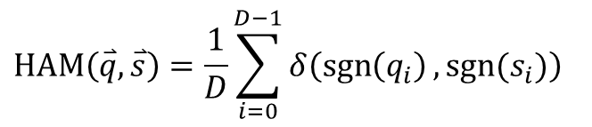




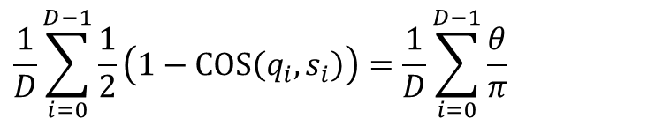











Hamming Distance & Cosine Distance
Relation between Hamming distance & cosine distance
  Re-interpretation of Hamming distance
  Rewrite the formula of Hamming distance using cosine function
$$HAM\left(\overset{⃑}{q}, \overset{⃑}{s}\right)=\frac{1}{D}\sum_{i=0}^{D−1}{δ\left(\operatorname{sgn}\left(q_{i}\right),sgn⁡(s_{i})\right)}$$
Same sign = 0 Opposite sign = 1
$$\frac{1}{D}\sum_{i=0}^{D−1}{\frac{1}{2}\left(1−COS\left(q_{i}, s_{i}\right)\right)}=\frac{1}{D}\sum_{i=0}^{D−1}{\frac{θ}{π}}$$
Same dir. = 0 Opposite dir. = 1
$$1−cos\left(θ\right)=0$$
$$1−\cos\left(θ\right)=2$$
$$\overset{⃑}{s}$$
$$\overset{⃑}{q}$$
$$\overset{⃑}{s}$$
$$\overset{⃑}{q}$$
$$q_{i}$$
$${sgn⁡(q}_{i})$$
$$q_{i}$$
$${sgn⁡(q}_{i})$$
$$δ$$
$$δ$$
3
1
3
-2
1
1
-1
1
3
1
3
-2
1
1
-1
1
$$θ=0$$
$$θ=π$$
$$s_{i}$$
$$\operatorname{sgn}\left(s_{i}\right)$$
0
0
1
1
$$s_{i}$$
$$\operatorname{sgn}\left(s_{i}\right)$$
0
0
1
1
2
5
-2
9
1
1
1
-1
2
5
-2
9
1
1
1
-1

Slide 4






Hamming Distance & Cosine Distance
Relation between Hamming distance & cosine distance
  Re-interpretation of Hamming distance
  Rewrite the formula of Hamming distance using cosine function
$$HAM\left(\overset{⃑}{q}, \overset{⃑}{s}\right)=\frac{1}{D}\sum_{i=0}^{D−1}{δ\left(\operatorname{sgn}\left(q_{i}\right),sgn⁡(s_{i})\right)}$$
Same sign = 0 Opposite sign = 1
$$\frac{1}{D}\sum_{i=0}^{D−1}{\frac{1}{2}\left(1−COS\left(q_{i}, s_{i}\right)\right)}=\frac{1}{D}\sum_{i=0}^{D−1}{\frac{θ}{π}}$$
3
1
3
-2
$$θ$$
0
0
1
1
$$q_{i}$$
$$θ$$
$$q_{i}$$
$${sgn⁡(q}_{i})$$
$$δ$$
$$δ$$
$$θ$$
3
1
3
-2
1
1
-1
1
$$s_{i}$$
$$\operatorname{sgn}\left(s_{i}\right)$$
0
0
1
1
$$θ$$
2
5
-2
9
1
1
1
-1
2
5
-2
9
$$s_{i}$$

Slide 5
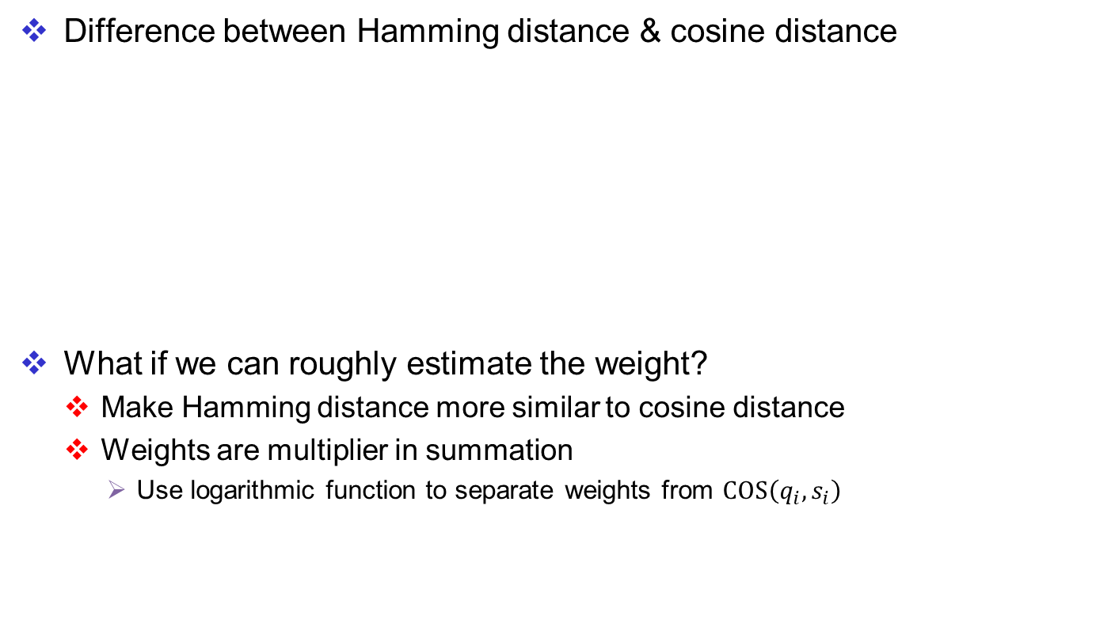
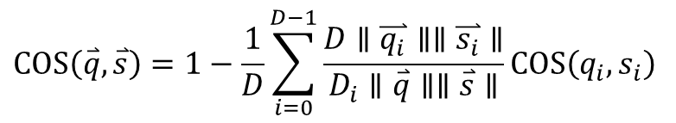
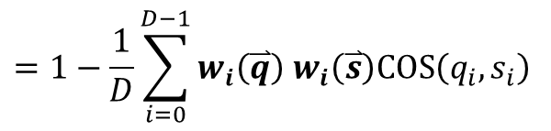
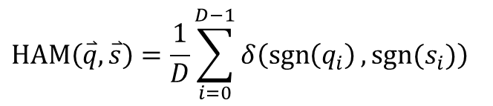
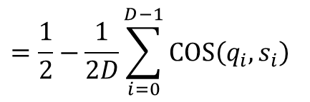
Hamming Distance & Cosine Distance
Difference between Hamming distance & cosine distance
What if we can roughly estimate the weight?
  Make Hamming distance more similar to cosine distance
  Weights are multiplier in summation
    Use logarithmic function to separate weights from $COS\left(q_{i}, s_{i}\right)$
$$HAM\left(\overset{⃑}{q}, \overset{⃑}{s}\right)=\frac{1}{D}\sum_{i=0}^{D−1}{δ\left(\operatorname{sgn}\left(q_{i}\right),sgn⁡(s_{i})\right)}$$
$$COS\left(\overset{⃑}{q}, \overset{⃑}{s}\right)=1−\frac{1}{D}\sum_{i=0}^{D−1}{\frac{D∥\overset{⃑}{q_{i}}∥∥\overset{⃑}{s_{i}}∥}{D_{i}∥\overset{⃑}{q}∥∥\overset{⃑}{s}∥}}COS\left(q_{i}, s_{i}\right)$$
$$=\frac{1}{2}−\frac{1}{2D}\sum_{i=0}^{D−1}{COS\left(q_{i}, s_{i}\right)}$$
$$=1−\frac{1}{D}\sum_{i=0}^{D−1}{w_{i}\left(\overset{⃑}{q}\right) w_{i}\left(\overset{⃑}{s}\right)COS\left(q_{i}, s_{i}\right)}$$
Unweighted vs Weighted

Slide 6


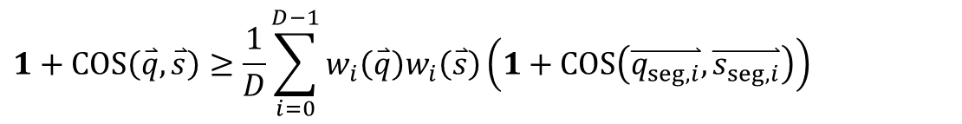
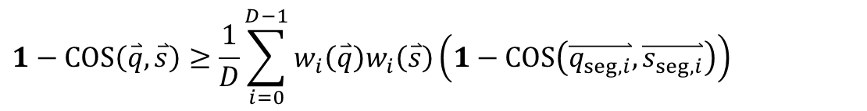
Estimation of Weights
$$w_{i}\left(\overset{⃑}{v}\right)=\frac{\sqrt{D}}{\sqrt{D_{seg}}}\frac{\left|v_{i}\right|}{\left|\overset{⃑}{v}\right|}$$
First using Cauchy-Schwarz ineq.
We get
$$\frac{1}{D}\sum_{i=0}^{D−1}{w_{i}\left(\overset{⃑}{q}\right)w_{i}\left(\overset{⃑}{s}\right)}≤1$$
$$1−COS\left(\overset{⃑}{q}, \overset{⃑}{s}\right)≥\frac{1}{D}\sum_{i=0}^{D−1}{w_{i}\left(\overset{⃑}{q}\right)w_{i}\left(\overset{⃑}{s}\right)\left(1−COS\left(\overset{⃑}{q_{seg,i}},\overset{⃑}{s_{seg,i}}\right)\right)}$$
$$1+COS\left(\overset{⃑}{q}, \overset{⃑}{s}\right)≥\frac{1}{D}\sum_{i=0}^{D−1}{w_{i}\left(\overset{⃑}{q}\right)w_{i}\left(\overset{⃑}{s}\right)\left(1+COS\left(\overset{⃑}{q_{seg,i}},\overset{⃑}{s_{seg,i}}\right)\right)}$$

Slide 7
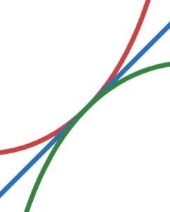
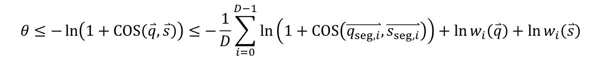
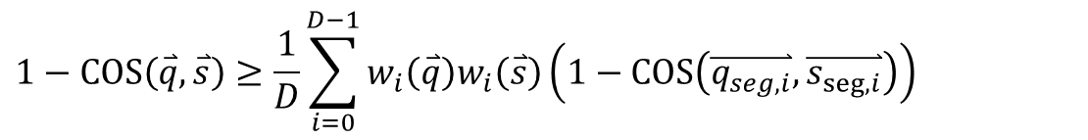
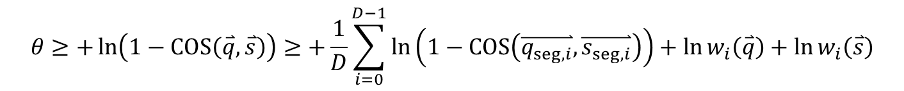
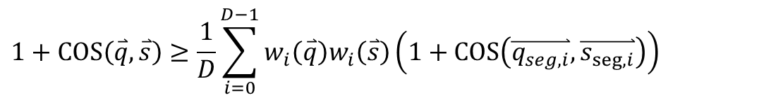
Estimation of Weights
$$w_{i}\left(\overset{⃑}{v}\right)=\frac{\sqrt{D}}{\sqrt{D_{seg}}}\frac{\left|v_{i}\right|}{\left|\overset{⃑}{v}\right|}$$
Using Jensen’s ineq. & log-cosine ineq
We get
$$−ln(1+cos(θ)≥θ≥ln(1−cos(θ)$$
$$1−COS\left(\overset{⃑}{q}, \overset{⃑}{s}\right)≥\frac{1}{D}\sum_{i=0}^{D−1}{w_{i}\left(\overset{⃑}{q}\right)w_{i}\left(\overset{⃑}{s}\right)\left(1−COS\left(\overset{⃑}{q_{seg,i}},\overset{⃑}{s_{seg,i}}\right)\right)}$$
$$1+COS\left(\overset{⃑}{q}, \overset{⃑}{s}\right)≥\frac{1}{D}\sum_{i=0}^{D−1}{w_{i}\left(\overset{⃑}{q}\right)w_{i}\left(\overset{⃑}{s}\right)\left(1+COS\left(\overset{⃑}{q_{seg,i}},\overset{⃑}{s_{seg,i}}\right)\right)}$$
$$θ≥+\ln\left(1−COS\left(\overset{⃑}{q}, \overset{⃑}{s}\right)\right)≥+\frac{1}{D}\sum_{i=0}^{D−1}{\ln\left(1−COS\left(\overset{⃑}{q_{seg,i}},\overset{⃑}{s_{seg,i}}\right)\right)}+\ln{w_{i}\left(\overset{⃑}{q}\right)}+\ln{w_{i}\left(\overset{⃑}{s}\right)}$$
$$θ≤−\ln\left(1+COS\left(\overset{⃑}{q}, \overset{⃑}{s}\right)\right)≤−\frac{1}{D}\sum_{i=0}^{D−1}{\ln\left(1+COS\left(\overset{⃑}{q_{seg,i}},\overset{⃑}{s_{seg,i}}\right)\right)}+\ln{w_{i}\left(\overset{⃑}{q}\right)}+\ln{w_{i}\left(\overset{⃑}{s}\right)}$$

Slide 8
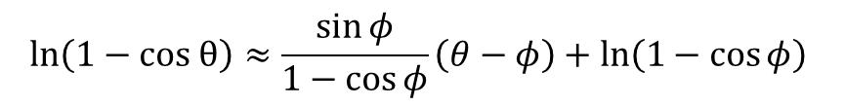

Estimation of Weights
$$w_{i}\left(\overset{⃑}{v}\right)=\frac{\sqrt{D}}{\sqrt{D_{seg}}}\frac{\left|v_{i}\right|}{\left|\overset{⃑}{v}\right|}$$
Using Taylor Expansion to make approximation of logarithmic function
We get
$$ln\left(1−cos θ\right)≈\frac{\sin{φ}}{1−\cos{φ}}\left(θ−φ\right)+ln\left(1−\cos{φ}\right)$$

