Slide 1
Title
Speaker : B11901027 王仁軒
Mentor : Rick Huang
Advisor: Prof. An-Yeu (Andy) Wu
Date : 2025/05/02

Slide 2
Outline

Slide 3
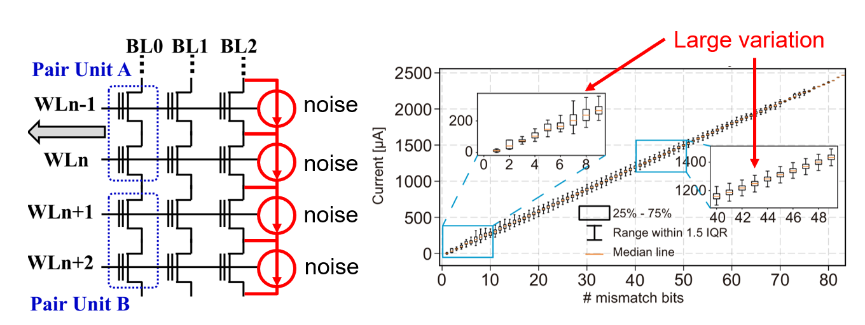
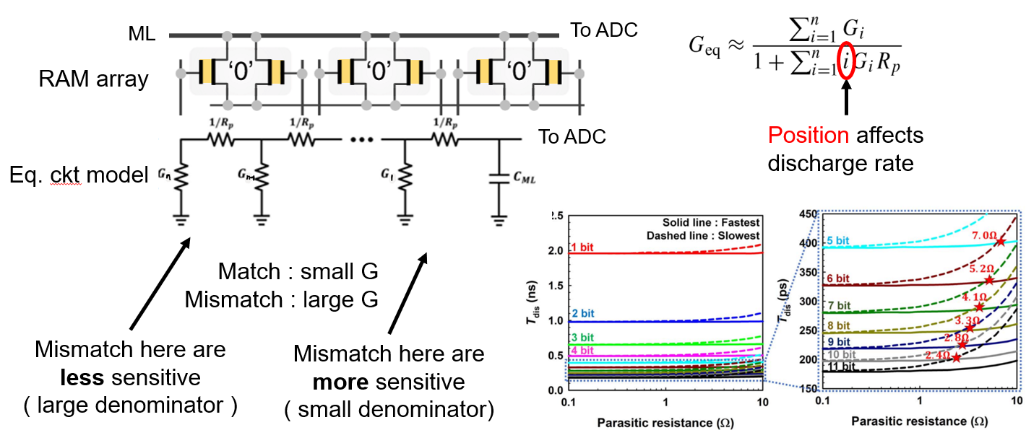
Analog Non-Ideal Effects of TCAM
TCAM : Ternary content addressable memory
Analog non-ideal effects of in-memory-search
Noise from memory device
Thermal noise
Flicker noise
Leakage current
Parasitic effects of lump elements
Resistance
Capacitance

Slide 4
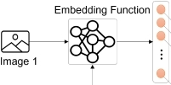

Method 1 : Noise-Aware Training
Noise-Aware Training
Inject simulated noise into embeddings while training the model
Evaluate the Trained model on different noise levels
Training
Model
+
+
+
Train on cloud server
Simulate noisy device by injecting noise to embeddings
+
Embedding
Testing
Model
Deploy the model to device
Simulate the device on server
Noisy Embedding

Slide 5
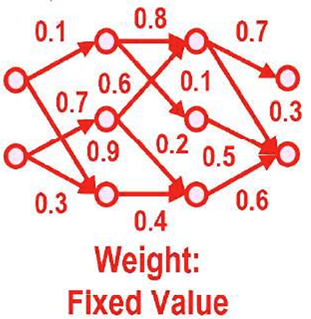
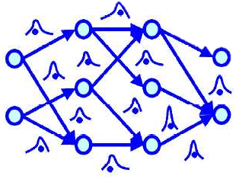
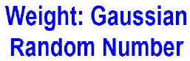
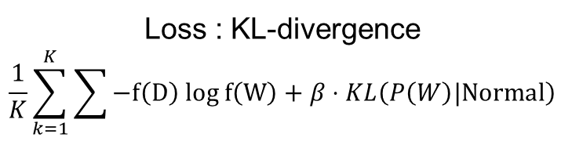

Method 2 : Bayesian Neural Network
Bayesian Neural Network (BNN)
Train a robust model that embraces noise
BNN minimizes KL-divergence (maximize Evidence Lower Bound, ELBO)
CNN
BNN
Loss : Cross Entropy
$$\sum{−P\left(D\right) log P\left(W\right)}$$
Loss : KL-divergence
$$\frac{1}{K}\sum_{k=1}^{K}{\sum{−f\left(D\right) log f\left(W\right)}}+β⋅KL\left(P\left(W\right)|Normal\right)$$
Mean of cross entropy loss acorss samples
Ensure robustness against noise

Slide 6
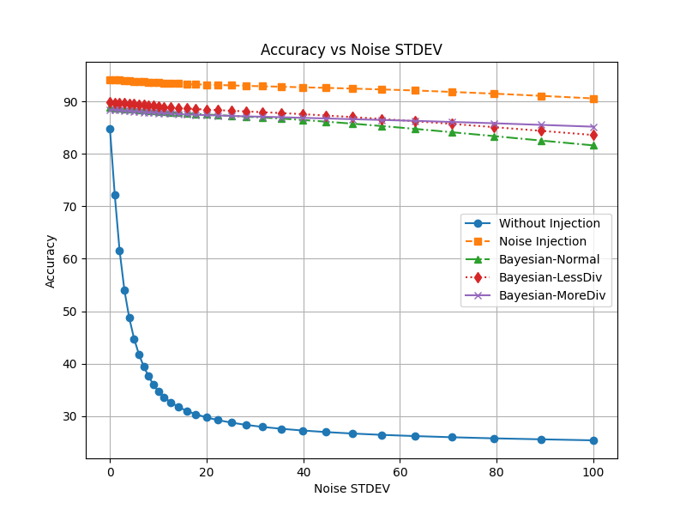
Robustness Against Noise
Both method works well on different datasets
Trade-off between accuracy on clean data & noise tolerance
Tolerance against large noise
Little noise has great effect
High acc.
large noise

Slide 7
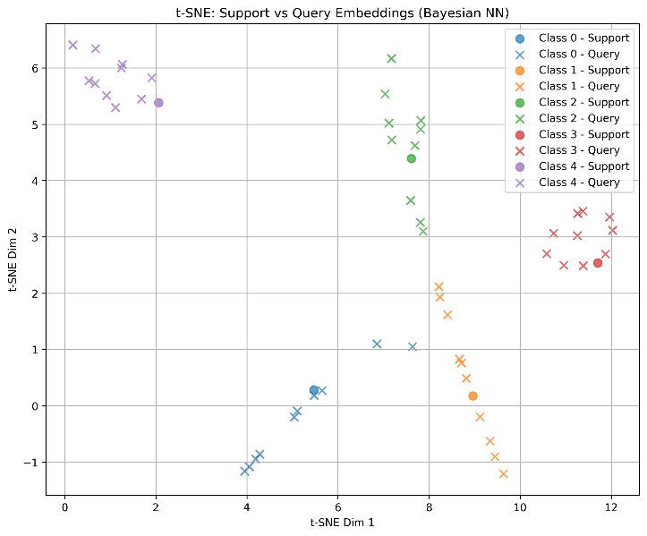
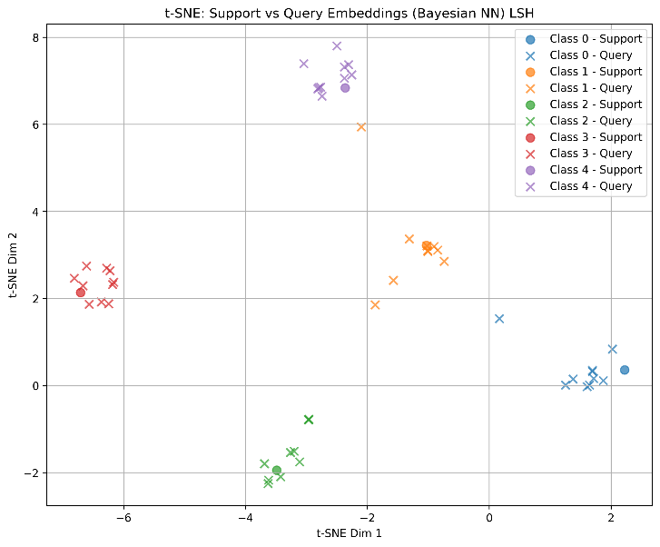
2-D Data Visualization
Visualize data using t-SNE
Visualization method that maintains spatial distance
Map angular distance to spatial distance using Locality-Sensitive Hashing
1
Random
hash vectors
0
1
Closer data has similar hashed result
0
1
0
0
0
Unwanted behavior due to cosine distance

Slide 8
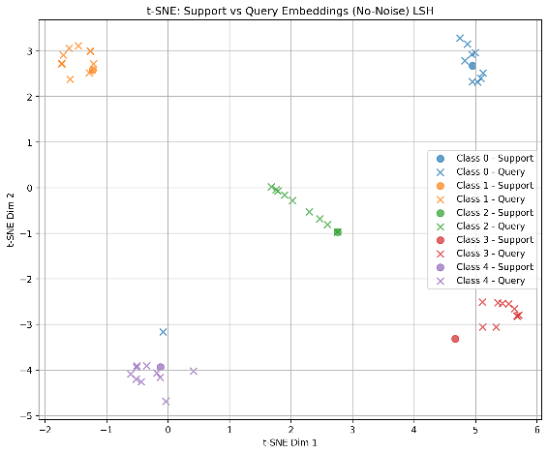
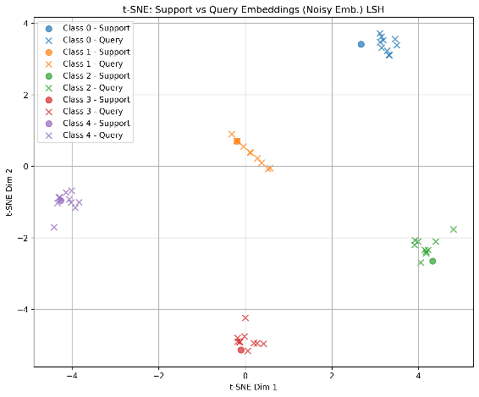
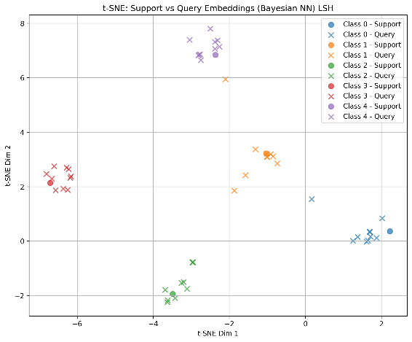
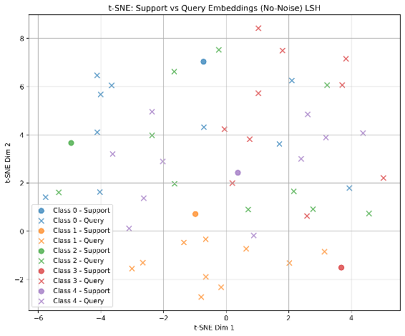
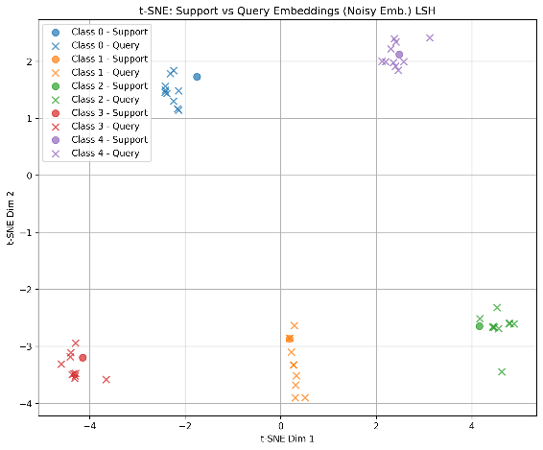
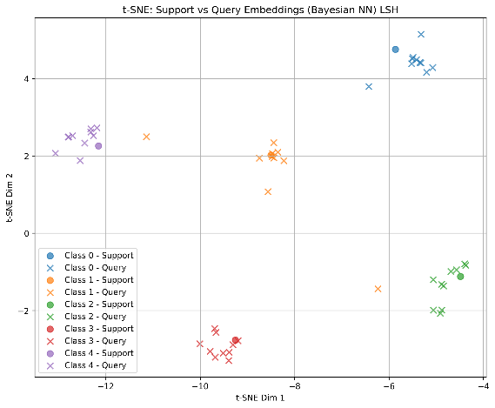
2-D Data Visualization with LSH
Visualization Result
Baseline
Noise-Aware Training
Bayesian NN
Zero Noise
Large Noise
Low accuracy

Slide 9
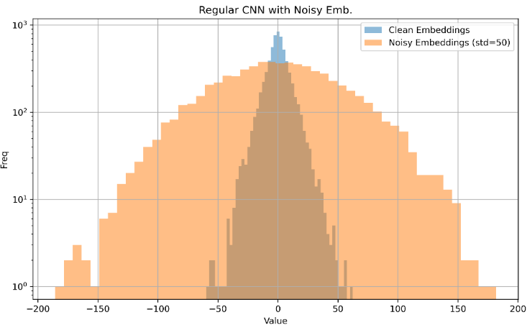
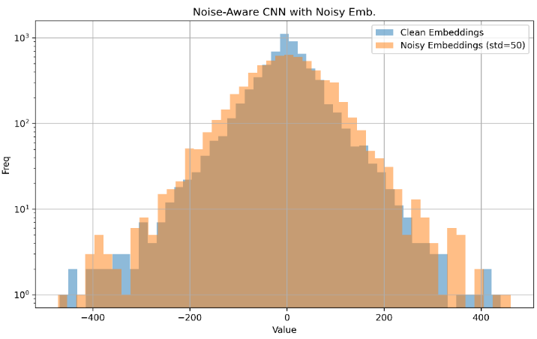
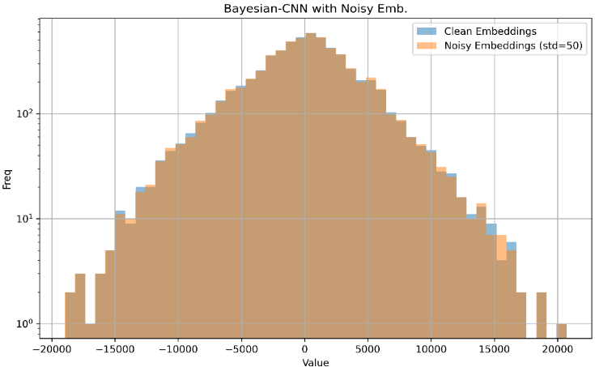
Origin of Noise Resilience in NN
Collect the value of every embeddings
Blue : Original embedding value distribution
Orange : New distribution on simulated noisy device
Baseline
Noise-Aware Training
Bayesian NN
27 % accuracy
Noise dominates the embedding
92 % accuracy
Noise has little impact on embedding
88 % accuracy
Noise has almost no impact on embedding

Slide 11

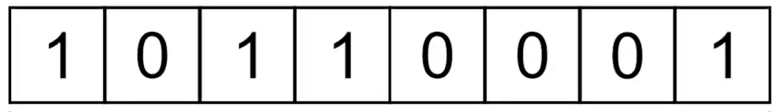

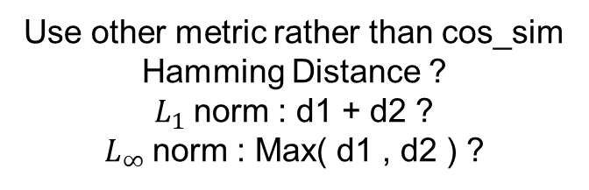

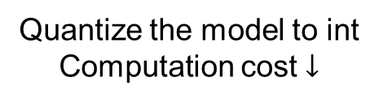


From Angular to Distance Metric
Cosine similarity
Compute floating-point value is costly
$$D$$
$$\{$$
$$\}$$
Quantize the model to int
Computation cost $↓$
Int8 for each dimension
d1
Use other metric rather than cos_sim
Hamming Distance ?
$L_{1}$norm : d1 + d2 ?
$L_{∞}$norm : Max( d1 , d2 ) ?
$L_{2}$Norm : d
d2
$$θ$$

Slide 12






Exact-Match Search with $L_{∞}$ Norm
$L_{∞}$ norm – Using exact-match search
Find the smallest square containing the query
Encode ranges into ternary vector $V={\left\{0, 1, ∗\right\}}^{D}$
Represent a square using ranges
If query is in the range: HIT !
$$y=\left[c,d\right]$$
$$x=\left[a,b\right]$$
$$Q=\left( \left[2,2\right] ,\left[4,4\right] \right)$$
$$→\left( \left[1,3\right] ,\left[3,5\right] \right)$$
$$→\left( \left[0,4\right] ,\left[2,6\right] \right)$$
Iteratively expand from query
1
Iterative !
Less space Long time
3
2
$∋$ Class green
query
$$G=\left\{\left( \left[1,1\right] ,\left[6,6\right] \right),\left( \left[0,2\right] ,\left[5,7\right] \right),\left( \left[0,3\right] ,\left[4,8\right] \right)\right\}$$
Create squares from existing data
$$B=\left\{\left( \left[5,5\right] ,\left[3,3\right] \right),\left( \left[4,6\right] ,\left[2,4\right] \right),\left( \left[3,7\right] ,\left[1,5\right] \right)\right\}$$
1
query
More space Short time
Ref: Encoding Short Ranges in TCAM Without Expansion: Efficient Algorithm and Applications

Slide 13
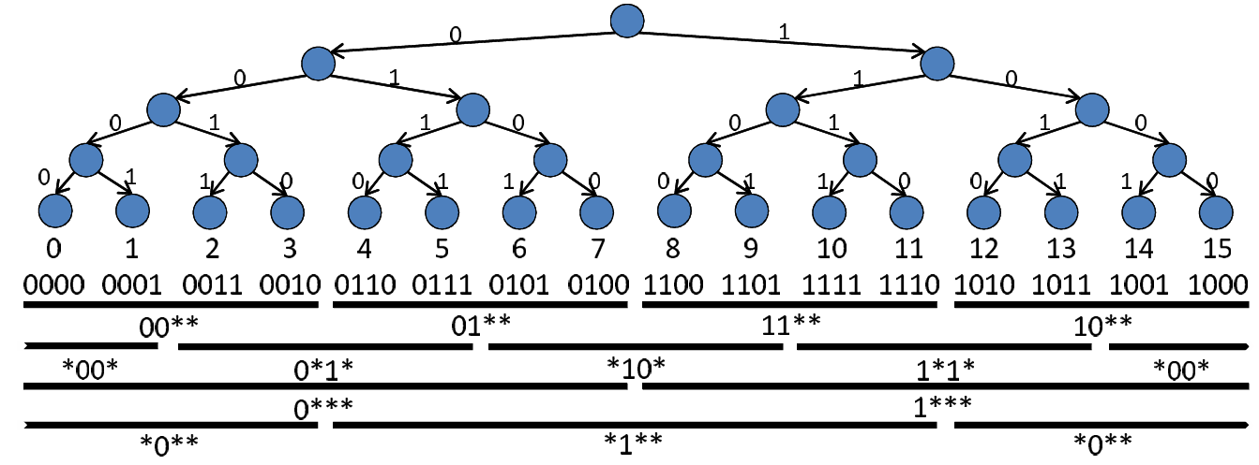


Range Encoding
$L_{∞}$ norm
Realization of “Squares”
Gray code varies 1b for neighbors
Good for encoding ranges
But has some restrictions
Range Starts from $a⋅2^{n}$
length = $2^{n (or +1)}, n<\frac{precision}{2}$
4-bit example
Gray code
Gray code + offset ( postfix ) + Intersection
0
1
2
3
00
01
11
10
Offset
0
1
0*
1*
2
*0
*1
*0
3
4
**
5
Range = 2 OK
Range = 3 Fail
[3,5] = [2,5] $∩$ [3:6]
Ref: Encoding Short Ranges in TCAM Without Expansion: Efficient Algorithm and Applications

Slide 14

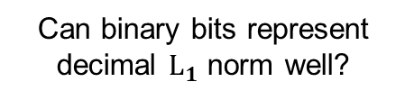

Best-Match Search with $L_{1}$ Norm
$L_{1}$ norm ( Hamming distance) – Using best-match search
Regular method : Use 8-bit ADC
Method to avoid using ADC : cut the data into segments
Avoids using 2-bit ADC
Can binary bits represent decimal $L_{1}$ norm well?
1 0 1 1 0 0 1 1
1 1 0 0 0 0 1 1
High Vt Sence Amp
B
15-11=4 but 1111–1011 = 1
V
A
1
2
0
0
Thermometer code
Low Vt Sence Amp
0 -> 00000000
3 -> 00000111
5 -> 00011111
+
AB = 00 / 10 / 11
Diff = 2 1 0
3
Ref: SAPIENS: A 64-Kbit RRAM-Based Non-Volatile Associative Memory for One-Shot Learning and Inference at the Edge

Slide 15
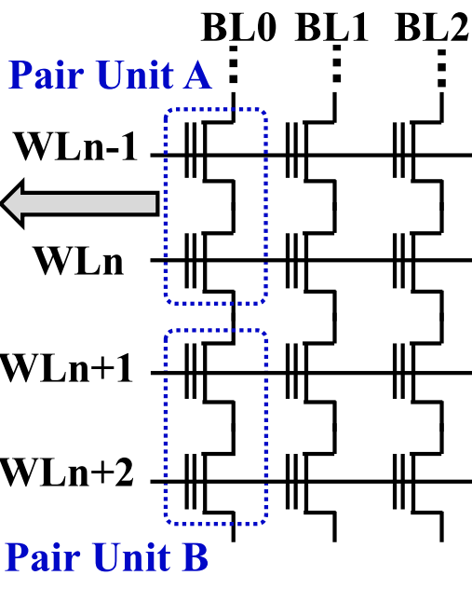
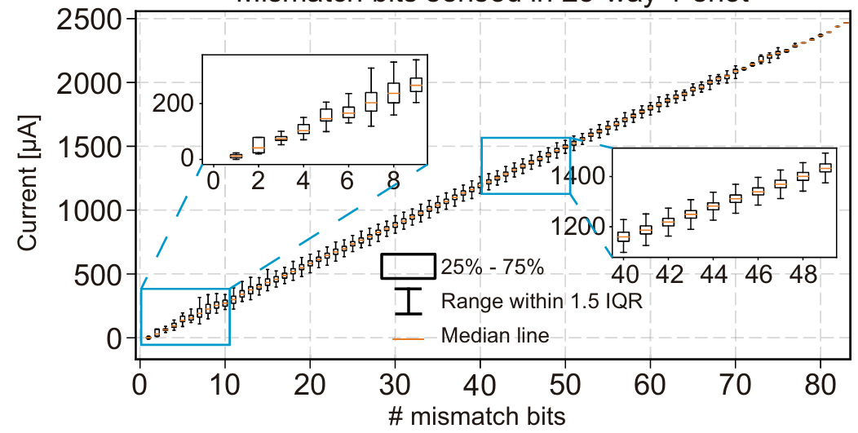
Problems of Best-Match TCAM
Analog non-idealities
Noise of storage elements accumulates
Parasitic effects of Match-Line
Large variation
noise
noise
noise
noise
Ref: Experimentally validated memristive memory augmented neural network with efficient hashing and similarity search

Slide 16
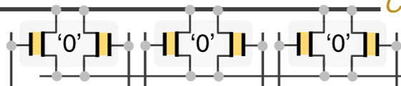
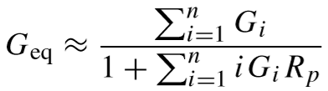
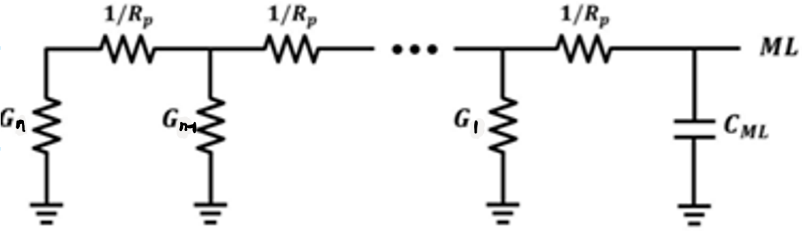
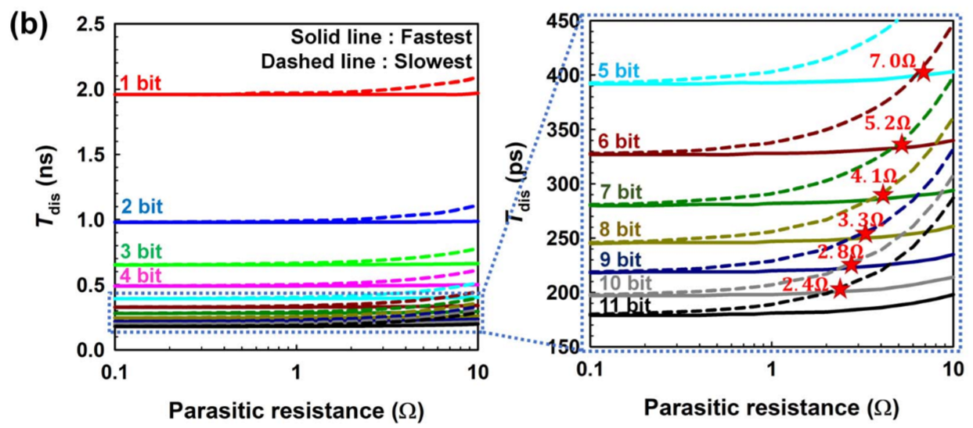
Problems of Best-Match TCAM
Analog non-idealities
Noise of storage elements accumulates
Parasitic effects of Match-Line
ML
To ADC
RAM array
To ADC
Position affects discharge rate
Eq. ckt model
Match : small G
Mismatch : large G
Mismatch here are less sensitive
( large denominator )
Mismatch here are more sensitive
( small denominator)
Ref: In-Memory Nearest Neighbor Search With Nanoelectromechanical Ternary Content-Addressable Memory

Slide 17
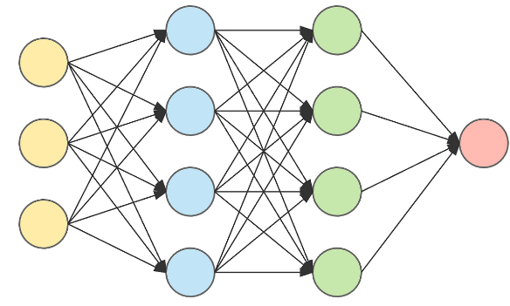

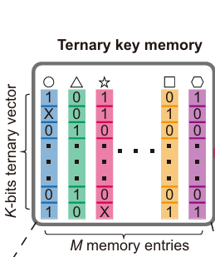
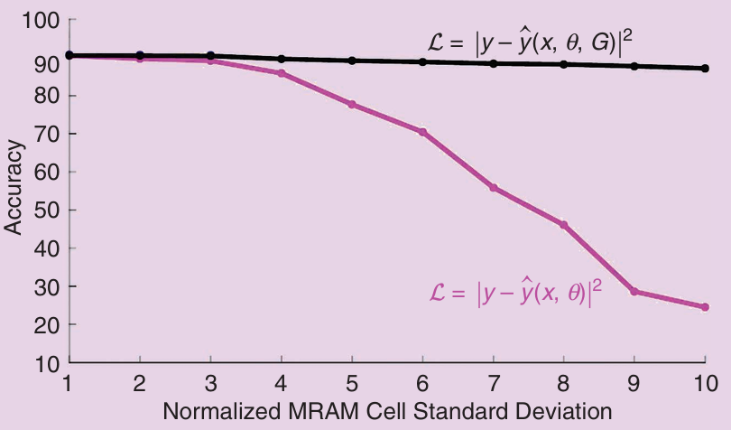

Overcome Analog Non-Ideal Effects
Analog non-idealities
Noise-aware training (Compute-in-memory case)
Noise of analog circuits could hazard our performance
Inject noise into model to make it noise-resistant
What if we inject noise into embeddings?
w/ noise
injection
$$f\left(θ\right) \sim Gaussian\left(0,σ\right)$$
w/o noise injection
or more complicated
device noise model (costly)
Ref: In-Memory Computing Advances and Prospects

Slide 18
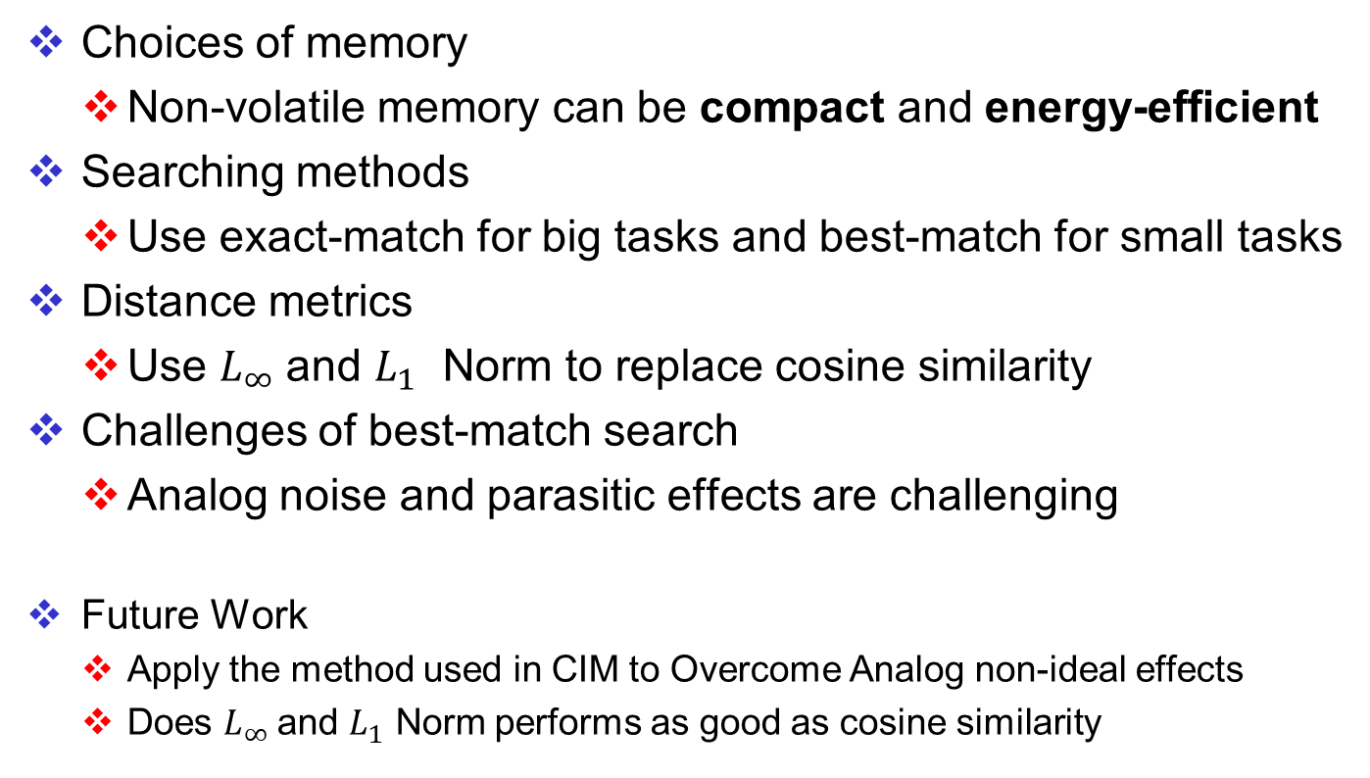
Conclusions and Future Work
Choices of memory
Non-volatile memory can be compact and energy-efficient
Searching methods
Use exact-match for big tasks and best-match for small tasks
Distance metrics
Use $L_{∞}$and $L_{1}$ Norm to replace cosine similarity
Challenges of best-match search
Analog noise and parasitic effects are challenging
Future Work
Apply the method used in CIM to Overcome Analog non-ideal effects
Does $L_{∞}$and $L_{1}$ Norm performs as good as cosine similarity

