Slide 1
Design Technology Co-Optimization for In-Memory Search
B11901027 王仁軒
PPT Template Credit : Jie-Hong Roland Jiang

Slide 2
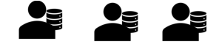




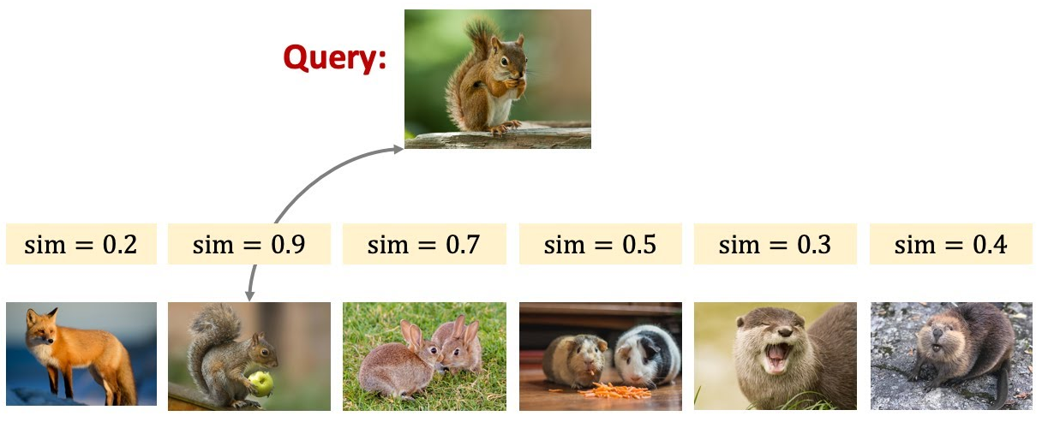
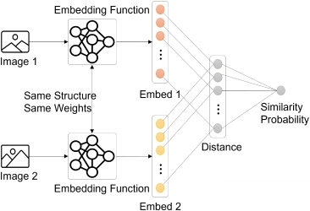
Few/One Shot Learning
Traditional classification models suffers from catastrophic forgetting when learning new domains
Search all data stored in the memory
Cosine similarity!

Slide 3
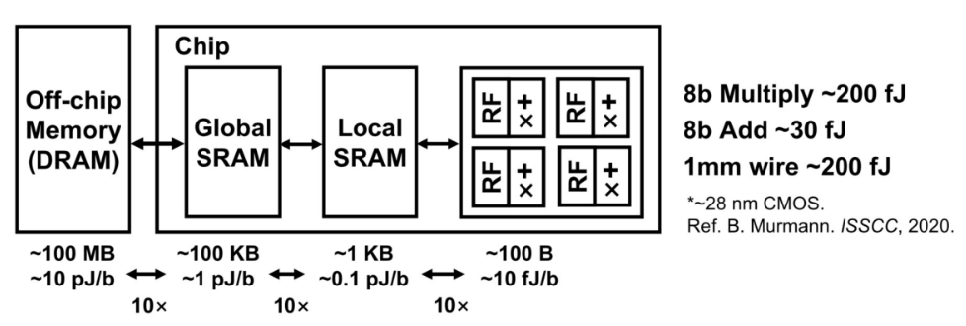

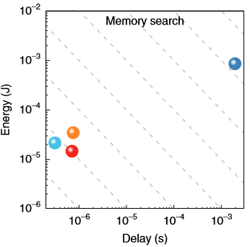
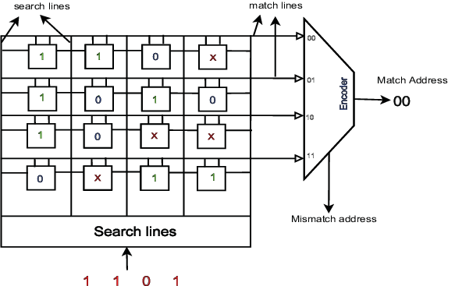
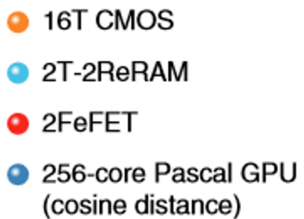
Traditional computer architecture
Traditional computer requires frequent data transfer between CPU and RAM for ML
In memory search structure
60%↑power
von Neumann bottleneck
1
Parallel !
0
Scalable !
0
0
The array structure of memory allows us to lower the complexity of computing

Slide 4
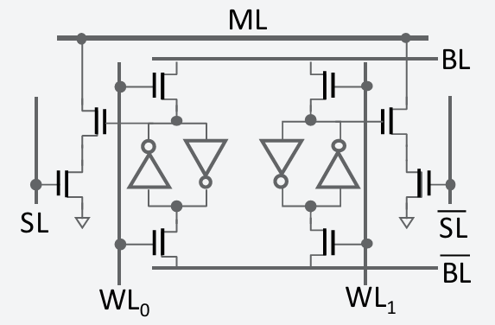
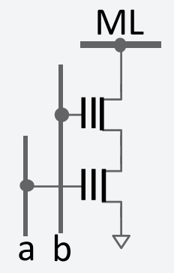
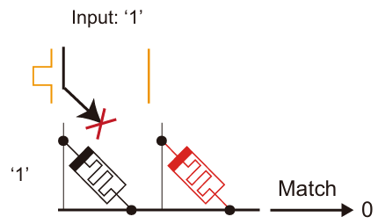
Types of Memory
Volatile vs Non-Volatile
16T CMOS
2T Flash/FeFET
2T RRAM Crossbar
Cannot cut off power
LEAKAGE !
Large area
Low power
Low leakage
Compact area
Low power
Acceptable leakage
Compact area

Slide 5
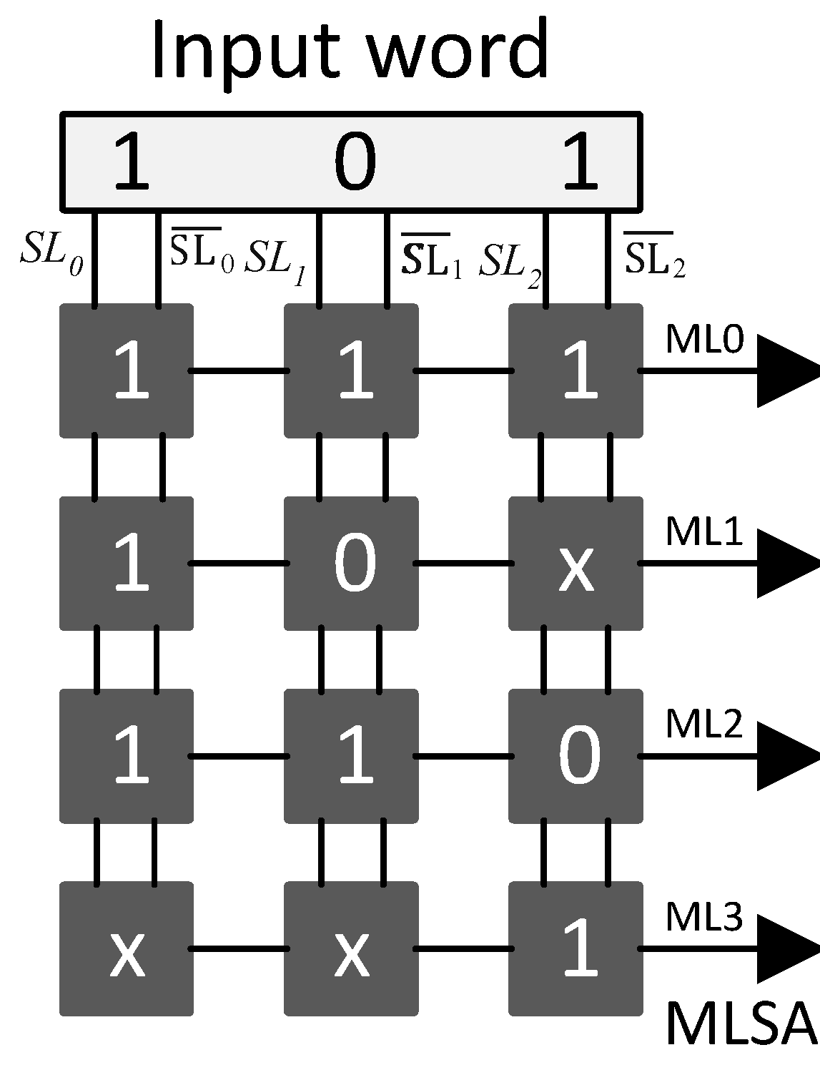

Types of Searching
Exact-match vs Best-match TCAM
Difference
0
1
1
HIT !
0
HIT !
0
2
1
0
Don’t require complex circuit for post processing | Require other analog circuit (Winner Take All ckt, ADC…)
Can scale up to MB/GB | Scale is limited to kB due to analog non-idealities and area
Functionality is restricted (need special encoding) | Finds the most similar entry (hamming distance)

Slide 6
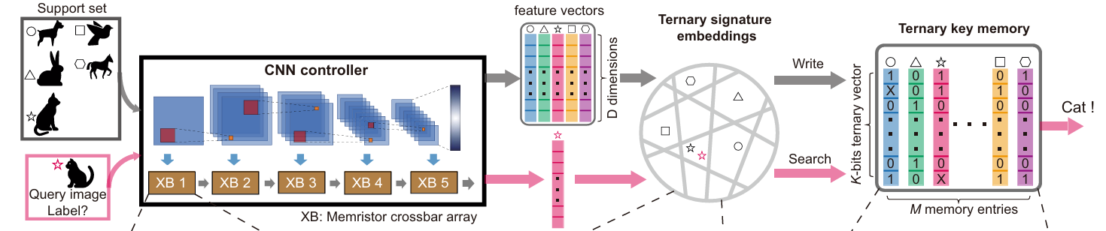
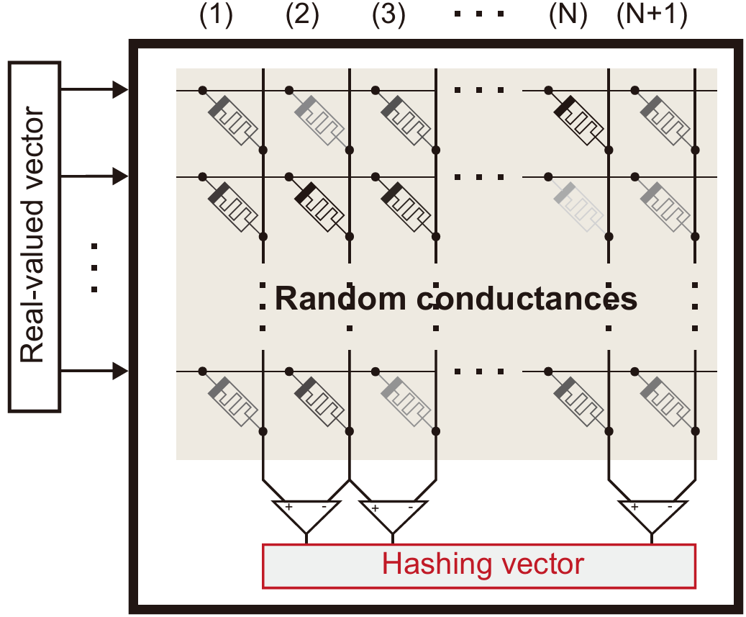
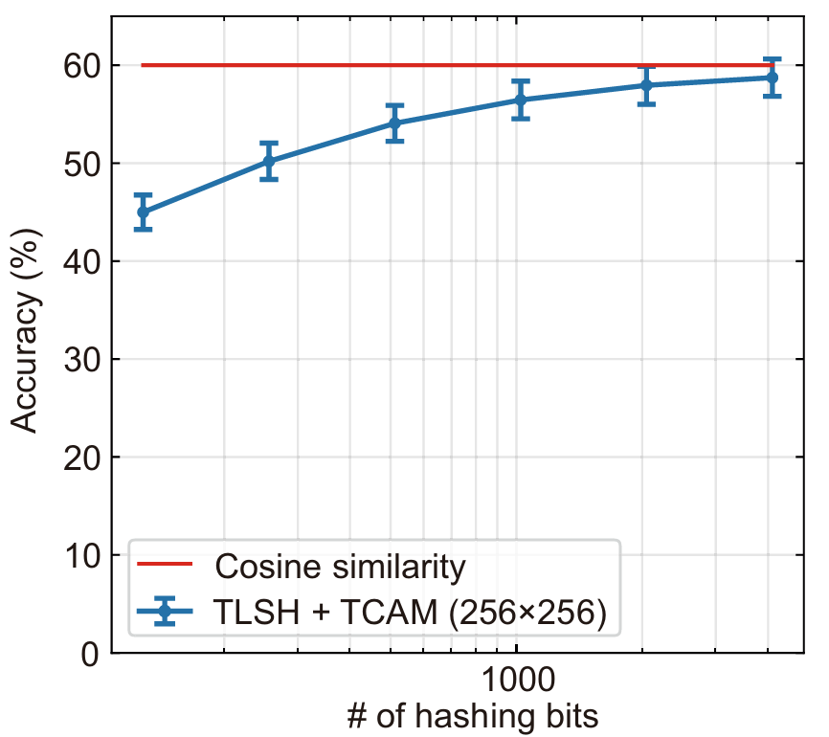

Pre-Processing for Best-Match TCAM
Simulating cosine similarity by hardware
Locality sensitive hashing
Use device variations
As natural hashing
Performance → cos_sim
As hashing bits ↑↑
> : 50%
< : 50%

Slide 7
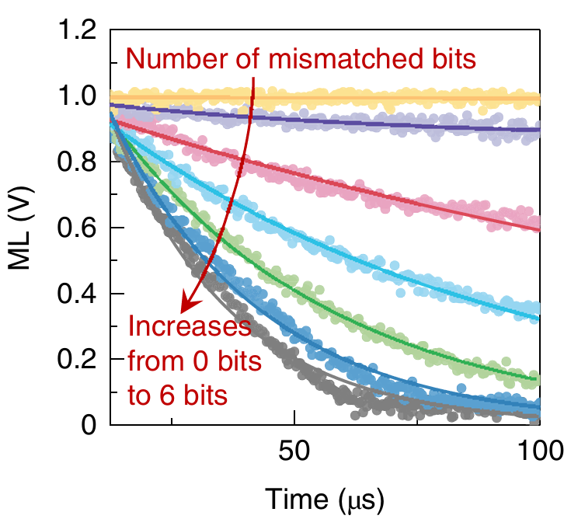
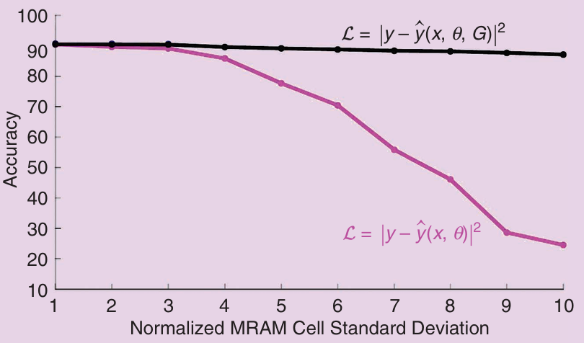
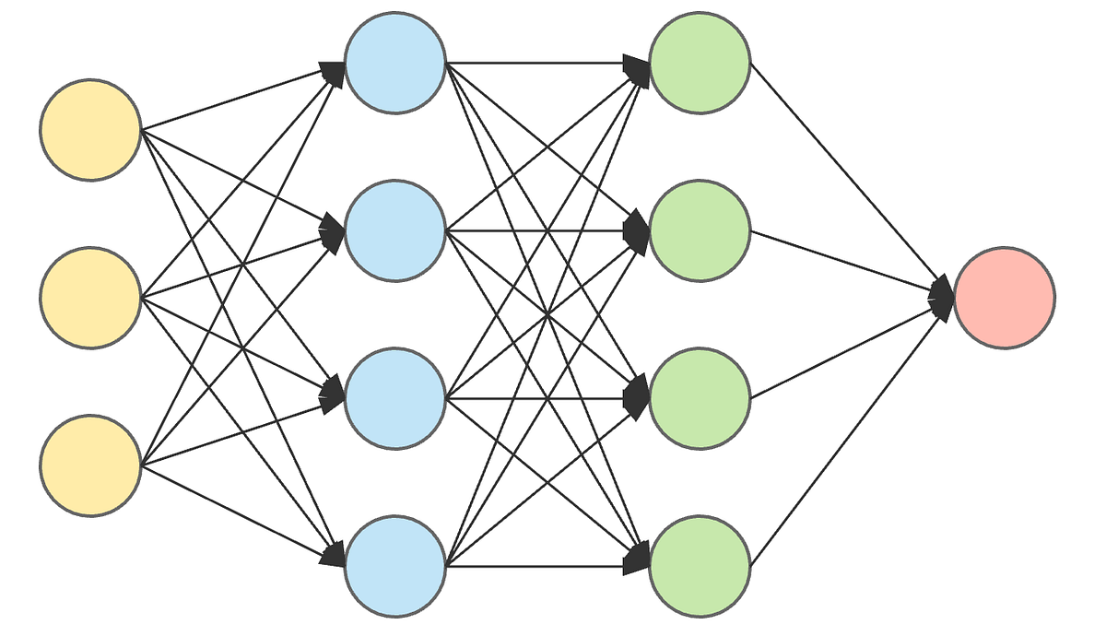

Pre-Processing for Best-Match TCAM
Noise-aware training
Noise of analog circuits could hazard our performance
Inject noise into model to make it noise-resistant
w/ noise
injection
w/o noise injection
$$f\left(θ\right) \sim Gaussian\left(0,σ\right)$$
or more complicated
device noise model

Slide 8
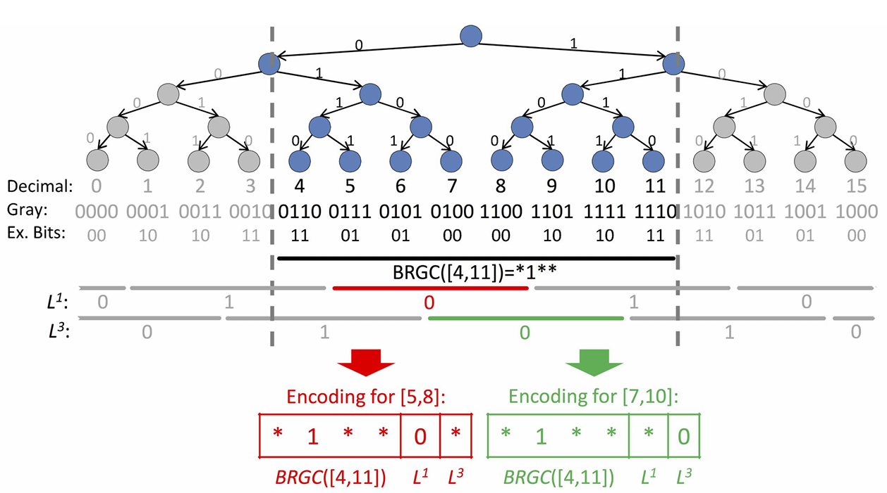

Encoding for Exact-Match TCAM
Find the smallest square containing the query
Encode ranges into ternary vector $V={\left\{0, 1, x\right\}}^{2}$
If query is in the range: HIT !
L-infinity norm
Not cos_sim
query
query
More space
Short time
Less space
Long time
Less space Short time
But require range-to-range encoding
Gray code can represent ranges of power of 2
Other ranges requires more bits to disquinsh
While Gray code does not maintain difference information → Only suitable for Exact-Match
query

