Slide 1
Adder Tree / MAC
B11901027 王仁軒
PPT TemplateCredit : Jie-Hong Roland Jiang

Slide 2
Energy Efficiency
TOPS/W drops from 0.65 to 0.33 with the increase of input toggle rate
Tcycle = 2.6ns, 2.30 TOPS/mm2

Slide 3
Power of All Adder Tree Stages
Power of first few stages greatly depend on input toggle rate, while other stages do not

Slide 4
Input Initial condition
The proportion of 0’s in first input pattern does not affect the power of MAC

Slide 5
Input Initial condition
The power distribution in all stages are same as 50% 0’s input pattern’s result

Slide 6
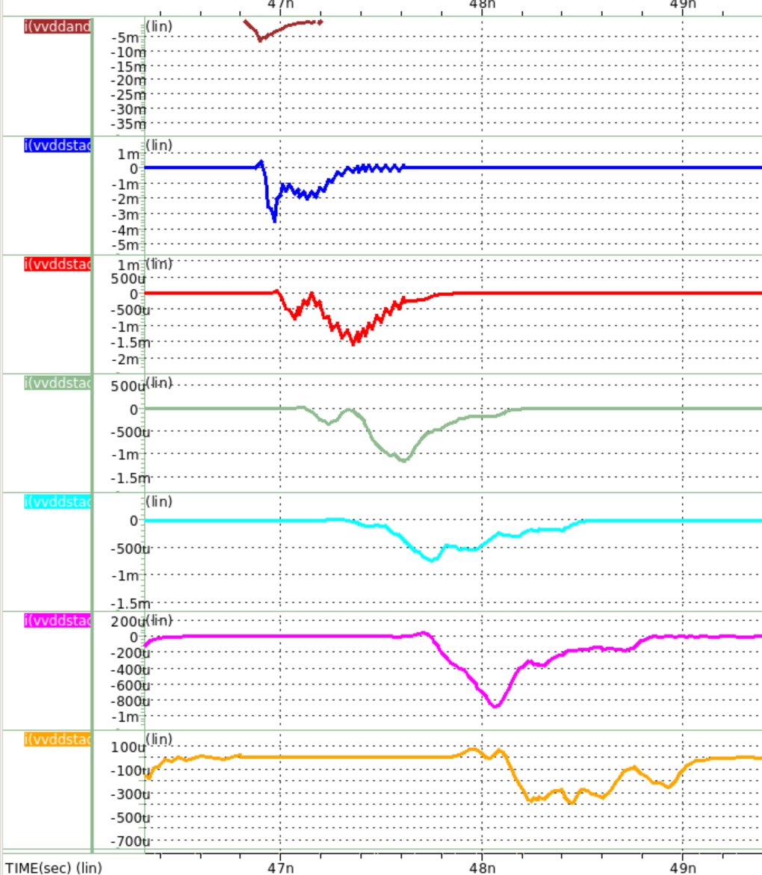
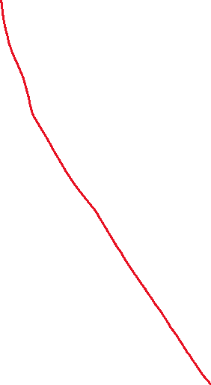
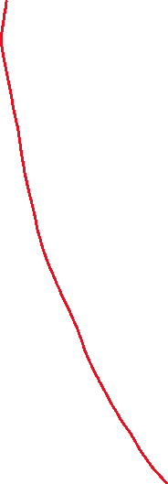
Timing diagram?
AND 7 mA
VDD1 3.5 mA
VDD2 1.6 mA
VDD3 1.2 mA
VDD4 0.7 mA
VDD5 0.9 mA
VDD6 0.3 mA

Slide 7
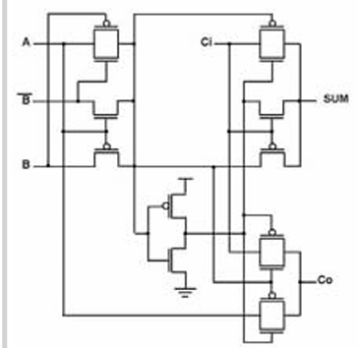
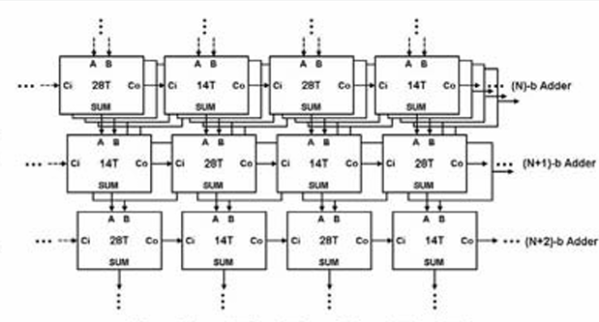
Interleaved FA
Interleave 28T FAs along with 14T Fas
30% smaller than the original design
But require longer cycle time (2.9ns)
Consumes 18% more power

Slide 8
Interleaved FA
Energy Efficiency and Area Efficiency
0.26 TOPS/W, 2.97 TOPS/mm2
Interleaved FA structure consumes more power in most stages

Slide 9
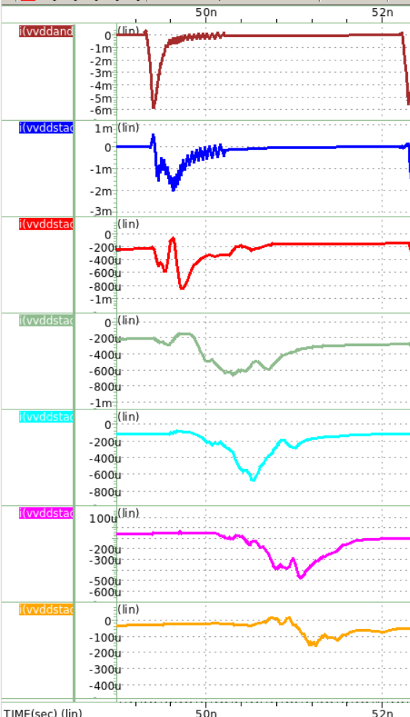
Interleaved FA
AND 6(7) mA
VDD1 2(3.5) mA
VDD2 0.8(1.6) mA
VDD3 0.6(1.2) mA
VDD4 0.7(0.7) mA
VDD5 0.5(0.9) mA
VDD6 0.15(0.3) mA

Slide 10
FA Sizing
High Vth for first few stages
But I don’t know how to modify Vth
Design first few stages smaller and last 2 stages larger
Alternative approach
May require more area

Slide 11
FA Sizing
Energy efficiency
0.26 -> 0.29 TOPS/W
Area efficiency
2.97 -> 2.81 TOPS/mm2

Slide 12
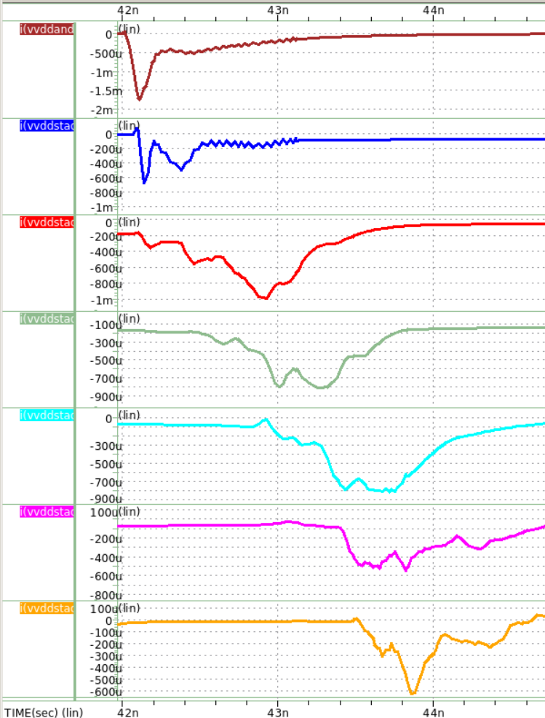
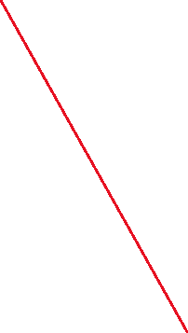
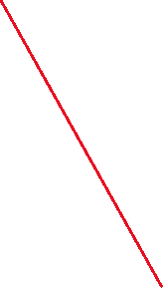
FA Sizing
AND 1.8(6) mA
VDD1 0.7(2) mA
VDD2 0.1(0.8) mA
VDD3 0.8(0.6) mA
VDD4 0.8(0.7) mA
VDD5 0.6(0.5) mA
VDD6 0.6(0.15) mA

Slide 13
FA Sizing
Apply on the original design
Energy efficiency
0.33 -> 0.36 TOPS/W
Area efficiency
2.30 -> 1.27 TOPS/mm2
Since minimum width is 250nm, increase L to lower drain current -> more area -> bad result

Slide 14
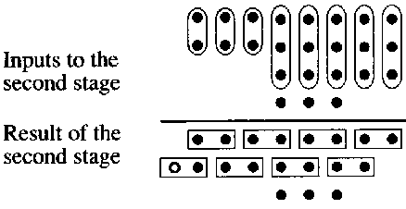
Adder Tree
Calculate 64 1-bit input with groups of 2 input adders
Why not use multiple input adder
Carry save adder design

Slide 15
Carry Save Adder Tree
For regular 64b to 6b adder tree
Require 120 Full adders
Ripple carry adders propagate carries in every stage
Long critical path
Carry save adder design
Only 64 full adders is used
Only need to propagate delay in the last stage
Relatively short critical path

Slide 16
Performance
0.45 TOPS/W
36% improvement w.r.t. the original design
4.49 TOPS/mm2
95% improvement w.r.t. the original design
2.3 ns cycle time
15% less than the original design

Slide 17
CSA Tree with interleaving
1st stage: 14T, 2nd stage: 28T ……
But ensure output are driven by 28T FA
37/64 FAs are replaced by 14T FA
Performance gets better!
0.54 TOPS/W, 4.70 TOPS/mm2

