Slide 1
Adder Tree / MAC
B11901027 王仁軒
PPT TemplateCredit : Jie-Hong Roland Jiang

Slide 2
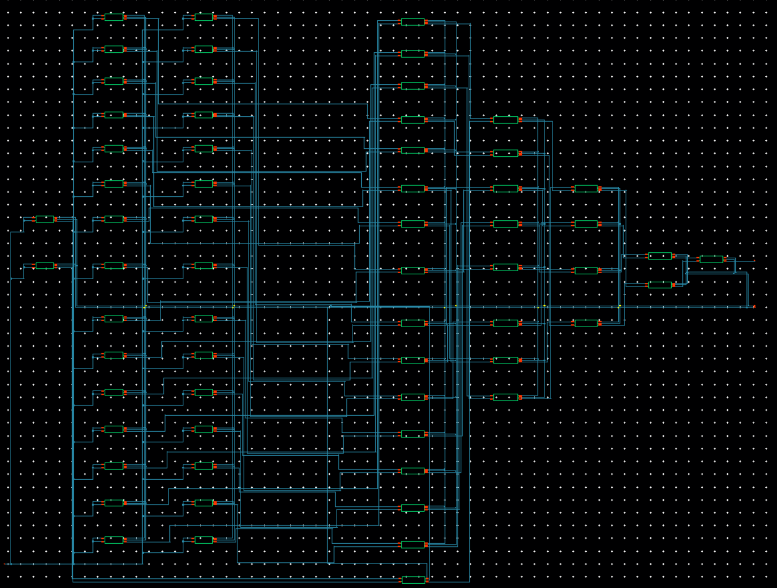
Adder Tree Implementation
1st 2nd 3rd 4th 5th6th
28T FA Wp 750n Wn 250n

Slide 3
Adder Tree Result
Allowable clock rate grows with VDD
0.37GHz at 0.9V, 1.54GHz at 1.8V
Delay decreases with VDD growth
5.15ns at 0.9V, 1.46ns at 1.8V

Slide 4
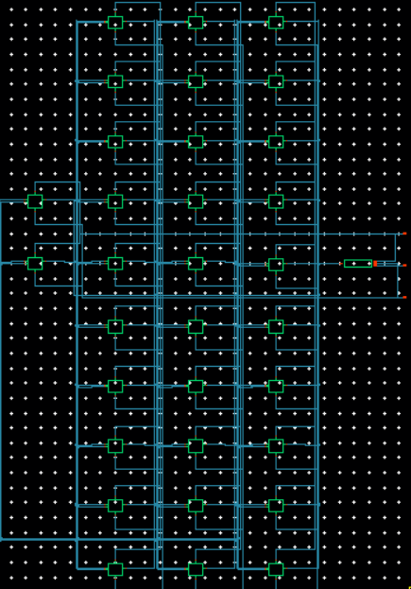
MAC Implementation
N bit MAC has N AND gate and one adder tree
64 bit MAC composed of one 32 bit MAC , two 16 bit MAC , and some additional FAs
32 bit MAC

Slide 5
MAC Result
Dynamic power grows with toggle rate
But decreases when toggle rate 0.8 -> 0.9
Due to 50% 1s and 0s in test data

Slide 6
MAC Result
Same situation occurs for 16 and 32 bit MAC

Slide 7
MAC Result
Delay
2.6 ns under 1.8 V, 8.9 ns under 0.9V supply

Slide 8
MAC Result
Energy efficiency
0.33 TOPS/W at 1.8V, 1.70 TOPS/W at 0.9V
Area efficiency
0.83 TOPS/mm2 at 1.8V, 0.20 TOPS/mm2 at 0.9V

Slide 9
MAC Result
Energy efficiency
4.38 TOPS/W for 16b, 0.72 TOPS/W for 64b
Area efficiency
3.76 TOPS/mm2 for 16b, 0.83 TOPS/mm2 for 64b

