Slide 1
Impact of ADC Loss in Different Hybrid Partial Product Shapes
B11901027 王仁軒
PPT TemplateCredit : Jie-Hong Roland Jiang

Slide 2
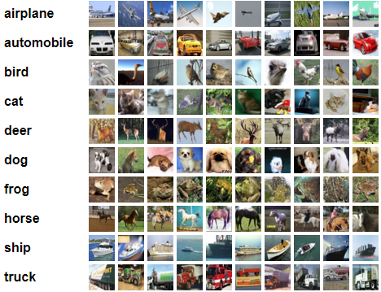
Flow
Part A : Analyze the effect of different partition method of partial sum
Lightning / Big-triangle / small-triangle
Part B : Use the result in part A to analyze the impact of analog loss on classification ML tasks
Analyze the characteristics of quantized CNN model
Apply the result in part A to the model
Resnet-18 on CIFAR-10

Slide 3
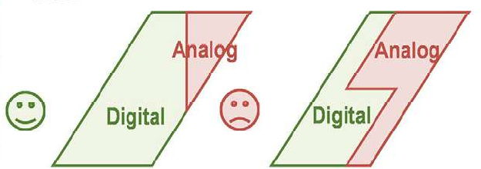
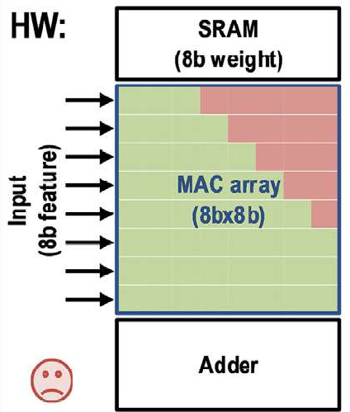
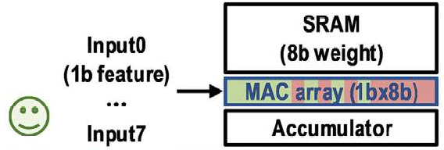
Part A : Shapes of Partial Sum
The definition of boundary between analog and digital part is a problem
Digital Part : High precision
Analog Part : Low precision
Digital Part : Bulky ckt
Analog Part : Less HW overhead

Slide 4

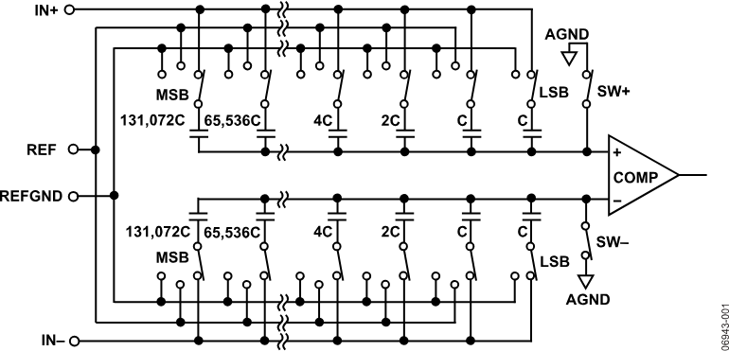
Part A : Shapes of Partial Sum
Digital Sum
Using digital multiplier and adder tree
Easy to simulate and calculate area
Analog Sum
Using analog multiplier and SAR ADC
SAR ADC implementation?
x n

Slide 5
Part A : Shapes of Partial Sum
Product = Digital sum + Analog Sum = Digital sum + Ideal Sum * loss
Digital sum
Analog sum

Slide 6
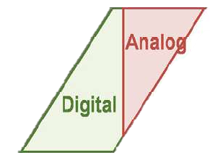
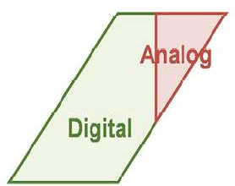
Part A : Shapes of Partial Sum
Types of Shapes
Lightning : Bit-serial scheme
Big triangle : Bit-rotation scheme
Small triangle : Bit parallel scheme
Lightning
Big Triangle
Small Triangle

Slide 7
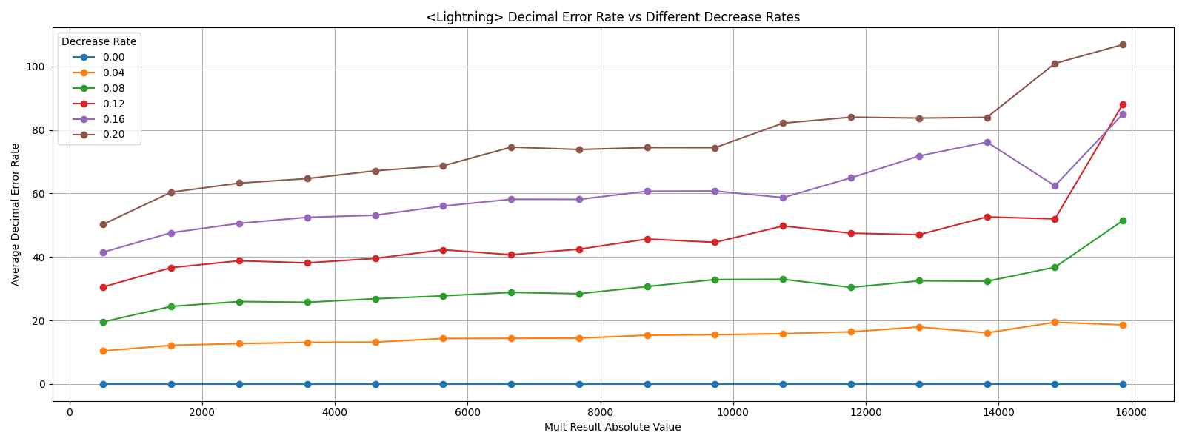
Part A : Shapes of Partial Sum
Lightning
Error in ADC
Error of its value
Analog loss

Slide 8
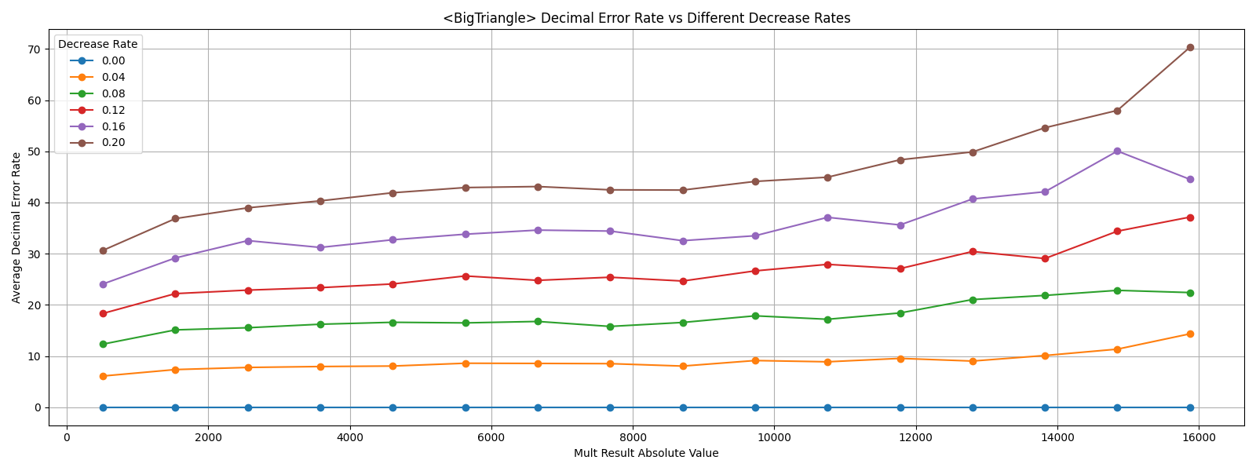
Part A : Shapes of Partial Sum
Big Triangle
Error in ADC
Error of its value
Analog loss

Slide 9
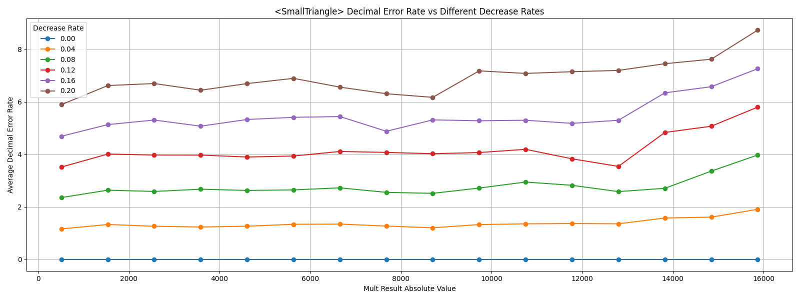
Part A : Shapes of Partial Sum
Small Triangle
Error in ADC
Error of its value
Analog loss

Slide 10
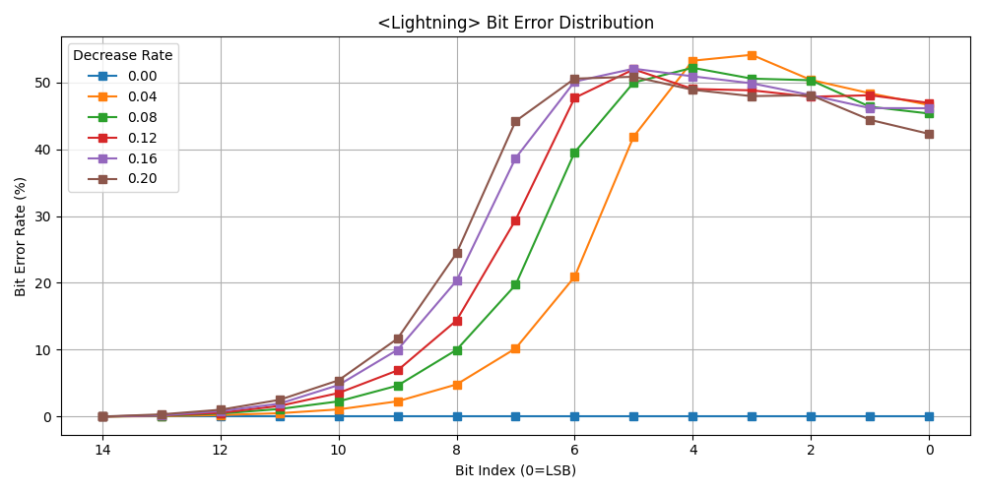
Part A : Shapes of Partial Sum
Lightning
Error in ADC
Error rate in bits
Analog loss

Slide 11
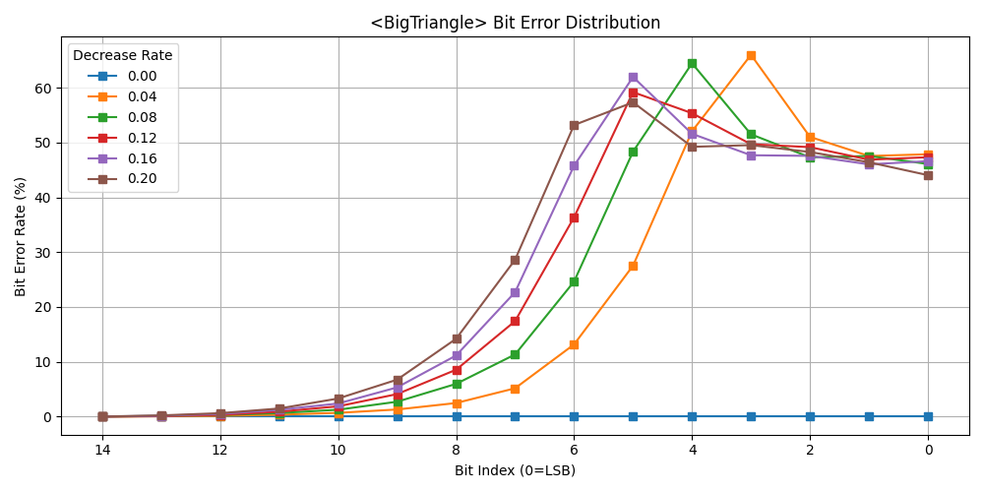
Part A : Shapes of Partial Sum
Big Triangle
Error in ADC
Error rate in bits
Analog loss

Slide 12
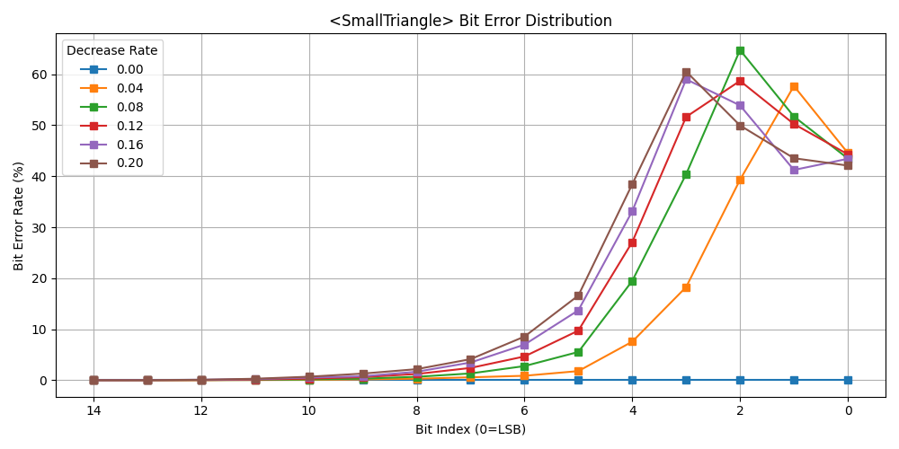
Part A : Shapes of Partial Sum
Small Triangle
Error in ADC
Error rate in bits
Analog loss

Slide 13
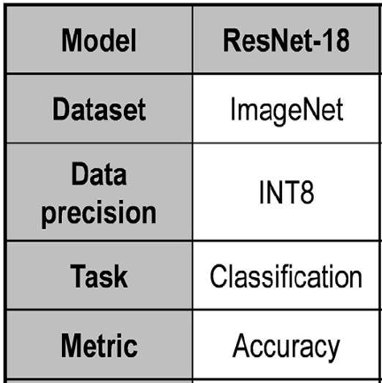
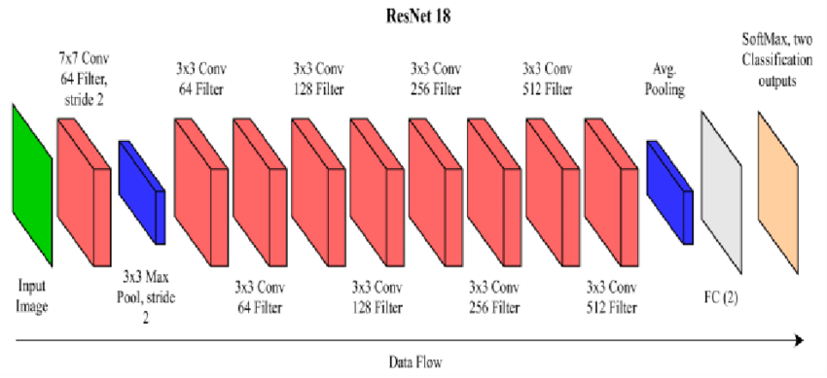
Impact of Analog Loss
The dataset used in the paper is ImageNet
ImageNet is not implemented in torch
Use a simpler dataset CIFAR-103
ResNet-18
Trained using fp precision
Quantize to int8 after training
Compute MAC result for each layer and apply loss
-LOSS
Gaussian(-Loss,0.01)

Slide 14
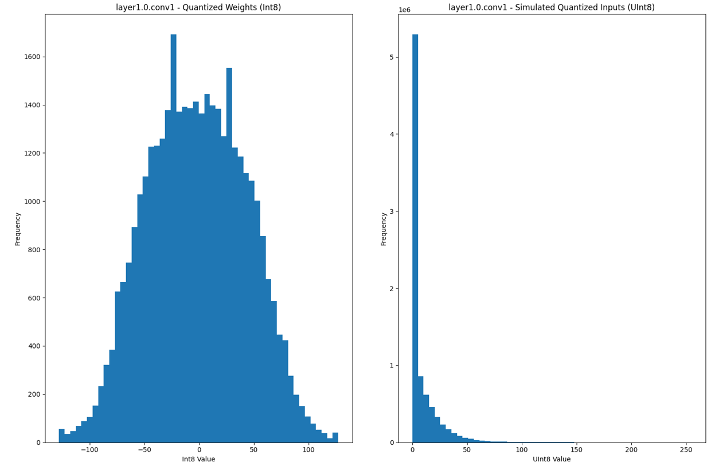

Impact of Analog Loss
Analysis of the quantized model
Most of the quantized weight are within $±100$
Most of the quantized input activation < 50
MAC result are within $±5000$
Analog loss
Use the result of this part

Slide 15
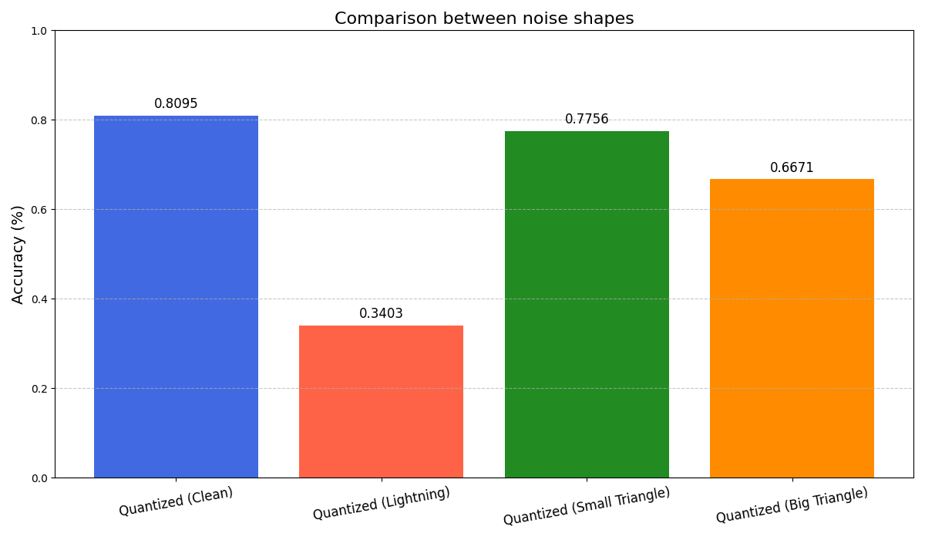

Impact of Analog Loss
Accuracy drop of ResNet-18 if loss is applied
What about area of ckt?
Lightning : bit-serial : 2x3 FA + 15 FA and 1 shift + 32C
Small $Δ$: bit-parallel : 49 FA + 130C
Big $Δ$: bit-rotate : 2x3 FA + 15 FA and 1 shift + 8C
58% drop
4% drop
18% drop
Sign bit
processing
Sum the product
Bit precision
alignment
Analog
Sum

Slide 16
Conclusion
Comparison between different shapes
Lightning
Big Triangle
Small Triangle
Decimal Loss (0.1 Loss) | 36 | 20 | 3.5
Accuracy | Large drop (58%) | Acceptable drop (18%) | Low drop (4%)
Adder Area | 21 FA | 21 FA | 49 FA
Capacitors Used | 32 C | 8 C | 130 C

