Slide 1
Parasitic Effects on Dual-Granularity Cooperative Quantization (DGCQ) System
B11901027 王仁軒
PPT TemplateCredit : Jie-Hong Roland Jiang

Slide 2
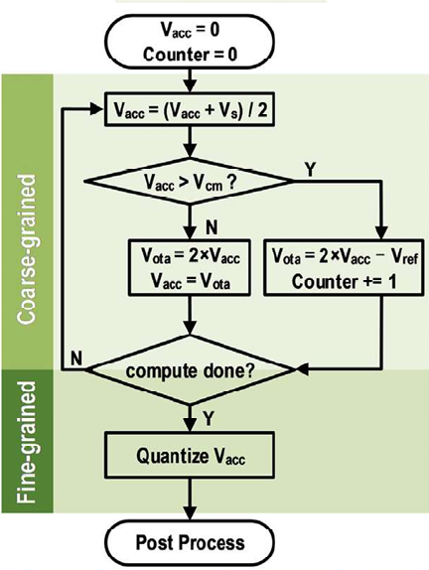
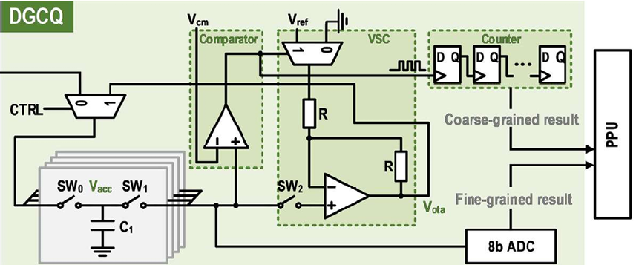
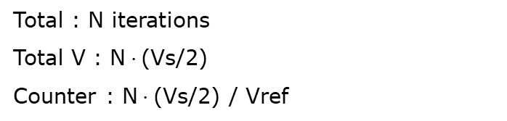
Recall
Dual-granularity cooperative quantizer
When quantizing analog voltage, use another ckt to calculate an approximated result
Low precision
Vs (MAC result)
Total : N iterations
Total V : N$⋅$(Vs/2)
Counter : N$⋅$(Vs/2) / Vref
High precision

Slide 3
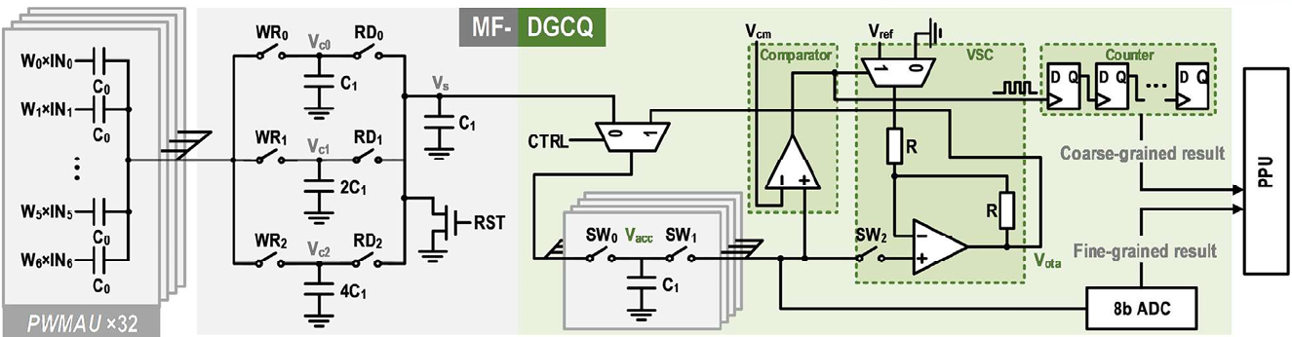

Quantizing MAC Voltage
Coarse-grained method
Takes $2^{n}$ iterations to get n bit precision
Area is roughly a fixed value
SAR ADC
Takes n iterations to get n bit precision
Area is proportional to $2^{n}$ (dominated by caps)
8 x 32 x 8
0.01100011010 x VDD
Coarse-grained
Fine-grained

Slide 4




Quantizing MAC Voltage
Partition of coarse/fine grained result
Suppose Vref=VDD
0.01100011010 x VDD
Coarse-grained
Fine-grained
After 8 iteration, $V_{acc}=8V_{s}−\left\lfloor 8V_{s}\right\rfloor$
$8V_{s}=$011.00011010 x VDD
$\left\lfloor 8V_{s}\right\rfloor =$011.00000000 x VDD
$V_{acc}=$000.00011010 x VDD

Slide 5
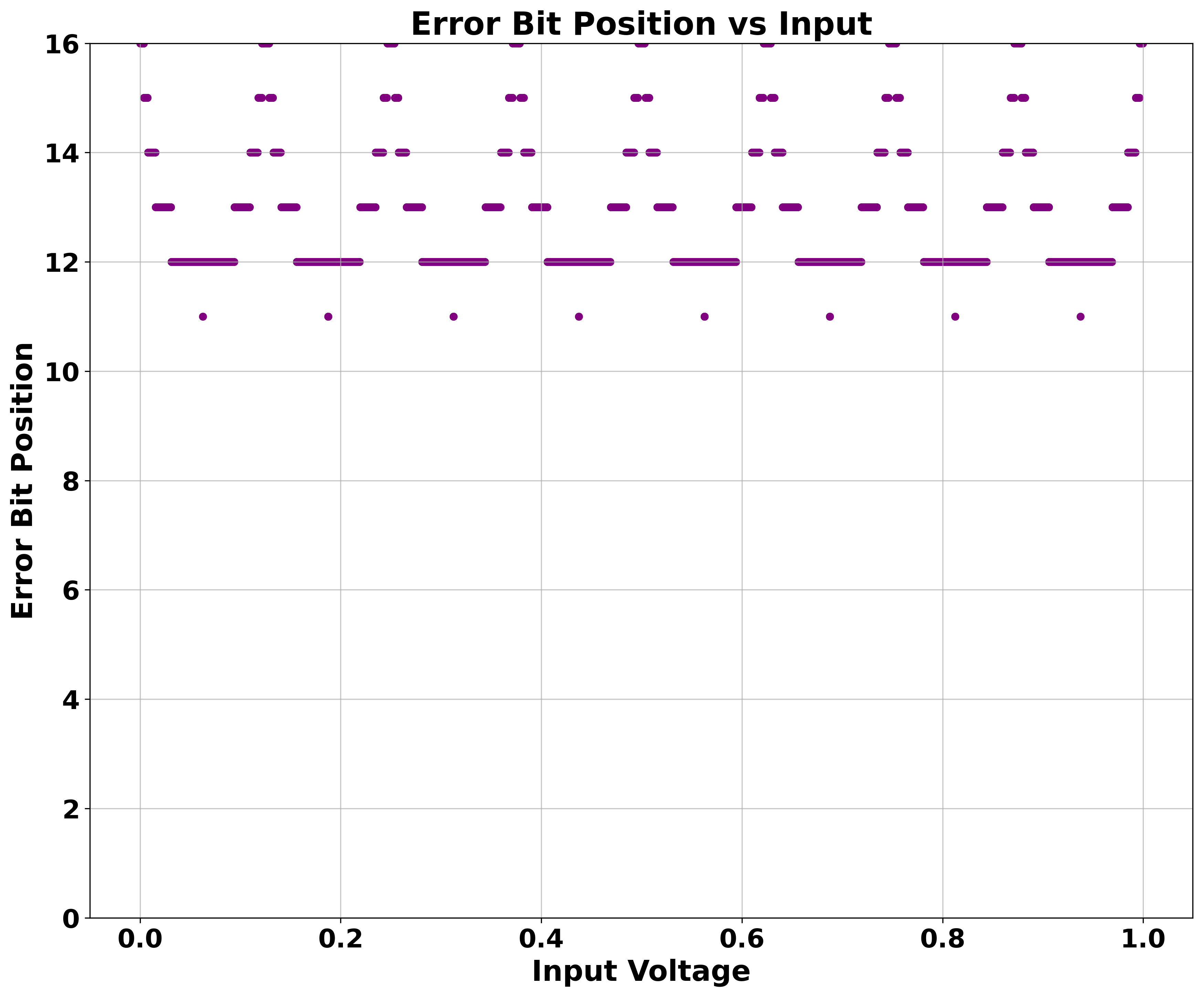
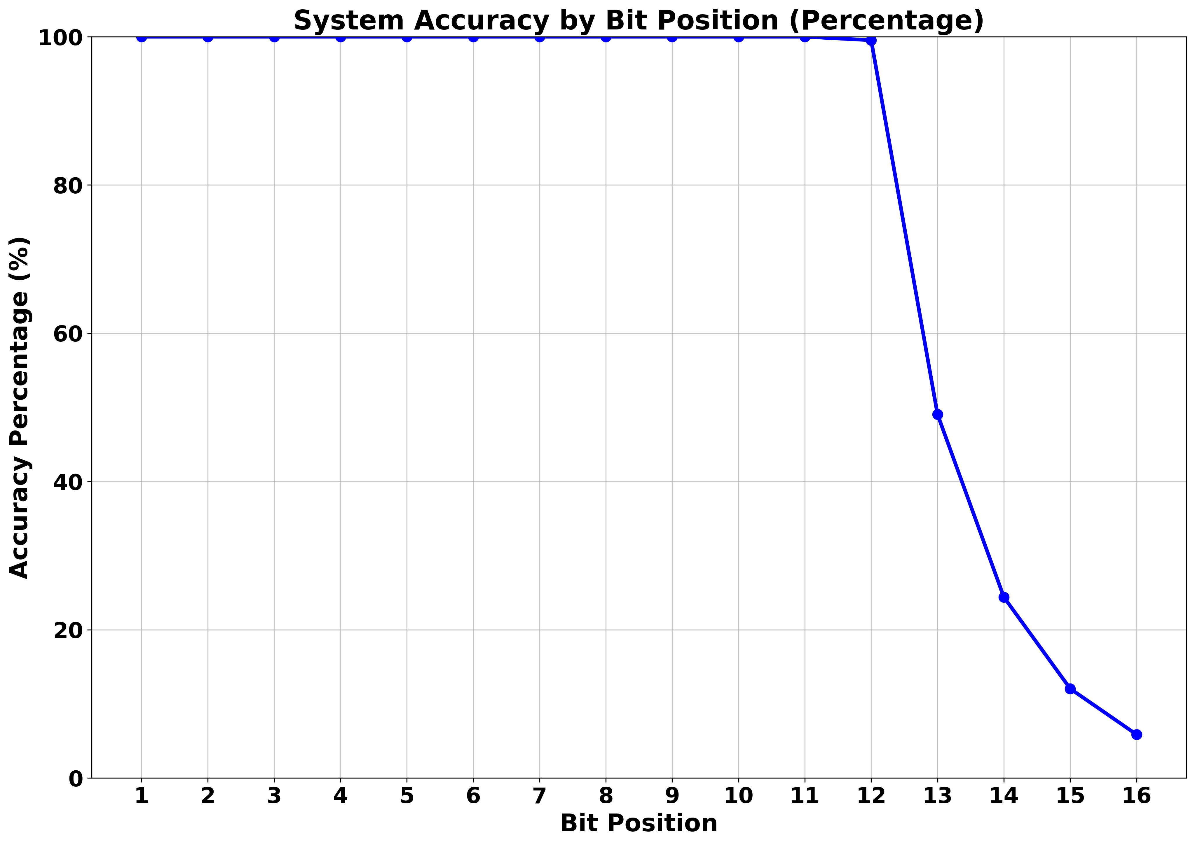
Quantizing MAC Voltage
3-bit coarse, 8-bit fine
Bit precision can reach 12 bit in most situation (lossless)

Slide 6
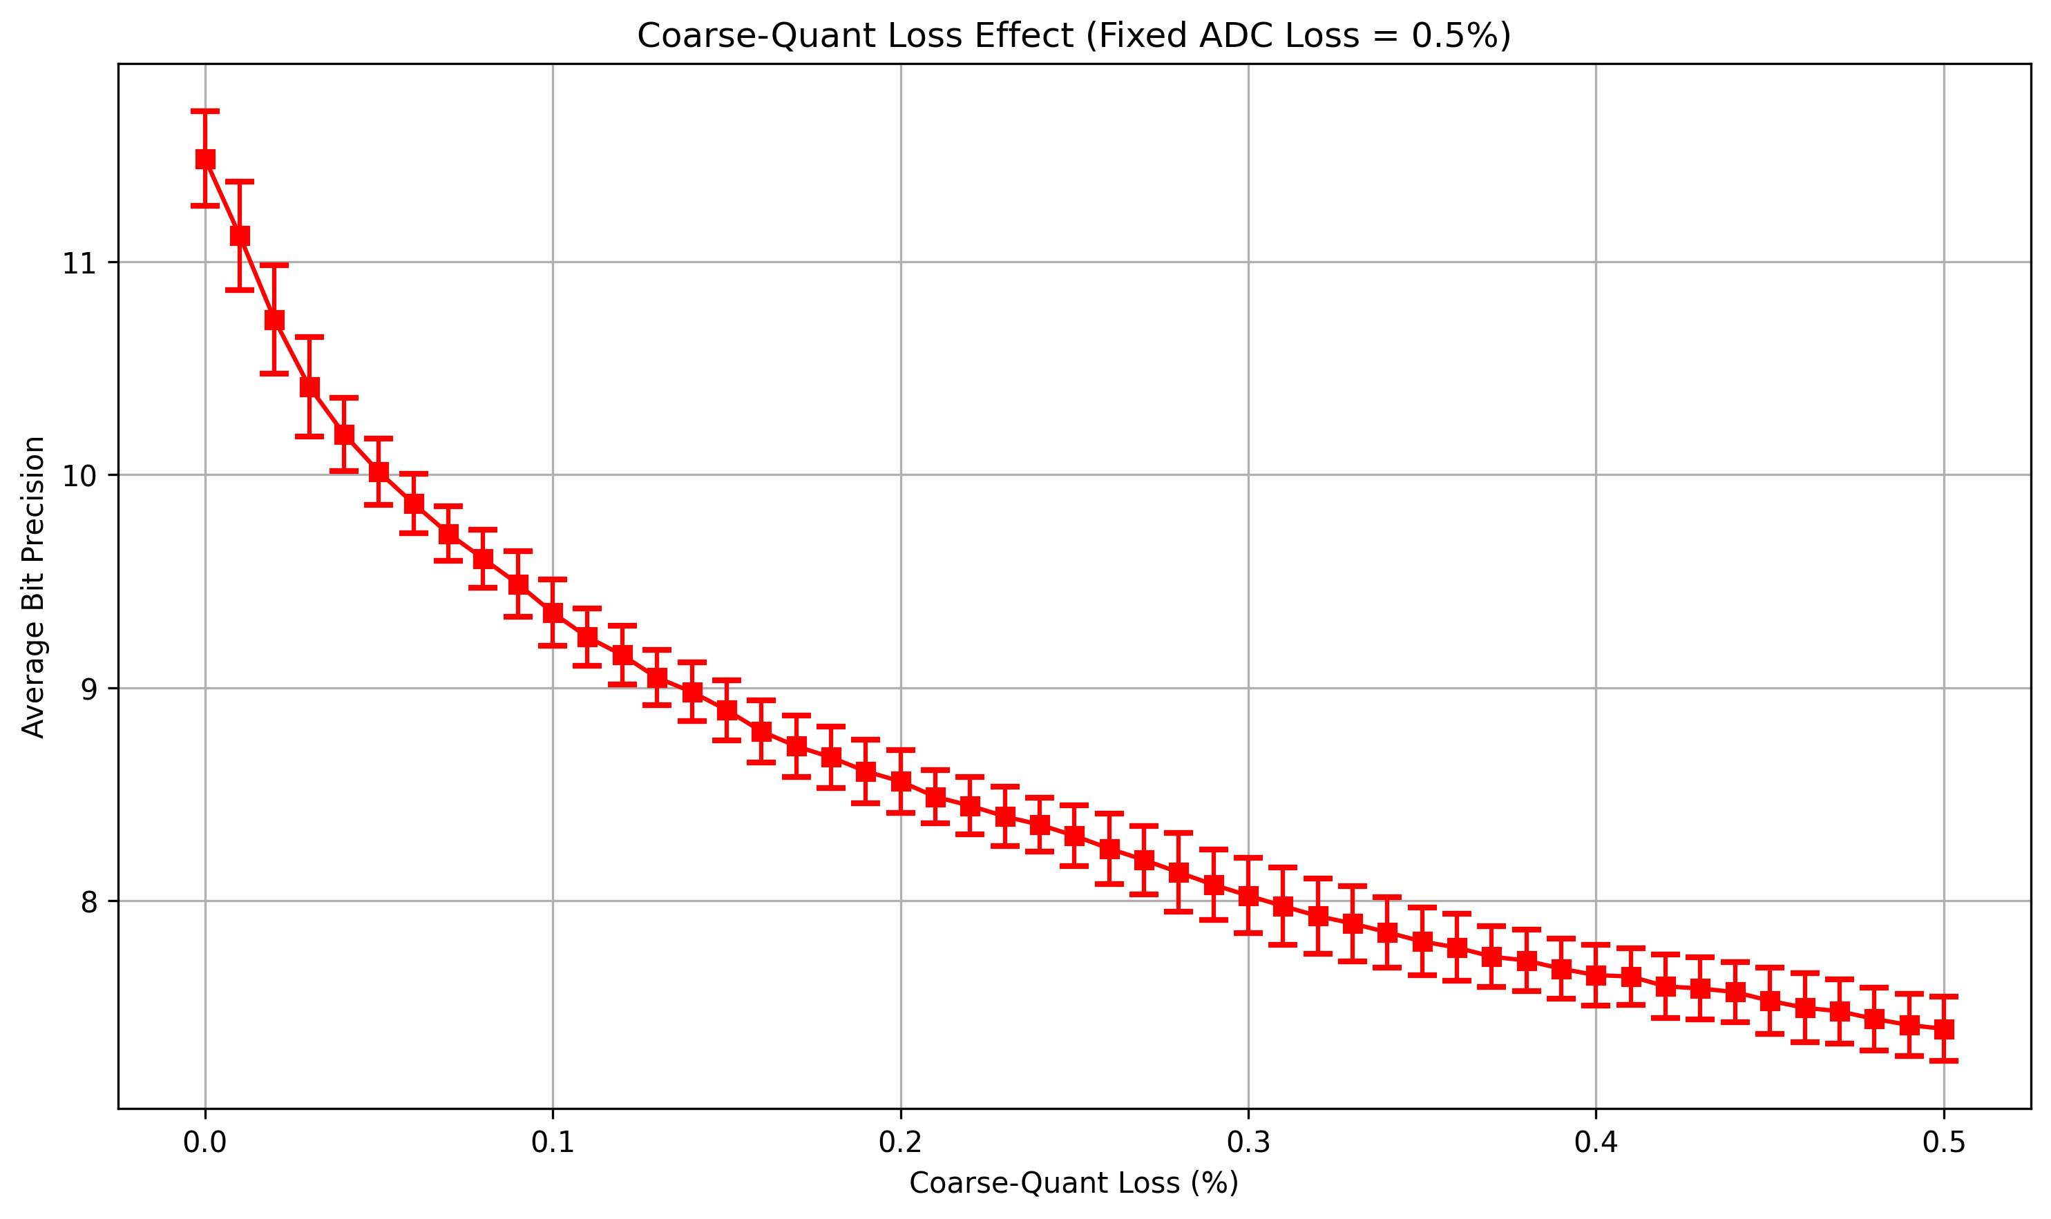
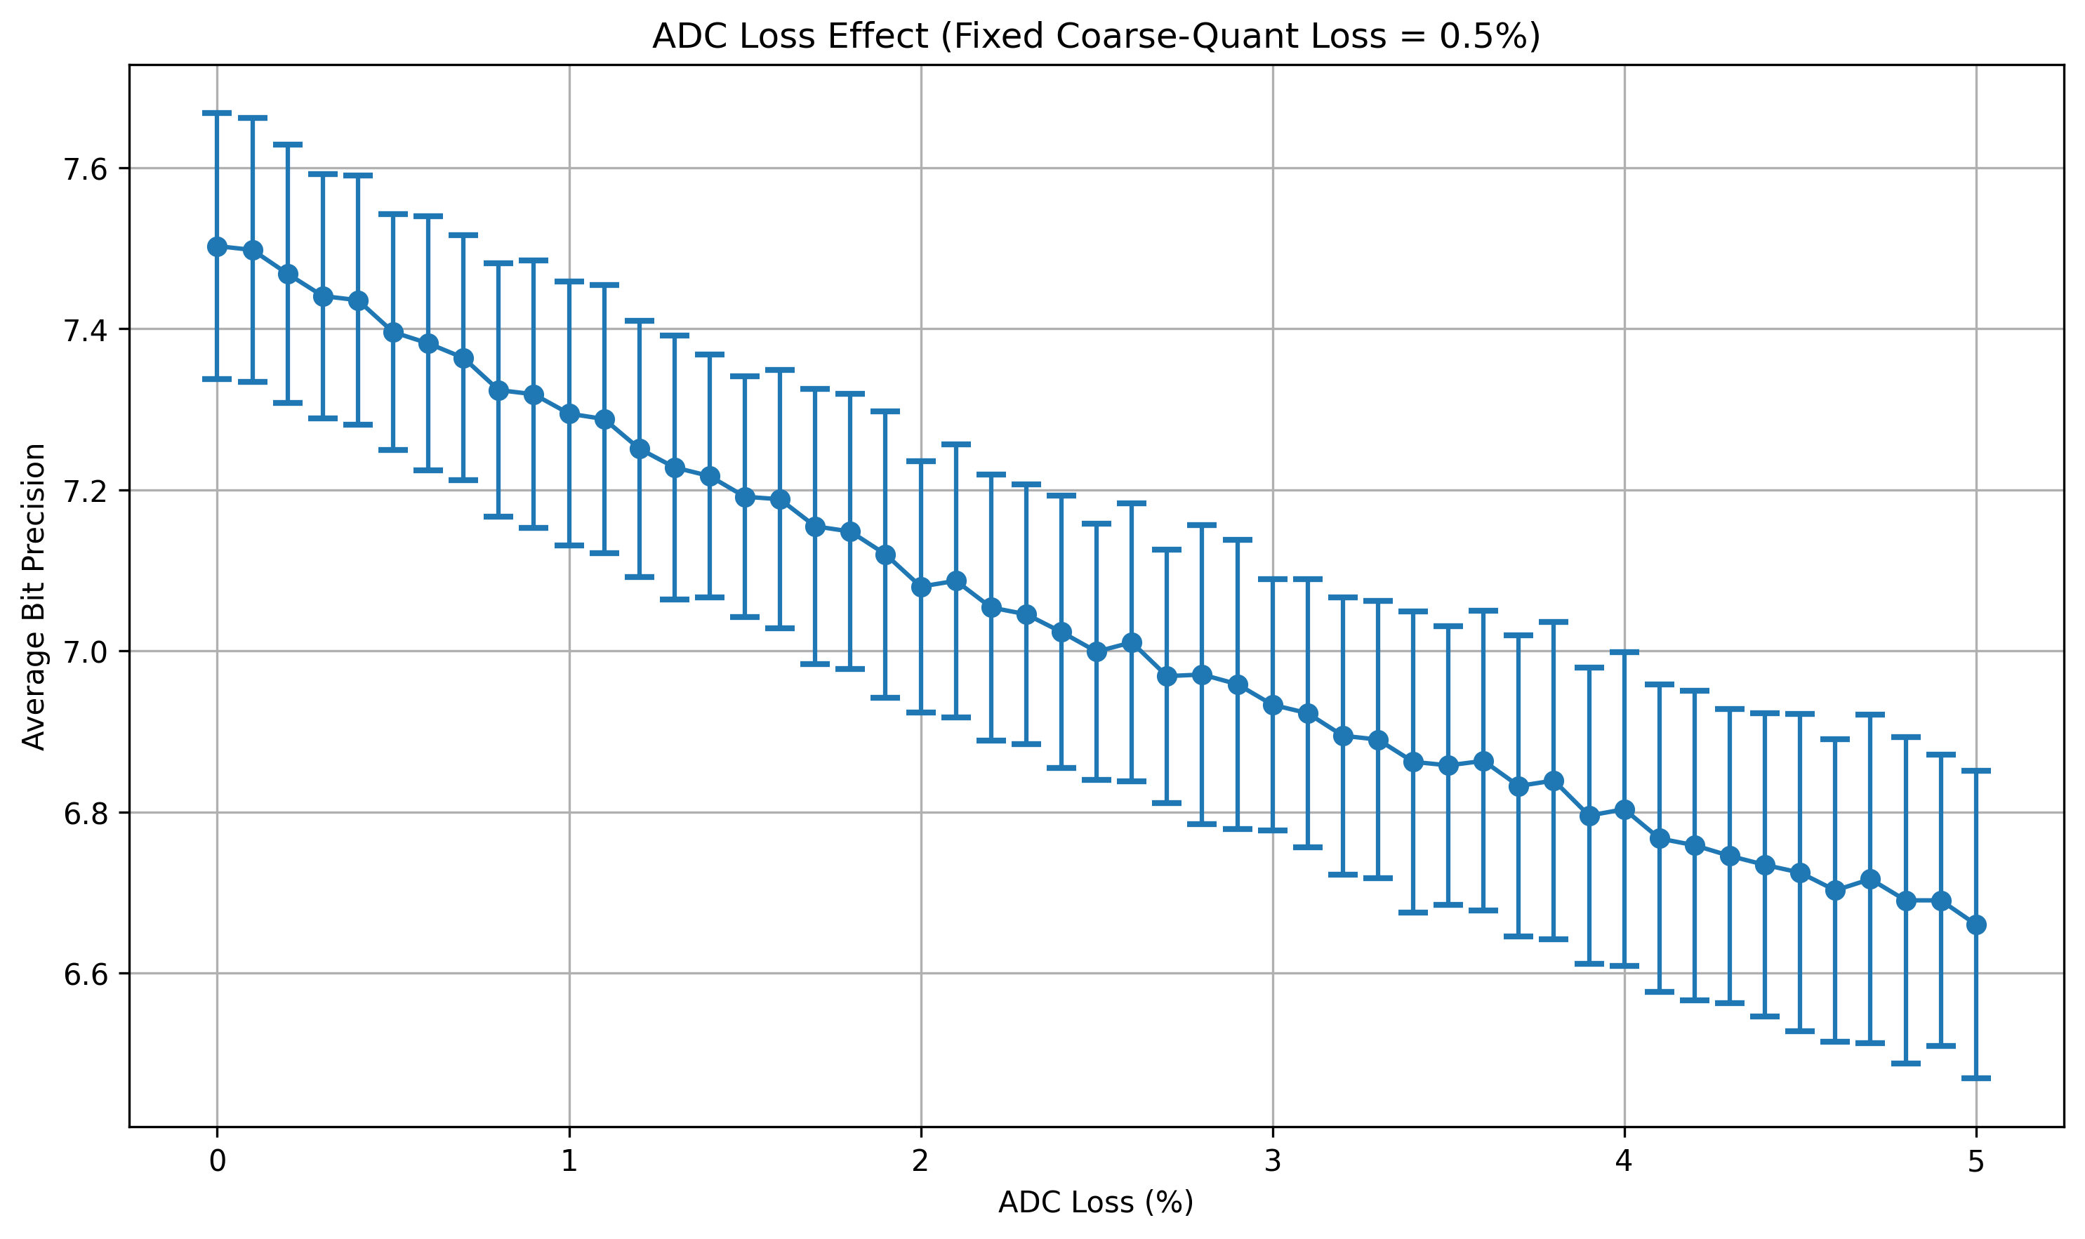
Parasitic Effect
Coarse-grained method is iterative
Loss in each iteration accumulates
ADC is also a source of noise
AVG bit precision
AVG bit precision
Exponential
Linear
Coarse-grained loss (%)
ADC loss (%)

Slide 7
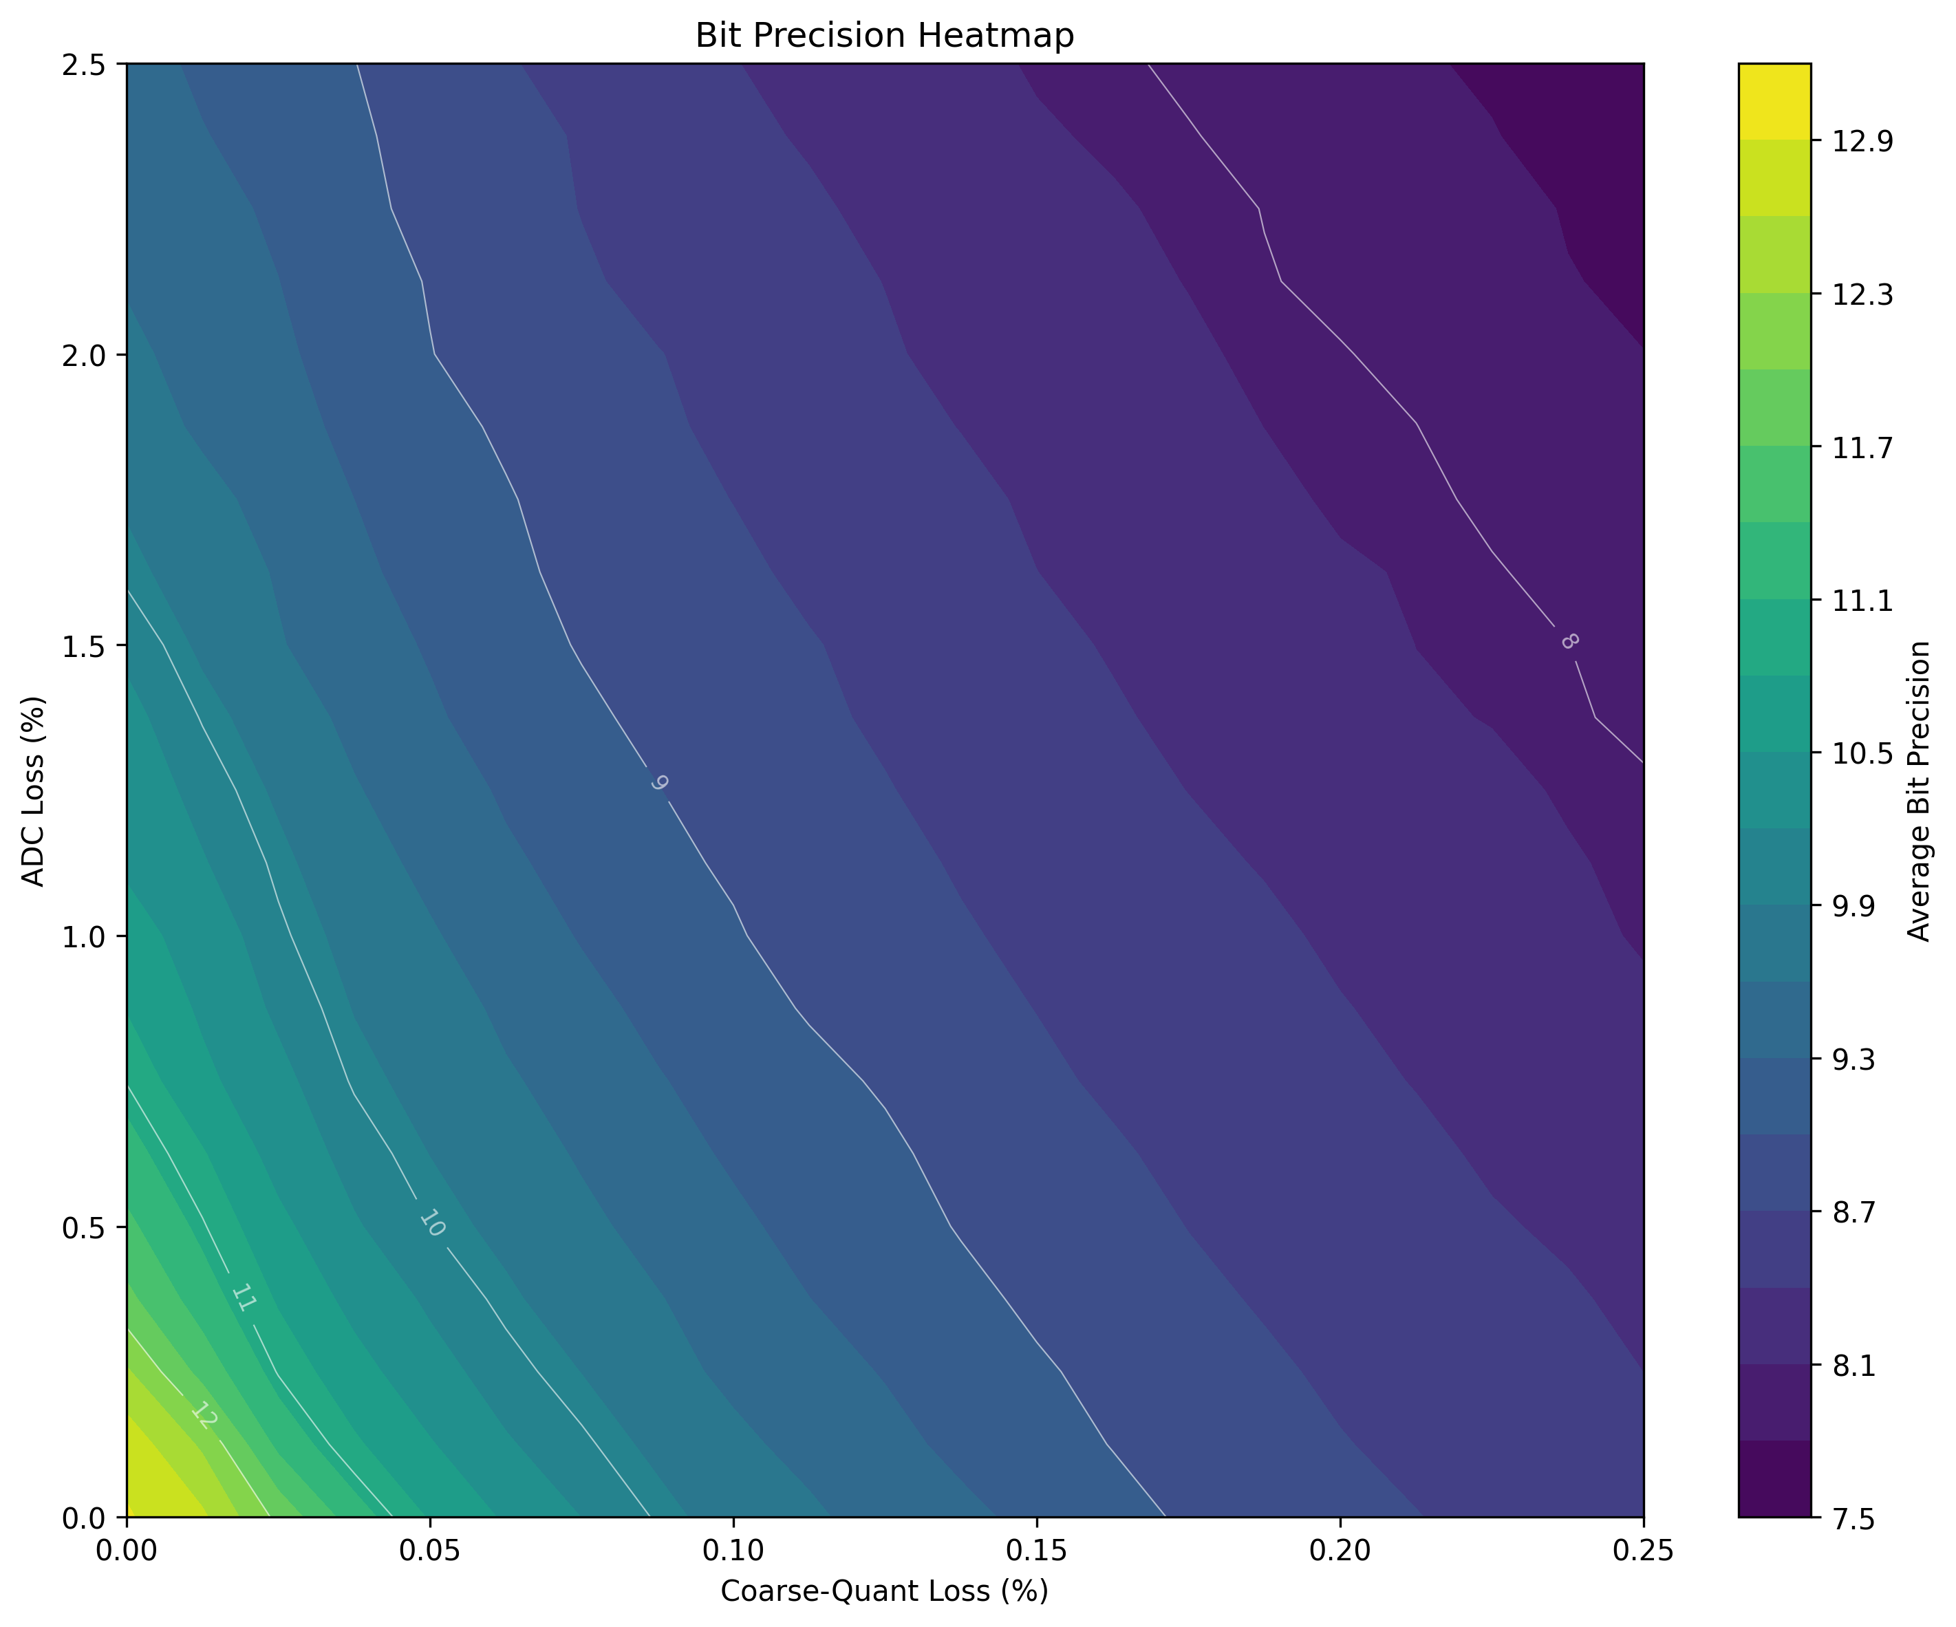
Parasitic Effect
Coarse-grained method is iterative
Loss in each iteration accumulates
ADC is also a source of noise
11 bit

Slide 8
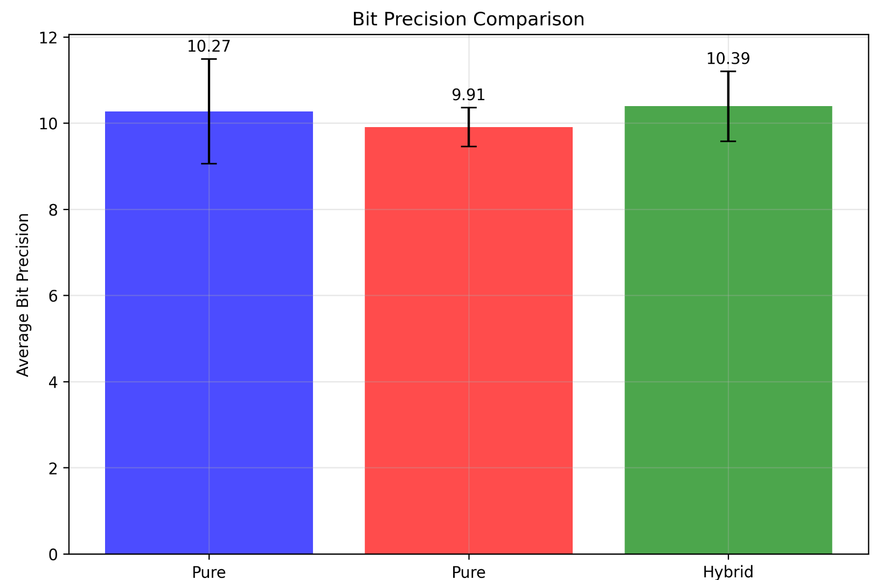
Effect of DGCQ (Lossy Case)
ADC : Large area, larger loss
Coarse-grained : Time-consuming
Dual-granularity : Less area, low loss, fast
Best in general
Fine-Grained
Coarse-Grained
DGCQ

Slide 9
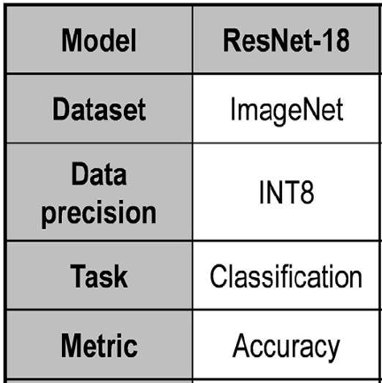
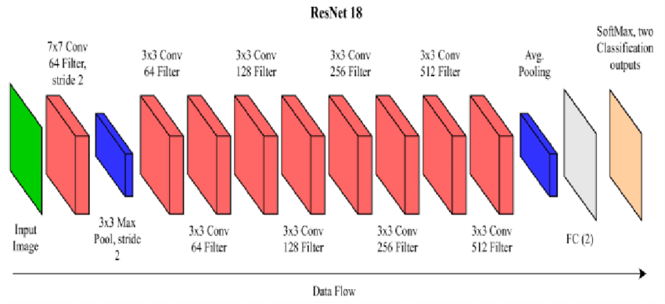
Effect of DGCQ on ML Tasks
The dataset used in the paper is ImageNet
ImageNet is not implemented in torch
Use a simpler dataset CIFAR-10
ResNet-18
Trained using fp32 precision
Quantize to int8 after training
Compute MAC result for each layer and apply loss
-LOSS
Gaussian(-Loss,0.01)

Slide 10
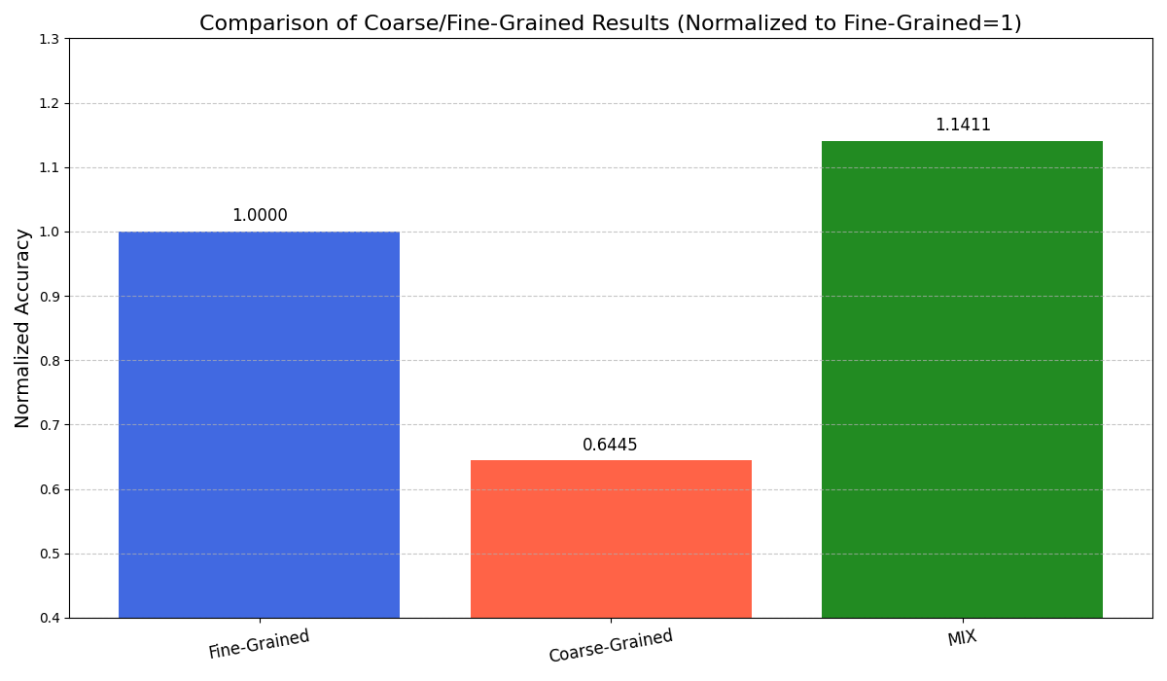
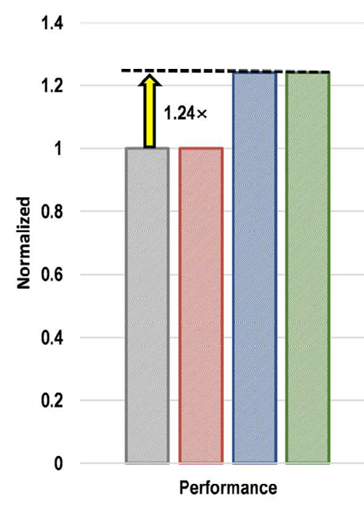
Effect of DGCQ on ML Tasks
Comparison between coarse/fine-grained value
DGCQ : Merge 2 types of granularity
1.14x
Fine-Grained
Coarse-Grained
DGCQ

