Slide 1
Impact of ADC Loss in Different Hybrid Partial Pruduct Shapes
B11901027 王仁軒
PPT TemplateCredit : Jie-Hong Roland Jiang

Slide 2
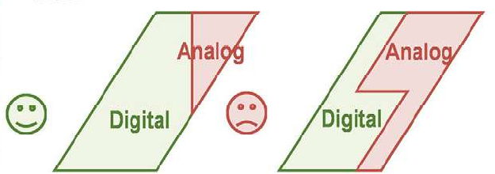
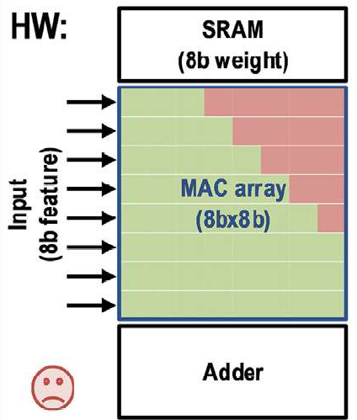
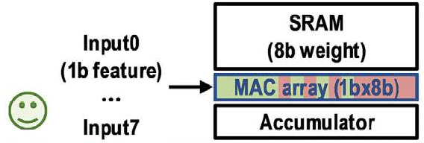
Shapes of Partial Sum
The definition of boundary between analog and digital part is a problem
Digital Part : High precision
Analog Part : Low precision
Digital Part : Bulky ckt
Analog Part : Less HW overhead

Slide 3

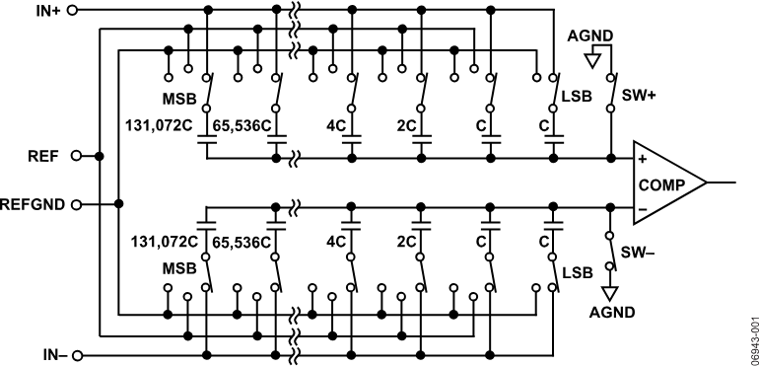
Shapes of Partial Sum
Digital Sum
Using digital multiplier and adder tree
Easy to simulate and calculate area
Analog Sum
Using analog multiplier and SAR ADC
SAR ADC implementation?
x n

Slide 4
Shapes of Partial Sum
Product = Digital sum + Analog Sum = Digital sum + Ideal Sum * loss
Digital sum
Analog sum

Slide 5
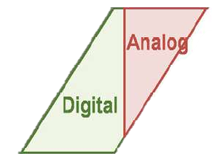
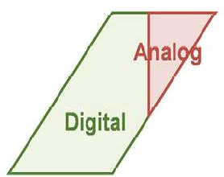
Shapes of Partial Sum
Types of Shapes
Lightning : Bit-serial scheme
Big triangle : Bit-rotation scheme
Small triangle : Bit parallel scheme
Lightning
Big Triangle
Small Triangle

Slide 6
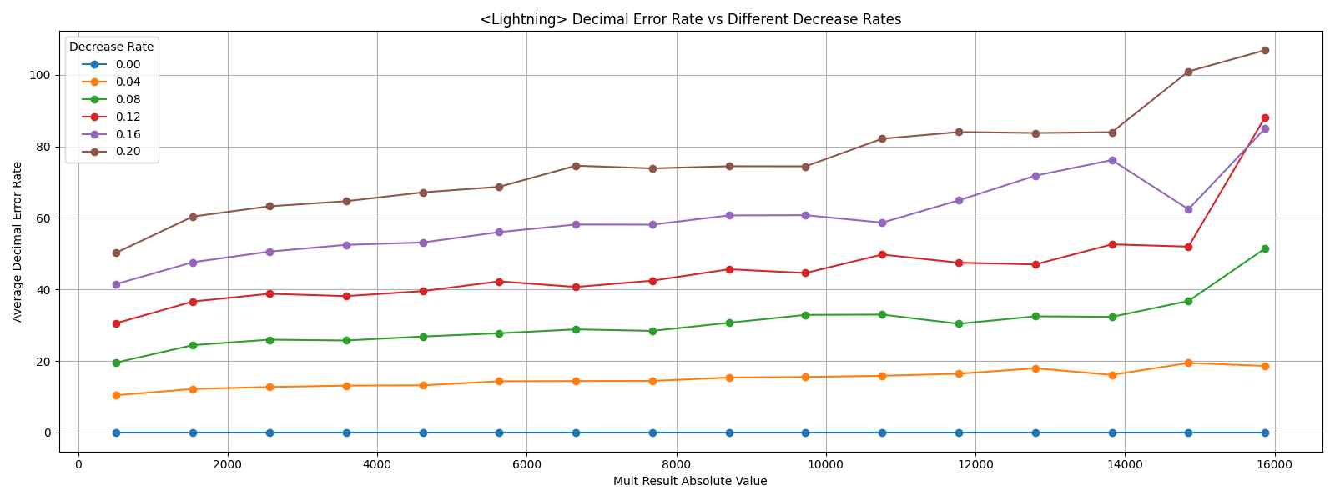
Shapes of Partial Sum
Lightning
Error in ADC
Error of its value

Slide 7
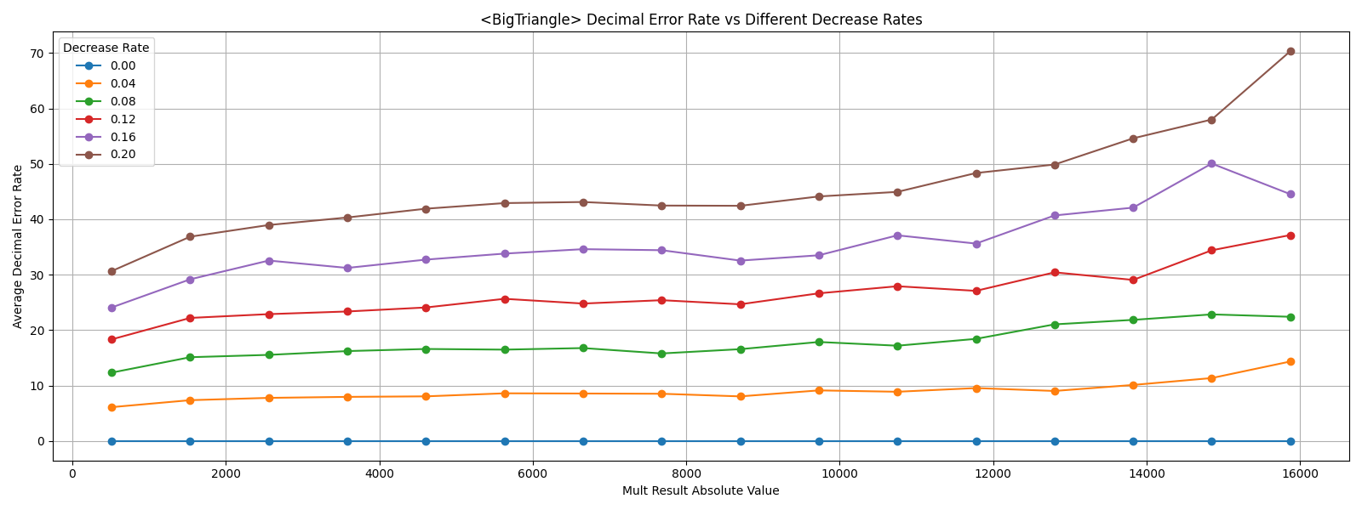
Shapes of Partial Sum
Big Triangle
Error in ADC
Error of its value

Slide 8
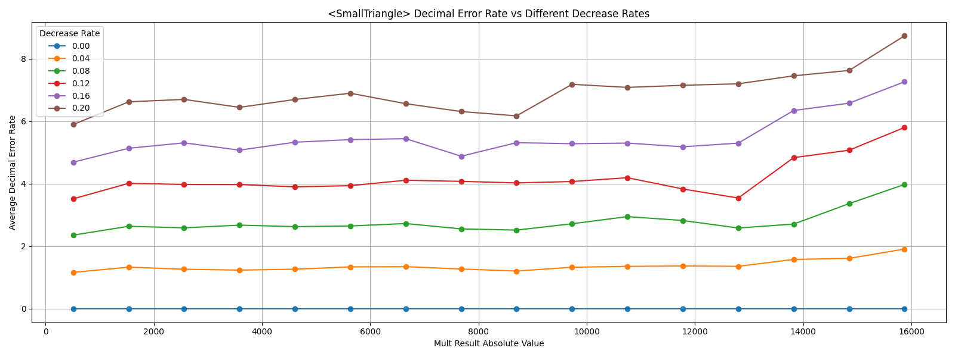
Shapes of Partial Sum
Small Triangle
Error in ADC
Error of its value

Slide 9
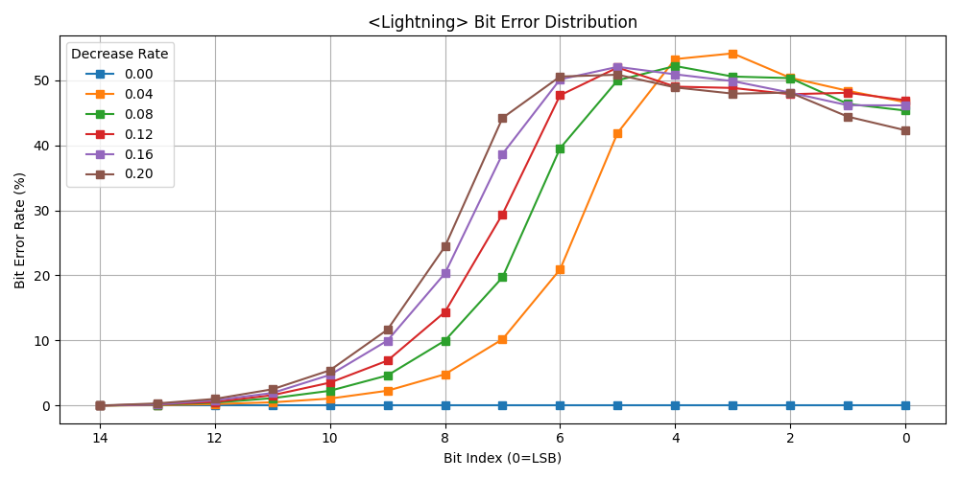
Shapes of Partial Sum
Lightning
Error in ADC
Error rate in bits

Slide 10
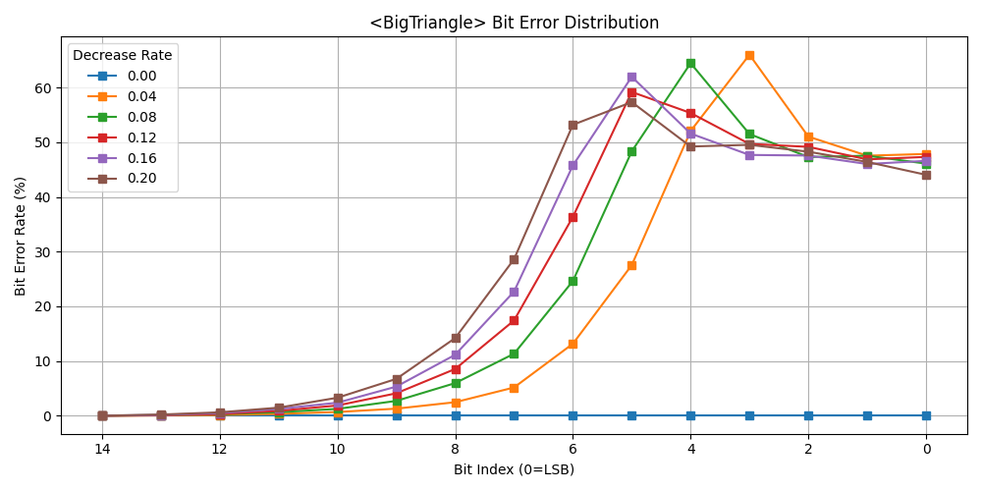
Shapes of Partial Sum
Big Triangle
Error in ADC
Error rate in bits

Slide 11
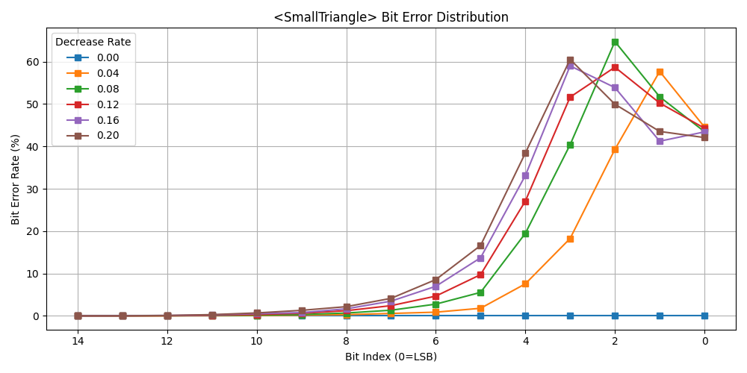
Shapes of Partial Sum
Small Triangle
Error in ADC
Error rate in bits

