Slide 1
AND / FA
B11901027 王仁軒

Slide 2







NM with Wa Variation
SNM:
Noise margin does not change with Wa
RNM:
Noise margin $↑$with Wa $↓$
WNM
Noise margin $↑$with Wa $↑$
Wa = 0.36 um
0.794
Wa = 0.48 um
0.794
Wa = 0.60 um
0.794
$$=$$
$$=$$
Wa = 0.36 um
0.373
Wa = 0.48 um
0.291
Wa = 0.60 um
0.222
$$>$$
$$>$$
Wa = 0.36 um
0.467
Wa = 0.48 um
0.473
Wa = 0.60 um
0.475
$$<$$
$$<$$

Slide 3
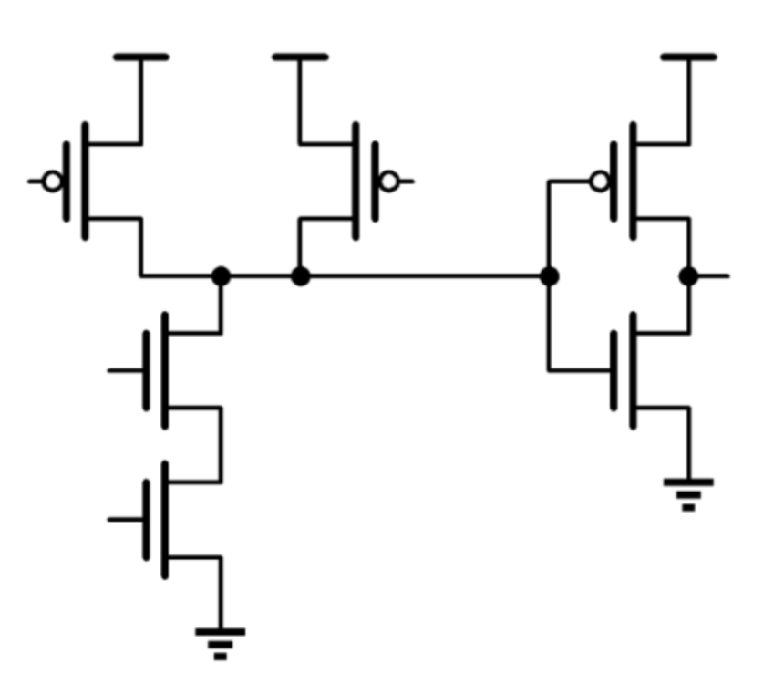

AND
Fastest at FF, slowest at SS
No Sizing -> rise time = 2x fall time

Slide 4
AND
Delay: FS > TT
Unbalanced size -> maximum delay at falling

Slide 5
AND
High VDD -> Faster

Slide 6


AND (Adjust W by 40%)
Adjust Wn,nand
Adjust Wp,nand

Slide 7
AND (Adjust W by 40%)
Adjust Wn,inv
Adjust Wp,inv

Slide 8
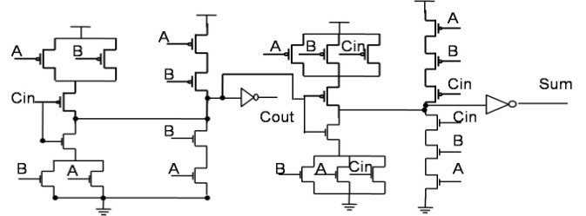

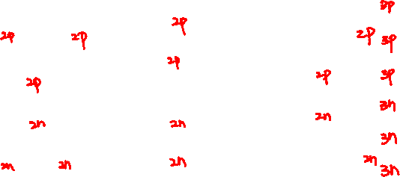
28T Full Adder
Structure
Cout = MAJ(A , B , Cin)
Sum = ABC + (A + B + Cin)$\overline{Cout}$
Wp = 0.75u, Wn = 0.25u

Slide 9
28T Full Adder
Fastest at FF, slowest at SS

Slide 10
28T Full Adder
High VDD -> Faster

Slide 11
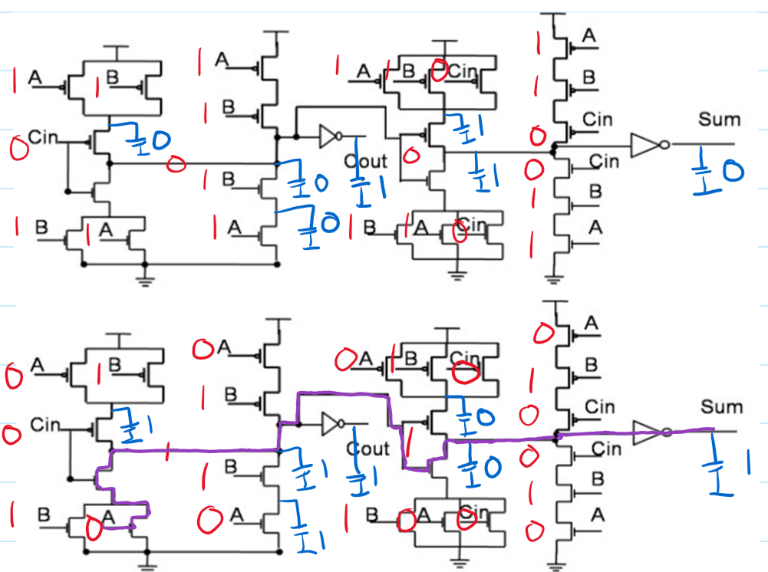
28T Full Adder
Critical path
A: 1->0 , B: 1 , Cin: 0, Cout: 1->0, Sum: 0->1

Slide 12
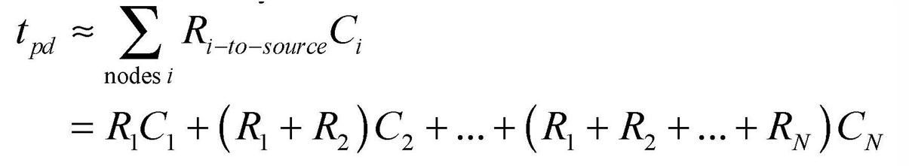
28T Full Adder
Critical path
A: 1->0 , B: 1 , Cin: 0, Cout: 1->0, Sum: 0->1
Delay can be estimated by Elmore RC model
Longer path -> larger effective capacitance

Slide 13
28T Full Adder (Adjsut W by 40%)
Adjust Wn (excluding inverters)
Adjust Wp (excluding inverters)
Shorter delay when reducing size of Wp
Max/Min delay happens at Sum : 0 -> 1

