Slide 1
2021 / 2022
B11901027 王仁軒

Slide 2
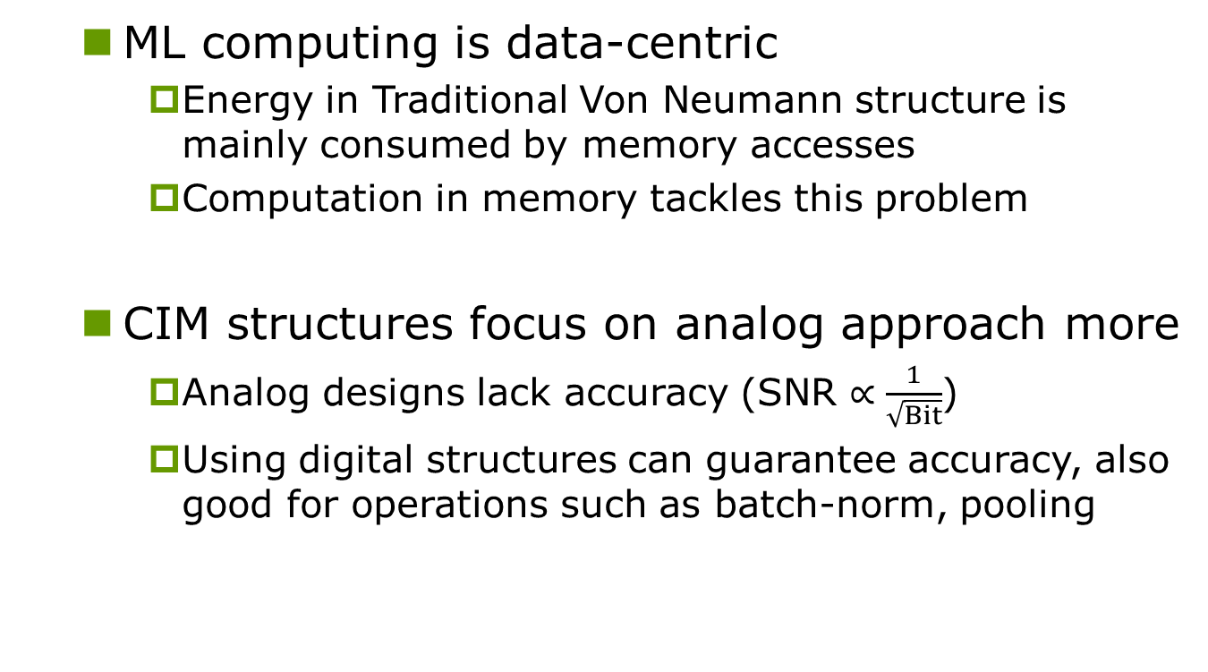
Motivation & Background
ML computing is data-centric
Energy in Traditional Von Neumann structure is mainly consumed by memory accesses
Computation in memory tackles this problem
CIM structures focus on analog approach more
Analog designs lack accuracy (SNR $∝\frac{1}{\sqrt{Bit}}$)
Using digital structures can guarantee accuracy, also good for operations such as batch-norm, pooling
INPUT
ALU
Memory
OUTPUT

Slide 3
Features
High bit-flexibility
Programmable bit-widths, signed/unsigned, and weights with 4, 8, 12, 16 bit widths..
Parallel MAC operations, with high energy/area efficiency and throughput

Slide 4
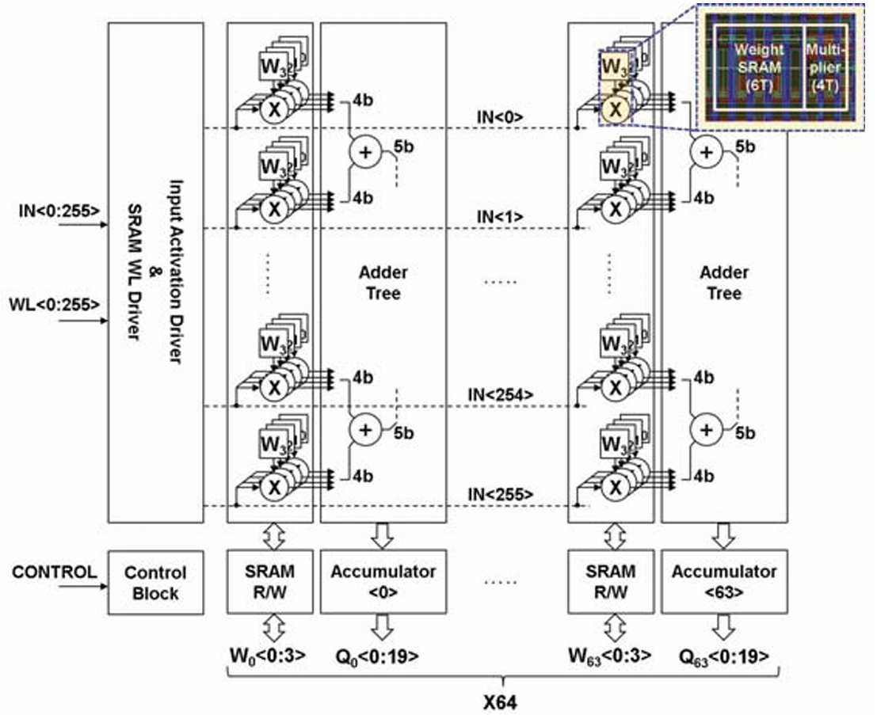
Structure
2 Mode: SRAM & CIM
SRAM: update weight
CIMW: MAC operation, support 256×64 multiplication

Slide 5
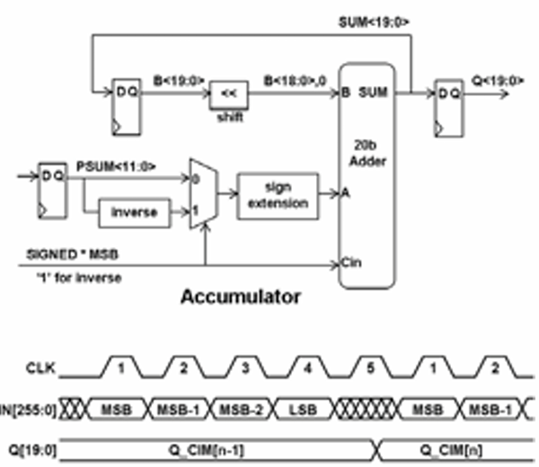
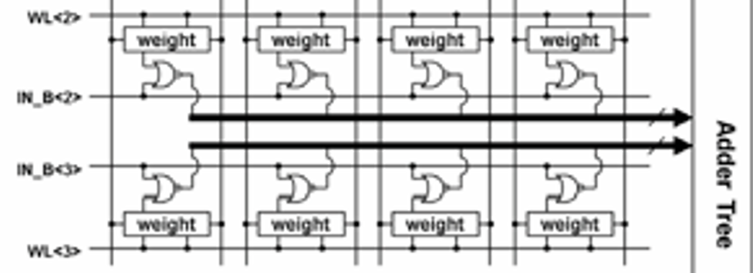
Structure
2 Mode: SRAM & CIM
SRAM: update weight
CIMW: MAC operation , support 256×64 multiplication
Require 5 cycles for
4-bit input activation

Slide 6
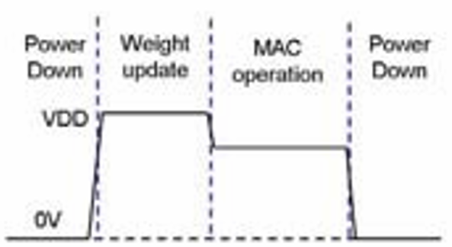
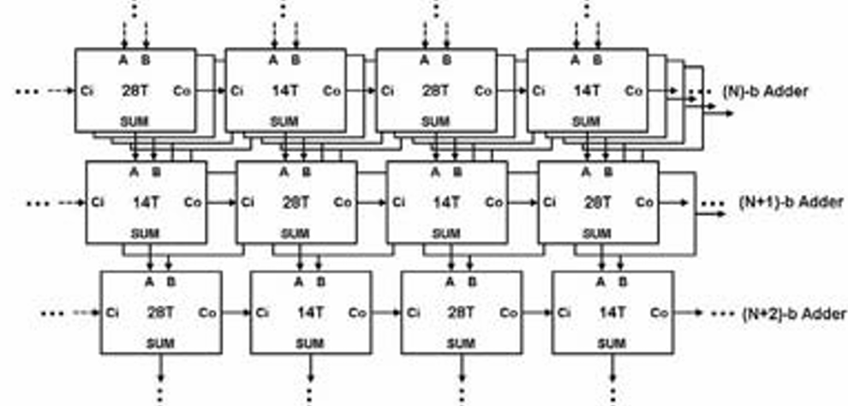
Structure
Dynamic voltage scaling
0.8V for weight updating
0.68V for MAC operation
Better NM and less dynamic power
Interleaved 28T & 14T Adder
Lower dynamic power

Slide 7
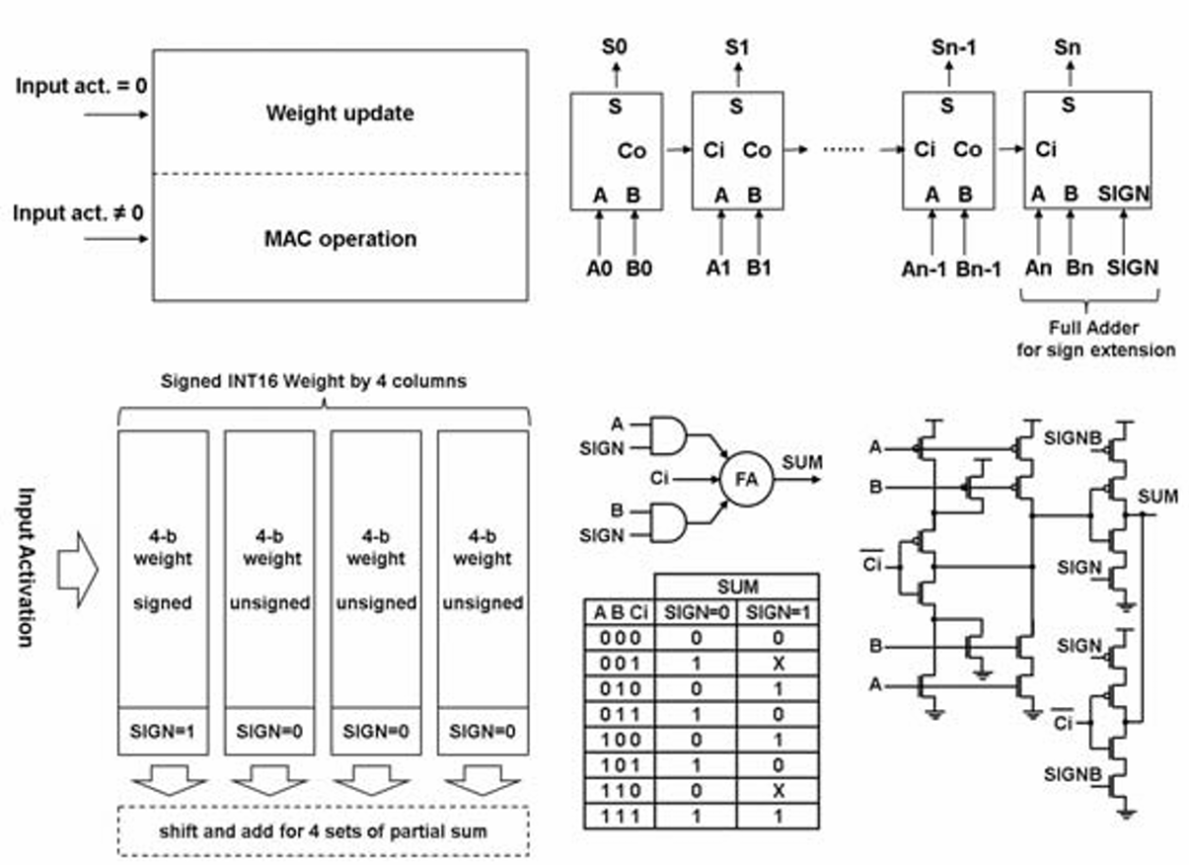
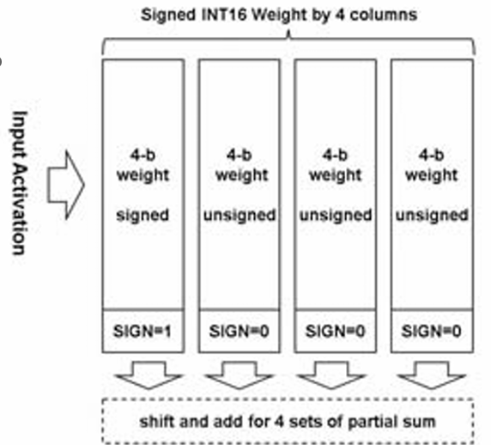
Structure
Update weight and perform MAC simultaneously
When input = 0, Update weight
Flexible bit width
Separate 16 bit into 4b signed And 3×4b unsigned

Slide 8
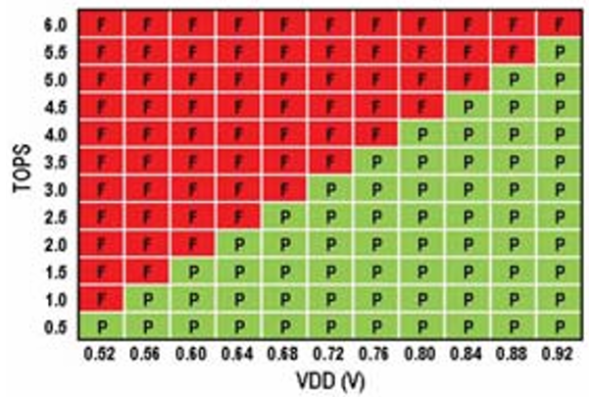
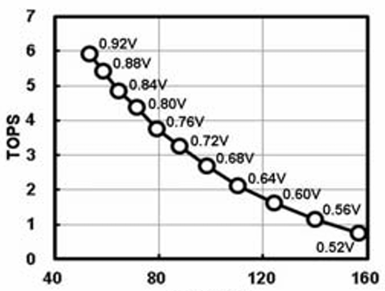
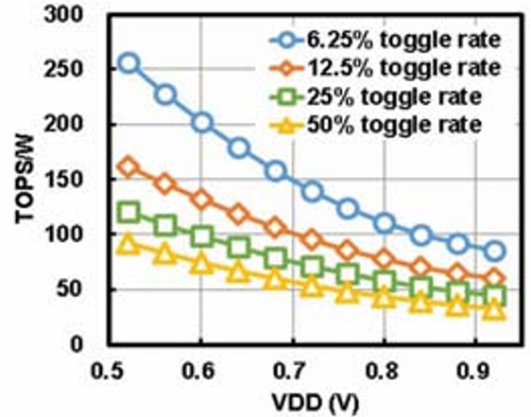
Result
89TOPS/W under 0.72V for a sparse pattern
(18% input toggle rate, 50% 1s for weights)
52TOPS/W for a dense pattern
(50% input toggle rate, 50% 1s for weights)
3.3TOPS from 0.72V at 25°C
TOPS/W and TOPS/area improving by 2.8× and 19× under 5nm process compared to 22nm design

Slide 9
Conclusion
Full precision
Digital adder tree structure with 256×64 bit sram array
Low power
Dynamic voltage scaling ( lower VDD for MAC )
Half of the 28T adders are replaced by 14T adders
Highly programmable
Support different input bit-width and weight bit-width
Requires extra adder for sign extension and control blocks

