Slide 1
Noise Margin
B11901027 王仁軒

Slide 2

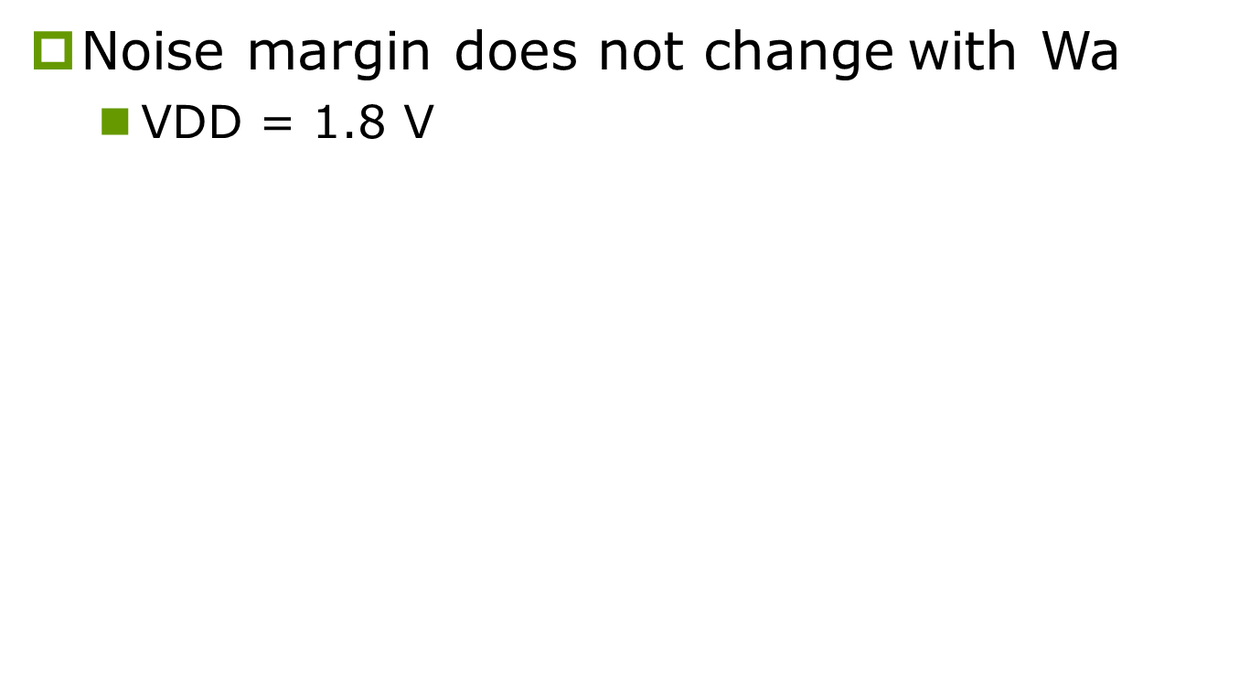

SNM (width)
Noise margin does not change with Wa
VDD = 1.8 V
Wa = 0.36 um
0.794
Wa = 0.48 um
0.794
Wa = 0.60 um
0.794
$$=$$
$$=$$

Slide 3



RNM (width)
Noise margin $↑$with Wa $↓$
VDD = 1.8 V
Wa = 0.36 um
0.373
Wa = 0.48 um
0.291
Wa = 0.60 um
0.222
$$>$$
$$>$$

Slide 4


WNM (width)
Noise margin $↑$with Wa $↑$
VDD = 1.2 V
Wa = 0.36 um
0.467
Wa = 0.48 um
0.473
Wa = 0.60 um
0.475
$$<$$
$$<$$

