Slide 1
Adder Tree / MAC
B11901027 王仁軒
PPT TemplateCredit : Jie-Hong Roland Jiang

Slide 2
Energy Efficiency
TOPS/W drops from 0.65 to 0.33 with the increase of input toggle rate
VDD = 1.8V

Slide 3
Power of All Adder Tree Stages
Power of first few stages greatly depend on input toggle rate, while other stages do not

Slide 4
Input Initial condition
The proportion of 0’s in first input pattern does not affect the power of MAC

Slide 5
Input Initial condition
The power distribution in all stages are same as 50% 0’s input pattern’s result

Slide 6
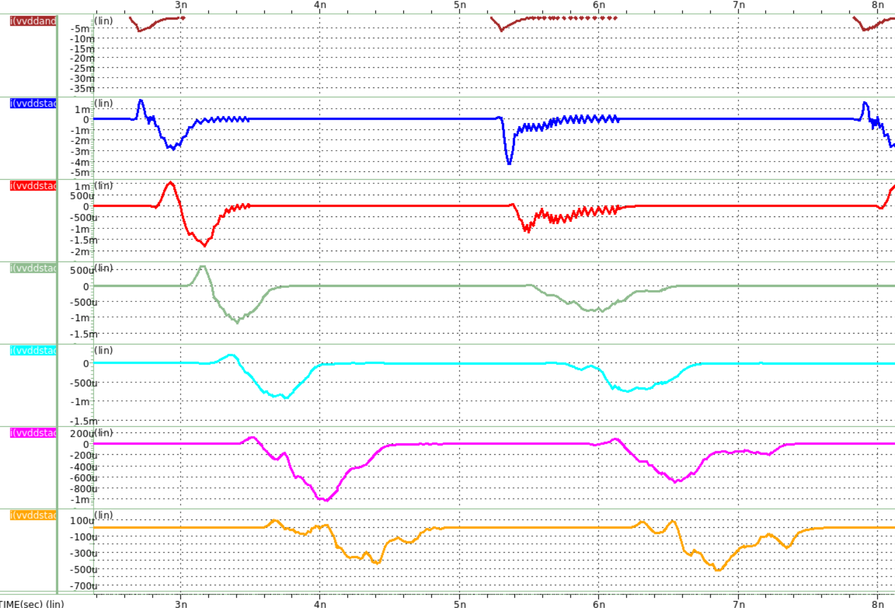
Timing diagram?
AND
VDD1
VDD2
VDD3
VDD4
VDD5
VDD6

Slide 7
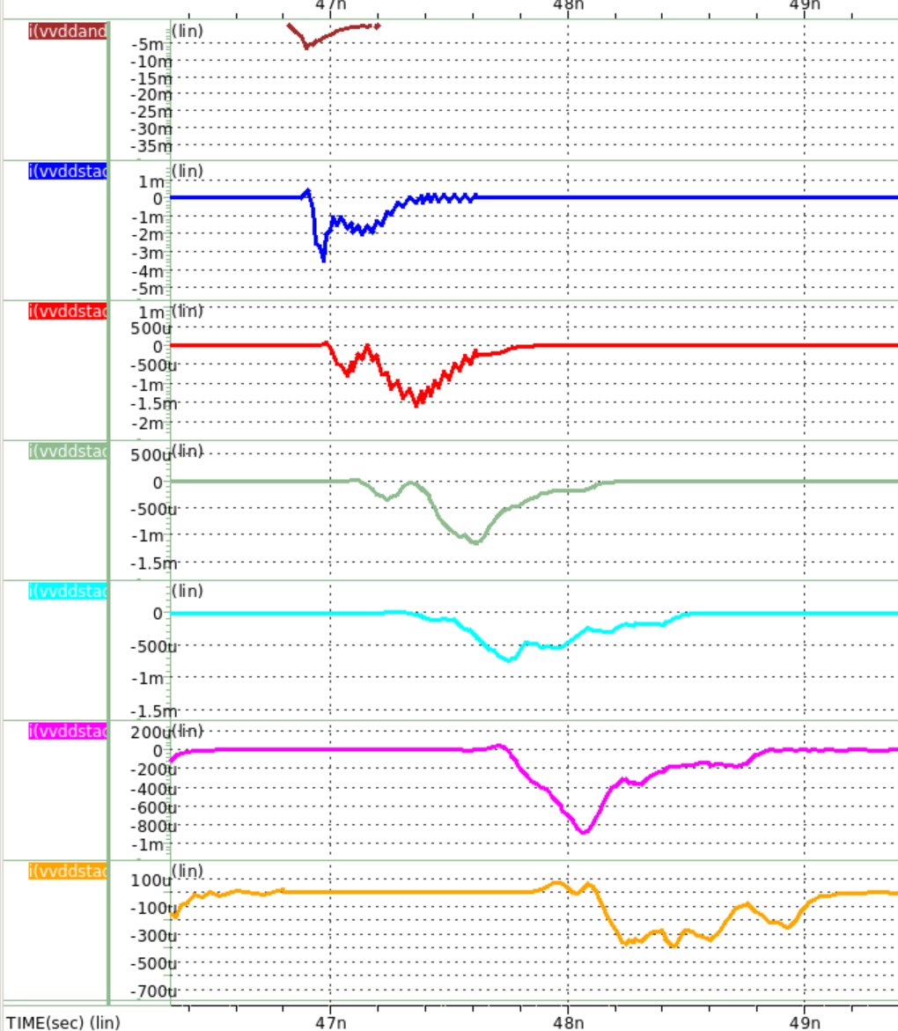
Timing diagram?
AND
VDD1
VDD2
VDD3
VDD4
VDD5
VDD6

