Slide 1
DATA ANALYTICS PROJECT
E-COMMERCE
SALES ANALYTICS
From Raw Data to Profitable Business Insights
MySQL
+
Power BI
PRESENTED BY
Chidi · Phebe · Toyeibat

Slide 2
Executive Summary
KEY VERIFIED METRICS
$2.326M
$292.273K
12.56%
TOTAL SALES
TOTAL PROFIT
PROFIT MARGIN
5,111
804
38,644
ORDERS
CUSTOMERS
QUANTITY
GROWTH
PROFITABILITY
DISCOUNT RISK
2026 was the strongest year for sales and profit.
Technology led category sales and profit, while Furniture showed weak profitability.
Discounts above 20% showed negative profit margins.

Slide 3
Business Objective & Questions
FROM SALES TO PROFIT
Help management understand not just where sales are coming from, but where the business is actually making profit or loss across sales, customers, products, regions, discounts and shipping.
1
2
3
4
5
›
›
›
›
Where are sales coming from?
Where is profit coming from?
Where are losses occurring?
What factors are affecting profitability?
What should management investigate?

Slide 4
Data & Tools
DATASET AND WORKFLOW
DATASET
MYSQL
POWER BI
Data Cleaning
Data Validation
EDA
SQL Analysis
Visualization
Dashboard Development
KPI Reporting
Business Communication
Superstore / E-Commerce Sales Dataset
→
→

Slide 5
Data Cleaning & Preparation
MYSQL
RAW DATA
→
SQL CLEANING
→
DATA VALIDATION
→
CLEAN DATA
10,194
10,192
IMPORTED ROWS
UNIQUE CLEANED ROWS
Removed duplicate records
Order & Ship Date converted and validated
Sales & Quantity checked for invalid / non-positive values
Discount values checked
Missing Profit values checked
Text fields checked for leading / trailing spaces
Shipping dates validated
Derived fields: Order Year, Quarter, Month, Month Number

Slide 6
Exploratory Data Analysis
ANALYTICAL FRAMEWORK
1
2
3
PURPOSE
Overall Performance
Time Trends
Category
EDA was used to identify patterns, performance gaps and the business questions requiring deeper analysis.
4
5
6
Region
Segment
Products
7
8
9
Customers
Discounts
Shipping

Slide 7
Overall Business Performance
SALES VS PROFIT BY YEAR
$2.326M
$292.273K
12.56%
5,111
804
3.96
SALES
PROFIT
MARGIN
ORDERS
CUSTOMERS
AVG SHIP DAYS
2026 · STRONGEST YEAR
$745,567.53
Sales
$95,926.35
Profit

Slide 8
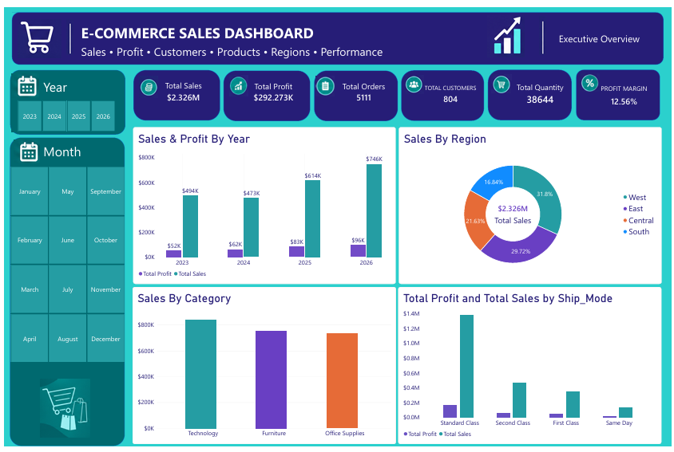
Power BI — Executive Overview
DASHBOARD PAGE 1
Provides management with a high-level view of sales, profit, orders, customers, quantity and profit margin.
INSERT POWER BI DASHBOARD HERE

Slide 9
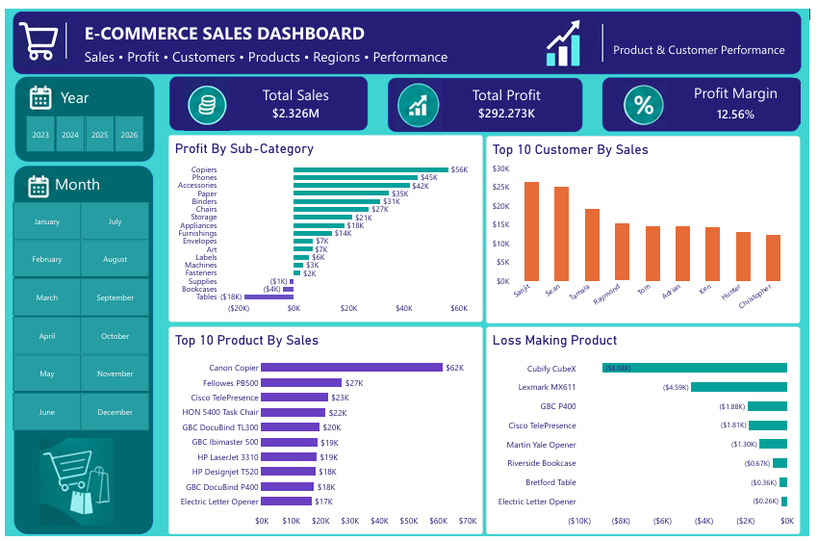
Power BI — Product & Customer Performance
DASHBOARD PAGE 2
Highlights customer and product sales performance while identifying sub-category and product-level profitability risks.
INSERT POWER BI DASHBOARD HERE

Slide 10
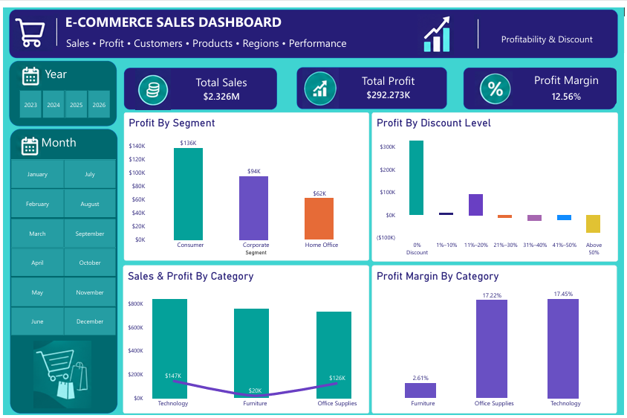
Power BI — Profitability & Discount
DASHBOARD PAGE 3
Examines profitability across customer segments, categories and discount levels.
INSERT POWER BI DASHBOARD HERE

Slide 11
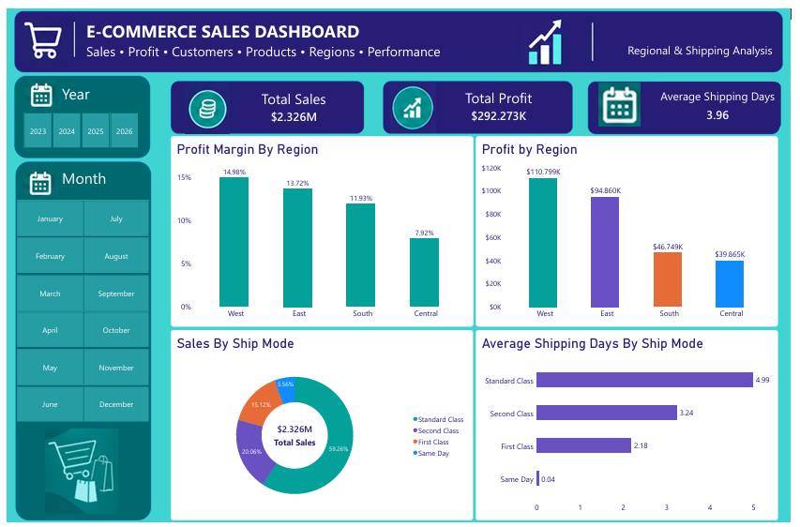
Power BI — Regional & Shipping Analysis
DASHBOARD PAGE 4
Examines regional sales and profitability alongside shipping mode and delivery performance.
INSERT POWER BI DASHBOARD HERE

Slide 12
SQL Analysis: High Sales, Low / Negative Profit
BUSINESS QUESTION 1
"Are there areas with high sales but low or negative profit?"
SELECT
State_Province,
City,
ROUND(SUM(Sales), 2) AS Total_Sales,
ROUND(SUM(Profit), 2) AS Total_Profit
FROM ecommerce_sales
GROUP BY State_Province, City
HAVING SUM(Sales) > 5000
AND SUM(Profit) < 500
ORDER BY Total_Sales DESC;
WHAT IT DOES
Identifies locations where strong sales activity is not translating into strong profitability.

Slide 13
SQL Analysis: Profitable Combinations
BUSINESS QUESTION 2
"Which combinations contribute most to profitable performance?"
SELECT
Product_Name,
Customer_Name,
Region,
Ship_Mode,
ROUND(AVG(Discount) * 100, 2) AS Average_Discount_Percent,
ROUND(SUM(Sales), 2) AS Total_Sales,
ROUND(SUM(Profit), 2) AS Total_Profit
FROM ecommerce_sales
GROUP BY Product_Name, Customer_Name, Region, Ship_Mode
ORDER BY Total_Profit DESC
LIMIT 20;
WHAT IT DOES
Combines product, customer, region, shipping mode and discount variables to investigate profitable combinations.

Slide 14
Key Business Findings
FIVE STRONGEST FINDINGS
1 · 2026 STRONGEST YEAR
2 · TECHNOLOGY LEADS
3 · FURNITURE WEAK PROFIT
2026
$146.5K
2.61%
$745,567.53 sales
$95,926.35 profit
profit on $839.9K sales, the highest category
$754.4K sales
$19.7K profit
4 · HIGH DISCOUNTS HURT
5 · REGIONS VARY
-$77.0K
14.98% vs 7.92%
profit at discounts above 50%
(-118.71% margin)
West vs Central margin

Slide 15
Business Recommendations
WHAT MANAGEMENT SHOULD DO
1
2
3
4
REVIEW DISCOUNTS
INVESTIGATE FURNITURE
ADDRESS LOSS-MAKING PRODUCTS
INVESTIGATE REGIONAL PROFITABILITY
Investigate high-discount transactions.
Review pricing, product mix and discount strategy.
Investigate products generating losses.
Review regions with strong sales but weak profit.
5
6
7
MANAGE CUSTOMERS BY VALUE
MONITOR SHIPPING PERFORMANCE
FOCUS ON PROFITABLE GROWTH
Use profit contribution alongside sales.
Consider shipping performance alongside sales contribution and operational cost.
Evaluate growth using both sales and profitability.

Slide 16
Sales growth and profitability are not always the same thing.
The analysis moves from raw data and SQL cleaning to EDA, Power BI visualization and actionable business recommendations.
THANK YOU
Questions & Discussion
Presented by Chidi · Phebe · Toyeibat
Raw Data
SQL Cleaning
Validation
Clean Data
EDA
Business Questions
Power BI
Insights
Recommendations

