Slide 1
PROJECT BY Chidi Onochie Ronald
LOGISTICS & SUPPLY CHAIN ANALYTICS
Improving Delivery Performance, Inventory Availability & Operational Cost Efficiency
Tools Used
MySQL · Power BI
100
577K
9.16%
17.1 days
Total Orderss
Total Revenue
Logistics Cost %
Avg Supplier Lead Time
Prepared by:
Chidi Onochie Ronald
August 2026
Notes:
Welcome. This presentation covers a logistics and supply chain analytics project built on MySQL, Power BI. It tells a business story: what the problem is, what we found, and what management should do.

Slide 2
Business Context
Who this analysis serves and why it matters
Supply Chain
Manager
Logistics
Manager
Procurement
Manager
Inventory
Manager
Finance /
Senior Mgmt
Balance delivery performance, inventory availability & logistics cost
Evaluate transportation modes, routes, shipping time & regional cost
Compare supplier cost, lead time & quality performance
Prioritise replenishment for low-stock & high-demand SKUs
Monitor revenue, logistics cost & overall cost efficiency
The Business Problem
▸ How do logistics costs compare across modes, suppliers and regions?
▸ Which low-stock and high-demand SKUs need immediate replenishment?
▸ Which suppliers balance cost, speed and quality most effectively?
▸ Where can upstream, transportation and regional changes reduce avoidable cost?
Notes:
Explain who the stakeholders are and what business problem they face. The key tension is balancing delivery speed, inventory availability, and cost simultaneously.

Slide 3
Dataset Overview
What data was analysed and what it covers
100
24
5
Total Records
Original Columns
Suppliers
One row per SKU
Product to quality fields
Supplier 1 – Supplier 5
5
4
100
Supplier Locations
Transport Modes
Unique SKUs
Chennai · Mumbai · Bangalore · Delhi · Kolkata
Road · Rail · Air · Sea
Candidate primary key
Product & Inventory
Supplier & Logistics
Delivery & Quality
SKU · Product Type · Price · Availability · Stock · Units Sold · Revenue
Supplier · Location · Lead Time · Logistics Cost · Mode · Route
Shipping · Manufacturing · Inspection · Defect Rate · Production
Notes:
100 records, 24 columns. SKU is unique — acts as the candidate key. No transactions date, no customer ID, no profit field — limitations acknowledged later.

Slide 4
Data Cleaning & Preparation
MySQL used to validate, standardise and enrich the dataset
01 NULL Checks
02 Duplicate Detection
03 Standardisation
Zero NULL values found across all key fields. Dataset was complete and ready for analysis.
No duplicate SKU values. No complete duplicate records detected. SKU confirmed as candidate key.
Used MySQL to rename and standardise multiple column field names; text fields were trimmed; ProductType was standardised to lowercase.
04 Data Type Correction
05 Validation Checks
06 Derived Fields Added
Monetary and numerical fields converted to DECIMAL and INT types for accurate aggregations.
Categorical fields verified. Numerical ranges checked using MIN, MAX and AVG for unusual values.
InventoryStatus · InventoryMovementRatio · LogisticsCostPercentage created; expanded EDA and business-analysis queries added for pricing, availability, carriers, manufacturing and quality.
Notes:
Keep this brief — 60 seconds. The cleaning was done in MySQL but do not show any SQL on this slide. The point is: the data was verified, standardised, and enriched before any analysis began.

Slide 5
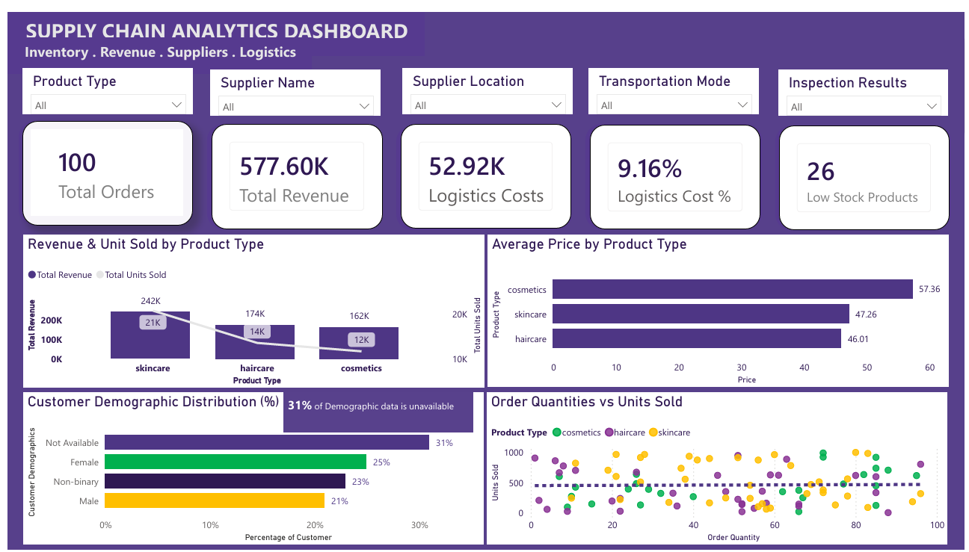
Dashboard Overview — Executive Summary
Three-page Power BI solution: KPIs · Inventory · Supplier & Logistics
100
Total Orderss
100 SKU records
577.6K
Total Revenue
Reported revenue
52.9K
Logistics Costs
9.16% of revenue
26
Low-Stock Products
Replenishment needed
1
Out-of-Stock
Immediate action
Notes:
Show the Executive Overview page on screen. Walk through the 5 KPI cards. Explain that the dashboard has 3 pages and filters allow drill-down by product type, supplier, location, transport mode, and inspection result.

Slide 6
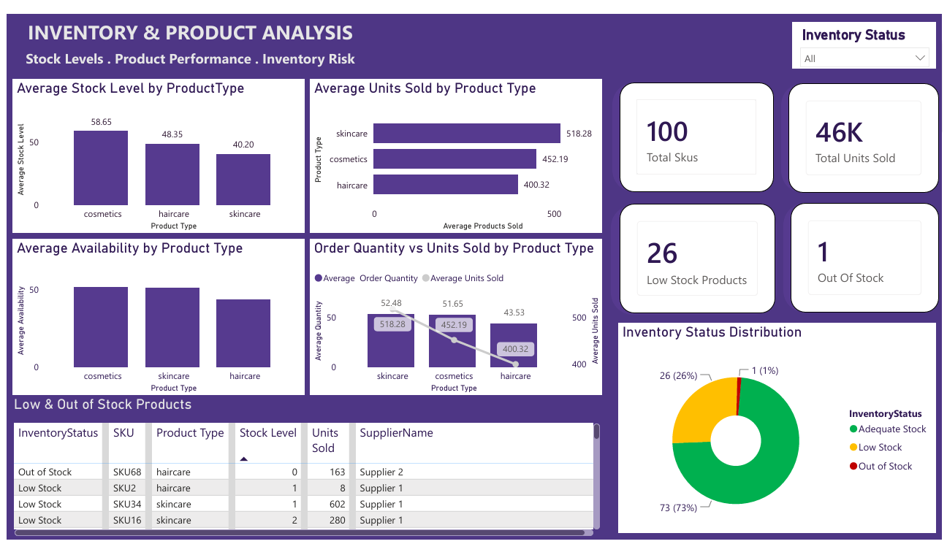
Inventory & Product Insights
Page 2 of the dashboard — stock levels, demand and replenishment priority
!
26 Low-Stock
SKUs with 1–20 units — replenishment priority table provided
1 Out-of-Stock
SKU68 (haircare) — stock = 0, units sold 163 — immediate action needed
46,099 Units
Total units sold across all 100 SKUs
Skincare Leads Demand
Key Message
13 low-stock SKUs have already sold at least 500 units. Skincare leads demand while carrying the lowest average stock, so demand-based replenishment should be prioritized.
Demand + Stock Risk
Notes:
Show Page 2 of the dashboard. Point to the replenishment table — it gives SKU-level detail: stock level, units sold, supplier, location. Skincare has the strongest demand and the thinnest stock buffer.

Slide 7
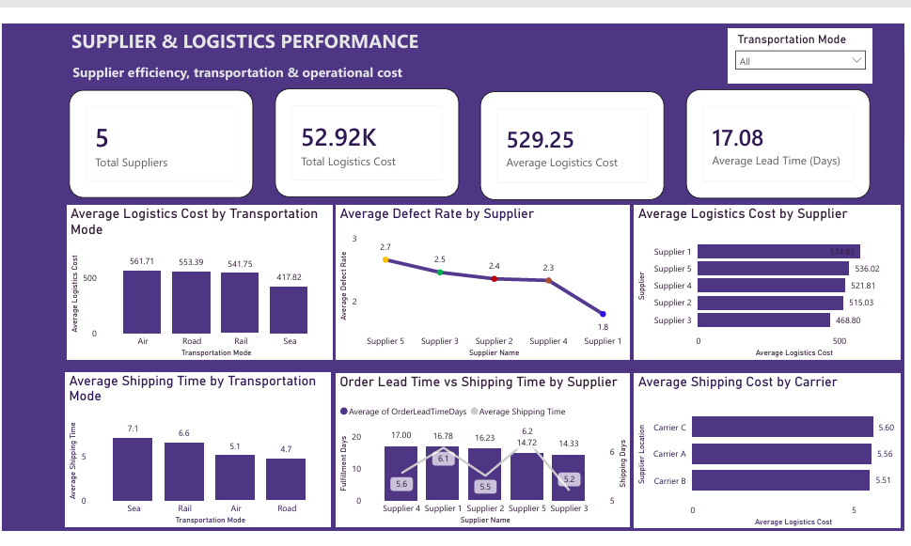
Supplier & Logistics Performance
Page 3 of the dashboard — cost, speed and supplier differences
5
52.9K
Total Suppliers
Logistics Cost
$529
17.1 days
Avg Cost/Order
Avg Lead Time
Supplier
Avg Cost
Lead Time
Profile
Supplier 1
574.85
14.8 days
Highest cost · Fastest
Supplier 2
515.03
~17 days
Mid cost · Mid speed
Supplier 3
468.80
20.1 days
Lowest cost · Slowest
Supplier 4
521.81
~17 days
Mid cost · Mid speed
Supplier 5
536.02
~16 days
High cost · Average speed
Notes:
Show Page 3. The key message: Supplier 1 is the most expensive but the fastest. Supplier 3 is the cheapest but the slowest. Management should not evaluate suppliers on cost alone.

Slide 8
Delivery & Transportation — Cost vs Speed Trade-Off
Choosing the right mode for the right shipment
The Trade-Off
🟢 Sea is the cheapest mode (417.82 avg) — but the slowest at 7.1 days. Best for non-urgent or bulk shipments.
🟡 Air is the most expensive (561.71 avg) and has the highest average order lead time at 18.3 days. Reserve for critical
shipments.
📌 Road has the fastest shipping time (4.7 days) at 553.39 avg logistics cost. Useful for time-sensitive regional delivery.
💡 Select the mode based on urgency, shipment economics and service requirements — not cost or speed alone.
Notes:
The two charts show the inverse relationship between cost and speed. Sea is cheapest but slowest. Air is fastest but most expensive. Road is a balance. Management should match the mode to the urgency of each shipment.

Slide 9
Regional Logistics Efficiency
Average logistics cost varies significantly by supplier location
Chennai — 621.75
HIGHEST cost — 45% above Mumbai. Review mode, route, carrier and supplier drivers.
Bangalore — 586.71
Second highest — 37% above Mumbai. Review carrier and route assignments.
Mumbai — 428.34
LOWEST cost — benchmark for efficient regional operations.
💡 Management Action: The 193 per-order Chennai–Mumbai gap should
be investigated before network or supplier decisions are scaled.
Notes:
Chennai costs 45% more than Mumbai. This is not a small variance. Management should investigate whether it is driven by transportation mode selection, route distance, specific carrier contracts, or supplier-specific logistics terms.

Slide 10
Key Business Insights
Five findings that management must act on
01
📦
Inventory Risk Is Material
02
📈
Skincare Has High Demand + Low Stock
03
🚢
Supplier 4 Is a Quality & Cost Risk
26 low-stock SKUs and 1 out-of-stock product. Without action, stock-outs will disrupt order fulfillment. SKU-level replenishment data is available in the dashboard.
Skincare averages 518 units sold per SKU and only 40.2 units of stock — the strongest demand-driven replenishment risk.
Supplier 4 has a 66.7% inspection failure rate, 62.71 average manufacturing cost and the lowest average revenue.
04
🗺️
Regional Logistics Cost Is Uneven
05
🏭
Upstream Lead Time Needs Attention
Chennai averages 621.75 logistics cost versus 428.34 in Mumbai — a 193 gap that warrants root-cause analysis.
Supplier lead time averages 17.1 days and manufacturing lead time 14.8 days versus 5.8 days shipping, pointing to upstream improvement opportunities.
Notes:
These are the five headline findings. No jargon. Deliver each one as a business implication — not as a technical observation. Pause after "45% more than Mumbai" and "Supplier 3 is cheapest but slowest" — those land well with operational audiences.

Slide 11
Strategic Recommendations
Six prioritised actions for management
Replenish 26 Low-Stock SKUs
HIGH
Protect Skincare + Review Haircare
HIGH
Review Supplier 4
MED
01
Prioritize the 13 low-stock SKUs that have already sold at least 500 units.
02
Tighten skincare reorder points and address haircare's lower availability and higher defect rate.
03
Set corrective actions for the 66.7% inspection failure rate and high manufacturing cost.
HIGH
Use a Cost + Speed + Quality Scorecard
MED
Create a Regular KPI Review
Investigate Chennai & Bangalore
MED
04
Review route, carrier, mode mix and supplier terms behind the high regional logistics cost.
05
Use Supplier 3 selectively for cost efficiency and Supplier 1 for speed-critical needs, subject to quality and capacity.
06
Monitor logistics cost %, lead time, shipping time, stock risk, defect rate and inspection failure rate.
Notes:
Walk through each recommendation. Link back to the finding: "Because Chennai costs 45% more, we recommend investigating cost drivers." Make the logic chain clear: insight → recommendation → impact.

Slide 12
Expected Business Impact
What management can expect if recommendations are implemented
📦
Lower Stock-Out Risk
🚚
Better Delivery Reliability
💰
Reduced Logistics Costs
Replenishing low-stock and high-demand SKUs reduces lost-sales and service-level risk.
Supplier, manufacturing and mode reviews target upstream and transportation delays.
Regional root-cause analysis and mode optimization can reduce the 9.16% logistics-cost burden.
🏭
Smarter Supplier Decisions
📊
Improved Inventory Control
Cost + speed + quality scorecards reduce over-reliance on any single supplier metric.
Regular KPI monitoring creates earlier warning signals for stock and quality exceptions.
Notes:
Link each impact directly to the recommendation above it. Management will want to know: what changes for us if we do this? Keep this slide business-focused — avoid technical language.

Slide 13
Data Limitations
What the dataset cannot tell us — and why that is important to acknowledge
📅
No Transaction Date
👤
No Customer Identifier
No transaction date means monthly, seasonal and time-series trends cannot be produced. The analysis is a point-in-time operational snapshot.
Customer demographic categories exist, but there is no customer ID suitable for customer-level profitability or lifetime-value analysis.
💹
No Profit Field
⏱️
No Single Fulfillment Time
Revenue is available, but cost of goods sold and profit are not. Revenue therefore cannot be interpreted as profitability.
There is no authoritative single fulfillment-time field. Supplier, manufacturing, shipping and order lead-time measures are treated as related operational indicators.
Notes:
Acknowledging limitations demonstrates analytical maturity. Interviewers and instructors respect analysts who know the boundaries of their data. State these clearly and briefly — do not dwell on them.

Slide 14
CONCLUSION
What this analysis tells management
The analysis identifies five management priorities: inventory replenishment, supplier quality and sourcing, transportation and regional cost optimization, upstream lead-time improvement, and continuous KPI monitoring.
📦
💰
🏭
🗺️
📊
Inventory | Replenishment
Logistics Cost | Optimization
Supplier | Quality & Performance
Upstream | Regional Efficiency
Continuous KPI | Monitoring
Notes:
This is your 30-second closing statement. Deliver it confidently without reading from the slide. The four pillars reinforce the structure of the whole analysis visually.

Slide 15
THANK YOU
Questions & Discussion
Chidi Onochie Ronald
Logistics & Supply Chain Analytics | MySQL · Power BI
August 2026
100
577.6K
26
9.16%
Total Orders
Total Revenue
Low-Stock
Logistics Cost
Notes:
Invite questions. Be ready to navigate back to specific dashboard pages if asked. Common questions: Why did you use MySQL? What would you do with more data? What is the biggest single recommendation?

