Slide 1

STM32 Workshop
Session 3
By Moktar SELLAMI

Slide 2
Plan
1
5
6
2
3
4
ARM Processors
RCC and Clock tree
Memory layout
Peripheral Configuration flow
Interrupts and NVIC
Bus Matrix AMBA

Slide 3

ARM Processors
ARM (Advanced RISC Machines)
It is a RISC instruction set processor.
Known for Low costs, low power consumption, and low heat generation.

Slide 4
ARM Processors
ARM provides Multiple Processors:
A-Profile
CORTEX-X - NEOVERSE - CORTEX-A
ISA: ARMV8-A ARMV9-A
Complexe Apps:
TVs, Smartphones, Automotive Head units, Cloud storage.
ARM-R
CORTEX-R
ISA: ARMV8-R
Realtime & safety critical Apps:
ADAS, Vehicle Steering systems, Networking, Storage equipments.
ARM-M
CORTEX-M
ISA: ARMV8-M
Mainstream Apps:
IoT, Embedded systems, wearables, Industry, smart homes…

Slide 5
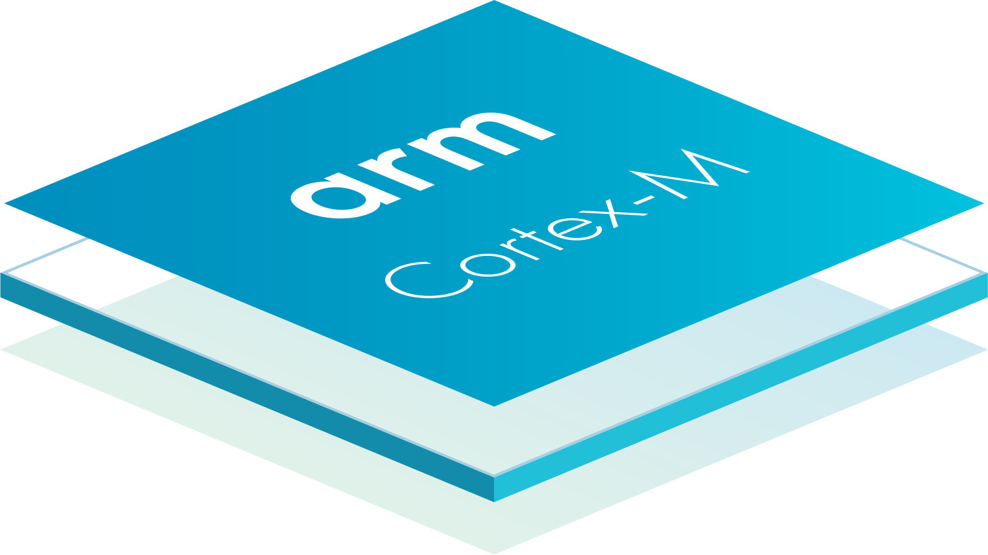
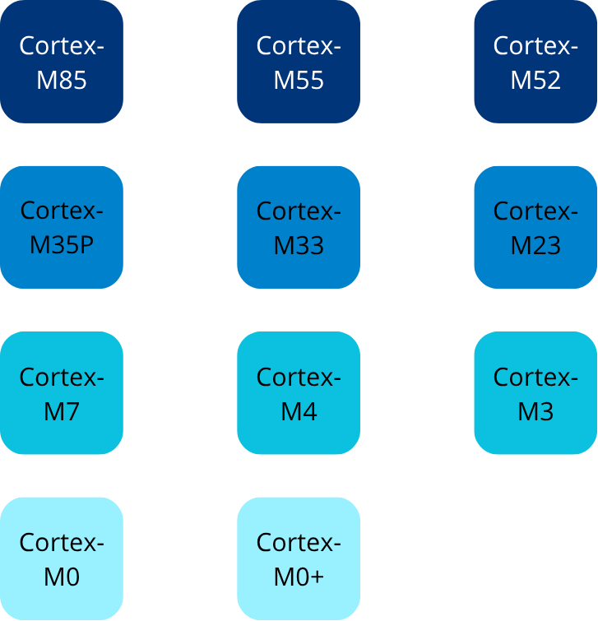
ARM CORTEX-M Processors
The ARM CORTEX-M Family
Cortex-M0 2009 Entry-level, ultra-low power ARMv6 Simplest, smallest core, Low cost
Cortex-M0+ 2012 Entry-level, ultra-low power ARMv6
Cortex-M3 2006 Mainstream Full ARMv7-M feature set,
Cortex-M4 2010 Mainstream + DSP ARMv7E-M Adds DSP instructions and optional FPU
Cortex-M7 2014 High-performance ARMv7 Dual-issue pipeline, higher clock speeds, FPU
Cortex-M23 2016 Secure entry-level ARMv8-M baseline with TrustZone support
Cortex-M33 2016 Secure mainstream ARMv8-M mainline + TrustZone + DSP/FPU options
Cortex-M55 2020 AI/ML focused ARMv8.1-M + Helium Technology
Cortex-M85 2022 High-performance AI/ML Helium Technology

Slide 6
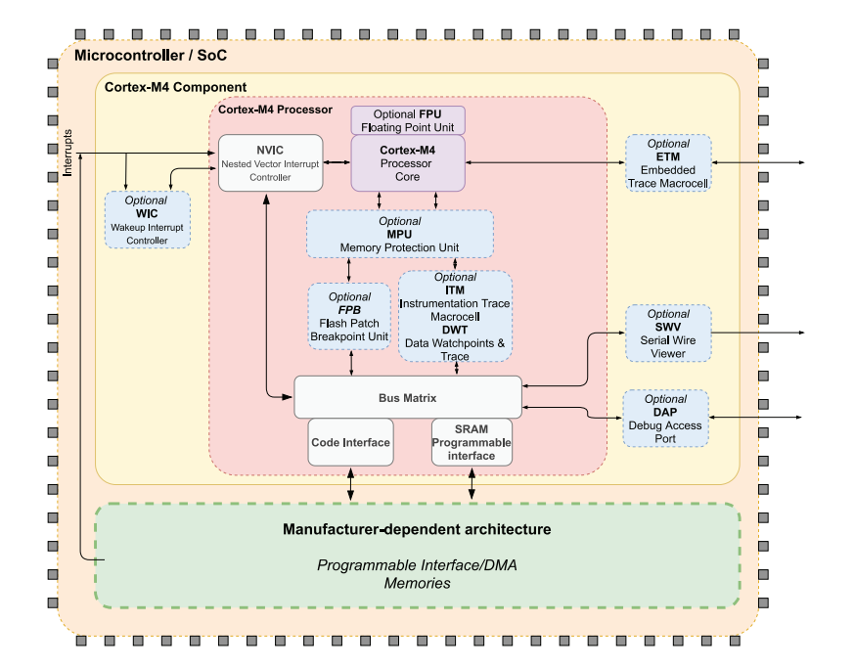
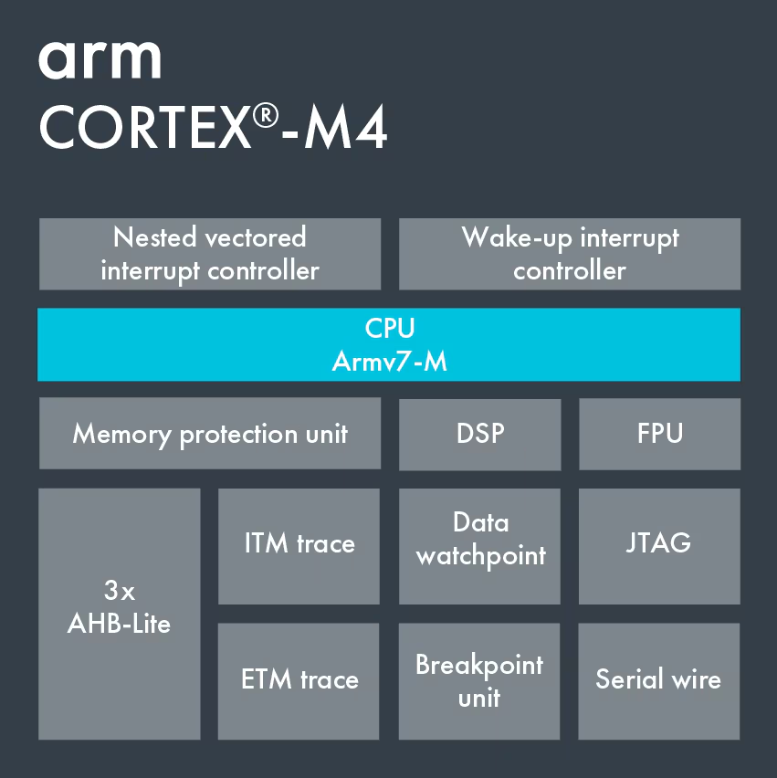
ARM CORTEX M–4

Slide 7
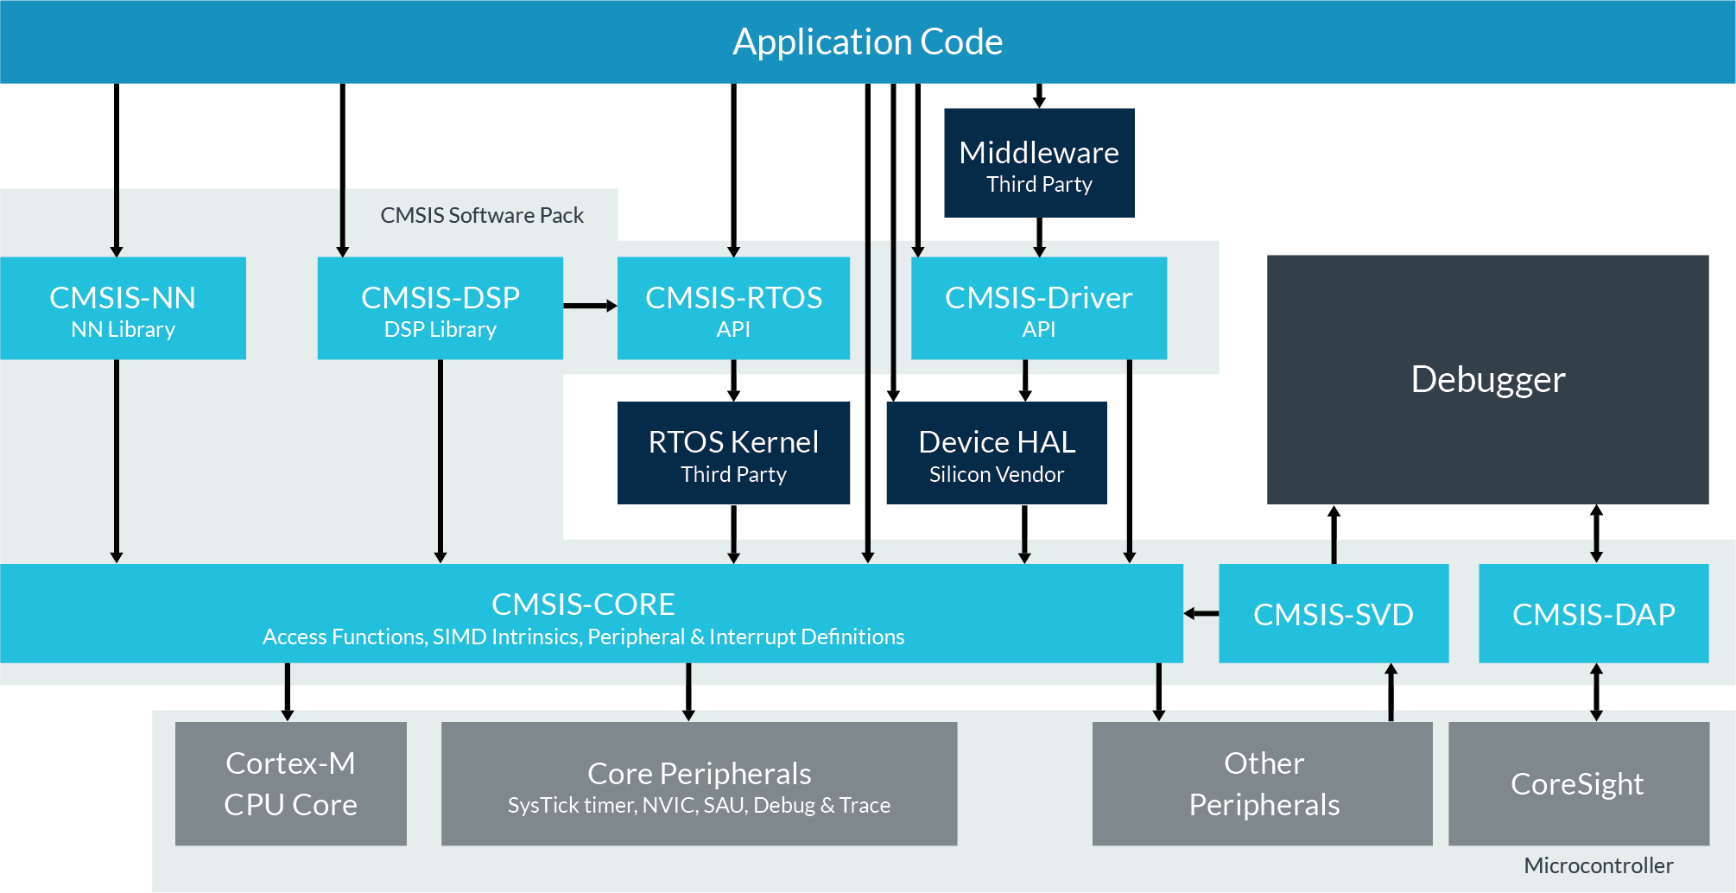
ARM CORTEX M–4: CMSIS
CMSIS (Cortex Microcontroller Software Interface Standard) is a vendor-independent software standard and a collection of libraries provided by ARM, designed to simplify software development on Cortex-M microcontrollers.

Slide 8

ARM CORTEX M–4: Thumb-2 ISA
ARM Thumb-2 ISA allows the intermixing of 32-bit instructions with the older 16-bit Thumb instructions. This facilitates maximum compatibility when running programs for the older architecture on the newer one.
Thumb-2 gives you almost the same performance as full 32-bit ARM instructions, but with much smaller code size.

Slide 9
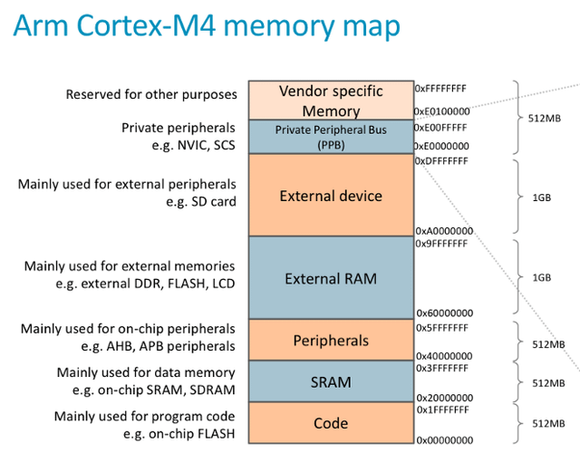
Memory Map: Cortex M4
The Cortex-M4 processor implements the ARMv7-M architecture with a 32-bit address space and 32-bit data path. 32-bit address space, there are 2^32 memory positions: 4 (Gb) of memory space,

Slide 10
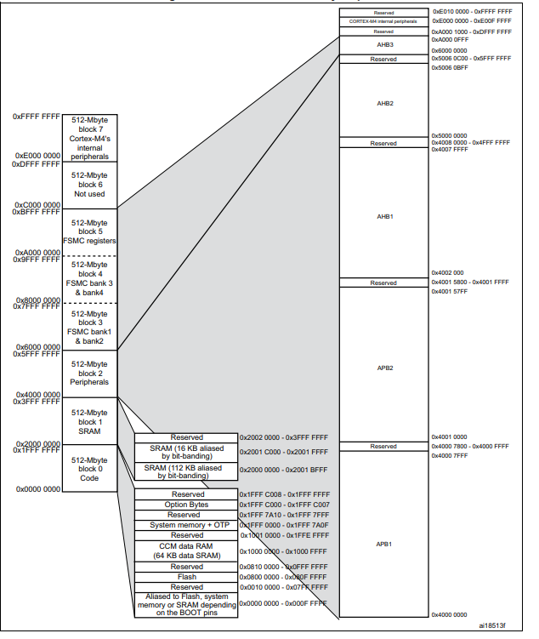
Memory Mapping STM32F407
Region Start Address End Address Size
Code (Flash) 0x0000 0000 0x1FFF FFFF 512 MB
SRAM 0x2000 0000 0x3FFF FFFF 512 MB
Peripheral 0x4000 0000 0x5FFF FFFF 512 MB
External RAM 0x6000 0000 0x9FFF FFFF 1 GB
System 0xE000 0000 0xFFFF FFFF 512 MB

Slide 12
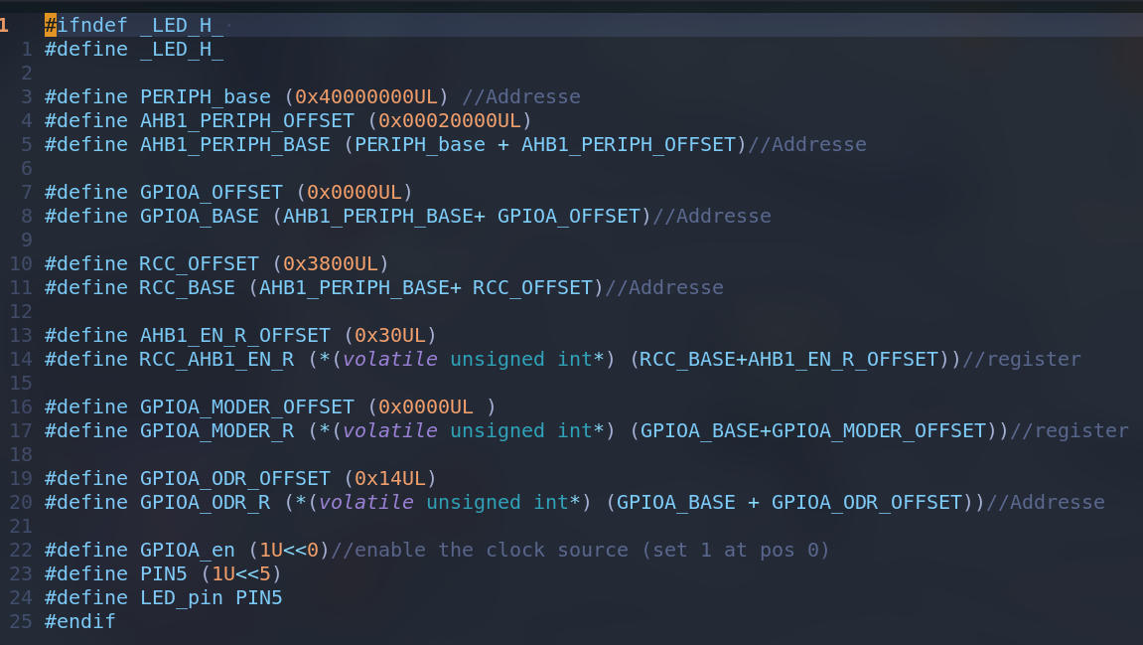
Memory Mapping: STM32F407

Slide 13
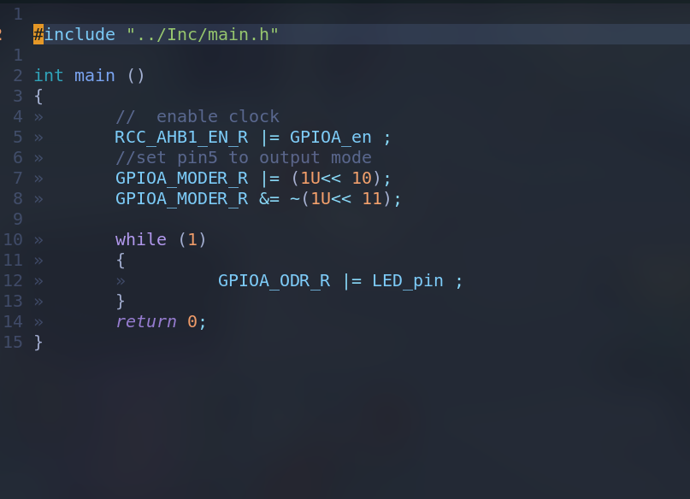
Memory Mapping: STM32F407

Slide 14
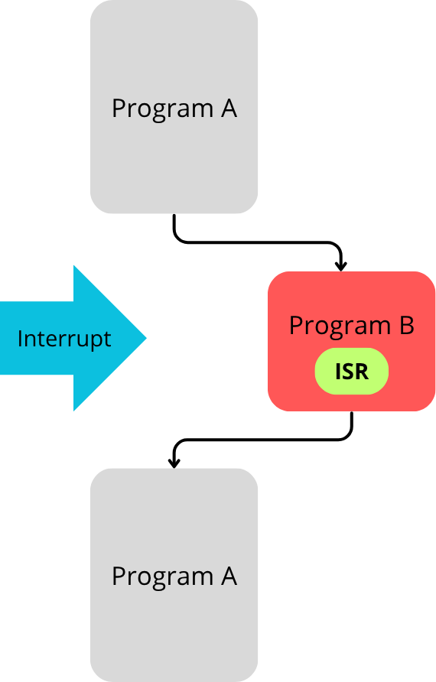
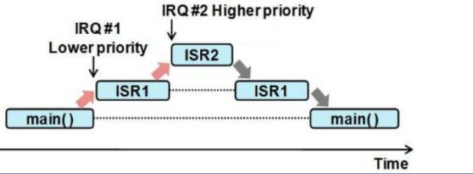
Interrupts:
An Interrupt is a signal that tells the CPU to pause its current program, execute a specific function called an Interrupt Service Routine (ISR) to handle the event, and then seamlessly return to what it was doing.
Execution Mode of a CPU:
Pooling Mode
Interrupt Mode
DMA
Interrupt source
Externel
Internal

Slide 15
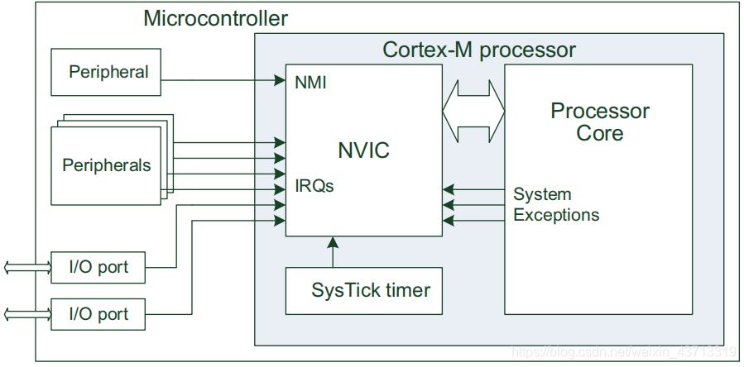
Interrupts: ARM Cortex M4 NVIC
NVIC: The Nested Vectored Interrupt Controller is the dedicated hardware unit inside an Arm Cortex-M processor that manages all these interrupts efficiently. It's the dispatcher that handles the fire alarms.

Slide 16
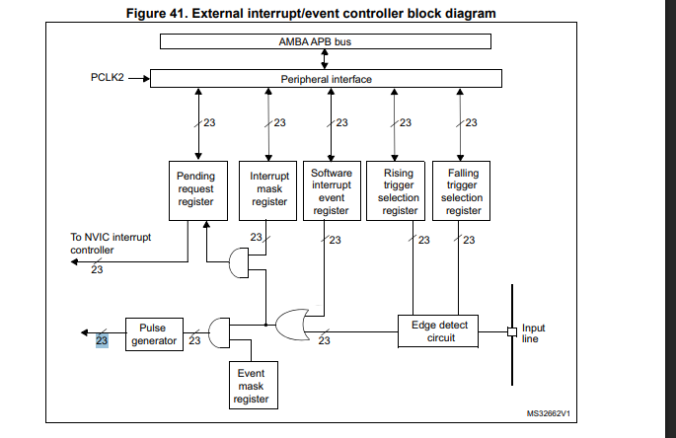
External Interrupts: NVIC STM32F407
The EXTI (External Interrupt/Event Controller) is a peripheral in the STM32F407 that specializes in detecting external pin changes and generating interrupts or events.

Slide 17
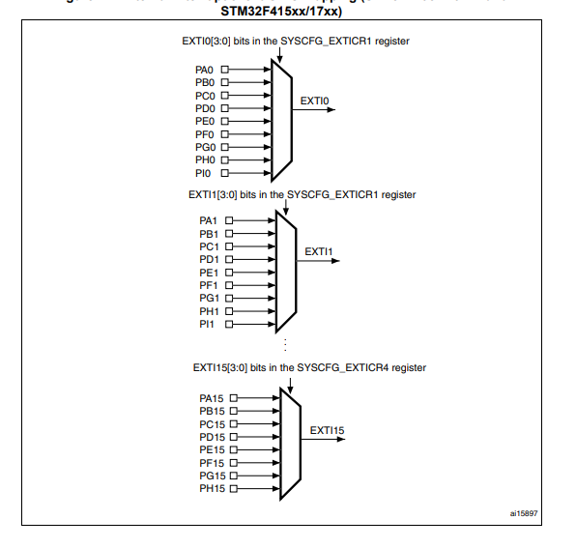
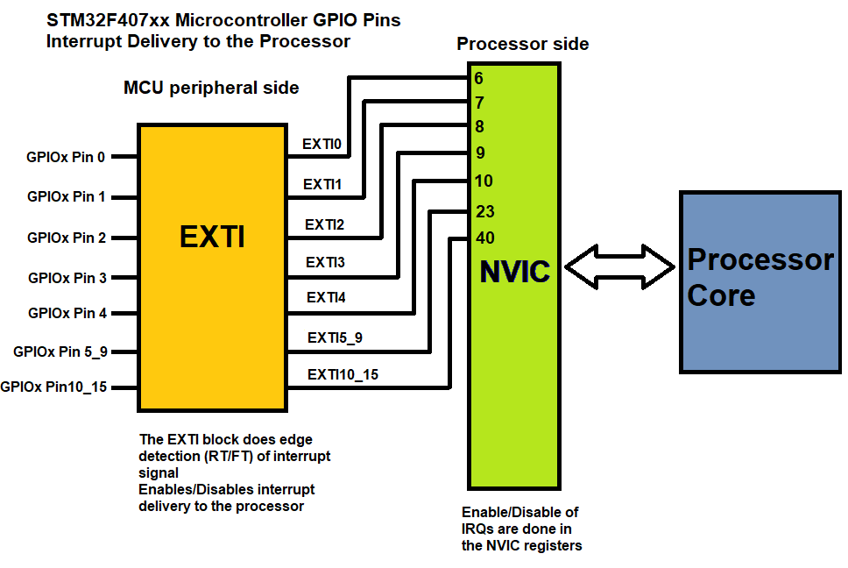
External Interrupts: STM32F407 EXTI

Slide 18
Internal Interrupts: CORTEX M4
Exceptions in Cortex-M: Internal interrupts
Reset: Runs after system reset.
NMI (Non-Maskable Interrupt): Highest priority interrupt, cannot be disabled; used for critical events (e.g., power-down).
HardFault: Generic fault for unhandled errors (instruction or system faults).
MemManage: Handles memory protection faults (via MPU).
BusFault: Handles bus access errors (instruction or data).
UsageFault: Handles invalid instruction or operation errors.

Slide 19
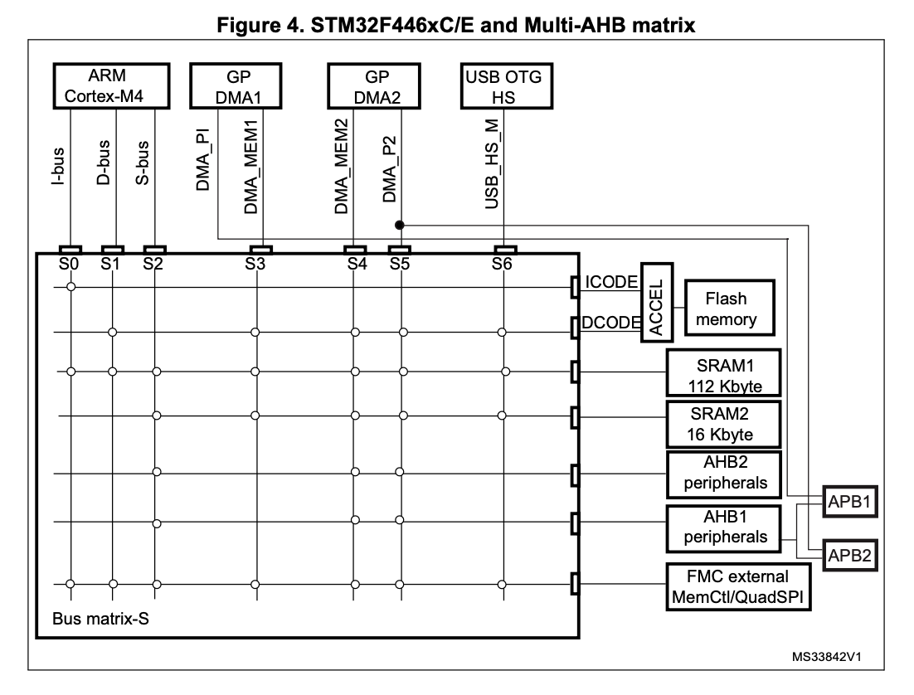
Bus Matrix: AMBA
Bus Matrix: AMBA
AHB: Advanced High performance Bus (186Mhz)
APB: Advanced peripheral Bus (84Mhz)
I-BUS
D-Bus
S-Bus

Slide 20
RCC and clock Tree

Slide 21
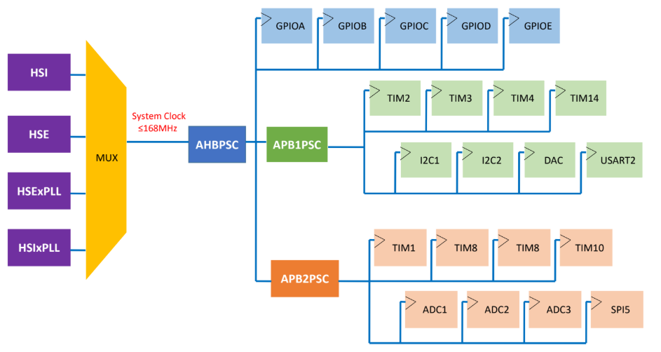
RCC and clock Tree

Slide 22
Peripheral Configuration flow - Generic
System Clock Configuration
Enable BUS Clock for GPIO
Enable BUS Clock for Peripheral
GPIO Configuration
Peripheral configuration
Main Program

Slide 23
Peripheral Configuration flow - Generic
System Clock Configuration: Set up the main system clock (HSI, HSE, PLL) and bus prescalers.
Enable BUS Clock for GPIO: Enable the clock for the GPIO port(s) used by the peripheral.
Enable BUS Clock for Peripheral: Enable the specific peripheral’s clock (e.g., USART, SPI, I2C).
GPIO Configuration: Configure GPIO pins (Mode, Speed, PullUP/PullDown)
Peripheral Configuration: Initialize and configure the peripheral itself .
Main Program: Your main loop or application logic using the configured peripheral.

Slide 24
Peripheral Configuration flow : Use case UART2
System Clock Configuration (RCC)
Enable BUS Clock for GPIO
(where Rx & Tx are connected)
Enable BUS Clock for UART2
GPIO Configuration (configure Tx & Rx as alternate function)
Peripheral configuration (configure UART2,ex set baudrate)
Main Program (send & receive)

Slide 25
Thank You

