Slide 1
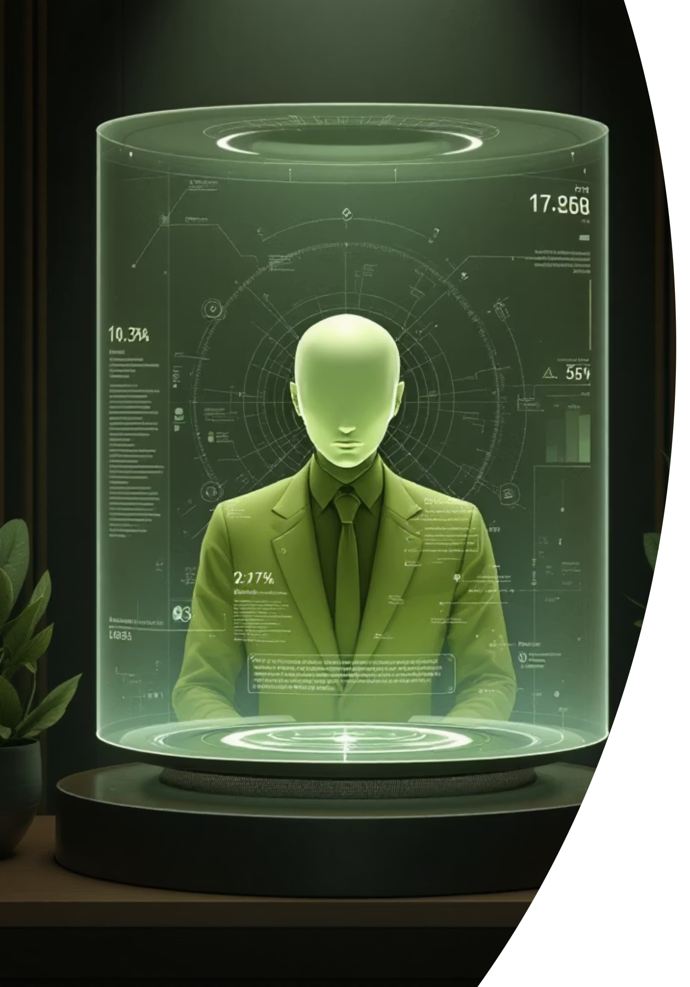
AI-Avatar Chatbot: Building the Future of AI Companions
Creating a conversational AI avatar that bridges the gap between digital interaction and human connection.
Team: Atharv Amit Jaju,
Onkar Mahadev Sonne,
Kritar Kishor Jain

Slide 2



The Vision & Objectives
Natural Conversations
Visual Personality
Intelligent Assistance
Voice and text interactions that feel human, supported by long-term memory and context awareness.
Dynamic, customizable 3D avatar that visually syncs with live chat using real-time lip-sync technology.
Extendable Agentic AI capable of handling real-world tasks like reminders, summarization, and scheduling.

Slide 3
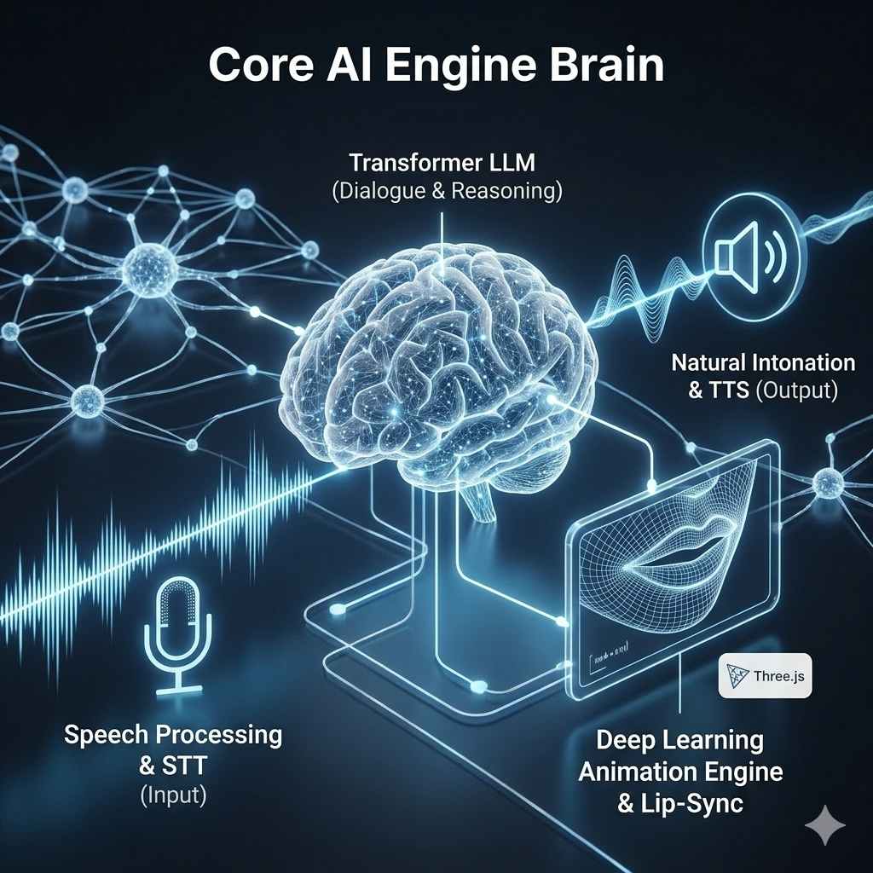
Core Technology Stack
Voice Processing
Language Model
Animation Engine
Advanced Speech-to-Text (STT) for capturing input and realistic Text-to-Speech (TTS) for natural intonation.
Transformer-based architecture acting as the "brain" to handle dialogue, reasoning, and response generation.
Deep learning-based audio-to-lip sync integrated with Three.js to animate the avatar in real-time.

Slide 4
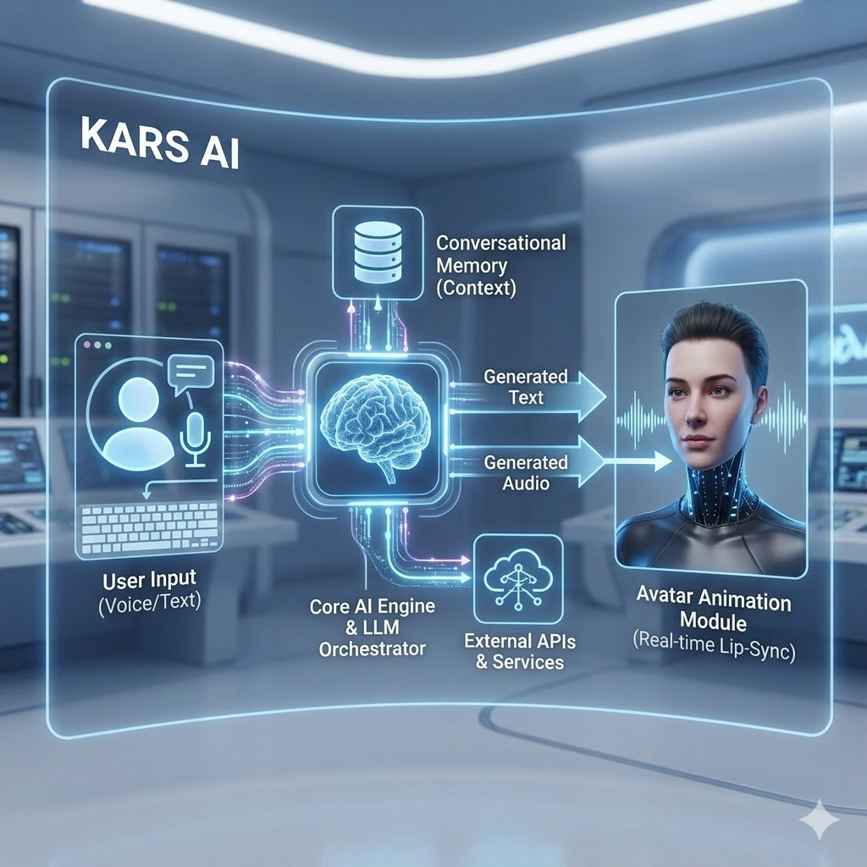




System Architecture
Input Phase
System captures user commands through voice or text.
Processing Phase
Core AI Engine gathers context using conversational memory and external APIs.
Generation Phase
LLM Orchestrator formulates response, streaming text and audio output.
Output Phase
Audio drives Avatar Animation Module, delivering lip-synced response through clean interface.

Slide 5

Memory & Privacy Controls
Conversation History
Persistent memory module maintains context across sessions, building upon previous interactions naturally.
Personal Preferences
System learns communication styles and user needs to provide a highly tailored experience.
User-Modifiable Privacy
Granular, opt-in controls allow users to manage exactly what information is stored and utilized.

Slide 6
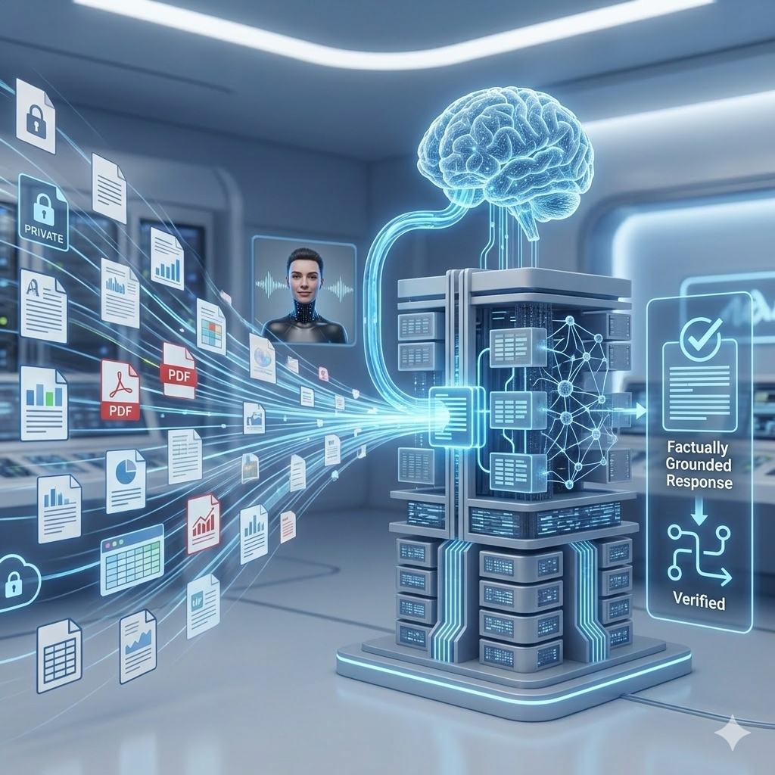
Knowledge Grounding (RAG)
01
02
Anchoring AI in Facts
Personal Document Analysis
Integrates Retrieval-Augmented Generation (RAG) pipeline to connect LLM to dedicated vector database.
Pulls information from external sources like private files to use as background context.
03
Eliminating Hallucinations
Ensures responses are factually accurate, relevant, and verifiable rather than relying solely on LLM's baseline training.

Slide 7
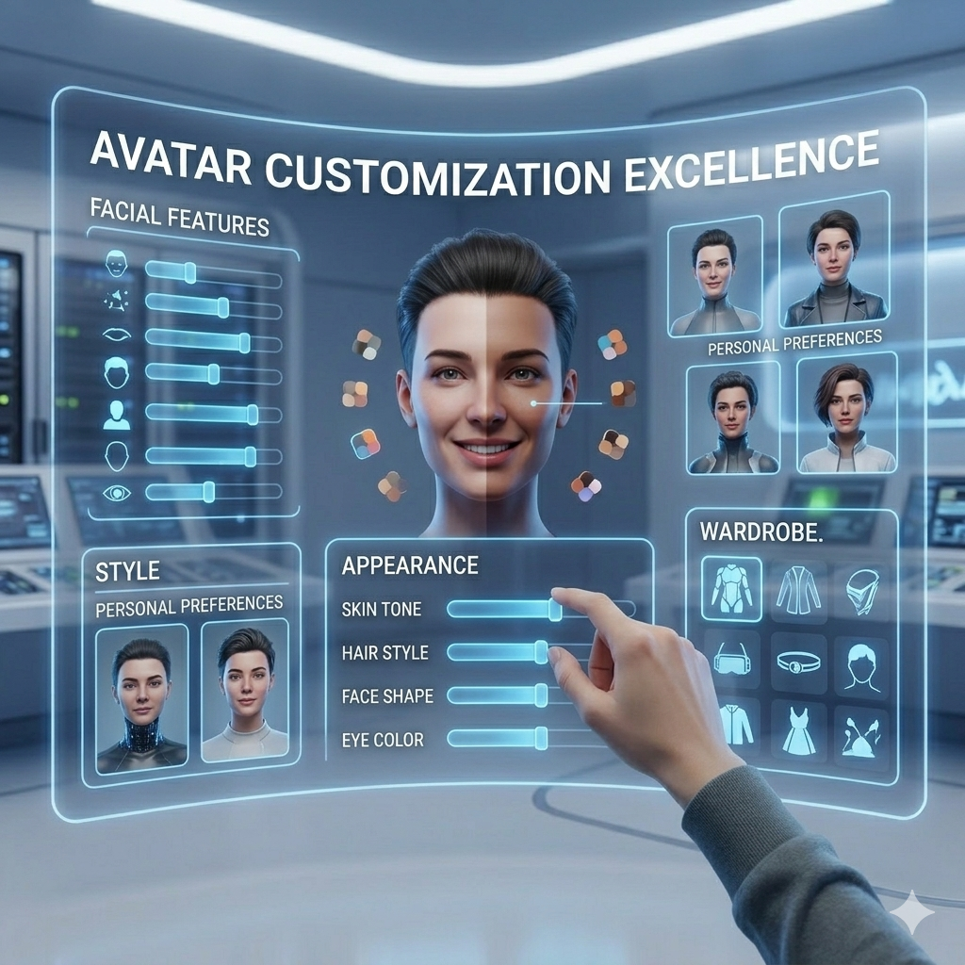


Avatar Customization Excellence
Facial Features & Appearance
Users can adjust facial structures, body types, and movement patterns to create an authentically representative companion.
Style & Wardrobe
Personalize clothing, accessories, and overall aesthetics to craft a unique visual identity.

Slide 8
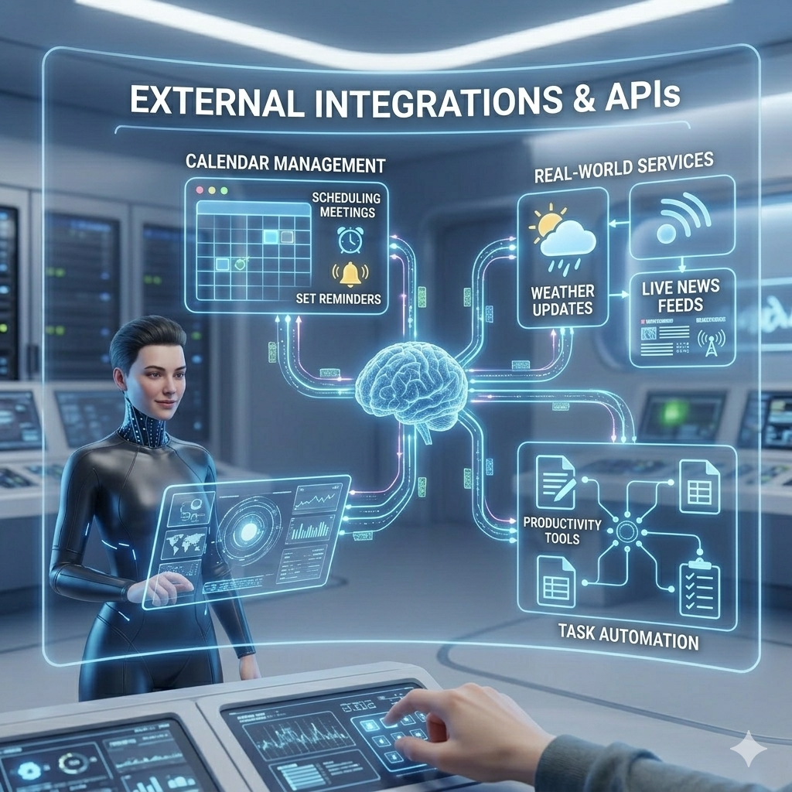


External Integrations & APIs
Calendar Management
Schedule meetings, set reminders, and manage daily agendas through natural conversation.
Real-World Services
Connect to external web services to fetch live data like weather updates and news.

Slide 9






Multi-Platform Accessibility
Mobile Apps (Future Scope)
Optimised mobile experience for on-the-go conversations with your AI companion.
Web Platform
Full-featured browser experience with rich visual interface and comprehensive functionality.
Virtual Reality (Future Scope)
Immersive VR interactions that create presence and deeper connection with your avatar.

Slide 10
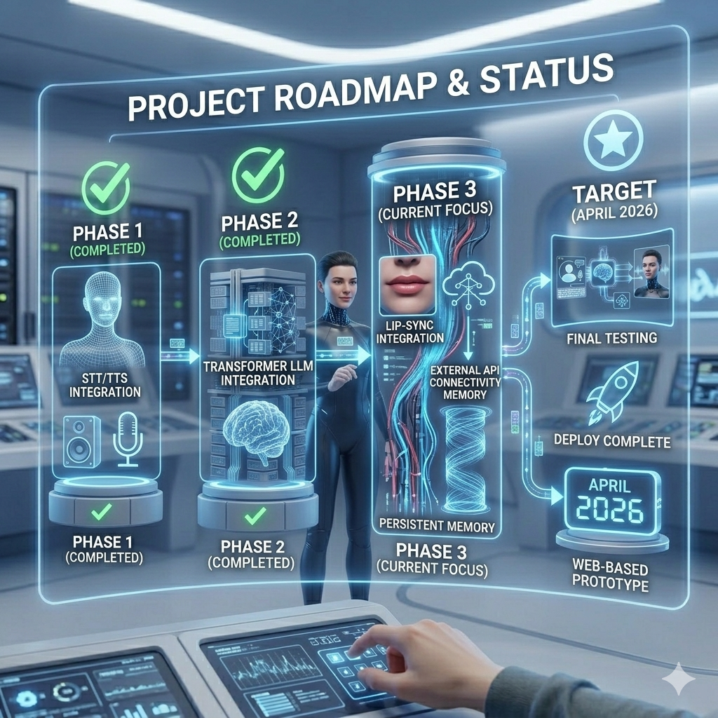
Project Roadmap & Status
Phase 1: Completed
Phase 3: Current Focus
Baseline Multimodal Interface, integrating STT/TTS and 3D render engine.
Real-time lip-syncing module, external API connectivity, and persistent memory.
1
2
3
4
Phase 2: Completed
Target: 2026
Integration of Transformer LLM and setup of RAG pipeline.
Final testing, debugging, and deployment of complete web-based prototype.

Slide 11

Thank You
Building the future of AI companions, one conversation at a time.
Team: Atharv Amit Jaju, Onkar Mahadev Sonne, Kritar Kishor Jain

