Slide 1
DATA SCIENCE CERTIFICATION PROJECT
Café Sales: Cleaning the Data
and Finding Insights
We took 10,000 messy sales records and cleaned them, explored them, and found useful patterns — using Python.
Presented by | Onkar Sonne Batch | B010
Python
Pandas & NumPy
Matplotlib / Seaborn
Jupyter Notebook

Slide 2
AGENDA
What We'll Cover
01
Project Goal
What we set out to do and why
02
The Data & Cleaning It Up
How we found and fixed problems in the data
03
Exploring the Data
The charts we made to understand the sales
04
What We Found
The main patterns hiding in the numbers
05
What the Café Should Do
Simple next steps based on what we learned
02

Slide 3
PROJECT GOAL
Turning Messy Sales Data
into Useful Information
10,000
Sales records we started with
This dataset copies what real sales data often looks like: some values are missing or wrong, marked with "ERROR" or "UNKNOWN" instead of just being blank.
9,031
Find and fix the problems in the data using Python
Clean rows left after fixing the data
✓
✓
Explore the sales to see patterns in products, payments and time
8
✓
Turn what we learn into simple, useful advice for the business
Different menu items
3
Ways customers can pay
03

Slide 4
THE DATA
Getting to Know the Data First
Before fixing anything, we looked at the data closely — its size, its columns, and how many values were missing.
Transaction ID
A unique number for each order
Total Spent
Quantity × Price — the full amount paid
Item
The menu item that was bought
Payment Method
Cash, Card, or Digital Wallet
Quantity
How many were bought (a number)
Location
Eaten in the café or taken away
Price Per Unit
The price of one item, in $
Transaction Date
The date of the purchase
04

Slide 5
CLEANING THE DATA
Five Simple Steps to Clean the Data
1
2
3
4
5
Find the fake values
Fix the column types
Fill in what we can
Remove what can't be fixed
Remove duplicates
→
→
→
→
"ERROR" and "UNKNOWN" are turned into real blank (missing) values
Numbers and dates were stored as text — we converted them back
If two of Quantity, Price, or Total were known, we worked out the third
Rows with no item name were dropped — nothing to rebuild them from
Any exact repeated rows were removed, then we checked again for gaps
The result: We started with 10,000 rows and kept 9,031 clean ones — filling in numbers wherever we could, instead of just throwing data away.
05

Slide 6
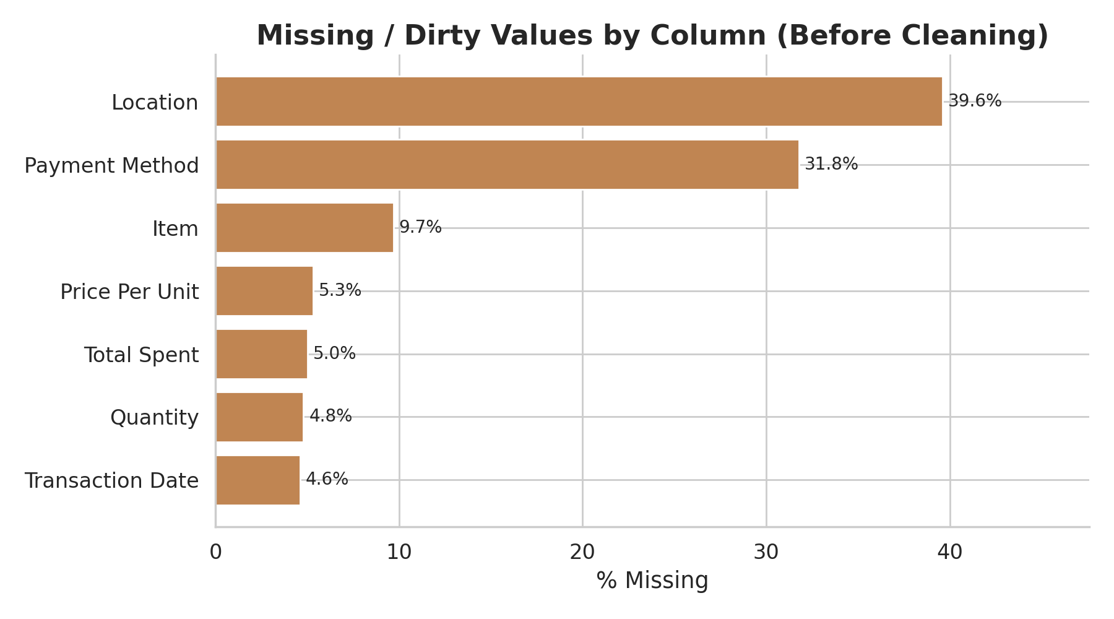
CLEANING THE DATA
How Messy Was the Data?
Every column had some missing or wrong values. Location and Payment Method were the worst.
~40%
Location
of values were missing
~32%
Payment Method
of values were missing
Chart 1 — % of missing values in each column, before cleaning
~10%
Item
missing — those rows were removed
06

Slide 7
EXPLORING THE DATA
How We Explored the Data
1
2
3
pandas & NumPy
Matplotlib & Seaborn
Jupyter Notebook
Loading the data, fixing types, and grouping it for summaries
Making the bar charts, histograms, boxplots, and heatmap
Where we wrote and ran all the steps, one at a time
We looked at the data in four ways:
Which items sell best
How customers behave
Trends over time
How numbers relate
07

Slide 8
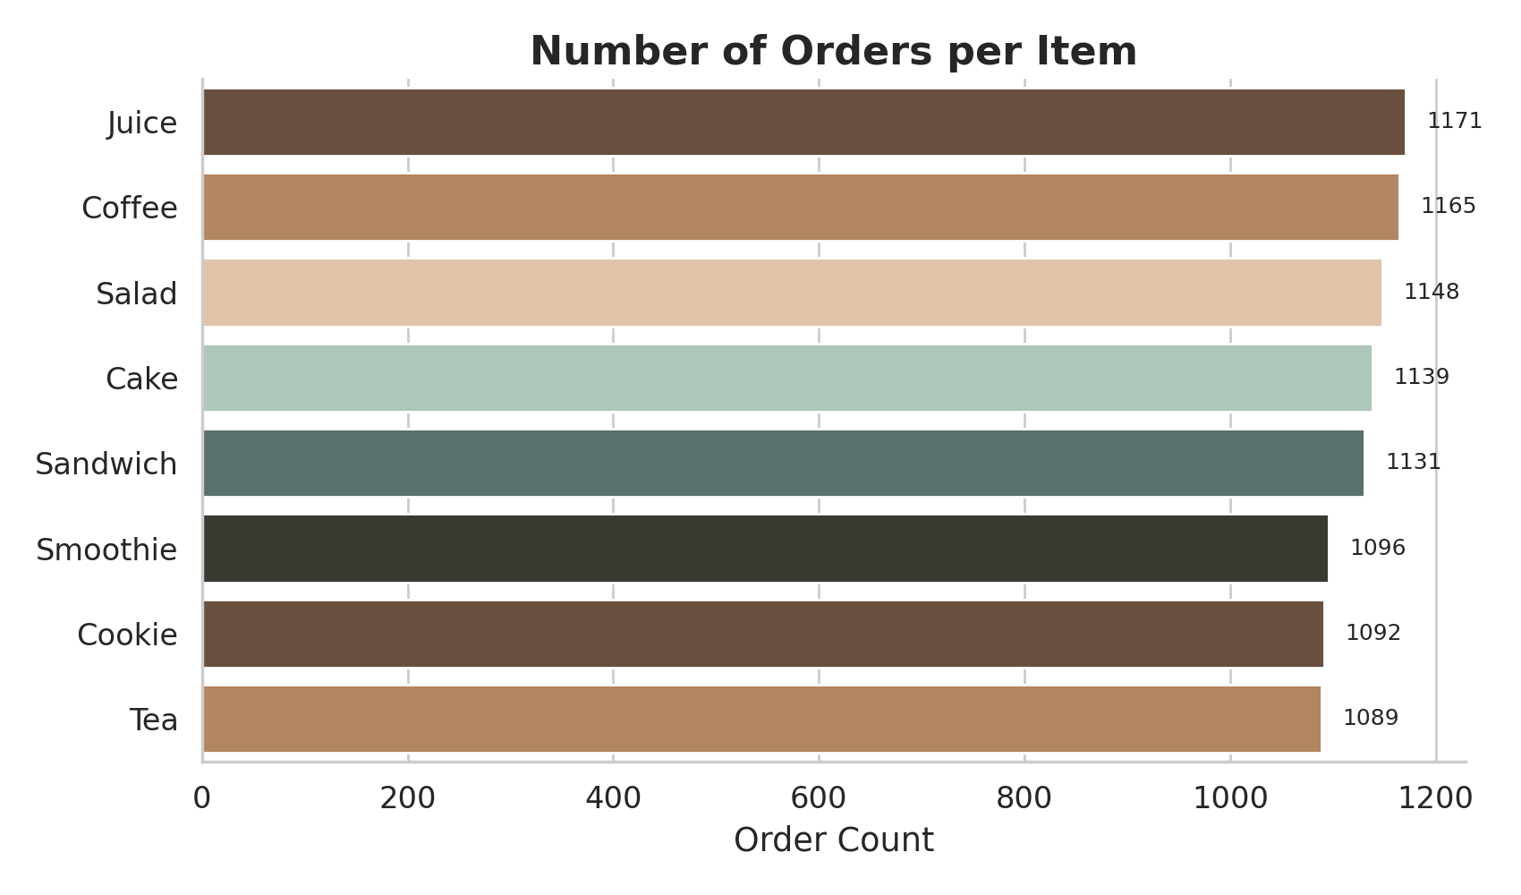
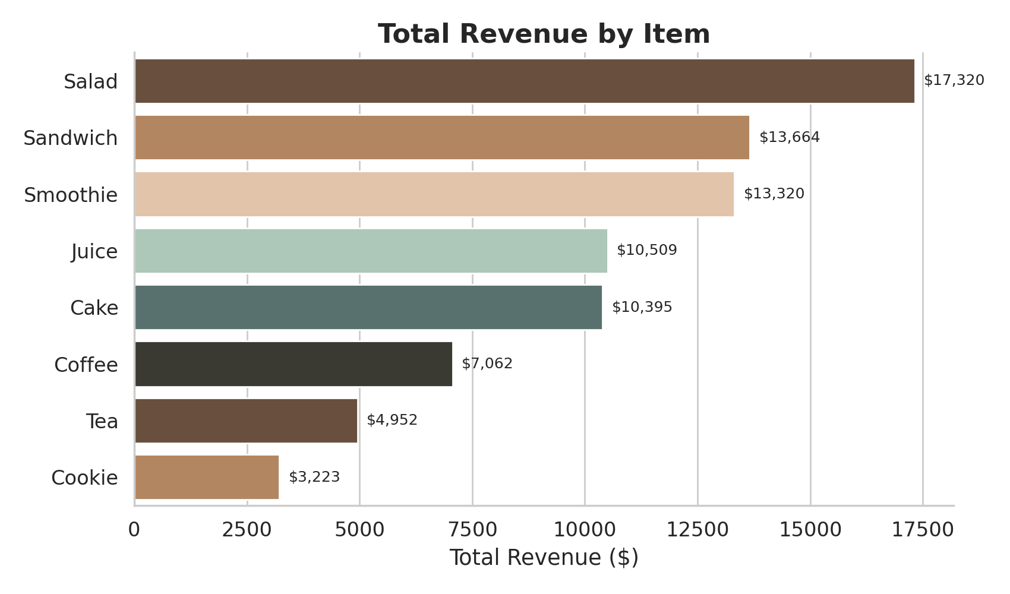
WHAT WE FOUND · 1
Which Items Sell the Most vs. Earn the Most
Customers order almost every item about the same number of times. But money-wise, it's different: Salad, Sandwich, and Smoothie bring in the most money, while Cookie and Tea bring in the least — even though people order them just as often. Selling a lot isn't the same as earning a lot.
08

Slide 9
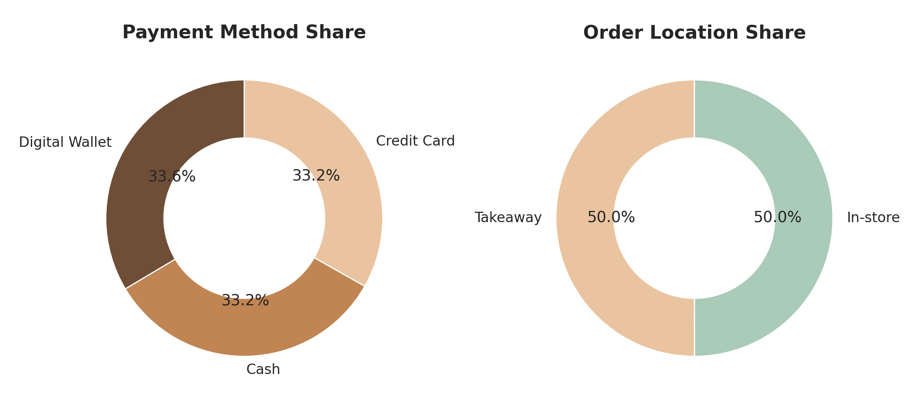
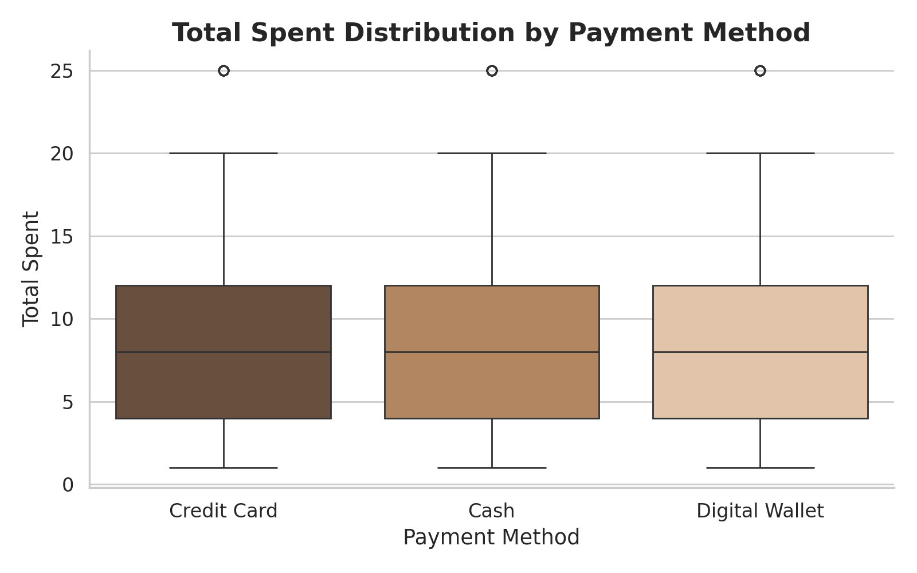
WHAT WE FOUND · 2
How Customers Pay and Where They Eat
Customers use Cash, Card, and Digital Wallet almost equally — no single way to pay is more popular. People eating in the café spend $9.10 on average, versus $8.79 for takeaway — a small gap, suggesting in-store customers tend to add a little extra to their order.
09

Slide 10
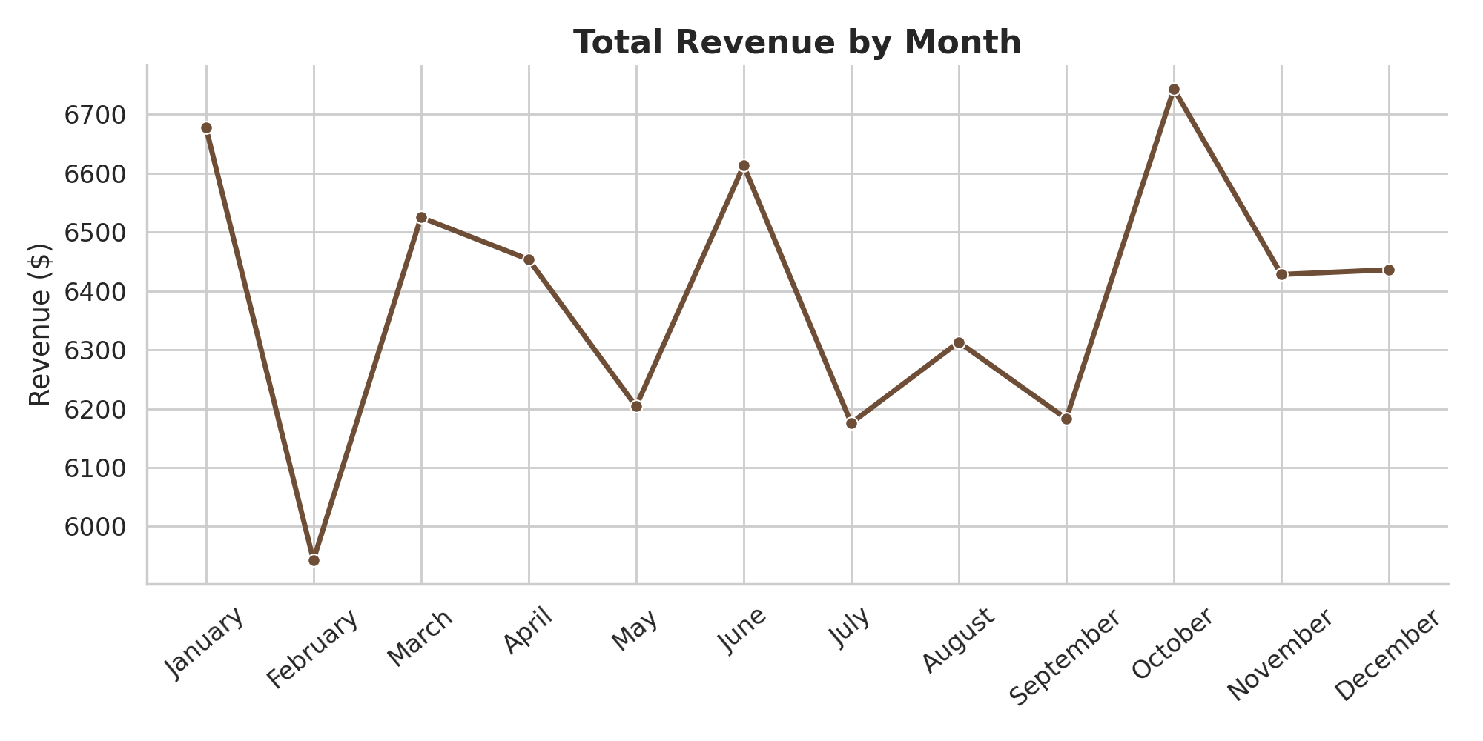
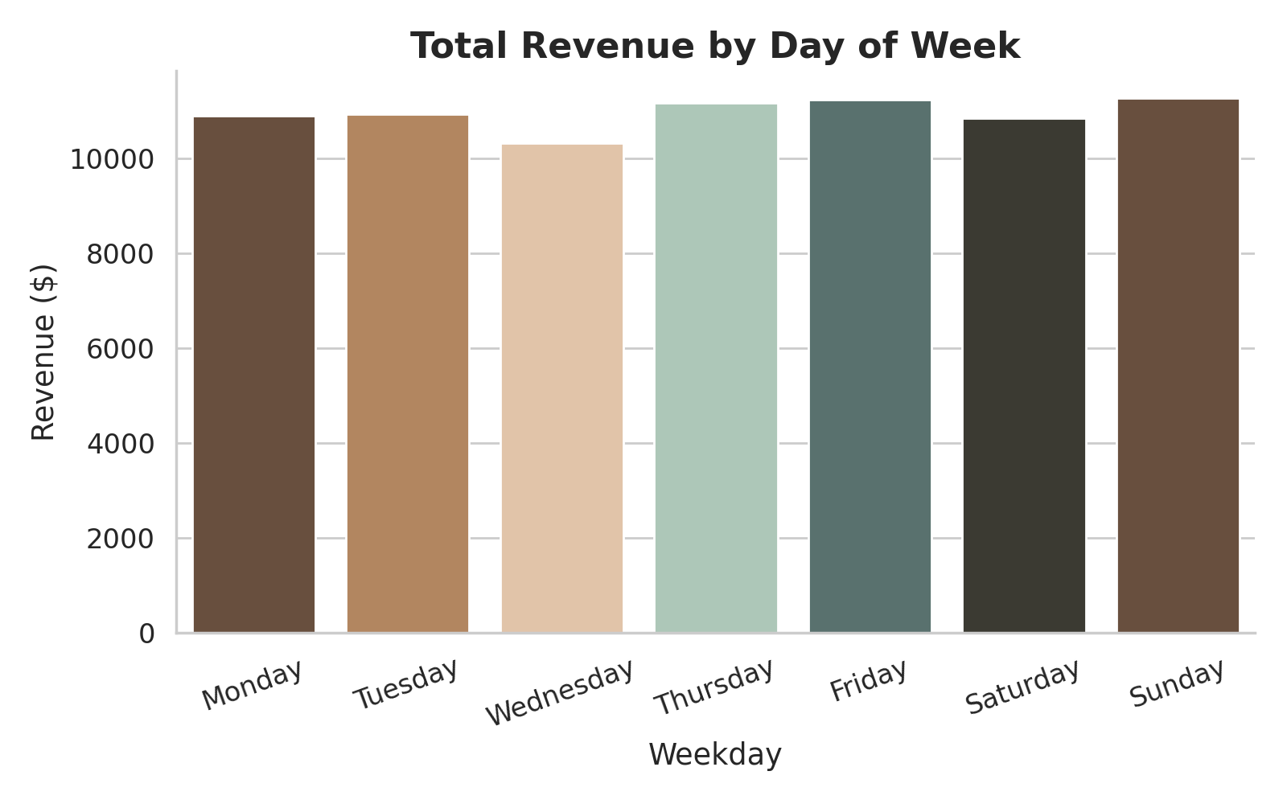
WHAT WE FOUND · 3
Do Sales Change Over Time?
Sales stay fairly steady across every month and every day of the week — there's no big jump or drop at any particular time. This makes it easier to plan staff and stock ahead of time.
10

Slide 11
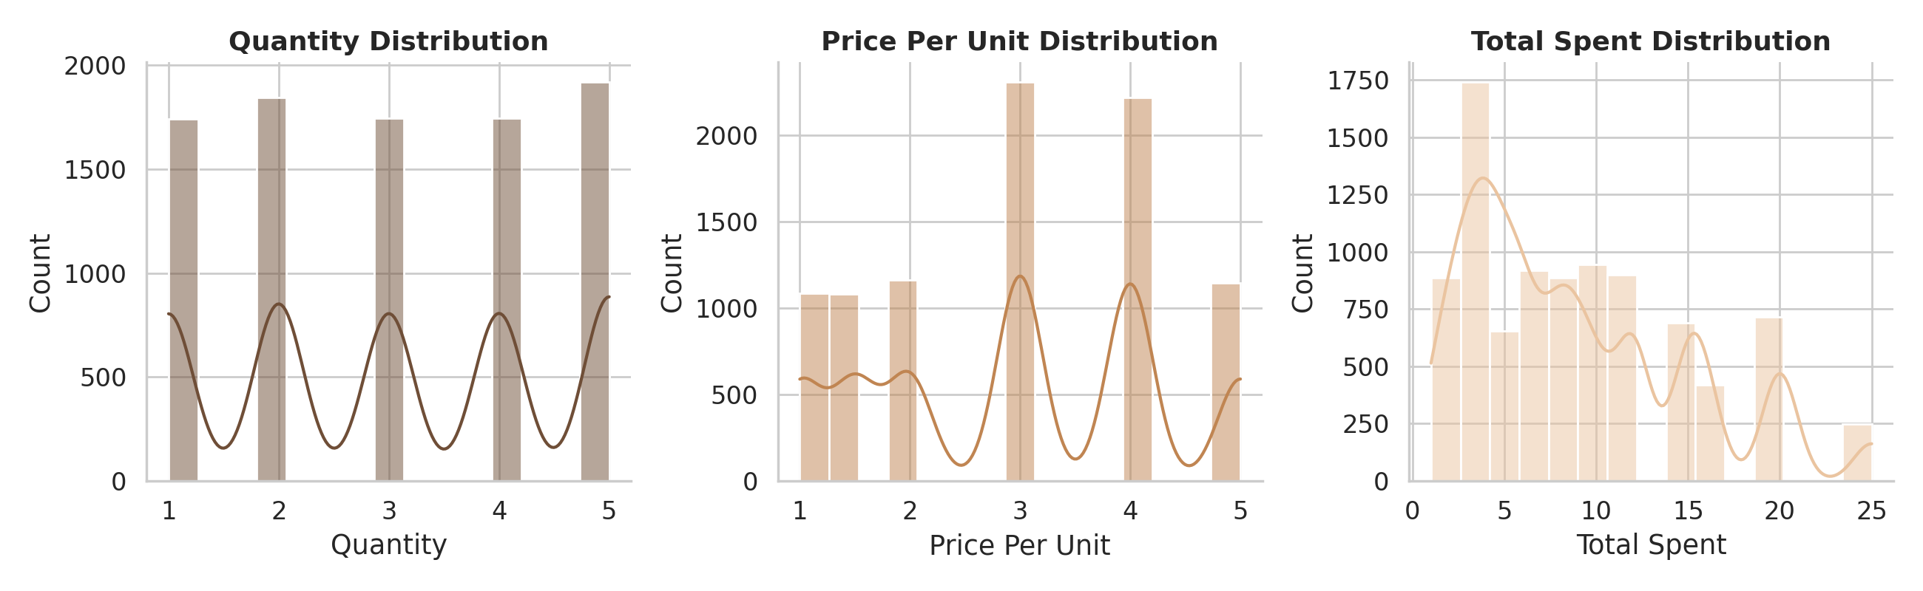
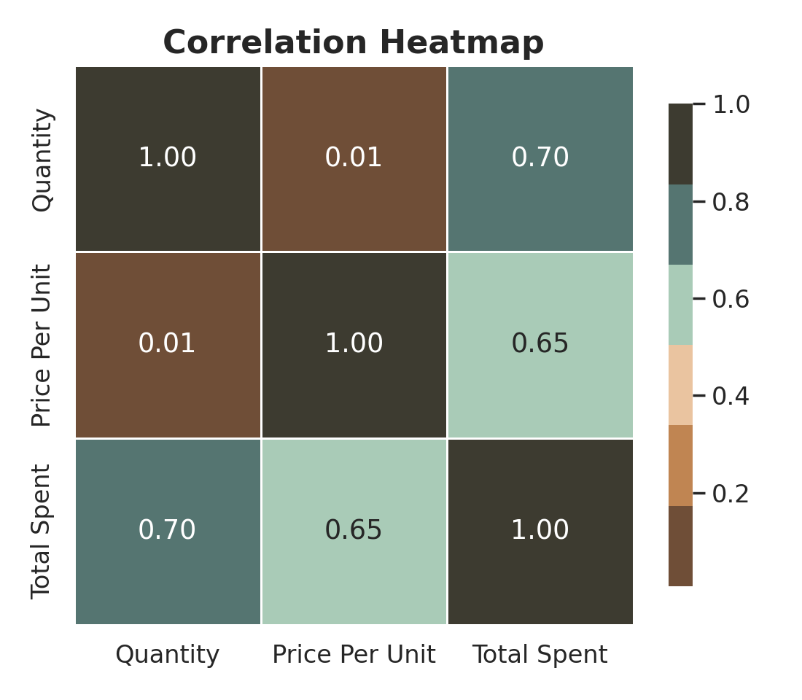
WHAT WE FOUND · 4
How the Numbers Relate to Each Other
Quantity, price, and total spent are all spread out evenly — no strange extreme values. The total amount spent goes up closely with both quantity and price, which makes sense. But quantity and price don't really relate to each other — prices aren't changed based on how much someone orders.
11

Slide 12
KEY FINDINGS
The Main Things We Learned
1
Bad data was the biggest hurdle
2
Best-sellers aren't always the top earners
Up to 40% of some columns were missing or wrong — we fixed what we could instead of deleting it
Salad, Sandwich & Smoothie make the most money; Cookie & Tea make the least, despite similar order counts
3
Eating in earns a little more than takeaway
4
Sales don't rise or fall much over time
$9.10 vs $8.79 average order — a small but steady difference
Revenue is spread evenly across months and days of the week
5
No one payment method is favored
6
The total amount paid makes sense
Cash, Card, and Digital Wallet are used about equally
It rises predictably with quantity and price, which confirms the data is now reliable
12

Slide 13
WHAT THE CAFÉ SHOULD DO
Simple Next Steps
→
Collect better data at checkout
→
Pair weak sellers with best-sellers
Make Payment Method and Location required fields, so we don't lose 30-40% of this info next time
Offer Cookie & Tea in combos with Salad, Sandwich or Smoothie to help them earn more
→
Encourage bigger takeaway orders
→
Plan staff and stock evenly
Suggest adding a drink or snack at takeaway checkout to close the small gap with in-store spending
Since sales don't change much by month or day, there's no need for big seasonal changes
→
Keep supporting all payment options
→
Turn this cleaning process into a habit
Cash, Card, and Digital Wallet are all used equally, so all three should stay available
Reuse the same cleaning steps each time new sales data comes in, to save time later
13

Slide 14
IN SHORT
Clean data leads to
better decisions.
This project took messy sales data through cleaning, exploring, and understanding it — the same steps used with real business data.
Thank You
Happy to answer any questions

