Slide 1
Manufacturing of Oxygen and Nitrogen using Linde’s process and PSA
Onkar Dubey (210107060)
Keshav Kulhari (210107043)
Pranay Bambole (210107063)
Group No :- 19

Slide 2
Introduction
Oxygen
• It is used to produce oxyacetylene flame to cut and weld metals [acetylene welding]
• Used in oxygen steelmaking process [oxygen steelmaking process]
• Used by mountain climbers, sea divers and high altitude airplane pilots [oxygen mask]
Nitrogen
• Used in manufacture of synthetic nitrogen oxide, ammonia, nitric acid [industrial chemicals]
• Used in manufacture of organic nitrates e.g: propellants and explosives.
• Synthetically produced nitrates are key ingredients of industrial fertilizer

Slide 3
Oxygen
• Oxygen was independently discovered by Carl Wilhelm
Scheele and Joseph Priestley in 1773 and 1774
respectively, but the work was first published by Priestley.
• Antoine Lavoisier named it oxygen in 1777, and his
experiments with oxygen helped to discredit the then popular phlogiston theory of combustion and corrosion.
Oxygen is produced industrially by
• Cryogenic Separation: fractional distillation of liquefied air
• Absorptive Separation: use of zeolites/silica gel with
pressure-cycling to concentrate oxygen from air
• Electrolysis of water: used only to an insignificant extent
• Membrane Separation

Slide 4
Nitrogen
• Nitrogen is a chemical element that occurs in all living
organisms, primarily in amino acids, proteins and in the
nucleic acids (DNA and RNA).
• The human body contains about 3% by weight of
nitrogen, the fourth most abundant element after oxygen,
carbon, and hydrogen.
• Nitrogen was discovered by Daniel Rutherford in 1772,
who called it noxious air or fixed air.
• He also explains that nitrogen does not support
combustion

Slide 5
Definitions Critical temperature is the temperature above which a substance cannot exist in a liquid state, regardless of the pressure applied . Critical pressure is the pressure required to liquefy a gas at its critical temperature . Liquefaction is the process of converting a gas into a liquid state by cooling or increasing the pressure of the gas until it condenses

Slide 6
Joule-Thomson Effect
If a gas is allowed to expand through a fine nozzle or a porous plug , so that it issues from a region at a higher pressure to a region at lower pressure , there will be a fall in temperature of the gas provided the initial temperature of the gas is sufficiently low

Slide 7
Two Processes
1. Linde’s Process
2. Pressure Swing Adsorption

Slide 8
Linde’s Process
The Linde process, developed by Carl von Linde around 1900, is a method for producing high-purity oxygen and nitrogen from atmospheric air
1.Air Compression: Atmospheric air is drawn into the process and compressed to about 200 atmospheres using multistage compressors. This compression increases the air temperature significantly
2.Air Cooling and Moisture Removal: The compressed air is cooled and moisture is removed. Cooling is achieved using water-cooling between compression stages and further cooling to around 10 to 30°C using ammonia refrigeration. Any moisture that condenses out during this process is removed by passage through a tower packed with solid KOH or activated alumina

Slide 9
3.Further Cooling to Liquefaction: The air, now at 200 atm and -30°C, is further cooled to its liquefaction temperature. This cooling is critical for the subsequent liquefaction of air components.
4.Liquefaction and Separation: The cooled, compressed air is then fed into a combined liquefier and separator unit. Here, the air is liquefied and separated into its constituents, oxygen, and nitrogen. This is achieved by exploiting the different boiling points of the two gases (-183°C for oxygen and -195.8°C for nitrogen).
5.Fractional Distillation: The liquefied air undergoes fractional distillation in a distillation column. The column allows for the separation of oxygen and nitrogen based on their different boiling points. The more volatile nitrogen boils off first and is collected at the top of the column, while the less volatile oxygen is collected at the bottom.

Slide 10
6.Joule-Thomson Effect: The Linde process relies on the Joule-Thomson effect for cooling. This effect causes a temperature drop when compressed gas expands through a valve, allowing for further cooling of the air to facilitate liquefaction.
7.Double-Column System: The heart of the Linde process is the double-column system, which consists of two columns for rectification. This system allows for more efficient separation of oxygen and nitrogen.
8.Storage and Distribution: The separated oxygen and nitrogen are stored in double-wall vacuum containers for storage or sale. The process is continuous, with air continuously fed into the system and the separated gases collected for use in various industries

Slide 11
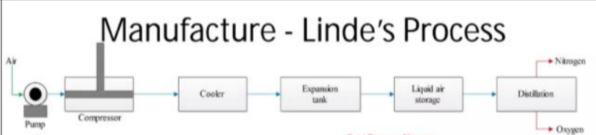
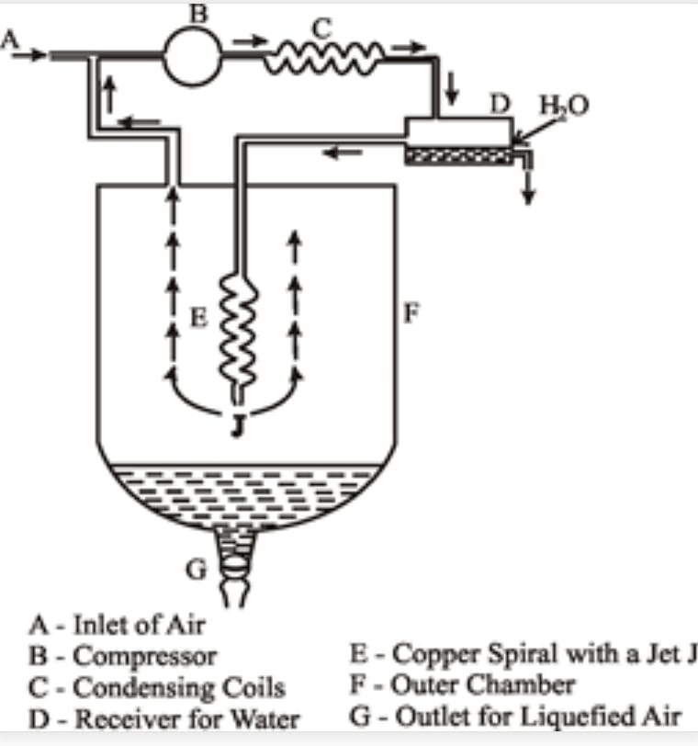

Slide 12
Pressure Swing Adsorption (PSA)
Pressure Swing Adsorption (PSA) is a widely used gas separation process that operates at near-ambient temperatures. It is based on the principle of selective adsorption of gases on a solid surface, typically an adsorbent material like zeolite or activated carbon.
1.Adsorption Under High Pressure: The PSA process begins with passing a gas mixture, such as air, through a vessel containing an adsorbent bed, typically zeolite. Zeolite attracts nitrogen more strongly than oxygen, so nitrogen is adsorbed onto the zeolite surface under high pressure, while oxygen passes through.

Slide 13
2.Separation of Gases: As the gas mixture flows through the adsorbent bed, nitrogen is trapped, and the gas exiting the vessel becomes richer in oxygen compared to the entering mixture
3.Reaching Adsorption Capacity: The zeolite bed eventually reaches its capacity to adsorb nitrogen. At this point, the pressure in the vessel is decreased, causing the adsorbed nitrogen to be released, or desorbed, from the zeolite.
4.Regeneration of Adsorbent Bed: The desorbed nitrogen is vented out, and the adsorbent bed is regenerated, ready for another cycle. The regenerated bed is then used in the next cycle of producing oxygen-enriched air

Slide 14
5.Continuous Production: To achieve near-continuous production, two adsorbent vessels are used alternately. While one vessel is adsorbing nitrogen, the other is being regenerated. The gas exiting the vessel being depressurized is used to partially pressurize the second vessel, which helps in energy savings.
6.Energy Efficiency: This pressure equalization process helps in maintaining a continuous flow of the target gas while minimizing energy consumption, making it a common practice in industrial applications

Slide 15
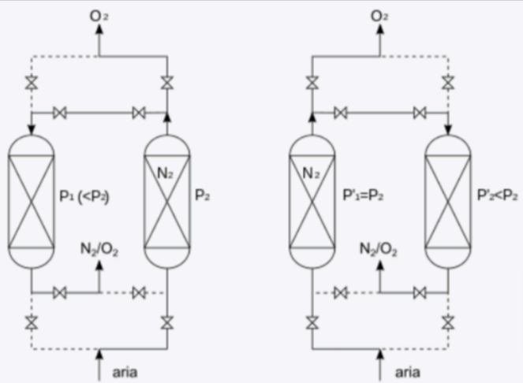

Slide 16
Comparison and Analysis
1.Operating Principle:
• Linde Process: The Linde process is based on the liquefaction and rectification of air. It involves compressing and cooling air to liquefy it, then separating the constituents of air (nitrogen and oxygen) through fractional distillation.
• PSA Process: PSA relies on the adsorption of gases onto solid surfaces under high pressure. Different gases are adsorbed onto the adsorbent material (e.g., zeolite) at different rates, allowing for the separation of gases in a mixture.
2.Energy Consumption:
• Linde Process: The Linde process requires significant energy input for compression and cooling of air to liquefy it, making it energy-intensive.
• PSA Process: PSA is generally more energy-efficient compared to the Linde process, as it operates at lower pressures and does not require liquefaction of gases

Slide 17
3.Purity of Products:
• Linde Process: The Linde process can produce very high-purity gases (e.g., oxygen and nitrogen) due to the fractional distillation process.
• PSA Process: PSA can also produce high-purity gases, but the purity levels may be slightly lower compared to the Linde process.
4.Cost-Effectiveness:
• Linde Process: The Linde process is often more costly to implement and operate due to its energy-intensive nature and complex equipment.
• PSA Process: PSA is generally more cost-effective for smaller-scale applications due to its lower energy requirements and simpler equipment.
5.Applications:
• Linde Process: The Linde process is used primarily for large-scale production of industrial gases, cryogenic liquids, and high-purity gases for various industries.
• PSA Process: PSA is used for smaller-scale applications, such as gas separation and purification in laboratories, medical oxygen concentrators, and small-scale industrial processes

Slide 18
Conclusion Linde Process: The Linde process is a well-established method for the large-scale production of industrial gases and cryogenic liquids. It is highly effective in producing high-purity gases, particularly oxygen and nitrogen, through the process of liquefaction and fractional distillation of air. However, the Linde process is energy-intensive and more suitable for large-scale industrial applications where high-purity gases are required.

Slide 19
Pressure Swing Adsorption (PSA) Process: The PSA process is a versatile and cost-effective method for gas separation and purification, particularly in smaller-scale applications. It operates based on the adsorption of gases onto solid surfaces under pressure, allowing for the separation of gases in a mixture. While the PSA process may not achieve the same level of purity as the Linde process, it is more energy-efficient and suitable for applications where lower purity levels are acceptable

Slide 20
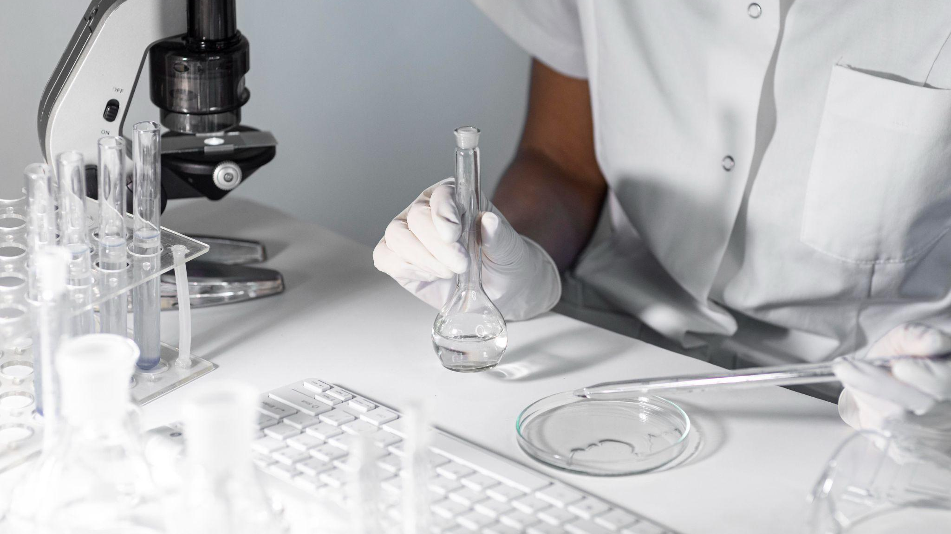
THANK YOU

