Slide 1

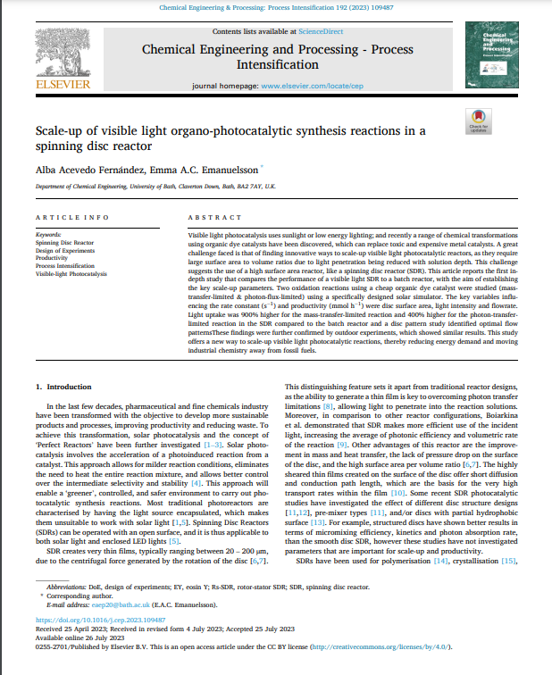
Scale up of visible light organo-photocatalytic synthesis reactions in a spinning disc reactor
ONKAR DUBEY
SHIVAM ADBHUTE
ARIJIT MOHANTA

Slide 2
Area of research
Specific area of research
​
Scale up of light organo-photocatalytic synthesis reactions in SDR​
Reaction Engineering

Slide 3
OBJECTIVE
Research Objective : We aim to optimize visible light photocatalytic synthesis using a custom tilting spinning disc reactor (SDR).
Sustainability Focus: Photocatalytic reactions offer sustainable and efficient synthesis but require fine-tuning for productivity and cost reduction.
SDR Benefits: We compare SDR to batch stirred reactors, highlighting thin film generation and increased surface area for enhanced efficiency.
Key Factors: Our study identifies critical factors affecting photocatalytic rate constants, including disc size, light intensity, and flow rates.
Industrial Scaling: We explore scaling photocatalytic reactions using the tilting SDR, tracking the sun's path for large-scale potential.

Slide 4

CONTENTS
INTRODUCTION
METHODOLOGY
NOVALTY
PARAMETERS
RESULTS AND DISCUSSIONS
LITERATURE REFERENCES

Slide 5
INTRODUCTION
Optimization for efficiency
Optimize organo-photosynthesis by fine-tuning light, temperature, and CO2 levels for maximum productivity.
Eco-Friendly Approach
Choose renewable energy sources and sustainable materials to minimize environmental impact.
Continuous Flow vs. Batch
Compare continuous flow reactors (SDR) and batch reactors for productivity and energy efficiency.
Scaling Challenges
Address challenges like heat management and mass transfer when scaling up the process.
Environmental Impact Assessment
Conduct a life cycle assessment to confirm the eco-friendliness of the scaled-up organo-photosynthesis method compared to traditional approaches.

Slide 6
METHODOLOGY
Experimental Setup: The research utilized a custom tilting spinning disc reactor (SDR) under natural sunlight, preventing evaporation with a glass lid and shielding the reservoir from light.
Design of Experiments (DoE): A DoE approach explored factors like light intensity, amine concentration, catalyst loading, flow rate, spin speed, and disc size in oxidative homocoupling of benzylamine and L-methionine oxidation.
Data Analysis and Visual Studies: Analysis using Pareto charts and Normal plots revealed disc size, light intensity, and flow rate as significant factors. Visual studies with a high-speed camera explored thin film formation, calculating film thickness and mean residence time.

Slide 7
Data Analysis: The obtained results were analyzed using Pareto charts and Normal plots to identify the significant factors affecting the reactions. The analysis revealed that factors like disc size, light intensity, and flow rate had the most significant impact on the reactions. The interactions between these variables were also found to be important.

Slide 8
NOVELTY
TARGETTED NOVELTY
Advancements in Photocatalysis: Spinning disc reactors offer significant improvements over traditional batch techniques for photocatalytic reactions.
Efficiency and Environmental Benefits: These reactors boost efficiency and promote eco-friendliness in photocatalysis.
Cost Reduction with Organic Dyes: Adoption of organic dye catalysts proves cost-effective.
Pollution Reduction: Organic dyes contribute to reducing pollution in photocatalytic processes.
SUBJECTIVE NOVELTY
Superior Photocatalytic Efficiency: The SDR outperformed batch reactors by utilizing photons four times more efficiently and achieving the highest productivity and PSYT.
Surface Area Optimization: The SDR's efficiency soared ninefold through the optimization of surface area.
Impressive PSYT: The SDR achieved an outstanding PSYT of 1.7 kW-1 day-1 for the (50cm) reaction, showcasing its superior performance.

Slide 9
PARAMETERS
Film thickness
Photon flux
PH of catalyst
Rate constant
Volume of reactor
Opacity of disc
CONTROLLING VARIABLES
Disc Diameter
Light Intensity
Flow Rate
Spin Speed
Input concentration
Amine concentration
CONTROLLED VARIABLES
Disc surface area
Mean Residence Time
Yield
PSYT
Disc temperature

Slide 10
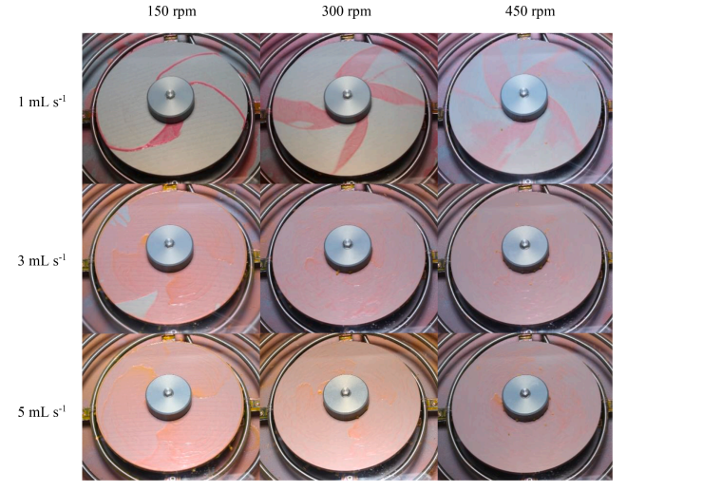
RESULTS AND DISCUSSIONS
Significant Reaction Parameters: The reaction rate is profoundly influenced by disc size, light intensity, and flow rate, and understanding how they interact with disc size is critical for efficient optimization and cost reduction.
Visual studies with a 20 cm disc at different
flow rates (1-, 3-, and 5-ml s -1) and
rotational speeds (150, 300, and 450 rpm).

Slide 11
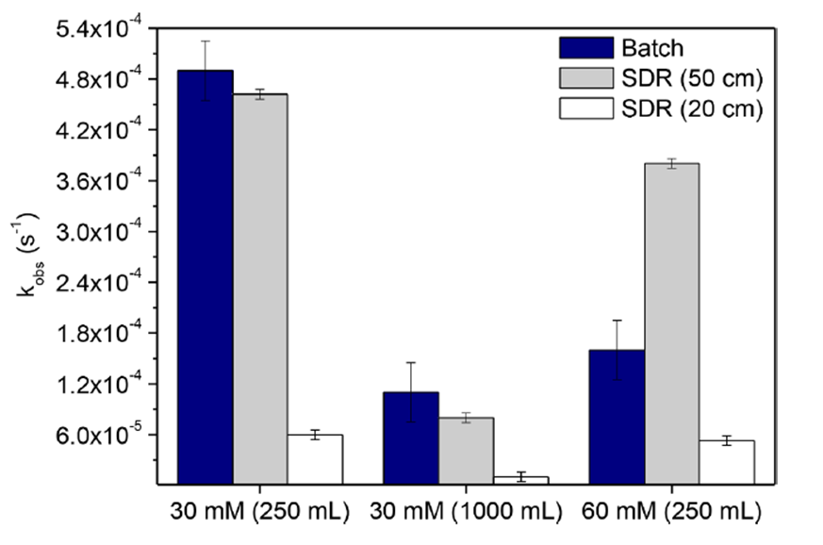
Role of Surface Area: Increasing the surface area, especially through larger discs, augments reaction rates. Nevertheless, scaling up traditional batch reactors proves to be economically unfeasible.
SDR's Performance Advantage: Spinning disc reactors (SDR) outshine batch reactors by providing superior control over reaction conditions and expediting reactions, particularly when employing larger discs.

Slide 12
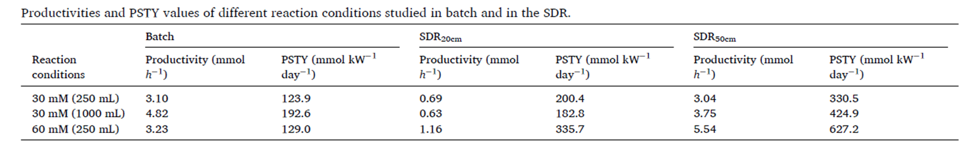
Rate constants of the performance of the batch stirred reactor and the SDR with 20 and 50 cm
Optimal Reaction Conditions: Achieving the highest reaction rates and productivity demands specific conditions: elevated light intensity, amine concentration, flow rate, minimal catalyst loading, and lower rotational speed, ultimately resulting in an optimal reaction rate.

Slide 13
Impact of Flow Patterns: Investigations into thin films reveal that flow patterns, influenced by flow rate and spinning speed, play a crucial role in influencing reaction rates. Smoother flow patterns enhance reactions, while irregular waves hinder mass transfer and light penetration.

Slide 14
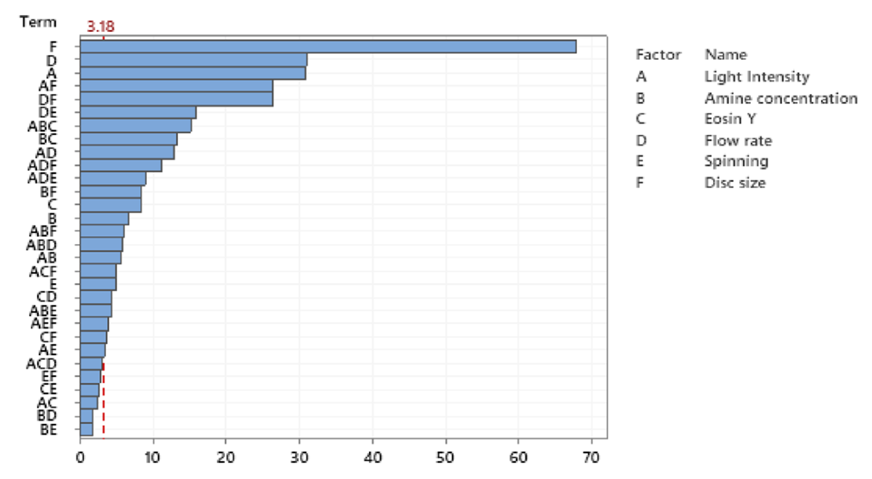
PARETO CHART

Slide 15
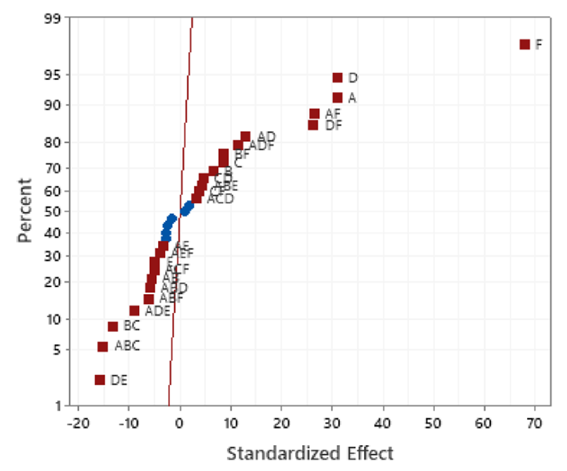
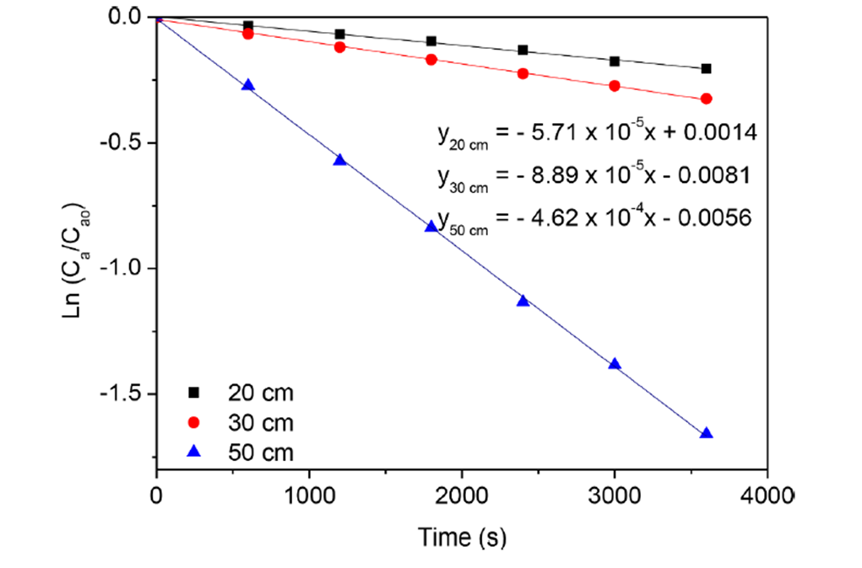
PLOT SHOWING THE MOST SIGNIFICANT FACTORS AFFECTING THE RATE CONSTANT.
COMPARISON OF LN (CA/CAO) VS TIME OF DIFFERENT DISC SIZES IN THE SDR

Slide 16
CONCLUSIONS
SDR Outperforms Batch Reactors: In two distinct reactions, the spinning disc reactor (SDR) demonstrated superior performance over batch stirred reactors concerning surface area, light intensity, and flow rate, resulting in heightened productivity and photon utilization efficiency.
Effectiveness Across Reaction Types: SDR effectively excelled in both photon-transfer-limited and mass-transfer-limited reactions, achieving higher reaction rates and productivity in solar photocatalysis compared to traditional batch reactors.
Flow Rate and Spinning Speed Interaction: The interaction between flow rate and spinning speed emerged as a critical factor influencing SDR's performance. Lower flow rates facilitated enhanced light penetration, while higher flow rates increased the surface-area-to-volume ratio.

Slide 17
Industrial Scaling Potential: SDR's capability to generate thin films and regulate reaction conditions positions it as a promising candidate for industrial-scale photocatalytic reactions. It offers a superior surface area-to-volume ratio and optimized solar energy utilization.
Optimal Conditions for Enhanced Efficiency: The research underscores the significance of selecting optimal reaction conditions to boost productivity and reaction rates in visible light photocatalytic synthesis. SDR emerges as a greener and promising alternative to traditional batch reactors for efficient solar-driven processes.

Slide 18
REFERENCES
D. Spasiano, R. Marotta, S. Malato, P. Fernandez-Ibanez, ˜ I. Di Somma, Solar photocatalysis: materials, reactors, some commercial, and pre-industrialised applications. A comprehensive approach, Appl. Catal., B. 170–171 (2015) 90–123 - https://doi.org/10.1016/j.apcatb.2014.12.050
S.D. Pask, O. Nuyken, Z. Cai, The spinning disk reactor: an example of a process intensification technology for polymers and particles, Polym. Chem. 3 (2012) 2698–2707, https://doi.org/10.1039/c2py20237a
E. Kayahan, D. Urbani, P. Dambruoso, A. Massi, L. Braeken, T. Van Gerven, M. Enis Leblebici, Overcoming mass and photon transfer limitations in a scalable reactor: oxidation in an aerosol photoreactor, Chem. Eng. J. 408 (2021), 127357 - https://doi.org/10.1016/j.cej.2020.127357
Creative Energy, European Roadmap for Process Intensification (ERPI), 2007. https://efce.info/efce_media/-p-531.pdf (accessed June 17, 2020).

Slide 19
THANK YOU

