Slide 1
Welcome

Slide 2





Slide 3
Content :
What is an Artifical Intelligence?
What is Importance of Artifical Intelligence?
Goals
Objectives
Advantages
Disadvantages

Slide 4
What is an Artifical Intelligence?
Artificial Intelligence (AI) refers to the development of computer systems that can perform tasks that typically require human intelligence. These tasks include understanding natural language, recognizing patterns, learning from experience, and making decisions. AI encompasses a broad range of techniques and approaches, including machine learning, deep learning, natural language processing, computer vision, robotics, and more.
The goal of AI is to create systems that can mimic, augment, or surpass human intelligence in various domains.

Slide 5
What is Importance of Artifical Intelligence?
Automation: AI can automate repetitive tasks, increasing efficiency and reducing human error in various fields such as manufacturing, customer service, and data analysis.
Decision Making: AI systems can analyze vast amounts of data to make informed decisions quickly and accurately, aiding in areas like finance, healthcare, and logistics.
Personalization: AI algorithms can analyze user preferences and behavior to provide personalized recommendations in fields such as e-commerce, entertainment, and marketing.
Prediction and Forecasting: AI models can analyze historical data to make predictions and forecasts, helping businesses anticipate trends and make strategic decisions.
Healthcare: AI can assist in medical diagnosis, drug discovery, personalized treatment plans, and remote patient monitoring, leading to improved healthcare outcomes.
Education: AI-powered educational tools can provide personalized learning experiences, adapt curriculum to individual student needs, and offer real-time feedback to enhance learning outcomes.

Slide 6
Natural Language Processing: AI technologies enable machines to understand and generate human language, facilitating communication, translation, and content generation.
Robotics: AI-driven robots can perform tasks in various environments, from manufacturing floors to hazardous locations like space or underwater, enhancing safety and efficiency.
Environmental Sustainability: AI can optimize resource management, predict natural disasters, and develop cleaner technologies, contributing to environmental conservation efforts.
Innovation: AI fosters innovation by enabling the development of new products, services, and business models across industries.

Slide 7
Goals of AI
Automation: Developing AI systems capable of automating routine tasks to increase efficiency and productivity across industries.
Decision Support: Creating AI algorithms to assist humans in making better decisions by analyzing vast amounts of data and providing actionable insights.
Problem Solving: Building AI systems capable of solving complex problems in fields such as healthcare, finance, transportation, and climate science.
Human Augmentation: Developing AI technologies to augment human capabilities, enabling individuals to perform tasks more effectively and efficiently.
Personalization: Creating AI systems that personalize experiences and services based on individual preferences, behaviors, and needs, such as personalized recommendations in e-commerce and entertainment.

Slide 8
Objectives of AI
1. Develop the problem-solving ability
2. Incorporate knowledge representation
3. Facilitate planning
4. Allow continuous learning
5. Encourage Social Intelligence
6. Promote creativity

Slide 9
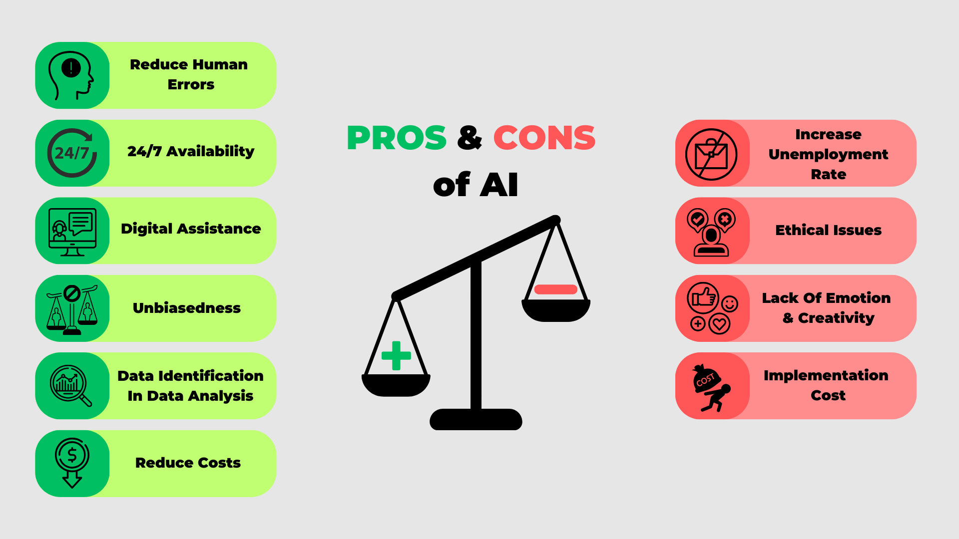

Slide 10
Thank You!!!

