Slide 1

A Presentation on “Contactless Distance Measurement System”
Under Project Based Learning(PBL)
Savitribai Phule Pune University, Pune
By
Mr. Sarthak Devidas Varade(60)
Mr. Aditya Rajendra Varpe(61)
Mr. Tejas Bhausaheb Varpe(62)
Mr. Onkar Uttam Waman(64)
Mr. Omkar Sunil Yelmame(65)
Under The Guidance of
Prof. R. N. Deokar

Slide 2
Presentation Outline
Introduction
Research Motivation
Problem statement
Aim and Objectives
Application of Project
Block Diagram
Working
Related Work
List of Hardware Required
Algorithm
Flowchart
Advantages and Disadvantages
Image of Hardware
conclusion
References

Slide 3
Introduction
Distance measurement of an object in front or by the side of a moving entity is required in a large number of devices. These devices may be small or large and also quite simple or complicated. Such distance measurement systems are available. These uses various kinds of sensors and systems. Low cost and accuracy as well as speed is important in most of the applications.
Among the various techniques of noncontact measurement, ultrasonic technique is the best when we need stable and accurate distance of obstacle, no matter what colour it is. It is also usable outside in the sun. As the human ear’s audible range is 20 Hz to 20 kHz, it is insensitive to ultrasonic waves, and hence the ultrasound waves can be used for applications in industries or vehicles without hindering human/other activity.
In this project, we are going implement such a measurement system which uses ultrasonic sensor unit and an Arduino Uno based system. The Arduino Uno is easily available at low cost. An error correction is applied to minimize the error in the measured distance. Ultrasound sensors are very versatile in distance measurement. They are also providing the cheapest solutions. Ultrasound waves are useful for both the air and underwater. Ultrasonic sensors are also quite fast for most of the common applications. The working of this system is to take input from ultrasonic sensor about the obstacle and send it for processing to Arduino, then display the results on the lcd screen.

Slide 4
Research Motivation
When measuring with a tape, there is a chance that it will bend and may lead to inaccurate readings. With a typical tape measure, it requires two-hand operation in many cases. Also, in market the laser-based measurement devices are available but they can’t be used in direct sunlight. As IR sensors distance measurement systems cannot work good in different light conditions and also cannot work in water, hence to overcome all these drawbacks we are going to build a low-cost system to measure the distance which will work under water and is not affected by varying light conditions.

Slide 5
Problem statement
To design and develop contactless distance measurement system which uses ultrasonic waves to detect obstacle, by using ultrasonic distance measurement sensor HC SR-04 and Arduino Uno consisting of microcontroller Atmega 328P

Slide 6
Aim and Objectives Research Title: contactless Distance Measurement System.
Aim:
The aim of this project is to design and develop contactless distance measurement system which uses ultrasonic waves to detect obstacle.
Objectives:
To study the working of ultrasonic sensor, Arduino uno, lcd display.
To study the behavior of ultrasonic waves i.e., reflection of ultrasound.
To measure distance without direct contact with the object.
To measure the distance with accuracy.
The main objective of this system is to measure the distance between system and the object without any physical contact with the object.

Slide 7
Application of Project
The proposed system can be used in following places.
Automobile self parking technology
Anti-Collision safety systems
Robotic obstacles detection system
Manufacturing technology

Slide 8
System Block Diagram
Battery
Ultrasonic
Sensor
HC-SR04
Object
Arduino
Uno
16*2 LCD Display

Slide 9
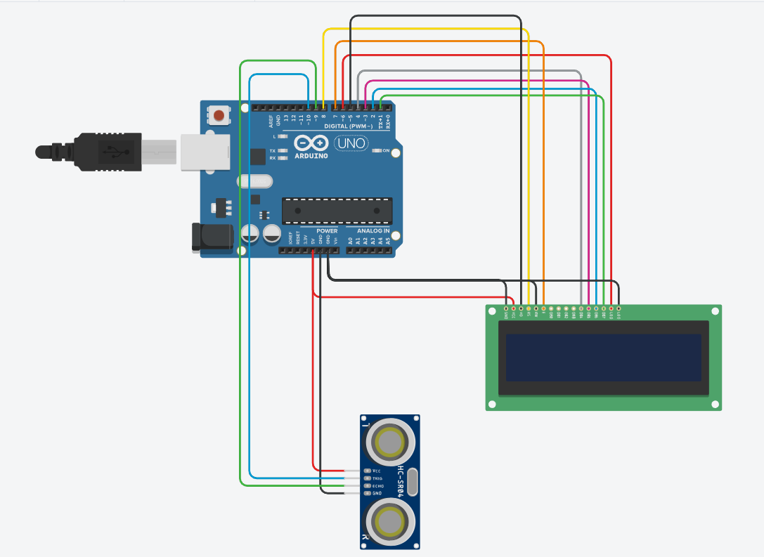
Working of System

Slide 10
circuit diagram for Arduino and ultrasonic sensor is shown above to measure the distance. In circuit connections Ultrasonic sensor module’s “trigger” and “echo” pins are directly connected to pin 18(A4) and 19(A5) of Arduino. A 16x2 LCD is connected with Arduino in 4-bit mode. Control pin RS, RW and En are directly connected to Arduino pin 2, GND and 3. And data pin D4-D7 is connected to 4, 5, 6 and 7 of Arduino.
First of all we need to trigger the ultrasonic sensor module to transmit signal by using Arduino and then wait for receive ECHO. Arduino reads the time between triggering and Received ECHO. We know that speed of sound is around 340m/s. so we can calculate distance by using given formula:
Distance= (travel time/2) * speed of sound
Where speed of sound around 340m per second.
A 16x2 LCD is used for displaying distance.

Slide 11
Related Work
SR NO. | Research Paper | Positive Aspects | Negative Aspects
1. | Design of an Ultrasonic Distance Meter[1] | It can measure distance very accurately | But the range of measurement is 2.5 m
2. | Obstacle Detection Using the Concept of Ultrasound[4] | It can detect obstacles in its path | It can only detect obstacle not the distance
3. | Optical Sensor for Noncontact Measurement of Lignin Content in High-Speed Moving Paper Surfaces[8] | The optical sensor is faster than ultrasonic sensor | But optical sensor cannot be used in direct sunlight or high temperature
4. | Embedded System Based Radio Detection and Ranging (RADAR) System Using Arduino and Ultra-Sonic Sensor[6] | It uses high intensity ultrasonic waves which can travel distance up-to 3 m | It is not portable which makes it hard to transport

Slide 12
List of Hardware Required
Arduino UNO Board.
Ultrasonic Sensor(HC-SR04)
LCD Screen(16*2)
Battery(9V)
Jumper Wires
SPST switch

Slide 13
Algorithm
Step 1: Start
Step 2: Transmit pulse and initialize the timer
Step 3: Count time until getting reflected pulse
Step 4: If get reflected pulse then stop the timer, else wait until getting reflected pulse
Step 5: Then send counted time to MCU for calculations
Step 6: After calculation send the results to display them on lcd screen
Step 7: End

Slide 14
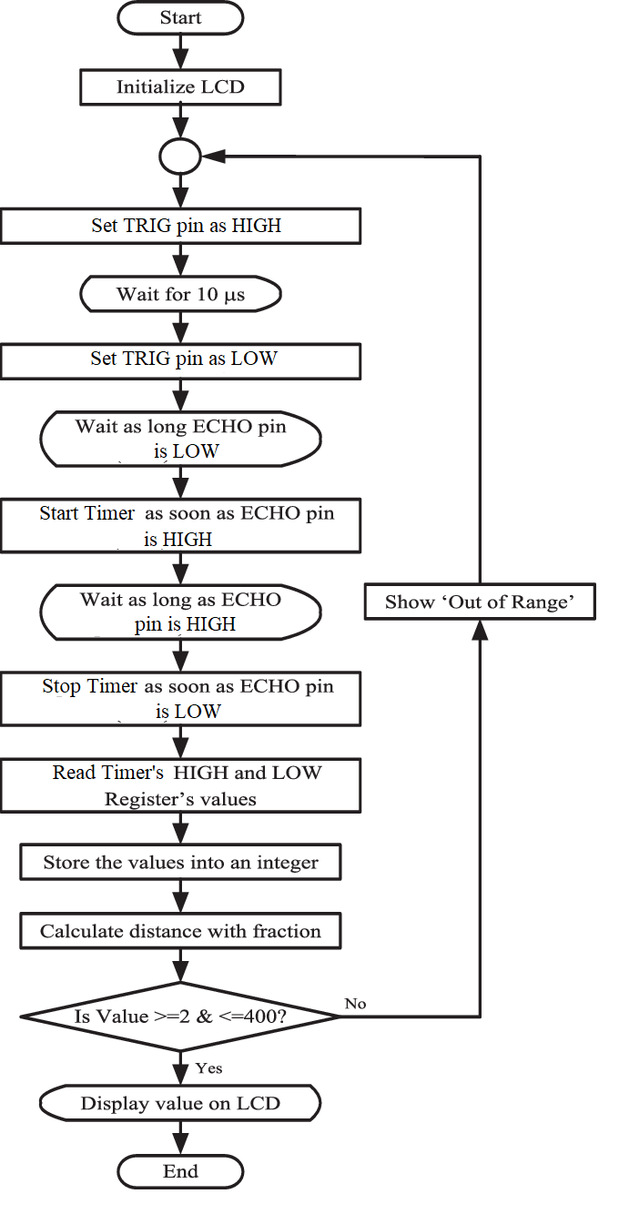
Flowchart

Slide 15
Advantages and Disadvantages
Advantages:
.It has sensing capability to sense all the material types. .This sensor is not affected due to atmospheric dust, rain, snow etc. .It can work in any adverse conditions. .It has higher sensing distance (in centimeters and inches) compare to inductive/capacitive proximity sensor types. .It provides good readings in sensing large sized objects with hard surfaces.
Disadvantages:
.It is very sensitive to variation in the temperature. .It has more difficulties in reading reflections from soft, curved, thin and small objects.

Slide 16
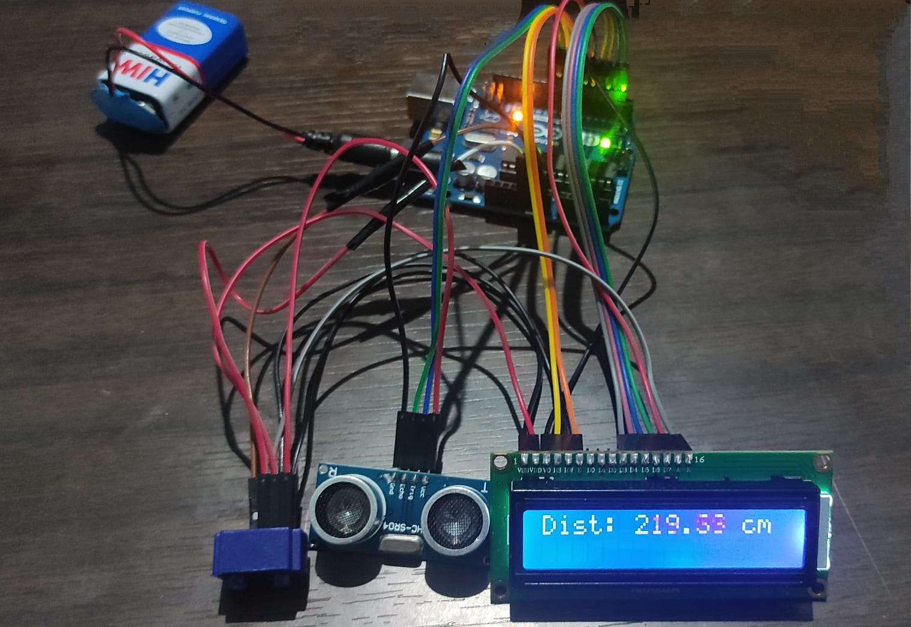
Image of Hardware prototype

Slide 17
Conclusion
The objective of the project was to design and implement an ultrasonic distance meter. The device described here can detect the target and calculate the distance of the target. The ultrasonic distance meter is a low cost, low a simple device for distance measurement. The device calculates the distance with suitable accuracy and resolution. It is a handy system for non-contact measurement of distance. The device has its application in many fields. It can be used in car backing system, automation and robotics, detecting the depth of the snow, water level of the tank, production line. This device will also have its application in civil and mechanical field for precise and small measurements. For calculating the distance using this device, the target whose distance is to be measured should always be perpendicular to the plane of propagation of the ultrasonic waves. Hence the orientation of the target is a limitation of this system. The ultrasonic detection range also depends on the size and position of the target. The bigger is the target, stronger will be the reflected signal and more accurate will be the distance calculated. Hence the ultrasonic distance meter is an extremely useful device.

Slide 18
References
Arefin Shamsul MD., & Mollick Tajrian (2013). Design of an Ultrasonic Distance Meter. International Journal of Scientific & Engineering Research Volume 4, Issue 3 M.
Rüeger, J. (1980). Recent developments in electronic distance measurement. Australian Surveyor. 30. 10.1080/00050326.1980.10442489.
Jetzt, J. J. (1979). Critical distance measurement of rooms from the sound energy spectral response. The Journal of the Acoustical Society of America, 65(5), 1204-1211.
Suleiman Khayal, Osama. (2016). Obstacle Detection Using the Concept of Ultrasound. 10.13140/RG.2.2.15918.82246.
Huang, C. F., Young, M. S., & Li, Y. C. (1999). Multiple-frequency continuous wave ultrasonic system for accurate distance measurement. Review of scientific instruments, 70(2), 1452-1458.
Ahman, Emmanuel & Maryam Oluwadamilola, Abdusalaam & Lukman, Ajao. (2017). Embedded System Based Radio Detection and Ranging (RADAR) System Using Arduino and Ultra-Sonic Sensor. American Journal of Embedded Systems and Applications. 5. 7-12. 10.11648/j.ajesa.20170501.12

Slide 19
References
7) H. Bhuyan, M. A. Rabby, M. A. Parvez and M. M. G. Tarik, “Microcontroller Based Display System Design using LED Array,” Proceedings of the Conference on Engineering Research, Innovation and Education, Shahjalal University of Science and Technology, Sylhet, Bangladesh, 11-13 Jan 2010, pp. 417-420.
8) Duval, “Advances in Analog Distance Sensing”, Sensors Magazine, September 2004.
9) K. Ramasubramanian, R. A. Chandini and V. Mallapragada, “Optical Sensor for Noncontact Measurement of Lignin Content in High-Speed Moving Paper Surfaces,” IEEE Sensors J., vol. 5, no. 5, pp. 1132-1139, 2005
BLOGS:
The ultrasonic sensor tutorial https://lastminuteengineers.com/arduino-sr04-ultrasonic-sensor-tutorial/
Arduino complete https://howtomechatronics.com/tutorials/arduino/ultrasonic-sensor-hc-sr04/

Slide 20
THANK YOU

