Slide 1

A Presentation on “Ultrasonic Glasses for the Blind”
Under Mini Project
Savitribai Phule Pune University, Pune
By
Sarthak Devidas Varade (68)
Onkar Uttam Waman (73)
Omkar Sunil Yelmame (74)
Under The Guidance of
Prof. R. K. Kharat

Slide 2
Presentation Outline
Introduction
Research Motivation
Problem statement
Aim and Objectives
List of Hardware Required
Block Diagram
Circuit Diagram
Components rating
Working
Related Work
Algorithm
Advantages and Disadvantages
Application of Project
conclusion
References

Slide 3
Introduction
Ultrasonic glasses for the blind is an innovative technology that aims to assist blind or visually impaired individuals in navigating their environment. These glasses use ultrasonic waves to detect objects and obstacles in the wearer's surroundings and convert this information into haptic feedback, providing a clearer picture of their environment, also detect whether obstacle is living thing or not by using PIR sensor.
This technology has the potential to improve the quality of life for individuals who are blind or visually impaired, allowing them to navigate unfamiliar environments with more confidence and independence. Additionally, Ultrasonic glasses can offer a more discreet and less invasive alternative to traditional assistive devices such as canes or guide dogs. Guide dogs and white canes are major tools to support the visually impaired. However, the number of guide dogs is predominantly smaller than, the number of visually impaired persons [2]. With the continuous advancements in technology, Ultrasonic glasses for the blind may become more accessible and widely available in the near future.
While Ultrasonic glasses for the blind are still a relatively new technology, they are rapidly evolving. Newer versions of the glasses are becoming smaller, lighter, and more affordable. Advances in artificial intelligence and machine learning are also being incorporated into the technology, allowing the glasses to learn from the wearer's movements and adapt to their needs & could recognize the obstacle.

Slide 4
Research Motivation
Blind and visually impaired individuals face significant challenges in navigating their surroundings. With the limitations and drawbacks of traditional assistive devices, such as canes and guide dogs, ultrasonic glasses use ultrasonic waves to detect objects and obstacles in the wearer's surroundings, providing a clearer picture of the environment. This can significantly improve the mobility and independence of blind and visually impaired individuals, allowing them to navigate unfamiliar environments with more confidence and ease.

Slide 5
Problem statement
To design and develop Ultrasonic Glasses for the Blind which uses ultrasonic waves to detect obstacle, as well as uses Infrared radiation detector to measure heat radiated by living things and provide a haptic feedback and sound signal to user about the obstacle.

Slide 6
Aim and Objectives
Aim:
The aim of this project is to design and develop Ultrasonic Glasses for the Blind
Objectives:
To build a wearable device for navigation of blind people.
To study the working of Ultrasonic sensor, PIR sensor, Arduino uno,
To study the behavior of ultrasonic waves i.e., reflection of ultrasound.
To measure distance without direct contact with the object.
To measure the heat radiated by the obstacle.
To detect obstacle & whether it is living or non-living between system and the object without any physical contact with the object.

Slide 7
List of Hardware Required
Arduino UNO R3
Ultrasonic Sensor Module (HC-SR04)
PIR Motion Detector Sensor Module (HC-SR501)
Flat Vibration Motor Module (1034)
Active Buzzer Module (5V)
9V Battery snap with DC jack
Male to Female Jumper Wires 40 pin, 30 cm
SPDT Slide switch
XF-25 Ultra Mini Breadboard

Slide 8
System Block Diagram
Battery
Object
Ultrasonic
Sensor
HC-SR04
Arduino
Uno
PIR Sensor HC-SR501
Buzzer
Flat Vibration Motor (1034) Module

Slide 9
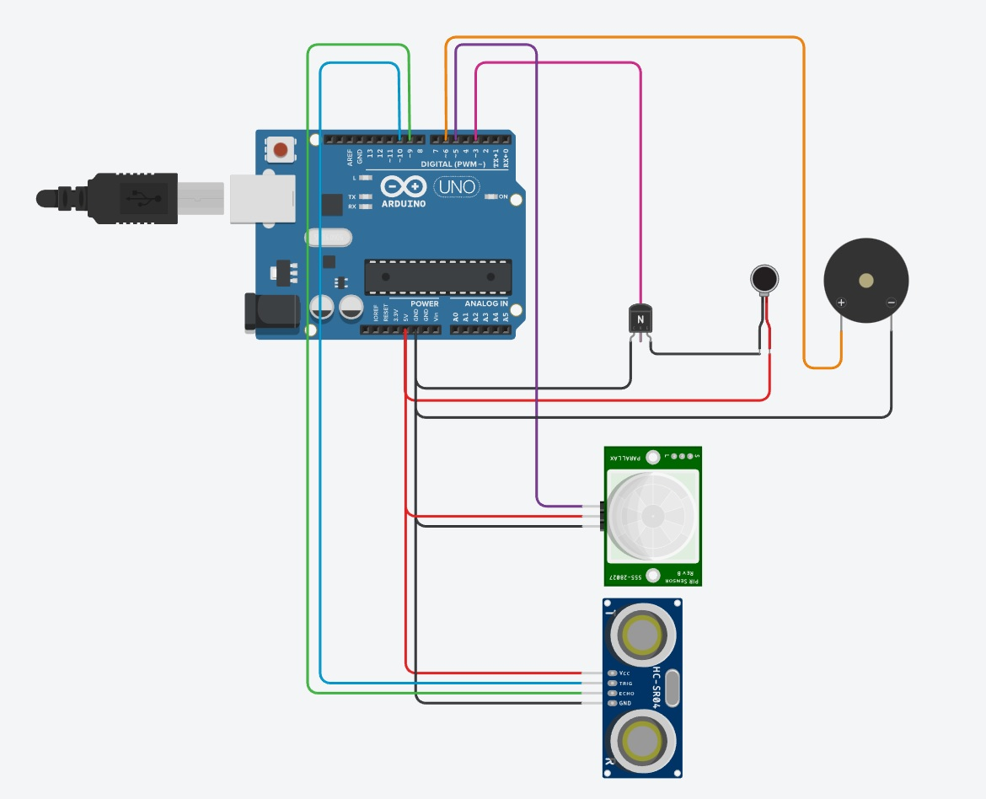
Circuit Diagram
Buzzer
Arduino Uno R3
Flat Vibration Motor (1034) Module
PIR Sensor HC-SR501
Ultrasonic
Sensor
HC-SR04

Slide 10
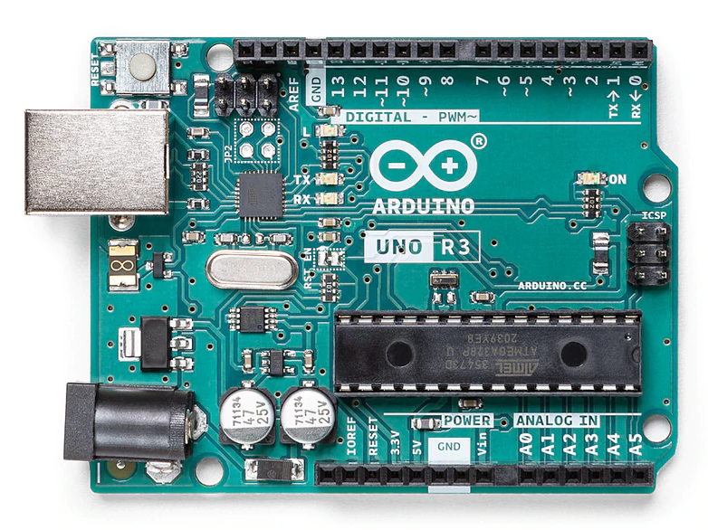
Components ratings
Arduino Uno R3
• Microcontroller: ATmega328P
• Operating Voltage: 5V
• Input Voltage (recommended): 7-12V
• Input Voltage (limits): 6-20V
• Digital I/O Pins: 14 (of which 6 provide PWM output)
• Analog Input Pins: 6
• DC Current per I/O Pin: 40 mA
• DC Current for 3.3V Pin: 50 mA
• Flash Memory: 32 KB of which 0.5 KB used by bootloader
• SRAM: 2 KB (ATmega328)
• EEPROM: 1 KB (ATmega328)
• Clock Speed: 16 MHz

Slide 11
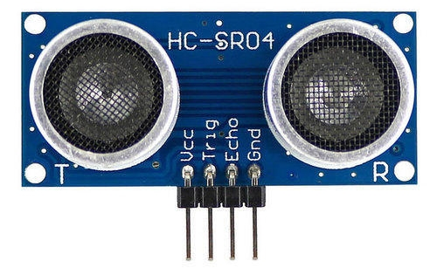
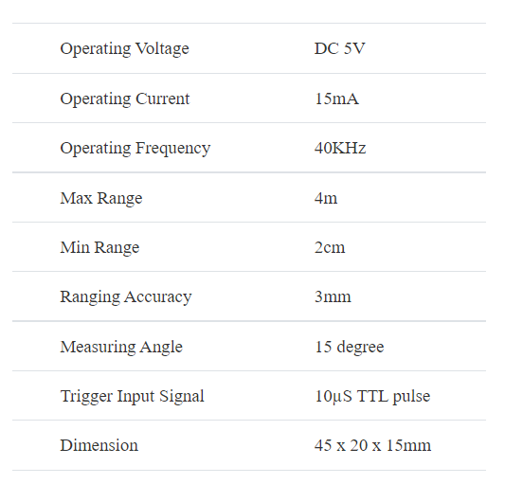
Ultrasonic sensor (HC SR-04)

Slide 12
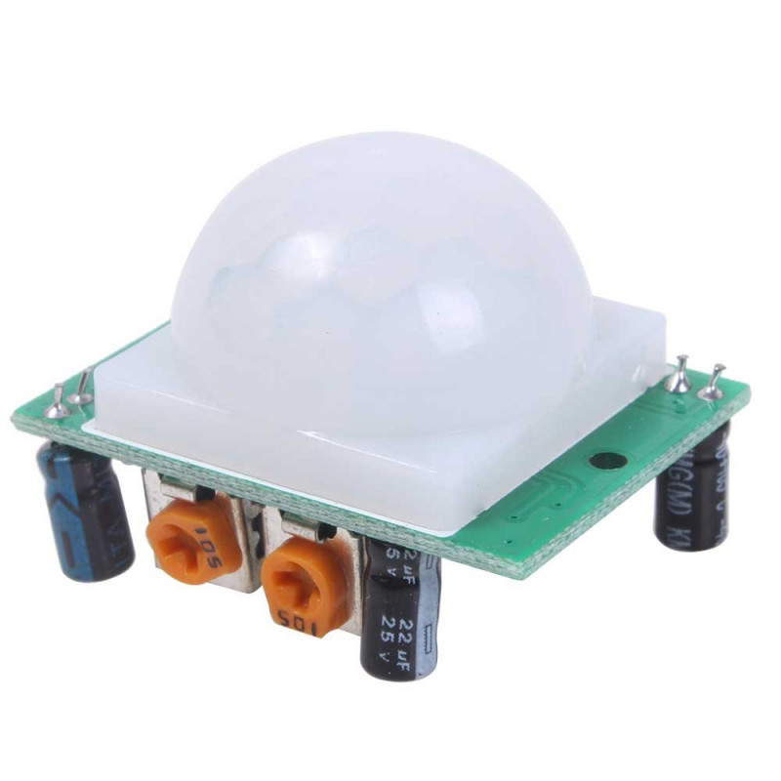
PIR Motion Detector Sensor Module (HC-SR501)
Working Voltage Range: DC 4.5V- 20V
Current Drain: <60uA
Detection Range: <140°
Voltage Output: High/Low level Signal: 3.3V TTL output
Detection Distance: 3 to 7m (can be adjusted)
Delay Time: 5 to 200s (Can be Adjusted, Default 5s +/- 3%)
Blockade time: 2.5s (Default)
Work temperature: -20-+80°C
Dimension: 3.2cm x 2.4cm x 1.8cm (Approx)
Sensitive Setting: Turn to Right, Distance Increases (About 7M); Turn to Left, Distance Reduce (About 3M)
Time Setting: Turn to Right, Time Increases (About 200S); Turn to Left, Time Reduce (About 5S).

Slide 13
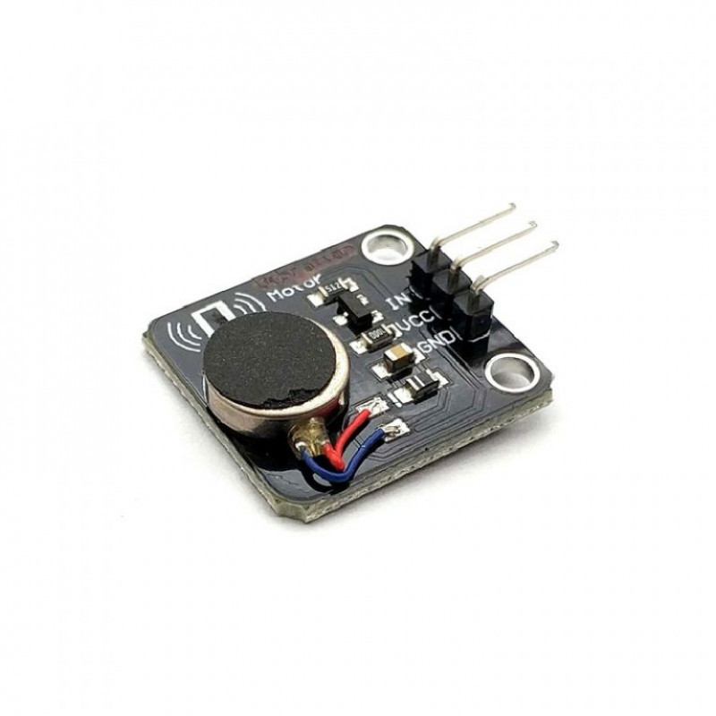
Flat Vibration Motor Module (1034)
Operating Voltage | 3 5.3 VDC
Motor Diameter | 10mm
Rated Speed | 9000 RPM (min)
Rated Voltage | 5 VDC
Rated Current | up to 60 mA
Starting Current | up to 90 mA
Starting Voltage | 3.7 VDC
Insulation Resistance | 10 M
Length (mm) | 23.5
Width (mm) | 21
Height (mm) | 8
Weight (gm) | 3

Slide 14
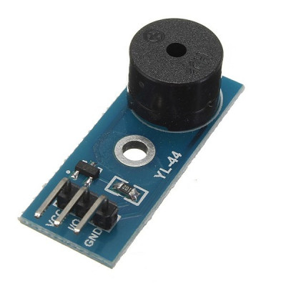
Active Buzzer Module (5V)
Name:3.3 to 5V Active Buzzer Alarm Module Sensor
Transistor drive module uses 8550
With fixed bolt hole- easy installation- 2.6mm aperture.
Operating voltage 3.3V-5V
PCB Dimensions: 34.28 mm (L) * 13.29 mm (W) * 11.5 mm (H)

Slide 15
Working
Ultrasonic glasses for the blind are a wearable device designed to help people who are visually impaired or blind navigate their surroundings using ultrasonic sensor, PIR sensor as input devices and a haptic vibration motor, buzzer as the output device. The glasses work by emitting high-frequency sound waves from ultrasonic sensors, which bounce off objects in the environment and return to the sensors, also PIR sensor detect heat radiation radiated by the obstacle. The time taken for the sound waves to return to the sensors is used to determine the distance of the objects from the wearer, also radiations is detected or not. This information is then transmitted to a control unit i.e., Arduino Uno, which is usually located in a box which is placed in pocket of wearer. The control unit processes the data and sends signals to a haptic vibration motor as well as buzzer located in the same box. The buzzer generates sound & haptic vibration motor generates vibrations that correspond to the distance and location of objects in the wearer's environment.
For example, if an object is very close to the wearer, the motor may generate a rapid vibration, while a slower vibration may indicate an object that is further away. Also if obstacle is living thing then buzzer generates sound. By feeling these vibrations and sound, the wearer can gain a better understanding of their surroundings and avoid obstacles. Overall, Ultrasonic glasses for the blind provide a valuable tool for people with visual impairments to navigate their surroundings and improve their independence and quality of life.

Slide 16
Related Work
SR NO. | Research Paper | Positive Aspects | Negative Aspects
1. | Automated Walk-in Assistant for the Blinds [1] | The proposed system consumes lower cost, lesser weight and simpler design. | But it uses an alarm which will produce noise pollution and disturbance to other people.
2. | A Wearable Walking Support System to provide safe direction for the Blind [2] | It uses a vibration motor for haptic feedback. | As all components are assembled on eyewear, it becomes bulky.
3. | Development of Glasses for Guiding Visually Impaired Using Ultrasonic Sensor and Microcontroller [3] | As all other components are assembled in a box, eyewear becomes lightweight. | But only one sensor is used which may not give accurate information
4. | A Unique smart Eye Glass for Visually Impaired People [4] | As it has three sensors, so more accurate distance is calculated. | As it uses earphones, it cannot be used for deaf people.
5. | Smart Guiding Glasses for Visually Impaired People in Indoor Environment [5] | The depth camera gives extra information about obstacle. | But the circuit is bulky as well as consumes large amount of power.

Slide 17
Algorithm
Step 1: Start
Step 2: Transmit pulse and initialize the timer
Step 3: Count time until getting reflected pulse, get signal from PIR sensor
Step 4: If get reflected pulse then stop the timer, else wait until getting reflected pulse
Step 5: Then send counted time to MCU for calculations
Step 6: After calculation send the signal to vibration motor.
Step 7: End

Slide 18
Advantages and Disadvantages
Advantages:
It has sensing capability to sense all the material types.
This sensor is not affected due to atmospheric dust, rain, snow etc.
The PIR sensor can detect whether obstacle is living thing or not.
Ultrasonic sensor has higher sensing distance (in centimeters and inches) compare to inductive/capacitive proximity sensor types.
It provides haptic(vibration) feedback as well as sound from buzzer.
Disadvantages:
Ultrasonic sensor is very sensitive to variation in the temperature.
The PIR sensor can be triggered by sources of infrared radiation other than human or animal motion, such as changes in temperature, sunlight

Slide 19
Application of Project
The proposed system can be used in following places:
As a navigation guide for the blind or people with impaired vision
Obstacle Detection
Classify obstacle as living or non-living

Slide 20
Conclusion
Ultrasonic glasses for the blind are a promising technology that can significantly improve the daily lives of visually impaired individuals. These glasses use ultrasonic waves to detect obstacles and provide haptic feedback to the wearer, as well as use Infrared Radiation to state whether obstacle is living thing or not and provide sound to the wearer allowing them to navigate their surroundings with greater ease and independence. The technology is still in the early stages of development, and there are some limitations to consider, such as limited detection range and accuracy.
However, with further research and advancements in technology, Ultrasonic glasses have the potential to become an essential tool for the blind and visually impaired community. They offer a new level of freedom and independence that was previously unavailable, and it is exciting to think about the possibilities that these glasses may bring in the future. We can add camera and Artificial Intelligence to the glasses to recognize obstacle & also can provide GPS navigation and voice calling.

Slide 21
References
“Automated Walk-in Assistant for the Blinds” by Muhammad Sheikh Sadi, Saifuddin Mahmud, Md. Mostafa Kamal, Abu Ibne Bayazid. Published in 2014 in the IEEE International Conference on Electrical Engineering and Information & Communication Technology
“A Wearable Walking Support System to provide safe direction for the Blind” by Kataoka Hiroto, Harashima Katsumi. Published in 2019 in the IEEE 34th International Technical Conference on Circuits/Systems, Computers and Communications (ITC-CSCC)
“Development of Glasses for Guiding Visually Impaired Using Ultrasonic Sensor and Microcontroller” by Wawan Setiawan, Rasim, and Jajang Kusnendar. Published in 2014 in the Journal of Multidisciplinary Engineering Science and Technology (JMEST)
“A Unique Smart Eye Glass for Visually Impaired People” by Md. Razu Miah, Md. Sanwar Hussain. Published in 2018 in the IEEE International Conference on Advancement in Electrical and Electronic Engineering (ICAEEE)
“Smart Guiding Glasses for Visually Impaired People in Indoor Environment” by Jinqiang Bai, Shiguo Lian, Zhaoxiang Liu, Kai Wang, Dijun Liu. Published in 2017 in the IEEE Transactions on Consumer Electronics

Slide 22
“Ultrasonic Glasses for the Blind: A Portable Aid for Obstacle Detection” by P. Mehta, A. Thakur, and A. Sharma. Published in 2017 in the IEEE Sensors Journal.
“Development of Ultrasonic Glasses for Blind People Using an ATmega328 Microcontroller” by M. Sahin, A. Erol, and H. Koyuncu. Published in 2019 in the journal Keyence of Intelligent & Robotic Systems.
“Ultrasonic Glasses for Visually Impaired: Human–Machine Interaction and Control System Design” by J. Geng, J. Fang, and J. Zhang. Published in 2021 in the IEEE Transactions on Instrumentation and Measurement.
“Ultrasonic Glasses for the Blind Using Raspberry Pi and Arduino” by M. Amor, A. Idoudi, and N. Bouden. Published in 2021 in the journal International Journal of Electrical and Computer Engineering (IJECE).
“Design and Implementation of Ultrasonic Glasses for the Blind Based on Wireless Sensor Network” by W. Zhang, C. Liao, and X. Huang. Published in 2021 in the IEEE International Conference on Artificial Intelligence and Computer Applications (ICAICA).

Slide 23
THANK YOU

