Slide 1

;
Department of Computer Science and Engineering
Mini Project- I Presentation on
“Smart Queue Monitoring System”
Presented By
Roll No. | Student Name
CS3029 | Satyajeet D. More
CS3030 | Onkar K. Patil
CS3031 | Prachi I. Sakate
CS3032 | Prashant K. Sawant
CS3043 | Sadabashya A. Mujawar
T. Y. CSE , Semester V , Year 2025 – 2026
Asst. Prof. Ms. P.R. Telshinge Dr. V. B. Ingale
Guide H. O. D. (CSE)

Slide 2
Agenda
The presentation will cover the following sections:
Introduction
Literature Survey
System Analysis and Design (Proposed Work & Methodology)
System Implementation (HW/SW Requirements & Flowchart)
Results
Future Scope
Conclusion
References
Outputs

Slide 3
Introduction
Queues are common in banks, hospitals, malls, airports, etc.
Traditional systems lack real-time monitoring and depend on human intervention.
Customers face frustration due to long waiting without knowing queue length or time.
AI & Computer Vision can automate queue detection with high accuracy.
The project aims to provide real-time queue length, waiting time estimation, and a live monitoring dashboard.
Queues are part of every public-facing service such as hospitals, banks, malls, airports, and government offices. Traditional queue systems like manual counting or token systems fail to provide real-time status of queue length or estimated waiting time. With advancements in AI and Computer Vision, it has become possible to automatically detect people, measure queue length, and predict waiting time using live video feeds. This project aims to create an AI-powered Smart Queue Monitoring System using YOLO and OpenCV, which provides real-time queue analytics through a web dashboard.

Slide 4
Literature Review
Manual and token-based systems lack real-time updates and accuracy.
Computer Vision methods exist but face issues in dense and crowded conditions.
Deep Learning models like YOLOv5/v8 offer high accuracy in person detection.
Existing systems mainly focus on counting, not on real-time dashboard integration.
Identified gap: lack of practical, deployable, real-time queue monitoring solutions.

Slide 5
Relevance of the Work
Increasing need for smart solutions in public and private sectors.
Helps reduce customer frustration by estimating waiting times.
Useful for optimizing staff allocation during peak hours.
Highly scalable across industries: retail, banks, hospitals, airports.
Cost-effective since it uses existing CCTV infrastructure.

Slide 6
Proposed Work
Use a live camera feed integrated with a YOLO model for real-time person detection.
Count number of people and compute queue metrics like queue length & average waiting time.
Build a web-based dashboard to display live queue statistics.
Ensure system runs in real time for practical deployment.

Slide 7
Proposed Methodology
Identify the need for real-time queue monitoring.
Capture video stream using webcam or recorded data.
Apply YOLOv5/v8 pretrained model for detection.
Use OpenCV to process each frame and count people.
Estimate average waiting time using service time formula.
Backend using FastAPI for data processing.
Dashboard using HTML, CSS, JavaScript.
Test under varying lighting and crowd conditions.

Slide 8
Hardware / Software Requirements
Hardware:
Laptop/PC (i5 or above, 8GB RAM)
Webcam / External Camera
Software:
Python 3.10+
Libraries: OpenCV, YOLOv5/v8, FastAPI, Pandas, Matplotlib
Frontend: HTML, CSS, JavaScript
OS: Windows / Linux

Slide 9
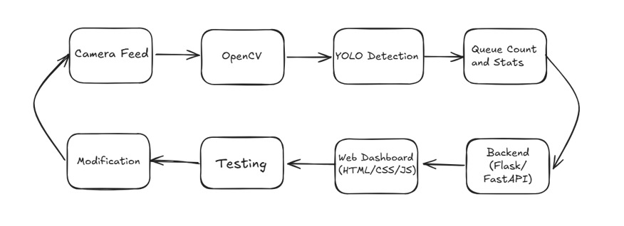
System Flowchart / Architecture

Slide 10
Future Scope
Integration with mobile and cloud-based alerts.
Multi-camera support for large-scale environments.
Improved analytics with AI predictions for rush hours.
Integration with queue token systems.

Slide 11
Conclusion
The system enhances customer experience using AI-powered real-time queue monitoring.
Reduces waiting frustration by predicting waiting time.
Helps organizations improve operational efficiency and resource allocation.
Can be deployed in multiple real-world sectors using existing CCTV setups.

Slide 12
References
AssertAI – AI Queue Management Applications
Ultralytics YOLO Documentation
OpenCV Tutorials
scikit-learn Documentation
ChatGPT

Slide 13
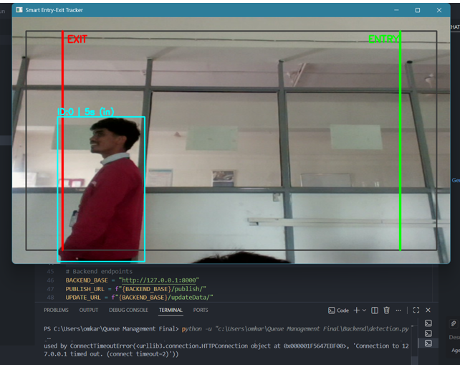
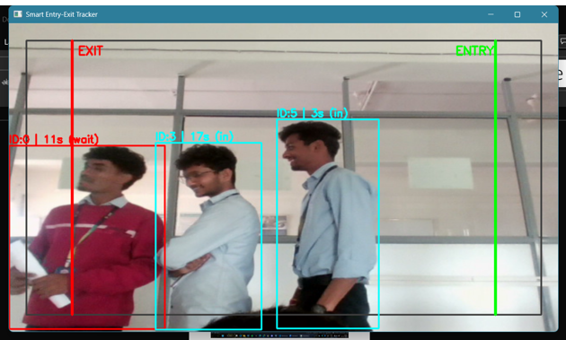
OUTPUT
Figure 1.1 Queue Started
Figure 1.2 People Entered

Slide 14
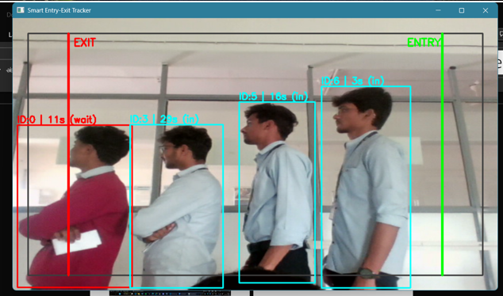
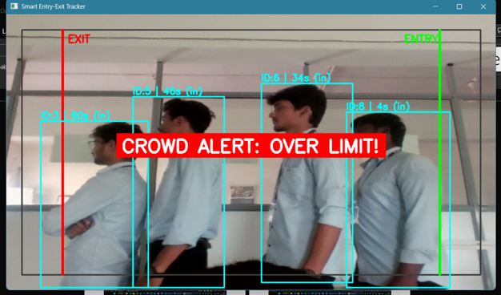
OUTPUT
Figure 1.3 Queue full
Figure 1.4 Queue Limit Exceed

Slide 15
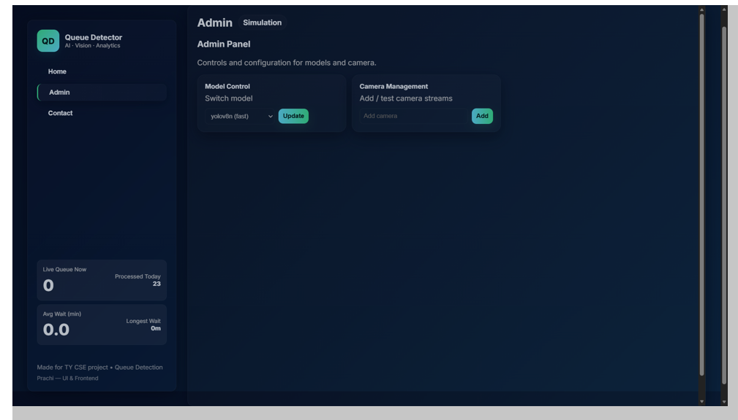
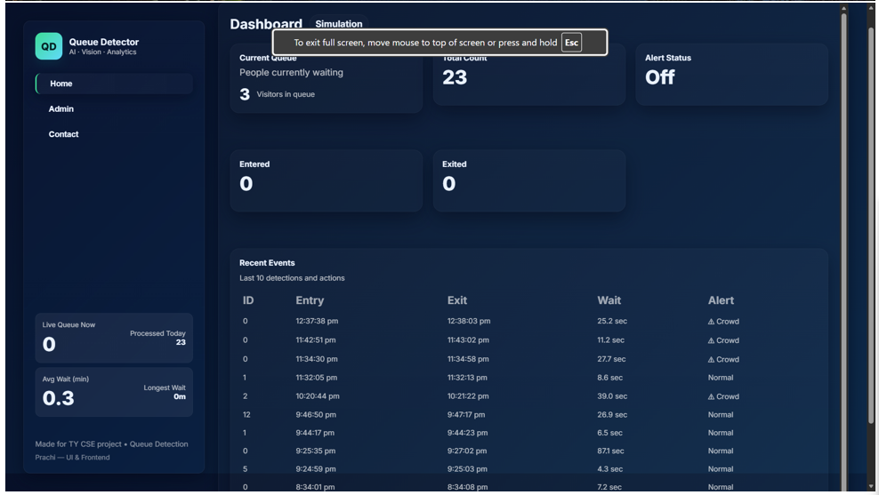
OUTPUT
Figure 1.5 Dashboard Screen

