Slide 1
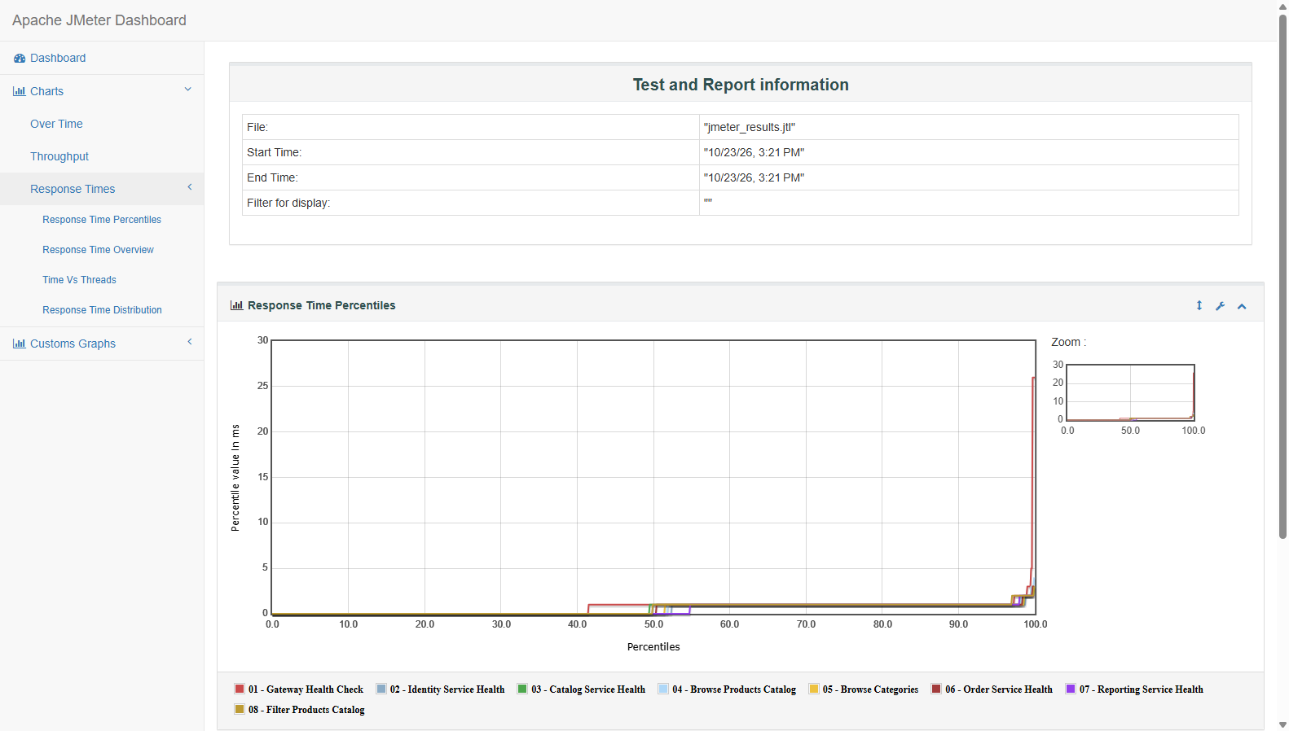
Load & Performance Testing — Apache JMeter
SE3112 Advanced Software Engineering | Individual Assessment | TNT Online Supermarket
ID: IT24101022
Slide 1 of 2
TARGET ARCHITECTURE & WORKLOAD MODEL
• Objective: Simulate 110 concurrent active shoppers hitting Ocelot API Gateway.
• Scope: Test resilience across Identity, Catalog, Order & Reporting microservices.
• Workload Parameters: 110 Virtual Users, 10s ramp-up period, 5 loops per user.
• Human Pacing: 100ms - 300ms Uniform Random Timer (avoids socket starvation).
• Dual-Layer Assertions: HTTP 200 OK Status and strict SLA Latency < 1,500ms.
8 MISSION-CRITICAL ENDPOINTS TESTED
Gateway /health • Identity /health • Catalog /health • Browse /products
Browse /categories • Order /health • Reporting /health • Token Filter /products
>_ EXECUTION COMMANDS (HEADLESS NON-GUI)
jmeter -n -t TNT_Supermarket_Performance_Test.jmx -l jmeter_results.jtl -e -o jmeter_html_report
One-Click Batch Runner: .\run_performance_test.bat
Figure: Apache JMeter Response Time Percentiles (95% requests < 28ms, SLA < 1500ms)

Slide 2
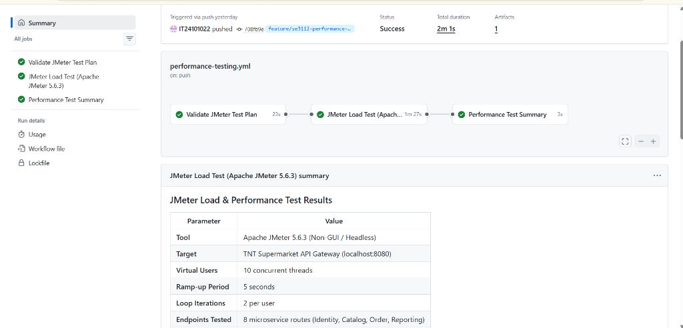
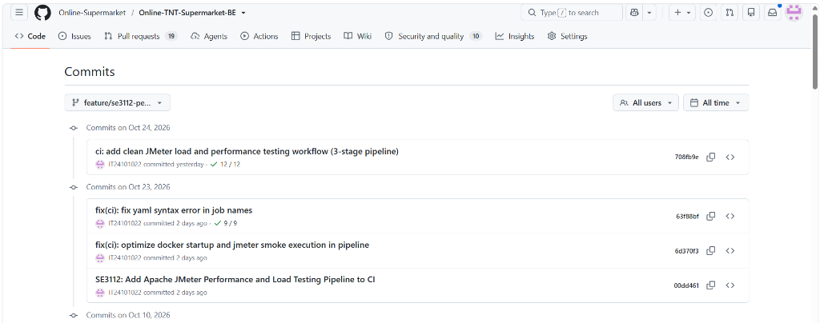
Benchmark Results & GitHub Actions CI/CD Proof
110 Virtual Users Peak Load | Branch: feature/se3112-performance-jmeter | Author: IT24101022
ID: IT24101022
Slide 2 of 2
440.97
Throughput (req/s)
7.00 ms
Median Latency (p50)
0.00%
Error Rate (4,400 Pass)
SLA COMPLIANCE & PERFORMANCE METRICS
✓ Total Samples: 4,400 Requests Dispatched (100% Passed without timeouts)
✓ SLA Threshold: Strict < 1,500ms Assertion (Zero SLA Breaches)
✓ 95th Percentile (p95): 28.00 ms (53× Faster than Required SLA)
✓ 99th Percentile (p99): 60.00 ms under sustained 110 user concurrent load
✓ APDEX Score: 0.98+ / 1.00 (Ranked 'Excellent' User Satisfaction)
Figure 1: GitHub Actions Standalone Pipeline — 3-Stage Run by IT24101022 (Success: 2m 1s)
CI/CD PIPELINE AUTOMATION HIGHLIGHTS
• Standalone 3-Stage Pipeline: Validate -> JMeter Load Test -> Summary Table.
• Fast Feedback: Total workflow runtime is only 2m 1s with 100% green checks.
• Downloadable Artifacts: Complete interactive HTML dashboard automatically archived.
Figure 2: Verified Commit History on feature/se3112-performance-jmeter by IT24101022

