Slide 1


Today's Lesson: MVC

Slide 2


What is MVC?

Slide 3
Programming Language

Slide 4
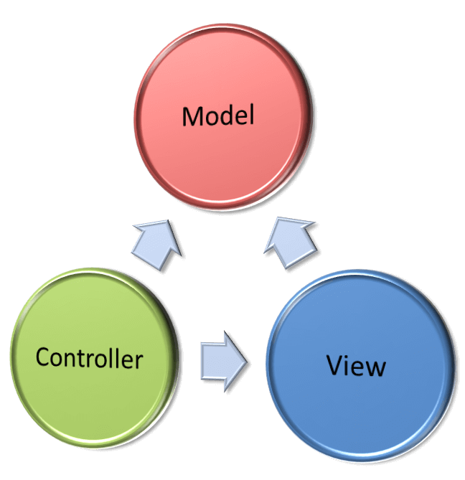

Model
View
Controller

Slide 5

MVC
Software Architecture design pattern
One of the most frequently design pattern
Separates application functionality

