Slide 1

A look into Saudi League transfers data
Bader Alhabashi - BI Analyst
Mohammed Alsubaie – Data Engineer
Anas Alwohaib – BI Developer & Analyst
Adel Al Wayili - Statistician

Slide 2
Agenda
1
Dataset
information about the dataset; fields, records..etc
2
Persona
The purpose or the person for whom we will create the presentation.
3
Dashboard
general overview of the dashboard designed for the persona.
4
Filter

Slide 3

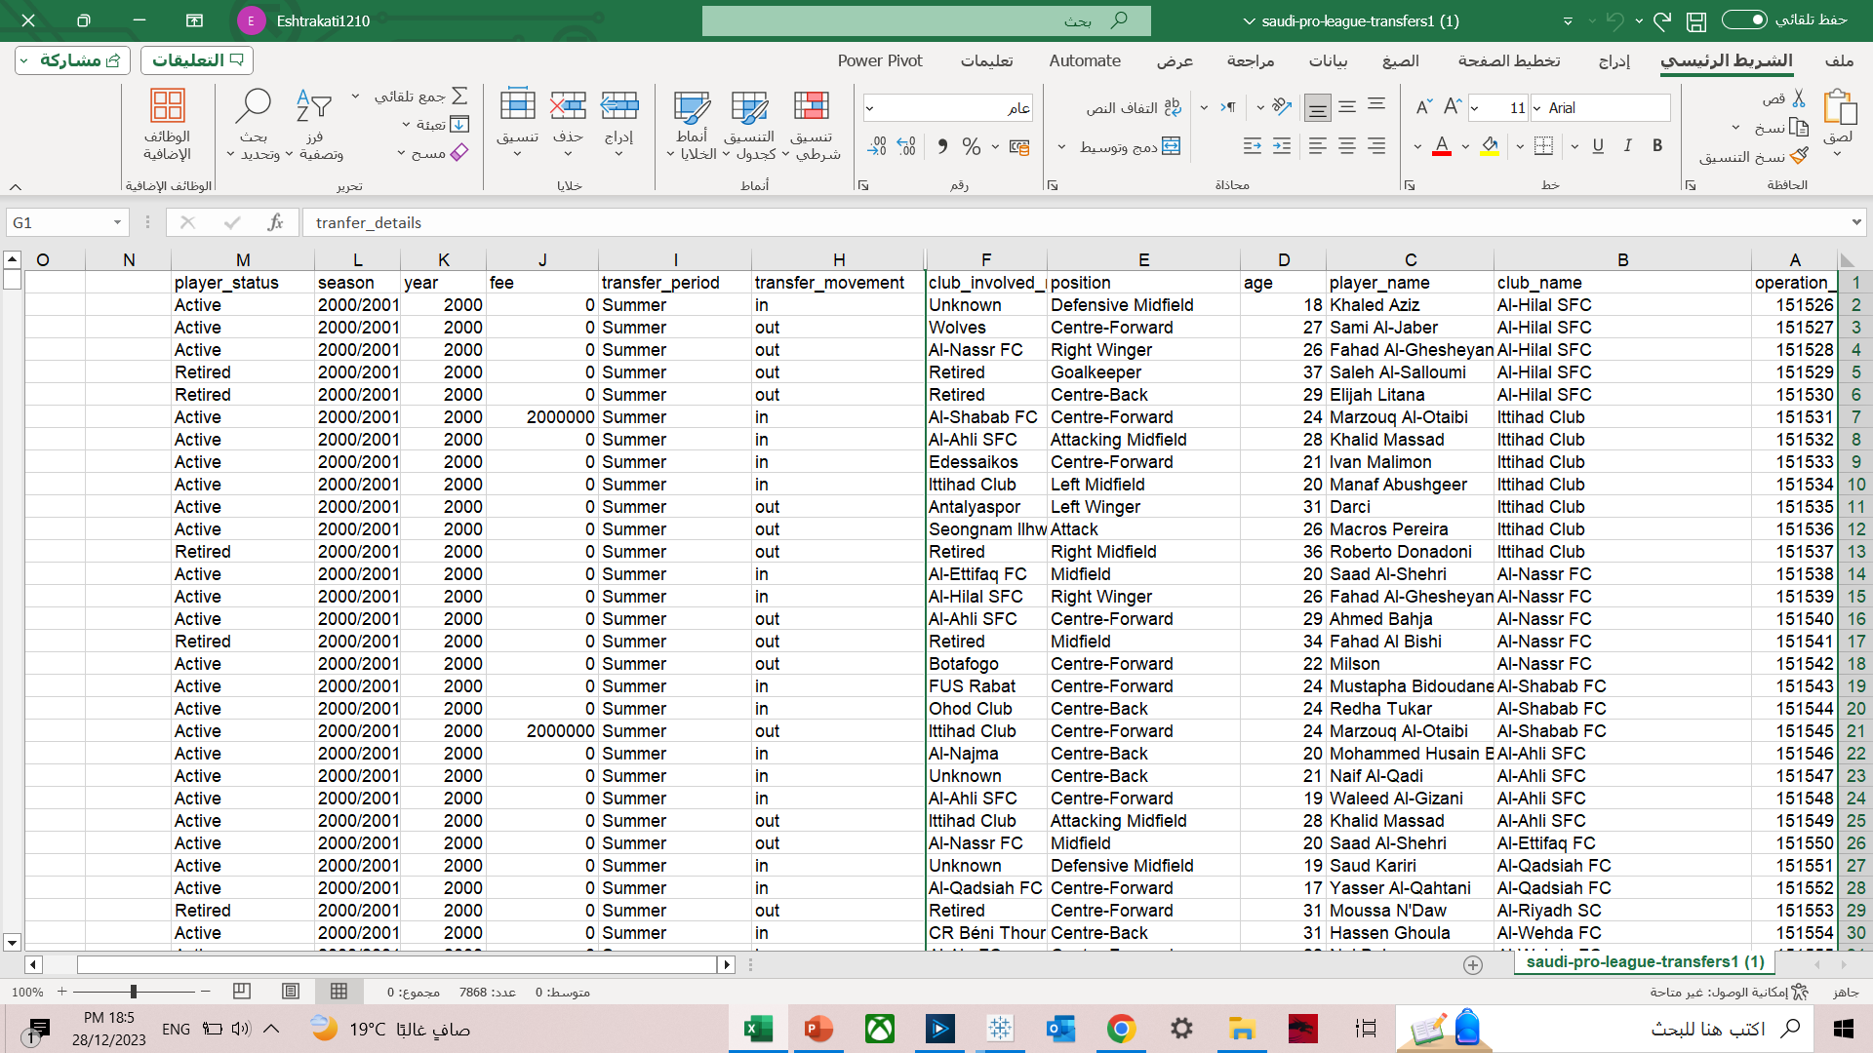
Dataset
The dataset contains information about all transfer details in the Saudi League from 2000 to 2023, including costs, transfer movements, and other relevant information.

Slide 4

Persona
This presentation has been created for a manager at the PIF to assess the overall situation regarding transfers in the Saudi League. It requires general statistics, and based on the results, decisions will be made to determine the approach for future support for the clubs.

Slide 5

Our Goal
In the future we will build a Data Warehouse for Saudi league transfers including Players stats and all the transfer details.

Slide 6
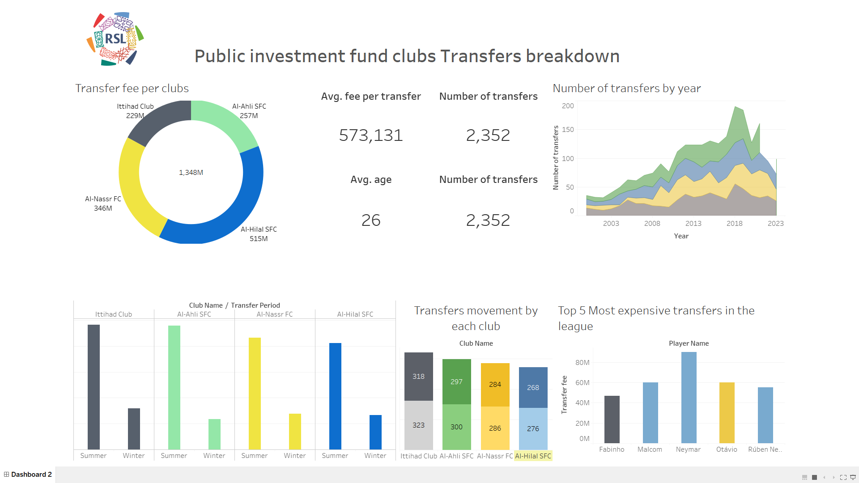
Dashboard

