Slide 1
ConvNeXt
Macro Design
Changing stage compute ratio
Changing stem to “Patchify”
ResNeXt-ify
Inverted Bottleneck
Large Kernel Sizes

Slide 2
ConvNeXt
Micro Design
Replacing ReLU with GELU
Fewer activation functions
Fewer normalization layers
Substituting BN with LN
Separate downsampling layers

Slide 3
Changing stage compute ratio
baseline ResNet-50: (3, 4, 6, 3) (3, 3, 9, 3)
Top-1 accuracy: 78.8% 79.4%

Slide 4
Changing stem to “Patchify”
stem: 指CNN中第一个下采样层
这里采用4*4，stride4的卷积进行下彩样
Top-1 accuracy: 79.4% 79.5%

Slide 5
ResNeXt-ify
依据ResNeXt的设计原则：使用更多的组，拓展宽度。
使用逐深度卷积，Top-1 acc: 80.5%

Slide 6
Inverted Bottleneck
先升维，再降维。
baseline: ResNet-50 acc 80.5% 80.6%
RexNet-200 acc 81.9% 82.6%
Inverted Bottleneck再大模型的效果比小模型好

Slide 7
Large Kernel Sizes
Moving up depthwise conv layer
origin: 1*1 & DW & 1*1
now: DW & 1*1 & 1*1
Increasing the kernel size
每个block采用7*7DW

Slide 8
Replacing ReLU with GELU
GELU可以看做是ReLU的平滑变体。
Top-1 acc: 80.5% 80.6%

Slide 9
Fewer activation functions
Top-1 acc: 80.6% 81.3%

Slide 10
Fewer normalization layers
在两个1*1卷积前只保留一个BN
Top-1 acc: 81.3% 81.4%

Slide 11
Substituting BN with LN
Top-1 acc: 81.4% 81.5%

Slide 12
Separate downsampling layers
Conv 2*2, stride 2
Top-1 acc: 81.5% 82.0%

Slide 13
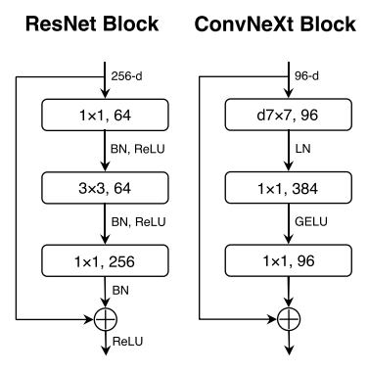
结构对比图

