Slide 1
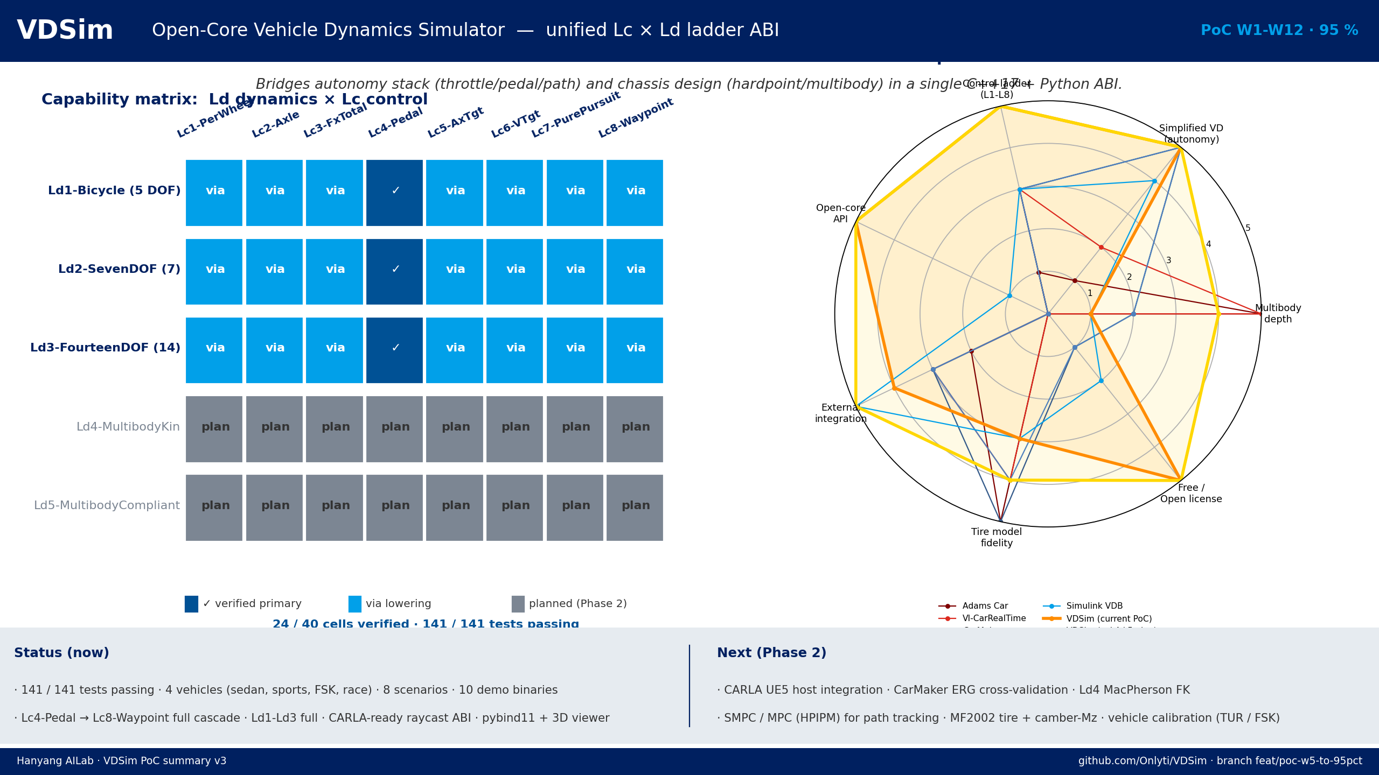
VDSim Open-Core Vehicle Dynamics Simulator
Bridges autonomy stack (throttle / pedal / path) and chassis design (hardpoint / multibody) in a single C++17 + Python ABI.
Notes:
VDSim PoC W1-W12 95% summary. Editable PNG-backed slide; replace with native shapes before printing to PDF for editable layers.

