Slide 1
Medical Ontology Using Neo4j Technology
Group Members :
Mubashir Zahid (1610146042)
Sakib Monir ( 1530964042)
Bakhtiyar Habib (1531038642)
S.M. Shahidul Alam ( 1620882042 )

Slide 2
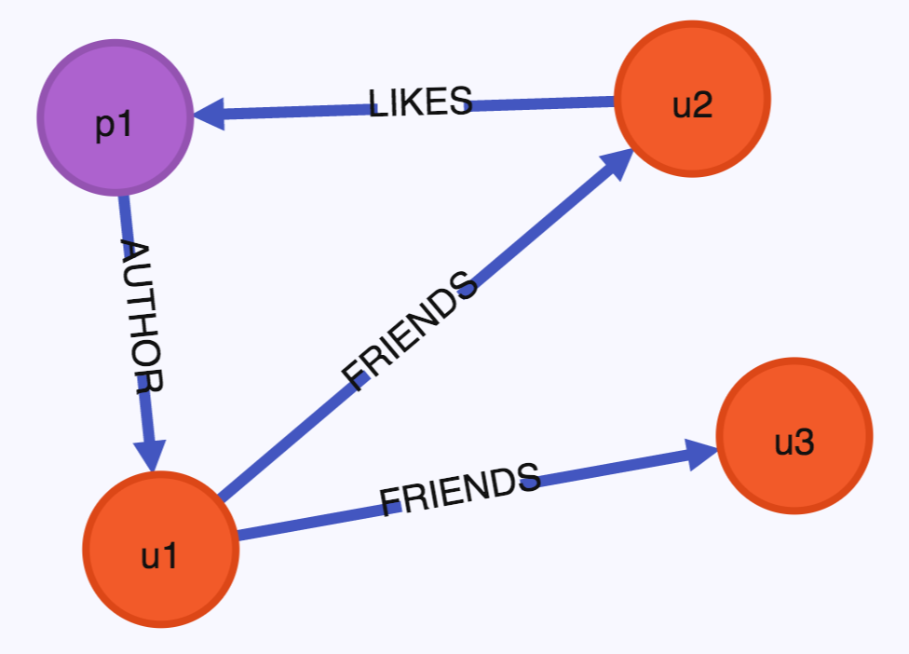
Introduction
What is a Graph Database?
In computing, a graph database (GDB) is a database that uses graph structures for semantic queries with nodes, edges, and properties to represent and store data

Slide 3
Introduction
Why Graph Databases?
Graph databases store relationships and connections as first-class entities
The data model for graph databases is simpler compared to other databases
They provide features like transactional integrity and operational availability

Slide 4
Neo4j
What is Neo4j ?
Neo4j is the world's leading open source Graph Database which is developed using Java technology
It is highly scalable and schema free (NoSQL)

Slide 5
Features of Neo4j
Data model (flexible schema)
ACID properties
Scalability and reliability
Cypher Query Language
Built-in web application
Drivers
Indexing

Slide 6
Advantages of Neo4j
Flexible data model
Real-time insights
High availability
Connected and semi structures data
Easy retrieval
Cypher query language
No joins

Slide 7
Main Objectives
The main objective will be to create a medical ontology lookup service. It will be a repository for biomedical ontologies consisting of types and properties of diseases and their subsequent treatment. It may also fulfill any number of other medical ontologies.
It will use neo4j graph database for the connectivity along will the powerful RESTful api that will be built with Spring boot framework, we may use an ontology search engine for dealing with the textual index and text search. Cypher query language will also be a useful tool in our arsenal

Slide 8
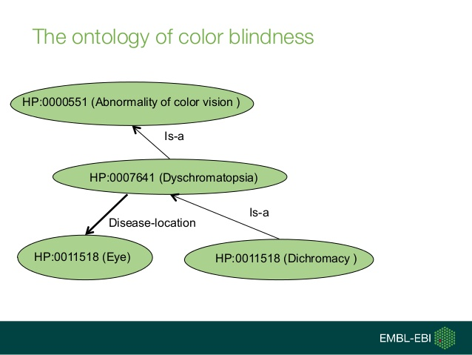

Slide 9
Challenges : Pros and Cons
In terms of performance, graph databases perform much better than relational databases; it is much faster and more intuitive. That’s why it will be very effective for the users (medical teachers, students or even patients) to understand many medical terminologies easily from our proposed work. Our work will handle huge volumes of data. It can also be used as a form of transactional database, storing critical data

Slide 10
Challenges : Pros and Cons
As a disadvantage we have very little expertise in the different building blocks of this project, Neo4j is practically new to us and it will take sometime to realize its full capabilities, using the spring boot framework for the REST api will also pose a challenge

Slide 11
Platforms
Neo4j graph database
Java programming language
Spring framework
Restful api
Cypher query language

Slide 12
THANK YOU

