Slide 1
Identity Tracking of a Disease as a Causal Chain
Kouji Kozaki, Riichiro Mizoguchi
ISIR, Osaka University, Japan
Takeshi Imai, Kazuhiko Ohe
Department of Medical Informatics, Graduate School of Medicine, The University of Tokyo, Tokyo, Japan

Slide 2
Life cycle of a disease
An individual disease undergoes change after it has appeared
It causes many disorders and symptoms
It could cause other diseases as a result of evolution
In some cases, some disorders might remain as aftereffect after the original disease has been cured
Even if the disease would be cured completely, it could influence on the patient as anamnesis in the future
The problem here is how such an evolution of a disease should be dealt with based on our disease ontology

Slide 3
Agenda of my talk
Brief summary of “River flow model of diseases” presented at ICBO2011
A new definition of diseases
A causal chain of clinical disorders
A new explanation of causal chains
Identity tracking of an evolving disease
Causal links
Practical theory of identity [EKAW 2010]
Identity of a causal chain of clinical disorders

Slide 4
Definition 1: Disease [ICBO2011]
A disease is a dependent continuant constituted of one or more causal chains of clinical disorders appearing in a human body and initiated by at least one disorder.
The main issue here is
How is a causal chain of clinical disorders a continuant?

Slide 5
Informal account of our “River flow model of diseases”
A river is similar to a disease as a causal chain
After it has been born as a river (as a disease), it extends further (causes some disorders) to reach another lake or to the sea. While extending, it branches (the branching perhaps causes the appearance of another disorder or symptom).
Finally, it may dry up because of climate change (cure).
Thus, the life of a river corresponds well to the life of a disease. Thus – in concordance with OGMS – both a river and a disease are continuants

Slide 6
What is a causal chain?
Causal chain =def a chain of entities linked by causal relation. There can be a causal chain of disorders, causal chain of processes, causal chain of events, etc. Note: What is causality is outside the scope of our research.
sequence of occurrents
sequential occurrents
event sequence (accident=>ambulance arrival =>…)
concurrent occurrents
directly connected processes (piston=>shaft=>wheel=>car)
state-mediated (clot growth=>decrease of cross-section=>..)
pseudo-simultaneous (collision=>breakage=>…)
A causal chain as a continuant is embedded in 2.2.

Slide 7
Causal chain of a disease
Life state of Organ-b
Organ-b is dying.
branching
t3
Organ-b is dying
…
t3
t3
Organ-a is dying
extending
t2
t2
Amount of oxygen is reducing
t2
The cross section is reducing
…
Change in state and structure
A blood clot is growing
Life state of Organ-a
Organ-a is dying.
t1
t1
t1
…
Disorder
(Abnormal
quality of an
organ)
The cross section of blood vessel is reducing.
Amount of oxygen supplied is reducing.
The size of the cross section of blood vessel
The victim arrived at a hospital
time
A blood clot is growing．
An ambulance came
Amount of oxygen supplied
The size of a blood clot
An accident happened
time
Disease as a
continuant
Causal link

Slide 8
Identity tracking of a causal chain

Slide 9
Three kinds of causal links
Definition 4: Ongoing causal link
This is a link which shows that the causal flow from the cause to the effect is ongoing.
Definition 5: Historical causal link
This is a link which shows that the causal flow from the cause to the effect had been terminated.
Definition 6: Pseudo-simultaneous causal link
This is a link which shows only pseudo-simultaneous relation between cause and effect. It is used mainly for causal events which can be viewed as that they happened at the same time. E.g., collision => break

Slide 10
Causal links and nodes
Ongoing
process
Ongoing
process
ongoing
Event or
Past event
Ongoing process
historical
Event
pseudo-
simultaneous
Event
Both happen almost at the same time

Slide 11
Four kinds of causal chains
Definition 7: Strongly-connected causal chain
Any causal chain all of whose causal links are ongoing causal links. That is, it is composed of only ongoing processes. A causal chain composed of one ongoing process is included as a special case.
Definition 8: Weakly-connected causal chain:
Any causal chain which includes at least one historical or pseudo-simultaneous causal link and at least one ongoing process.
Definition 9: Historical causal chain:
Any causal chain all of whose causal links are historical or pseudo-simultaneous causal links. That is, it is a causal chain composed only of terminated events.
Definition 10: Ongoing causal chain:
Any causal chain which has at least one ongoing process. It subsumes Strongly-connected and Weakly-connected causal chains.

Slide 12
Identity tracking of a disease
Any individual causal chain is born as a single ongoing process, that is, as a strongly-connected causal chain.
When an intermediate disorder is terminated and becomes an event, it becomes a weakly-connected causal chain keeping its identity.
It never changes its identity as far as it has at least one ongoing disorder.
So, issues are:
What identity can we use?
when does it lose its identity?

Slide 13
Identity in practice
Practical Considerations on Identity for Instance Management in Ontological Investigation, Proc. of EKAW2010
Identity of objects
Consideration on instance identity
4 kinds of instance identities
Identity for Exactness (Numerical identity)
Identity for Essentiality (Personal identity)
Identity for Counting (differentiation from others)
Identity for Replacement (I-Rep)
Identity which an instance of the whole continues to be itself without becoming another thing while whose parts are being replaced independently of their kinds and number of the replaced parts.
Notes:
This is the agenda of my talk.
At first, we will show our motivation through some examples.
Next, we will discuss identity of normal types. After summarization of identity in general, we will discuss four kinds of instance identities.
Then, we will discuss identity of roles using these four kinds of identity.
Finally, I will conclude my talk.

Slide 14
From “ongoing” to “historical”
When a causal chain becomes a historical causal chain, in which all the nodes become events, it becomes a new individual as a historical causal chain
An event is constituted of a process, and hence the event as a whole has a different identity from that of the process as its constituent.
Then, the causal chain changes in terms of I-Rep.

Slide 15
Strongly-connected causal chain
(1)
I_{ins}_1
Strongly-connected causal chain
Legend
(2)
I_{ins}_1
C_{ins}_A
Disorder (ongoing)
Deficiency of insulin
Elevated level of glucose in the blood
Disorder (terminated)
Strongly-connected causal chain
I_{ins}_1
(3)
…
C_{ins}_A
Ongoing causal link
Strongly-connected causal chain
I_{ins}_1
Historical causal link
(4)
…
C_{ins}_A
C_{ins}_B
Core causal chain
(each color
represents a disease)
Weakly-connected causal chain
I_{ins}_1
(5)
C_{ins}_A
…
C_{ins}_B
Weakly-connected causal chain
I_{ins}_1
C_{ins}_A
(6)
C_{ins}_B
…
Destroyed
nerval tissue
Historical causal chain
Historical causal chain
Constituted by
(7)
I_{ins}_2

Slide 16
Concluding remarks
Disease as a causal chain of clinical disorders which is a continuant
Identity of a disease as an evolving causal chain of clinical disorders
We need I-Rep as its identity to enable us to track evolving diseases properly
Future work
Harmonizing our definition with OGMS’s disposition

Slide 17
Thank you for your attention!
ご静聴有り難うございました！

Slide 18
Causal chain
sequence of causally-connected occurrents
that of events
event sequence (accident=>ambulance arrival =>…)
that of processes
directly connected processes (piston=>shaft=>wheel=>car)
state-mediated (clot growth=>decrease of cross-section=>..)
pseudo-simultaneous (collision=>breakage=>…)
sequence of causally-connected continuants embedded in 2.2 in such a way that each continuant constitutes its corresponding process

Slide 19
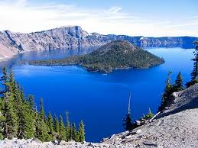
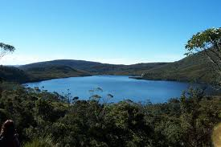
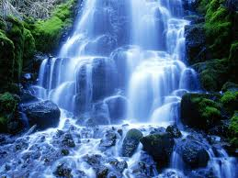
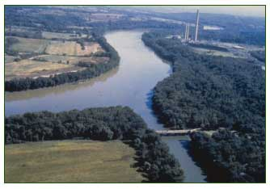
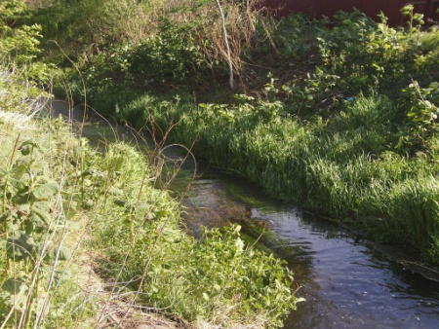
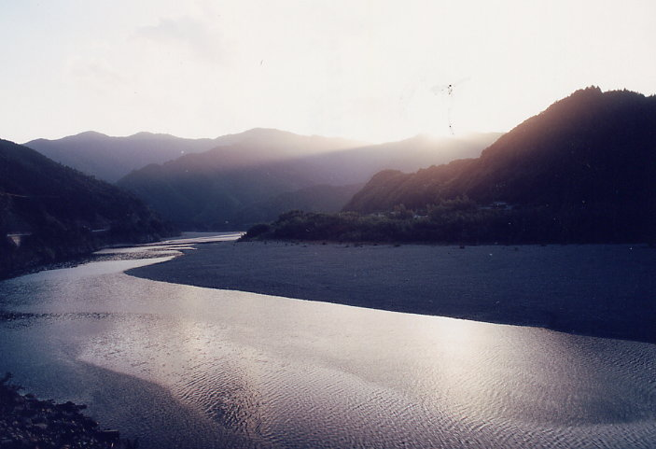
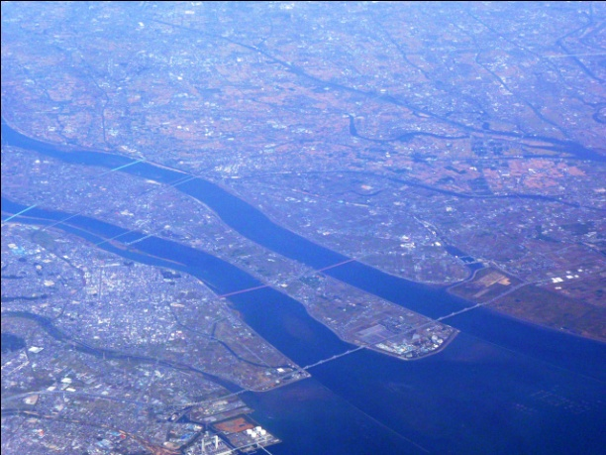
The life of a river
might dry up
branches
overflow
would reach
another lake
minimal flow
reaches the sea
extends and changes
its route, etc.

Slide 20
