Slide 1
A Framework for Organizing Role Concepts in Ontology Development Tool: Hozo
Sunagawa, E., Kozaki, K., Kitamura, Y., Mizoguchi, R.
I.S.I.R., Osaka University, Japan

Slide 2
Two Research Goals
To establish a conceptual framework for role organization in ontology
  What kinds of roles exist out there?
  How can individuals of roles be dealt with?
  How can the dependency between roles be dealt with?
To implement a role-oriented ontology tool
  Fundamental theories of roles are evolved, but few tools are designed to support ontology development based on the theories.
We answer these questions
based on their context dependency.
We’ve developed a computer environment
for building/using ontology
which can appropriately deal with roles.

Slide 3
Agenda
Conceptual framework for roles based on their context dependencies
  Roles in our research
  Instances of roles
  Categories of roles
  Primitive and compound roles
Organization of roles in Ontology
  Hierarchical organization of roles
  Upper, middle, lower level classes
  Our ontology tool

Slide 4
Conceptual Framework for treatment of Roles based on their Context Dependencies

Slide 5
Roles in Our Research
Role:
  What is recognized according to the way of participation of an entity in a context
    We have been focusing on the context dependency of roles
    as their essential attributes (rather than “player” link) .
        [Kozaki 2000,2002]
    “Context Dependency” corresponds roughly
    to “foundation” of roles and “role-of”.
        [Guarino 1992][Masolo 2004][Loebe 2005]
  Basic concept: a thing except roles
    Corresponding roughly to firstness by Sowa
Target roles of the research
  Teacher, Presenter, Audience, Minister, Patient, Actor, Fuel, Food, Symptom, Input/Output, Product…

Slide 6
Important distinctions
Role Concept, Potential player, Role-playing thing
  Role Concept:
    A concept which is played by something
  Class Constraint (Role-Playable Thing):
    Potential Player: a thing which is able to play a role
  Role-Holder (Role-Playing Thing):
    A thing which is playing a role
In a Context, a Player plays a Role (Role Concept),
and then, becomes a Role-Holder.
a School
a Person
a Teacher Role
a Teacher

Slide 7
Examples
In Context, Player plays Role (Role Concept), and then becomes Role-Holder.
Context
Player
Role
Role-Holder
Presentation
This presentation (“A Framework…”)
Person
I (Sunagawa)
Presenter Role
Presenter Role (of “A Framework…”)
Presenter
Presenter (of “A Framework…”)
This Symposium (AAAI FS-05)
Osaka Univ.
I (Sunagawa)
I (Sunagawa)
Participant ( Registration ID:1234)
Student Role (Student ID:5678)
Participant (Registration ID:1234)
Student (Student ID:5678)
Ministry
Traffic System
Medical Treatment
Diagnosis
Bicycle
Manufacturing
Person
Person
Person
State
Wheel
Thing
Minister Role
Pedestrian Role
Patient Role
Symptom Role
Front Wheel Role
Product Role (Produced Thing Role)
Minister
Pedestrian
Patient
Symptom
Front Wheel
Product

Slide 8
Context-Dependency of a Role Concept
Context Dependency
  Role concepts are recognized dependently on a context.
Based on the dependency, we can uncover the following three characteristics of:
  Instances of a role concept and a role-holder
  Categories of role concept
  Two kinds of role concepts: a primitive and a compound role concept

Slide 9
Behavior of a Player, a Role Concept and a Role-Holder
1. Instances of a Role Concept and a Role-Holder
Example: In Osaka High School, there is a vacancy on a Teacher
position. John fills it, and then he becomes a Teacher of the school.
A vacancy on the Teacher arises when the Teacher Role is not played.
  A vacancy is conceptualized as an instance of a role concept.
If Osaka High School does not exist, the instance of the Teacher role never exists.
  An instance of a role concept cannot exist independently of an instance of its context.
Teacher Role has two states:
  An instance of a role concept has two states:
  played and not played.
Teacher
context
Role-Holder
Osaka
High School
Teacher
Role
John
depend on
Role Concept
playing
Player

Slide 10
Behavior of (cont’d) a Player, a Role Concept and a Role-Holder
1 Instances of a Role Concept and a Role-Holder
Example: John is no longer recognized as a Teacher, when
  the position of the Teacher which John filled disappears
  John quits the Teacher
  John dies
A Role-Holder disappears in the cases:
(1) an instance of a Role concept disappears
(2) an instance of a Player stops playing the role
(3) an instance of a Player disappears
Teacher
context
Role-Holder
Osaka
High School
Teacher
Role
John
playing
depend on
Role Concept
Player
×（1）
×（2）
×（3）

Slide 11
Conceptual Framework of Role
1. Instances of a Role Concept and a Role-Holder
Context
Role-Holder
School
Teacher
Role Concept
Player
Teacher
Role
depend on
Person
play
Subject
Name
Height
Class
Age
Weight
Group A
Group B
Group C
The individual corresponding to Teacher is
the composite of these two instances and
totally dependent on them

Slide 12
Conceptual Framework of Role (Cont’d)
1. Instances of a Role Concept and a Role-Holder
According to the Semantics
of part-whole of the Context (teacher vs. wife)
Case 1:Two independent instances
1. Instance of Person
2. Instance of Teacher role
Case 2:One independent instance
1. Instance of Person
Instance of Wife Role is dependent
on the Person instance
Case 1 (Teacher)
Teacher
Role-Holder
context
Teacher
Role
Person
School
play
Role Concept
Player
depend on
Case 2 (Wife)
dependent on
Wife
Role-Holder
context
Wife
Role
Marital Relation
Person
play
Role Concept
Player
depend on

Slide 13
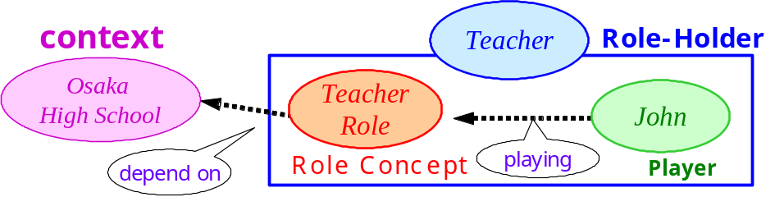
Main Claims of the Framework
Differentiation1 between
Role concept (teacher role) and Role-holder (teacher)
Differentiation2 between
Role-playing thing (John) and Role-playable thing (human)
“playing” link “play” link
Semantics of “play/playing” link is property inheritance
A Role-holder disappears when
(1) an instance of a Role Concept disappears
(2) an instance of a Player disappears
(3) an instance of a Player stops playing the role
Both Role concept and Role holder are class-like things and have instance-like things.
Any Role concept has its identity. An instance corresponding to Role- holder is the composite of an instance of its Player and that of Role concept.
Anti-rigid (role-holder) and
Dynamic (role and role-holder)
Relational (Founded)
Linked to Context

Slide 14
Categories of Role Concepts
2. Categories of role concept
Role Concepts are recognized in a Context.
In order to classify them according to categories of contexts, we can utilize their “foundation”.
e.g.
  Task Role
    Symptom Role (Fault Diagnosis)
    Conclusion Role (Reasoning)
  Functional role
    Steering Wheel role
    (Steering Function)
    Level control valve role:
    played by a flow control valve (Function)
  Action-related role
    Actor role (Any action)
    Teaching Agent role (Teaching Action)
    Target object role (Action object)
Top-level classification of concepts which can be contexts
  Process-related role
    Product role (Final output)
    Residue role
    (How it is processed)
  Relational role
    Friend role (Friendship)
    Parent role
    (Parent-Child Relation)

Slide 15
Primitive and Compound Role Concepts
3. Two kinds of role concepts
Example. 1
  Teacher is recognized not only as a staff member of School but also as a person who teaches students.
    Teacher Role is a composite of Staff Role and
    Teaching Agent Role.
Example. 2
  Only a Japanese citizen can be Japanese Prime Minister.
    Japanese Prime Minister Role can be played by Japanese Citizen who is played by a human.

Slide 16
Primitive and Compound Role Concepts
Cont’d
3. Two kinds of role concepts
  Some Role needs to be played together with other roles.
  In some case, a player stops playing one of the roles, and then, some of others will automatically be un-played.
    Requirement [Masolo04]
    Roles can play Roles. [Steimann00]
    Role-Holders can play Roles (in our terms).
  Such a role concept depends on multiple contexts.
    e.g. Peer tutoring context in Group learning
    A learner is expected to play “Peer tutor” role to learn by “Learning by Teaching” strategy. Peer tutor role depends on both of Learning Context and Teaching Context.
Two Kinds of Roles According to Complexity of their Context Dependencies
Primitive Roles
  have Single-Context Dependency
    e.g.) Speaker, Invitee, Learner, Teacher, Citizen, Minister…
Compound Roles
  have Multiple-Context Dependency
    e.g.) Invited Speaker, Peer tutor in “Learning by Teaching”, Japanese Primary Minister

Slide 17
Compound Roles
3. Two kinds of role concepts
Role-holders can play roles.
(an example of that only a Japanese citizen can be Japanese Prime Minister.)
J. Prime
Minister
context
Role-Holder
Japanese Ministry
J. Prime
Minister Role
Japanese
citizen
Role Concept
play
Player
depend on
Japanese
citizen
context
Role-Holder
Japanese political
System
Japanese
Citizen Role
Human
depend on
Role Concept
play
Player

Slide 18
Organizing Role Concepts

Slide 19
Hierarchical organization of Role Concepts
Organizing Role Concepts:
  To construct an is-a hierarchy of them in which classification and decomposition of their contexts will be made.
Two hierarchies in Ontology.
  a hierarchy of Basic Concepts (Players and Contexts)
  a hierarchy of Roles Concepts
Thing
a hierarchy
of
Basic Concepts
a hierarchy
of
Role Concepts

Slide 20
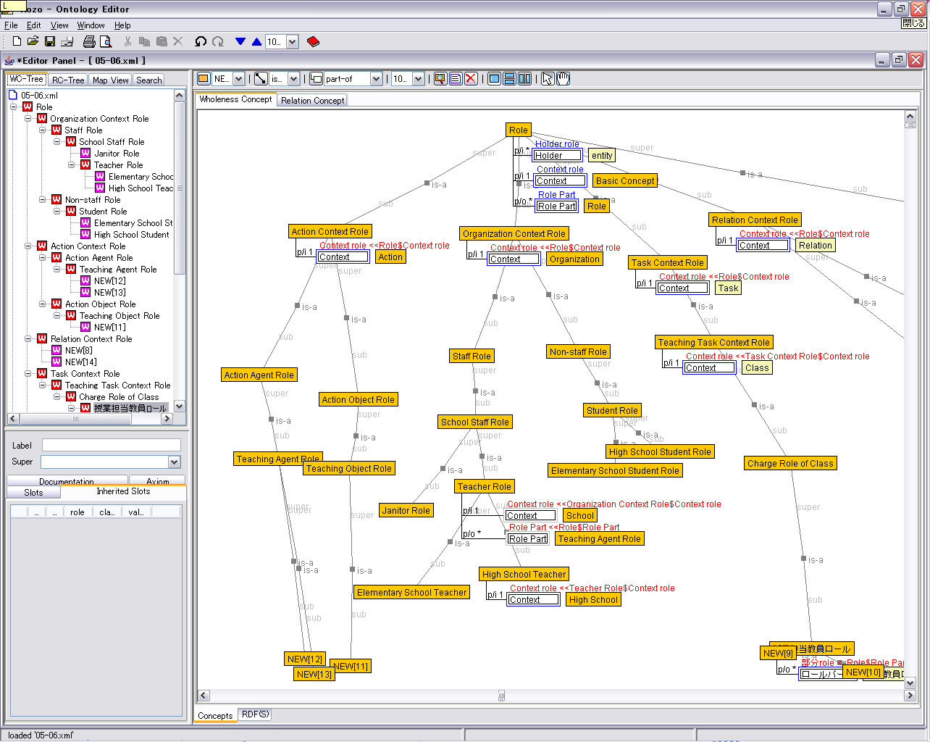
The Whole Image of a hierarchy of Role Concept

Slide 21
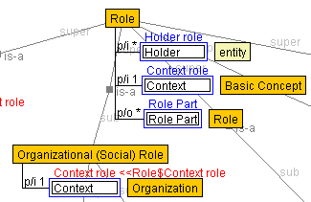
Supplementary Explanation
Role Concept
Role-Holder
Context
used in the case of
a compound role concept
[Kozaki 2000,2002]
In our framework, Role Concepts are represented by “Frame” with “Slots”.
  Yellow Squares correspond to frames and represent Role Concepts.
  Blue Squares and the ones to their right correspond to slots and their fillers. They represent their properties of the role.
Role Concepts are described by specializing each facet of the fillers.

Slide 22
The Whole Image of a hierarchy of Role Concept
upper classes
(for categorization)
middle classes
(for primitive role concepts)
lower classes
(for compound role concepts)

Slide 23
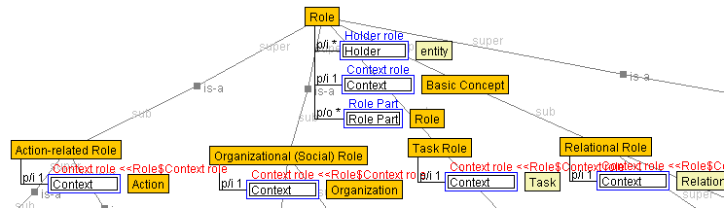
Organizing Role Concepts of Upper Classes
We can classify roles according to the categories of Contexts.
The categories are utilized at the top level of classification in a hierarchy of role concepts.
a hierarchy
of
Role Concepts

Slide 24
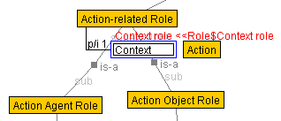
Organizing Role Concepts of Middle Classes
Primitive Roles, which depend on a single context, are organized at middle level classes by three guidelines:
  Organization according to the manners of participation of players in their contexts
  Organization according to is-a relations among their context
  Organization by definition of intermediate role concepts
a hierarchy
of
Role Concepts

Slide 25
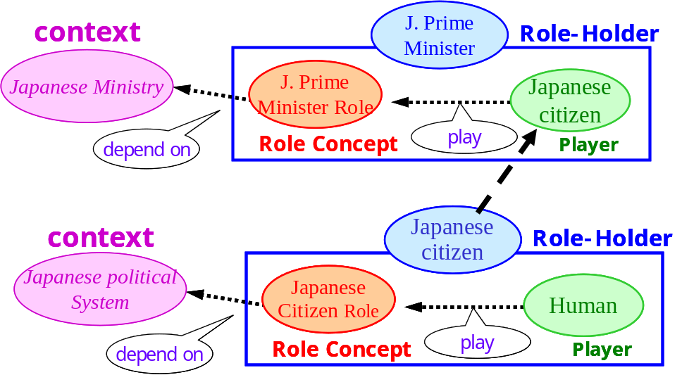
Organizing Role Concepts of Lower Classes
Compound role concepts, which depend on multiple contexts, are organized at the lower level classes.
To organize compound role concepts, we derive a framework called “Role Aggregation”.
“Role-holders can play roles.”
a hierarchy
of
Role Concepts

Slide 26
How to Aggregate Role Concepts
e.g. Teacher Role is a composite of Staff Role and Teaching Agent Role.
Decompose a compound role and identify roles as its components
  e.g.) A Teacher Role is decomposed into a Staff Role and a Teaching Agent Role
Choose its essential role among the components
  e.g.) The Staff Role is chosen as an essential of the Teacher Role.
Represent relations among the role concepts in two ways
  A: to define “is-a” and “part-of” relations among the compound roles and its components
  B: to use a Role-Holder as a Player of a Compound Role

Slide 27
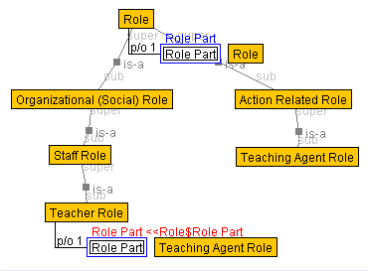
Representation of Role Aggregation: A
e.g. Teacher Role is a composite of Staff Role and Teaching Agent Role.
To define “is-a” and “part-of” relations among the compound roles and its component roles
  Teacher Role is defined by aggregating
    Staff Role: inheritance through is-a relation
    Teaching Agent Role: as a role-part
In the hierarchy of role concepts
  An “is-a” relation which we used in role aggregation correspond to “requirement” relation.
      [Masolo 2004]
  By Role Part, we mean a role concept defined as a part of a compound role.
(refer)

Slide 28
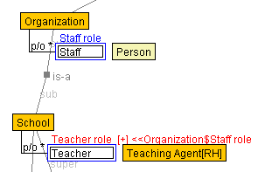
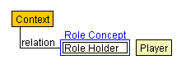
Representation of Role Aggregation: B
e.g. Teacher Role is a composite of Staff Role and Teaching Agent Role.
A Staff is defined as a player of a Teacher Role.
In the hierarchy of
basic concepts
LEGEND
(specialize)
representation of a concept in a hierarchy of basic concepts
(RH: Role Holder)

Slide 29
Scope of Our Framework
Classification by Context
Task role
  Symptom role (Fault Diagnosis)
  Conclusion role (Reasoning)
Functional role
  Steering Wheel role (Steering Function)
  Level control valve: played by a flow control valve (Function)
Action-related role
  Actor role (Any action)
  Teaching Agent role (Teaching Action)
  Target object role (Action object)
Process-related role
  Product role (Final output)
  Residue role (How it is processed)
Organizational (Social) role
  Staff role
  Student role, Nurse role [compound]
Relational role
  Friend role (Friendship)
  Parent role (Parent-Child Relation)
Compound role
  Japanese Prime minister Role (Head Role + Japanese Minister Role + Japanese Citizen role）
  Teacher role (School Staff +Teaching Agent)
Attribute role
  Height role: played by length
State-related role
  The Sick role (Sickness)
  Beginner role (history)
  UFO (Unidentified Flying Object)
Intransitive action-related role
  Walker, Runner
  Rotating object
Abstract role
  School staff role (Super class role of School teacher and School clerk roles)
Not covered yet
Scope of Our Tool
Scope of Our Framework

Slide 30
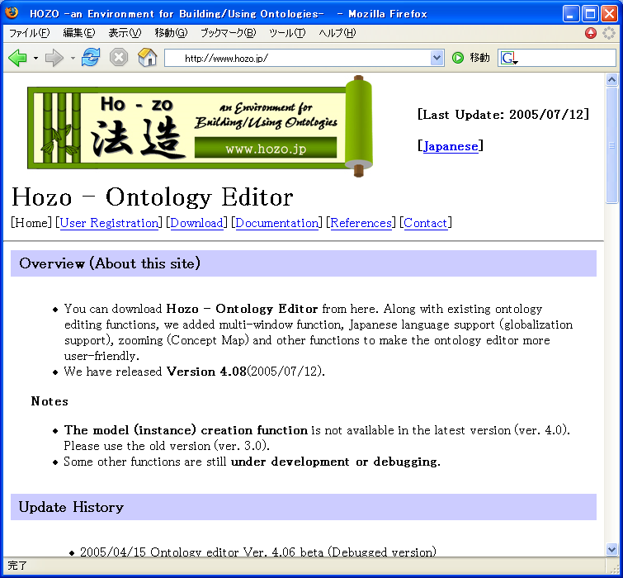
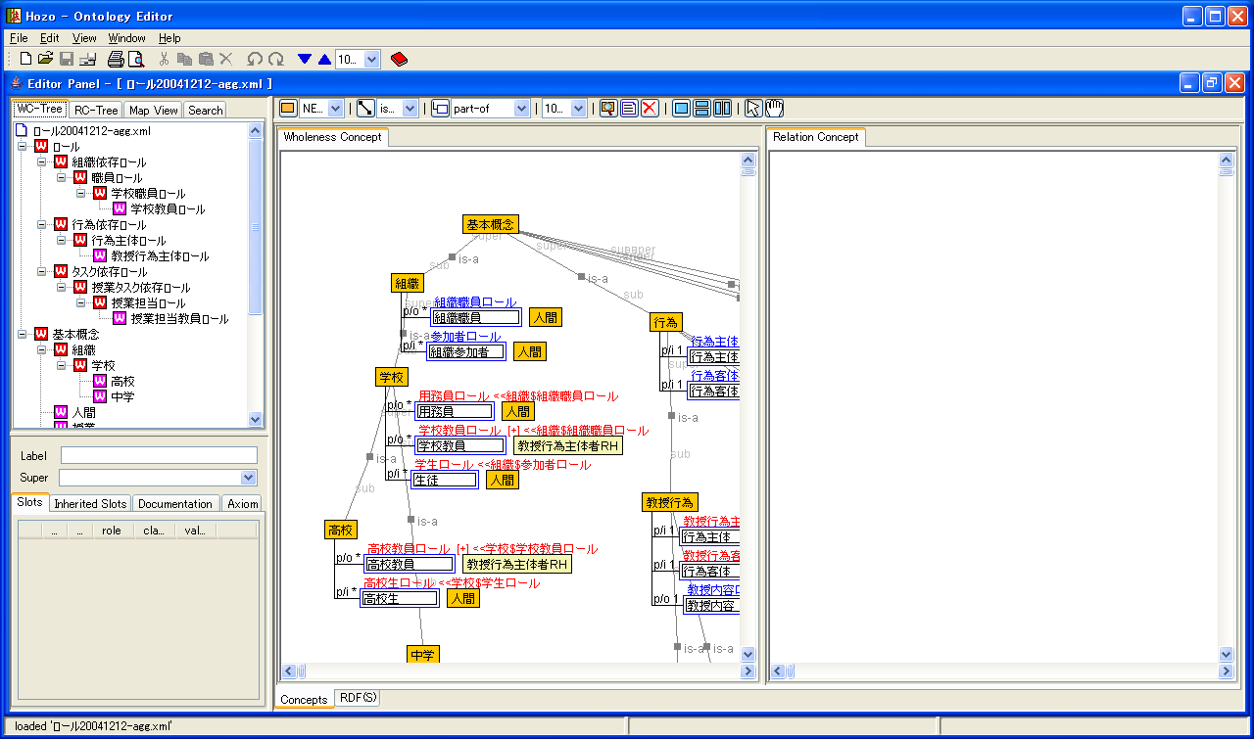
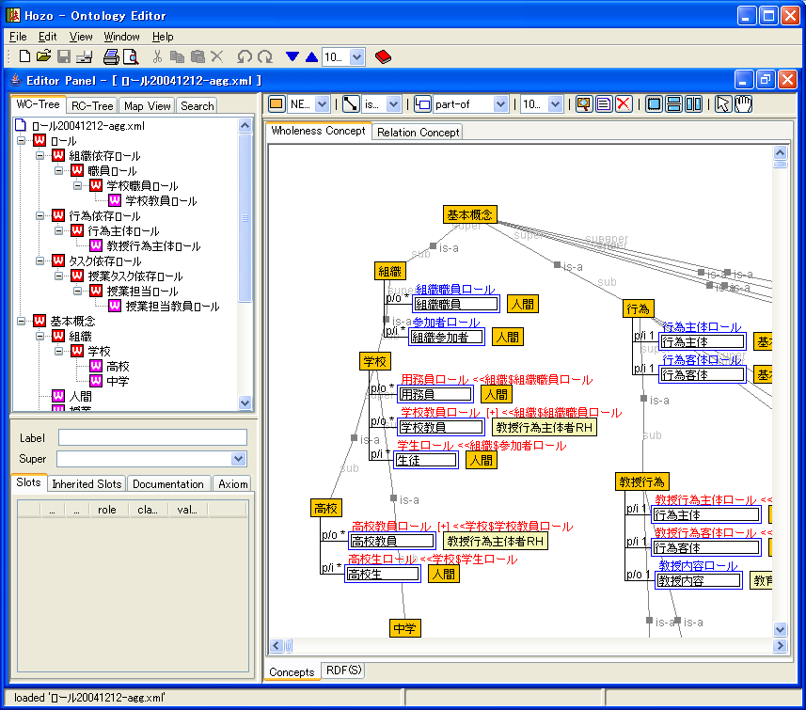
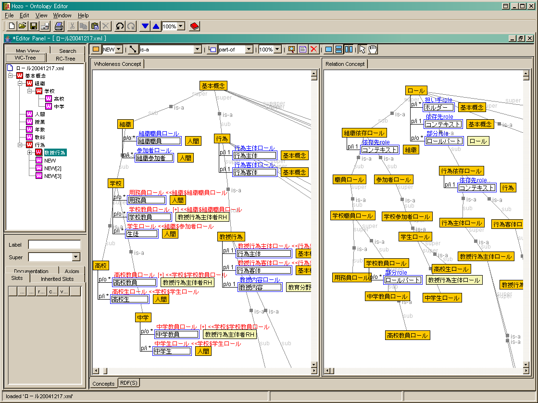
Implementation of Our Framework: Hozo
Hozo: an environment for building/using ontologies
  has been developed since 1997
  has supported role representation since 1999
      [Kozaki et al. 2002] Hozo: An Environment for Building/Using Ontologies Based on a Fundamental Consideration of Role” and “Relationship”. In Proceedings of EKAW2002
Supporting ontology development based on discrimination of role concepts from basic concepts
It will help developers of ontology
  To represent relations between roles
  To grasp a whole image of roles in a target world
Role Concept
http://www.hozo.jp
(mail: info@hozo.jp)
A Hierarchy of
Basic Concepts
(context and players)
A Hierarchy of
Role Concepts
(under development)

Slide 31
Concluding Remarks
Conceptual framework for roles based on their context dependencies
  Roles in our research
  Instances of roles
  Categories of roles
  Primitive and compound roles
Organization of Roles in Ontology
  Hierarchical organization of roles
  Upper, middle, lower level classes
  Implementation of our framework

Slide 32
Future Work
We plan to investigate
Extension of our framework to be able to deal with a concept which depends on other kinds of concepts
  e.g.) UFO, The Sick, Rotating Object, Weapon…
    several individuals can play the above, but it seems controversial to identify their contexts
Instance management of Roles
  e.g.) A Teacher can stop playing a Teacher Role if he/she quits teaching. Can a Father stop playing a Father Role (biologically)?
Inter-dependencies of components of Compound Roles
  In our framework, we can treat the dependency of a Compound Role to the essential component, but cannot yet the dependency among the components.

Slide 33
Thank you!
(and we will thank you much more if you download Hozo from http://www.hozo.jp )
Sunagawa, E., Kozaki, K., Kitamura, Y., Mizoguchi, R.
I.S.I.R., Osaka University, Japan

