Slide 1
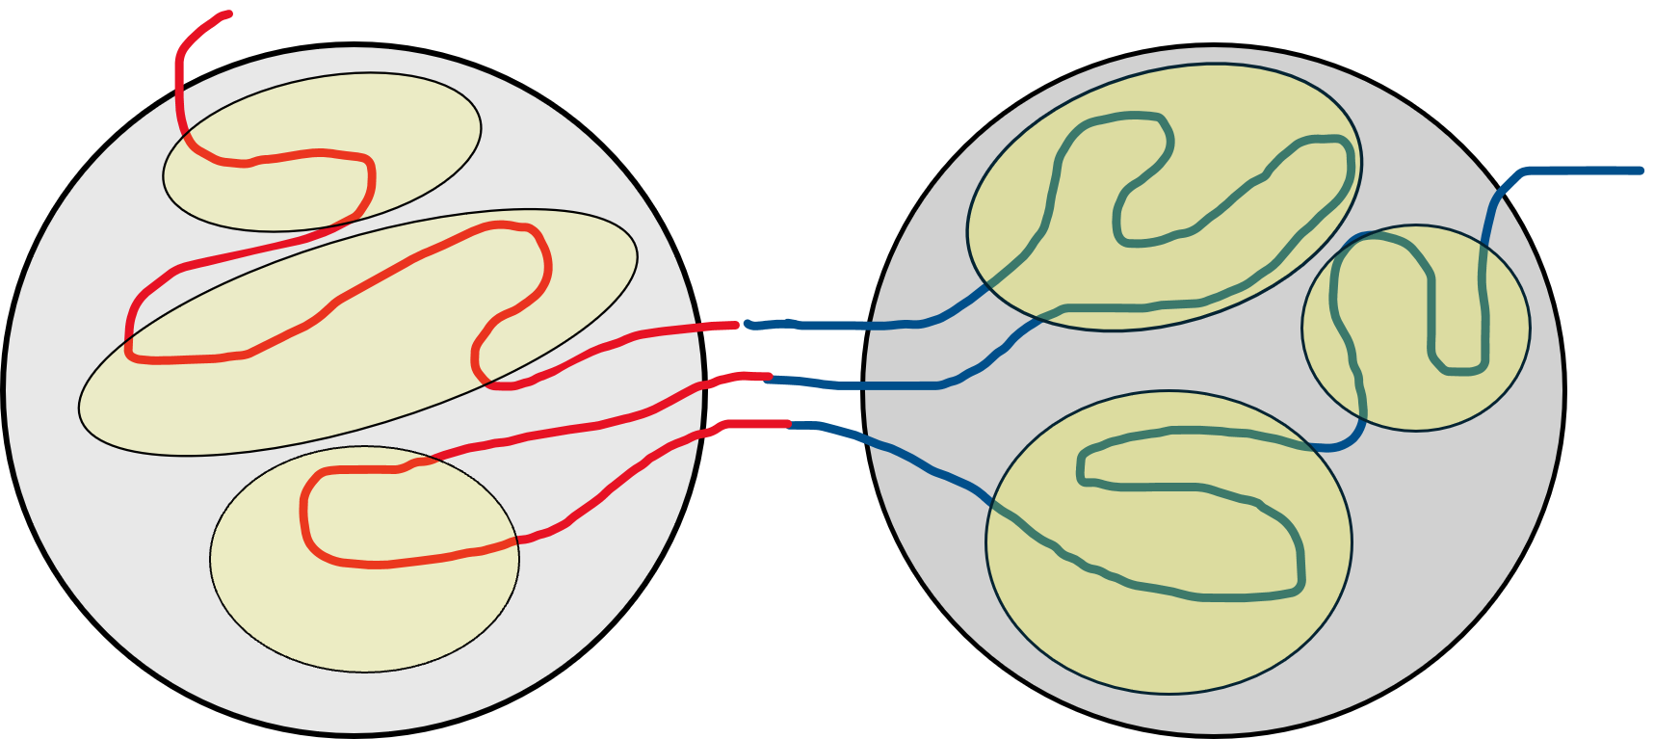
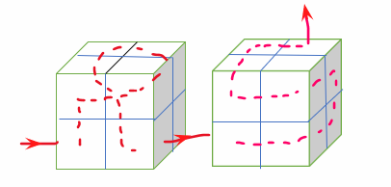
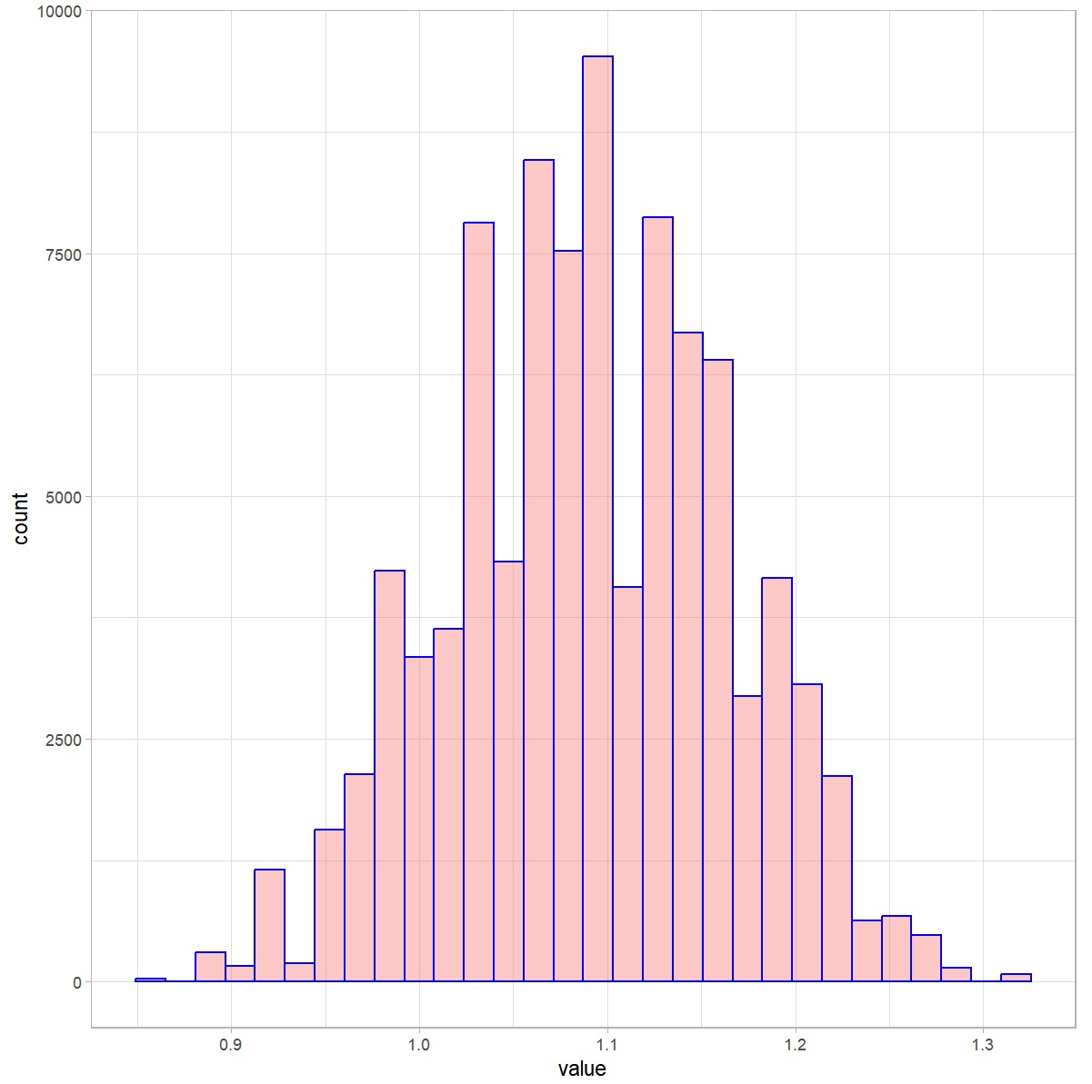


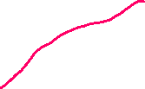








Lower Resolution
<Rs>
Model/Experiment
$$≠$$
TADs formed by Compartments
Genomic Distance
Resolution
Simulating
Chromatin Chains Inside TADs
Higher Resolution
<Rs>
Model/Experiment
<Rs>
Model/Experiment
Distribution of End-to-End Distance of TADs
$$≤$$
Genomic Distance
Genomic Distance
Resolution
Providing Resolution Consistency using
MC-TAD
Resolution

Slide 2
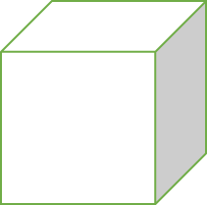

Slide 3





