Slide 1
Motion Graphs Path Synthesis
Nuno A. Silva
Luis Miranda

Slide 2
Agenda
Context
Path Synthesis
Expected Results
Implementation
Obtained Results
Conclusions

Slide 3
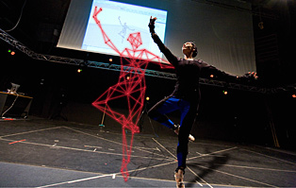
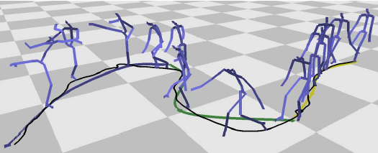
Context
Motion Graphs
A work by Lucas Kovar, et. Al
creating realistic, controllable motion
directed graph with pieces of original motion capture data is automatically generated

Slide 4
Context
We implemented the path synthesis module, based on Kovar’s et al. work
Shall be integrated into a larger virtual character locomotion system
OGRE engine was used as the basis for the entire project

Slide 5
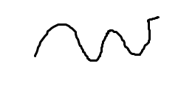
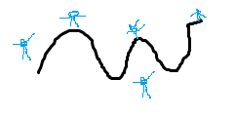
Path synthesis
User specifies a path
Search graph in order to generate the locomotion that best fits the path

Slide 6
Path synthesis
User defined path should be approximated by a spline
Search the graph to minimize the error
sum of the squared differences between the defined path and the produced locomotion
considering the arc-length distance

Slide 7

Expected Results

Slide 8
Implementation
FLUXOGRAMA HERE

Slide 9
Implementation
User path definition
Using the mouse the user defines points
The path is a sequence of vectors between points
Application constructs a line that passes trough the points
Ideally this line should be a spline
In the current state, our work only supports a straight line
After the path is defined, the user can press the space key to start error evaluation

Slide 10
Implementation
Using animations from motion graphs

Slide 11
Implementation
Choosing the correct animation

Slide 12
Implementation
How to put stuff in motion (for each segment of the user defined path, we have the corresponding animation with the lowest error)

Slide 13
Obtained Results
Live demo or just some pics?

Slide 14
Conclusions
This sucks

Slide 15
Motion Graphs Path Synthesis
Questions?

