Slide 1
Motion Graphs Path Synthesis
Nuno A. Silva
Luis Miranda

Slide 2
Agenda
Context
Path Synthesis
Expected Results
Implementation
Obtained Results
Conclusions

Slide 3
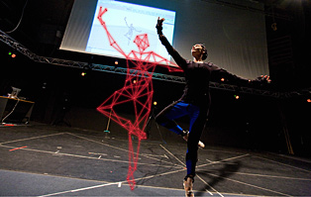
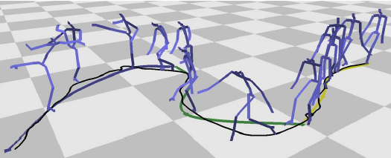
Context
Motion Graphs
A work by Lucas Kovar, et. Al
creating realistic, controllable motion
directed graph with pieces of original motion capture data is automatically generated

Slide 4
Context
We implemented the path synthesis module, based on Kovar’s et al. work
Shall be integrated into a larger virtual character locomotion system
OGRE engine was used as the basis for the entire project

Slide 5
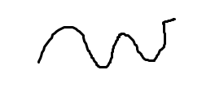
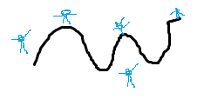
Path synthesis
User specifies a path
Search graph in order to generate the locomotion that best suits the path

Slide 6
Path synthesis
User defined path should be approximated by a spline
Search the graph to minimize the error
sum of the squared differences between the defined path and the produced locomotion
considering the arc-length distance

Slide 7
Expected Results
http://www.youtube.com/watch?v=UxG6U0jeOu8

Slide 8
Implementation
User path definition

Slide 9
Implementation
Using animations from motion graphs

Slide 10
Implementation
Choosing the correct animation

Slide 11
Implementation
How to put stuff in motion (for each segment of the user defined path, we have the corresponding animation with the lowest error)

Slide 12
Obtained Results
Live demo or just some pics?

Slide 13
Conclusions
This sucks

Slide 14
Motion Graphs Path Synthesis
Questions?

