Slide 1
Motion Graphs Path Synthesis
Nuno A. Silva pg17455
Luis Miranda pg14439

Slide 2
Agenda
Context
Path Synthesis
Expected Results
Implementation
Obtained Results
Conclusions and future work

Slide 3
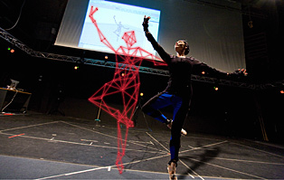
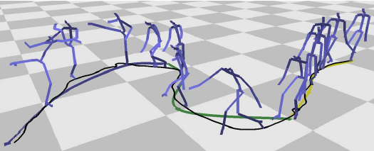
Context
Motion Graphs
A work by Lucas Kovar, et. al
creating realistic, controllable motion
directed graph with pieces of original motion capture data is automatically generated

Slide 4
Context
We implemented the path synthesis module, based on Kovar’s et al. work
Shall be integrated into a larger virtual character locomotion system
OGRE engine was used as the basis for the entire project

Slide 5
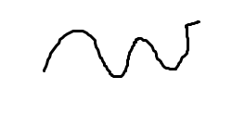
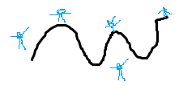
Path synthesis
User specifies a path
Search graph in order to generate the locomotion that best fits the path

Slide 6
Path synthesis
User defined path should be approximated by a spline
Search the graph to minimize the error
sum of the squared differences between the defined path and the produced locomotion
considering the arc-length distance

Slide 7

Expected Results

Slide 8
Implementation

Slide 9
Implementation
User path definition
Using the mouse the user defines points
The path is a sequence of vectors between points
Application constructs a line that passes trough the points
Ideally this line should be a spline
In the current state, our work only supports a straight line
After the path is defined, the user can press the space key to start error evaluation

Slide 10
Implementation
How to choose animations that fit the path defined by the user?
Associate an error to each animation:
Notes:
First a segment from the path defined by the user is selected, the path P.
For this segment, load and display the animations
Then, for each one of this animation, we start by running it (P’)
After the animation reaches the end, we can start to calculate the error
The error can be defined as the distance between the arclength of the point where the animation ends, in the animation path (P’) and the point at the same arclength in the user defined path (P).

Slide 11
Implementation
The process is repeated for all animations in each segment of the user defined path
Then, for each segment of the user defined path, we have the corresponding animation with the lowest error
Now, only remains to show the calculated motion

Slide 12
Obtained Results
Live demo

Slide 13
Conclusions and future work
Encountered some non expected problems:
The animation must be rendered to register the movements
MoCap animations do not start at position (0,0,0)
The implementation still has a lot to improve
Use splines for the user defined path
Correct the display of the calculated motion
Fully integrate with the remaining system
Improve user interaction

Slide 14
Motion Graphs Path Synthesis
Questions?

