Slide 1
DATABASE INTRUSION DETECTION SYSTEM WITH ML
YILDIZ TECHNICAL UNIVERSITY
Onur TURAN
19058006

Slide 2
ABSTRACT
Purpose and Scope of the Project Data Collection and Pre-Processing Machine Learning Algorithms Model Performance Evaluation Application and Real-World Use Future Studies and Suggestions for Improvement

Slide 3
Purpose and Scope of the Project

Slide 4

Project goals and motivation
Database Security
Our project aims to develop new strategies to improve database security. This will strengthen data protection processes.
Use of Machine Learning
We aim to increase intrusion detection using machine learning techniques
Intrusion Detection
Our goal is to minimize security vulnerabilities by detecting attacks at an earlier stage.

Slide 5

Current security threats and vulnerabilities
SQL Injection
Unauthorized Access
Data Breaches
Machine Learning Solutions

Slide 6
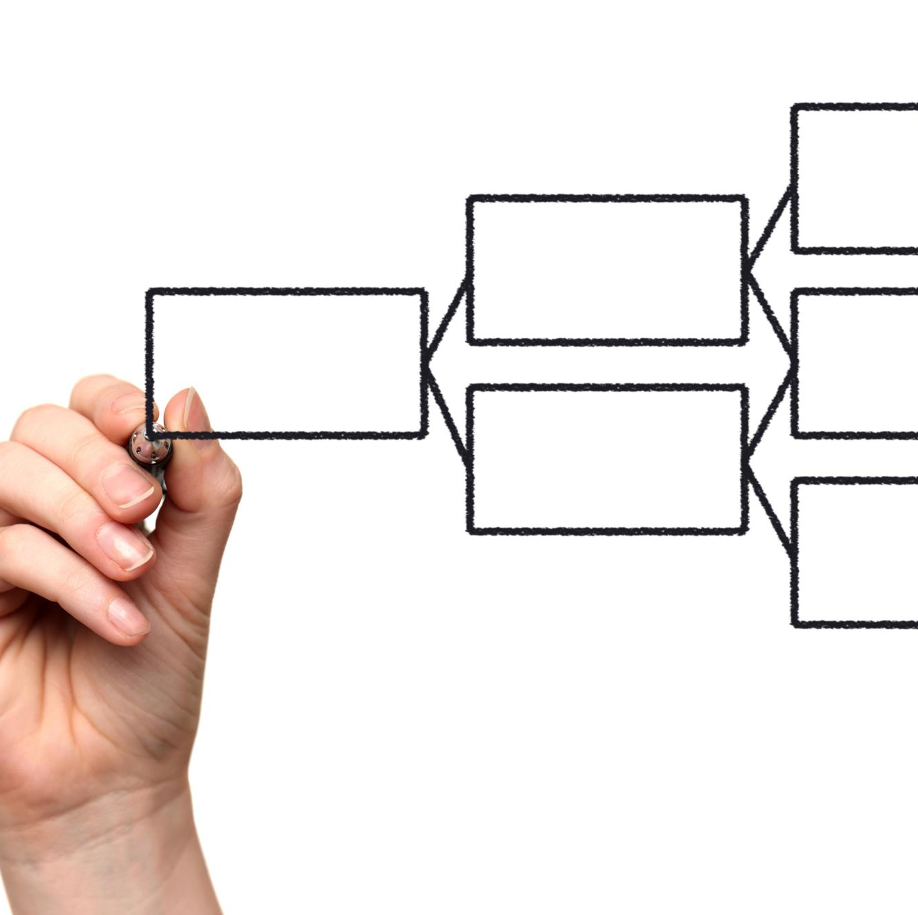
General structure and scope of the project
Data Collection
Pre-Processing
Algorithm Development
Model Performance Evaluation

Slide 7
Data Collection and Pre-Processing

Slide 8
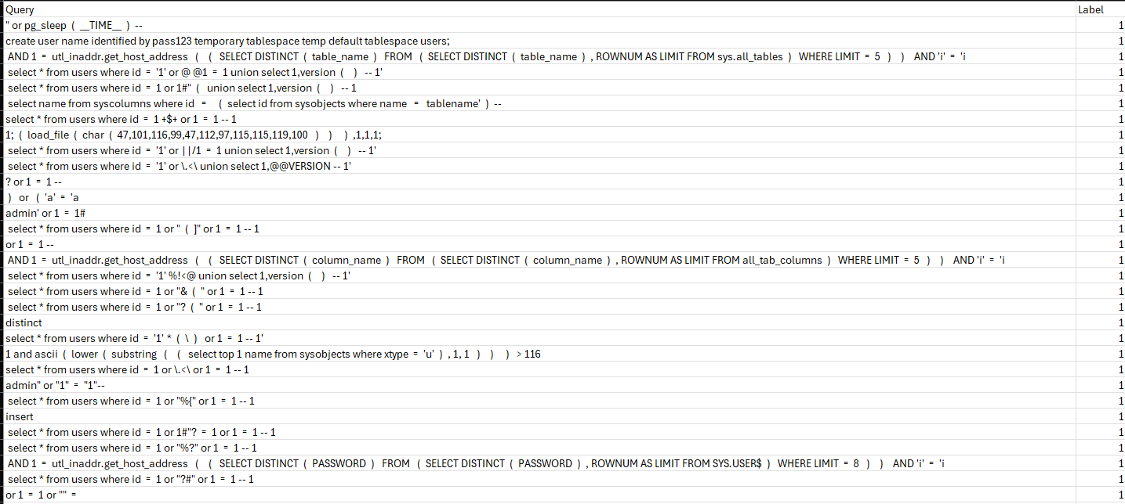
Data sources used and data collection methods

Slide 9
Data sources used and data collection methods

Slide 10
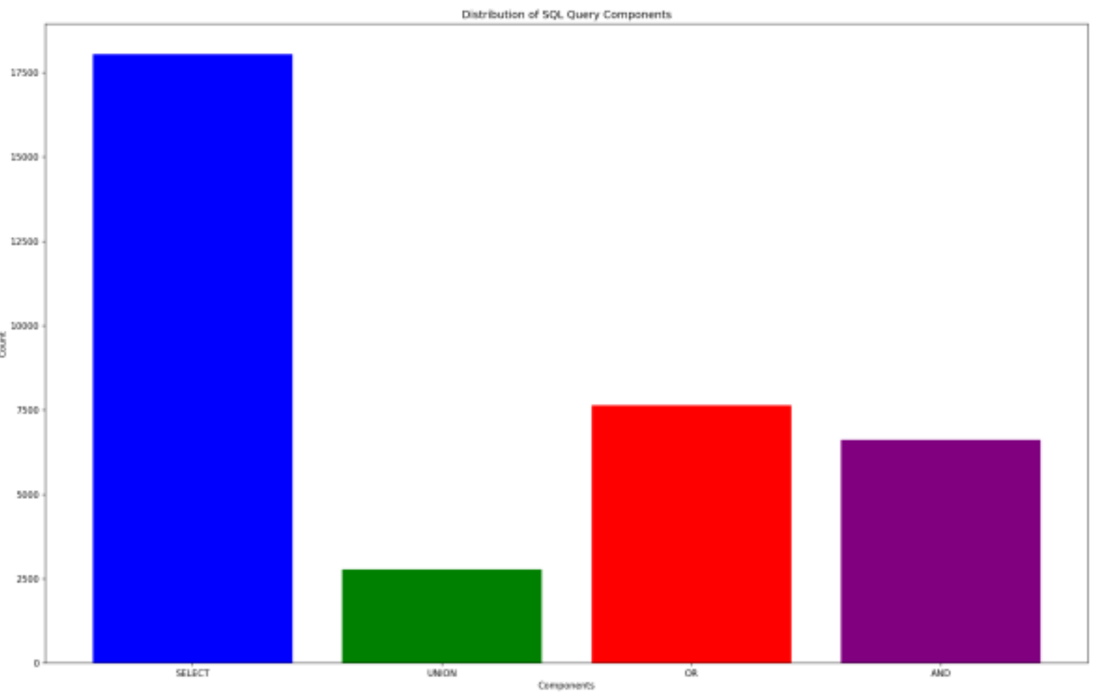

Slide 11
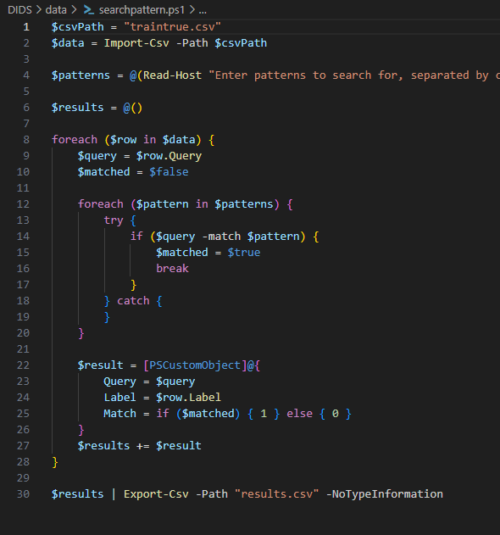
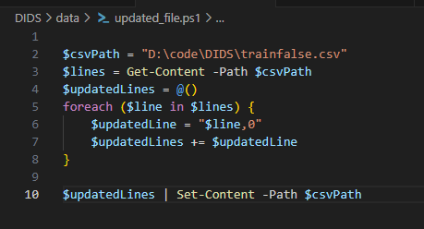
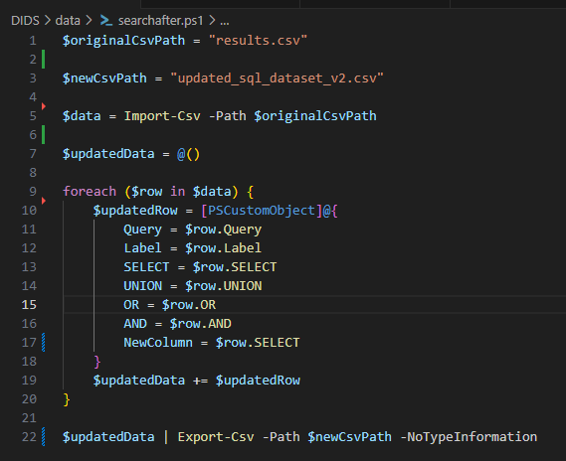

Slide 12
Tabii ki, iş akışınızı tablo olarak ekleyebilirim. İşte iş akışınızın tablo formatında bir özeti:
Bu tabloyu sunumunuza ekleyebilirsiniz. Başka bir konuda yardımcı olabilir miyim?
Step | Explanation
Pattern Search and Save Results(searchpattern.ps1) | Looks for specific patterns in the Query column in the traintrue.csv file. Writes matching lines to the results.csv file. This script determines whether certain patterns are present in the Query column and records the results as 1 (match found) or 0 (no match found) in the Match column.
Update a file by adding .0 to the end of lines(updated_file.ps1) | - Adds .0 to the end of each line in the trainfalse.csv file. Writes updated lines to the same file. This script updates the contents of the trainfalse.csv file by adding a value of 0 to the end of each line in the file.
Write Results to the Updated File(searchafter.ps1) | - results.csv reads the file and adds the SELECT column to the end of each row. Writes the results to the updated_sql_dataset_v2.csv file. This script creates a new CSV file by adding the SELECT column to each row in the results.csv file.

Slide 13
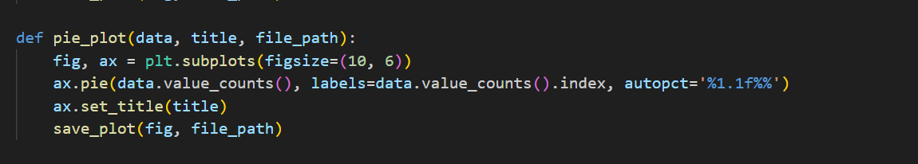

Slide 14
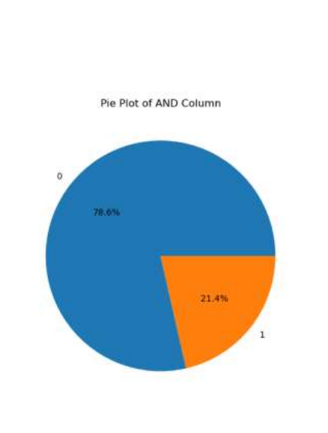
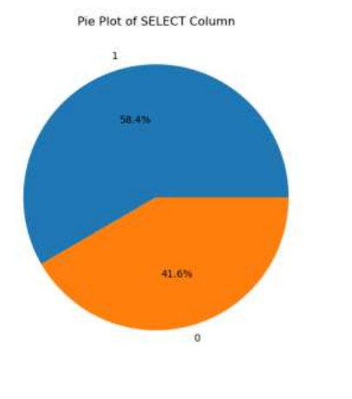
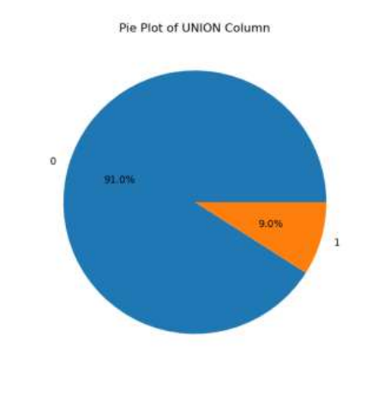
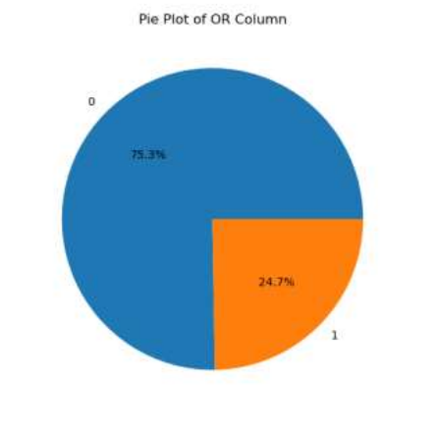
Feature splitting and feature extraction
Notes:
Veriler, modelin öğrenebilmesi için özelliklere (feature) bölünmektedir. Özellik çıkarımı, önemli verilerin belirlenmesini ve kullanılabilir hale getirilmesini sağlar, böylece modelin daha iyi sonuçlar üretmesine yardımcı olur.

Slide 15
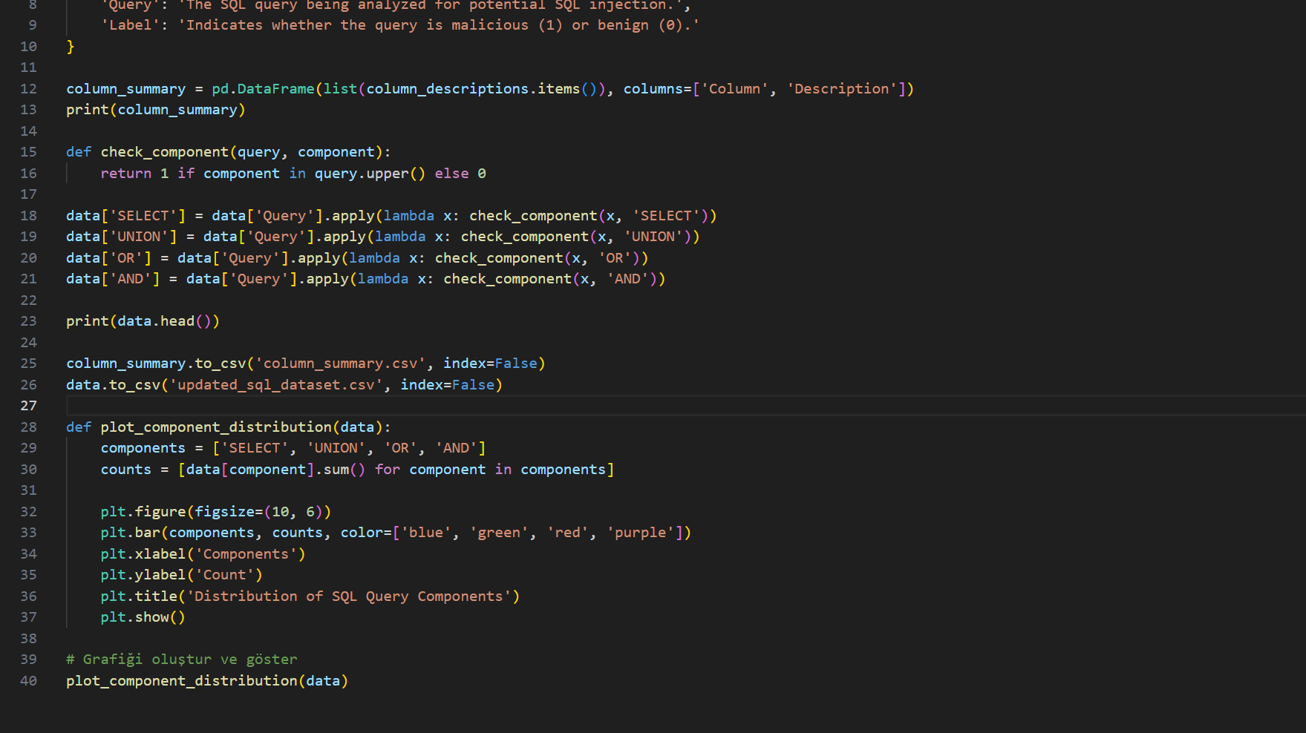


Slide 16
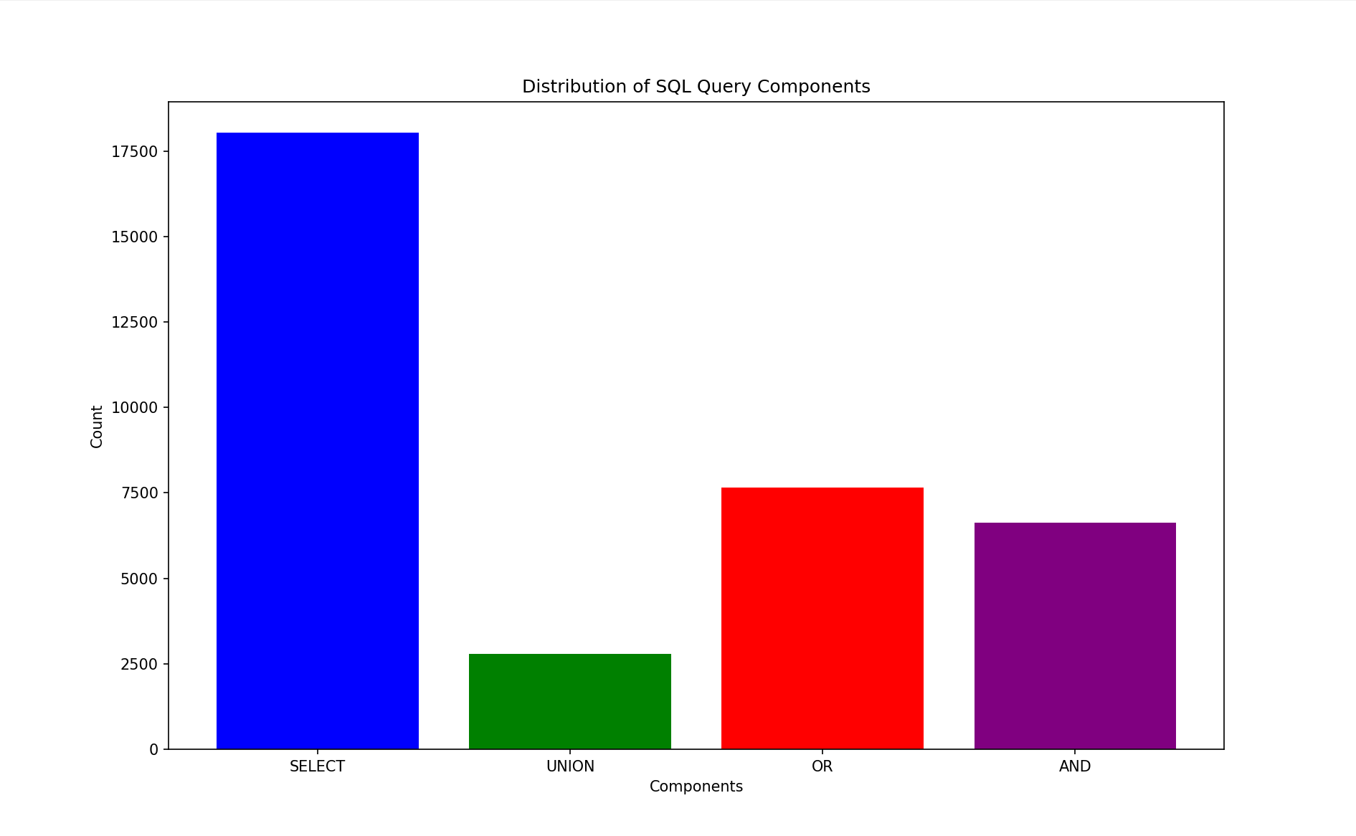

Slide 17
Model Performance Evaluation
Notes:
Modelin başarısını anlamak için performans değerlendirme metrikleri kullanılır. Bu bölümde, model değerlendirme metriklerini inceleyecek, elde edilen sonuçların analizi ve yorumlanmasını gerçekleştireceğiz.

Slide 18
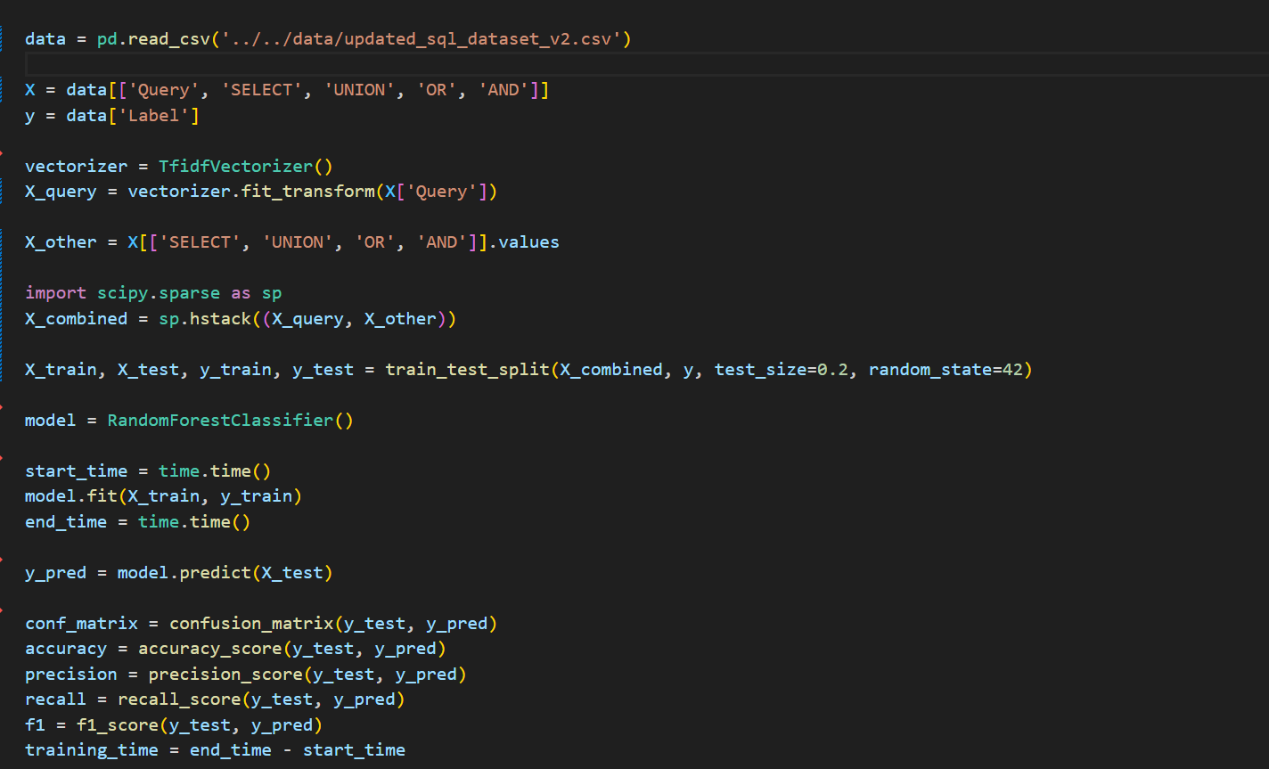

Slide 19
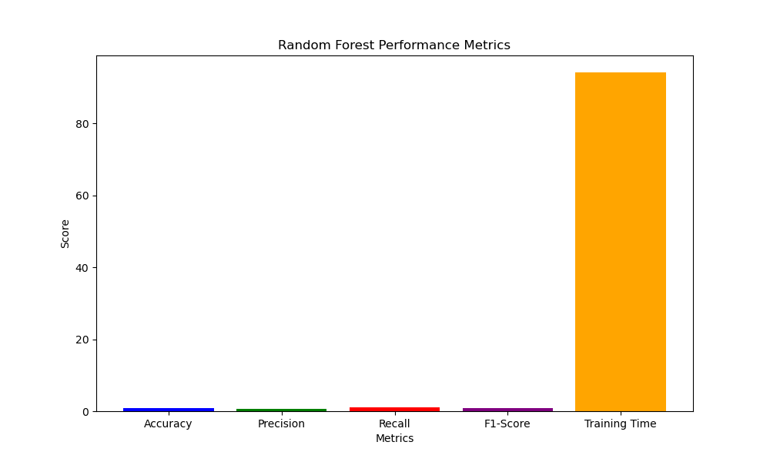

Slide 20
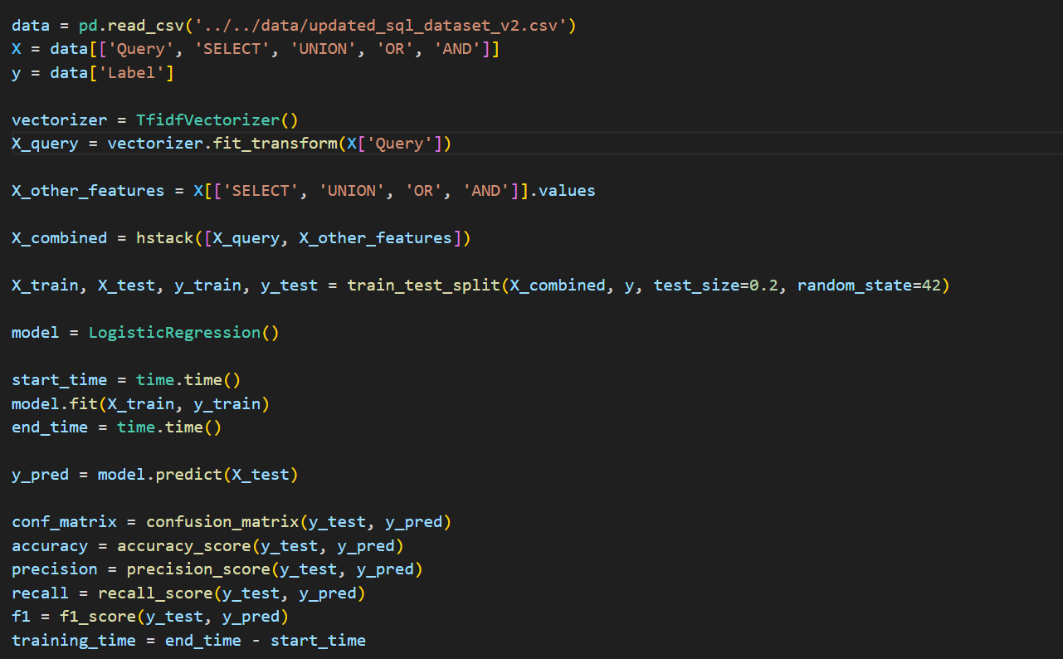

Slide 21
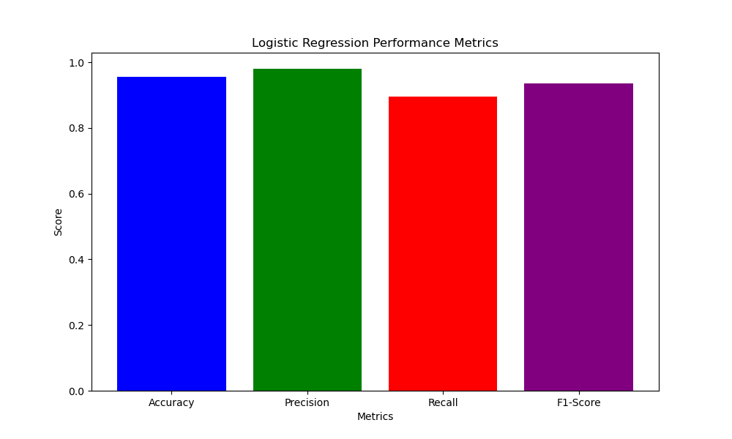

Slide 22
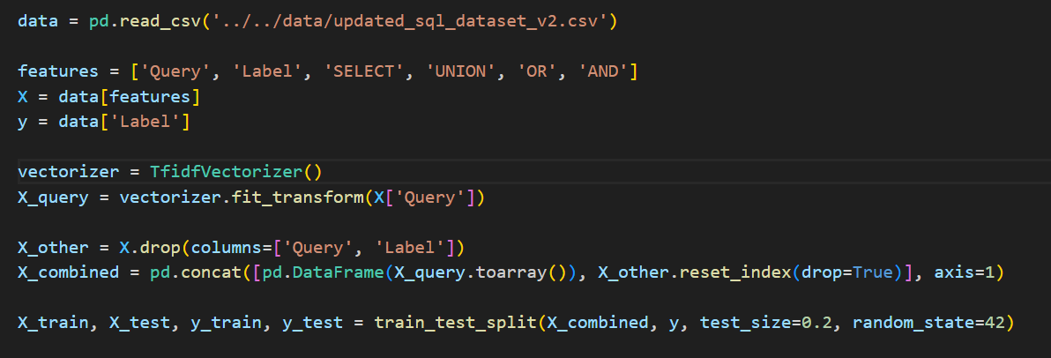

Slide 23
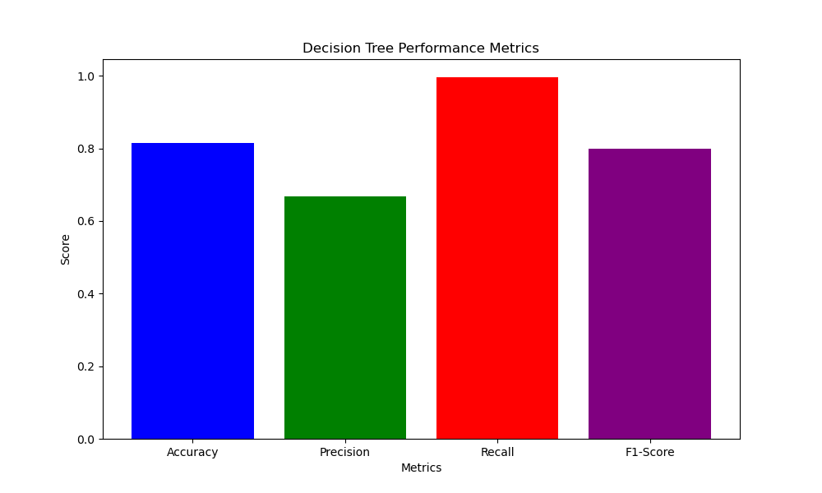

Slide 24
Future Studies and Suggestions for Improvement
Notes:
Son bölümde, sistemin gelecekteki gelişim alanlarını ve iyileştirme önerilerini tartışacağız. Algoritmaların ve modelin geliştirilmesi üzerine önerilerde bulunacağız.

Slide 25
Conculicion
In order to ensure the security of database systems and the effectiveness of security products in mobile environments, a model has been developed by examining and reprocessing commonly used SQL injection patterns

Slide 26
Future for project
This project’s area, network detection system, DevSecops and Database healtcheck status.
Future development:
As an AbuseIPDB reporter and researcher, I was tasked with identifying and isolating globally malicious machines that perform SQL attacks. My role involves thorough investigation and reporting of malicious activity to ensure that these threats are removed from the internet. By integrating this project into autonomous systems, I aim to improve cybersecurity measures and contribute to making the world a safer place for everyone.

Slide 27
Areas of future development of the system
FIREWALL
DB SERVICE
VPN
OS SERVICE
Demilitirazed Zone
DATABASE
OPERATION SYSTEM
Notes:
Sistem, sürekli olarak gelişmeye ve evrimleşmeye açıktır. Gelecek çalışmalarda, yeni algoritmaların ve tekniklerin entegrasyonu sağlanacaktır.

