Slide 1
Gait recognition
Identify people by walk and body shape

Slide 2
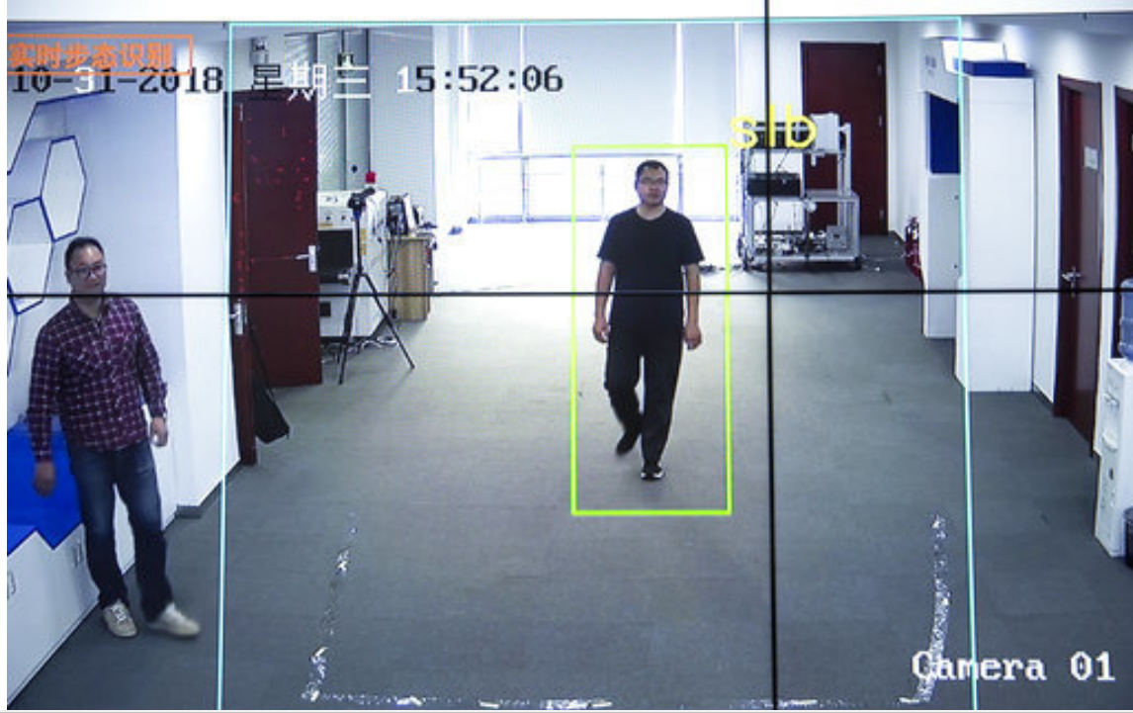
What is it & is it really a big step?
Identifying people by their unique gait features
Features are not hideable
No commitment is needed
Obtainable from a long distance (50 meters)
Low resolution cameras is enough (typical 2k)
Average recognition rate of up to 94.1%
Lowered correlation with face information and lighting conditions
➢ Could catapult surveillance to a new level & huge potential for commercialization

Slide 3
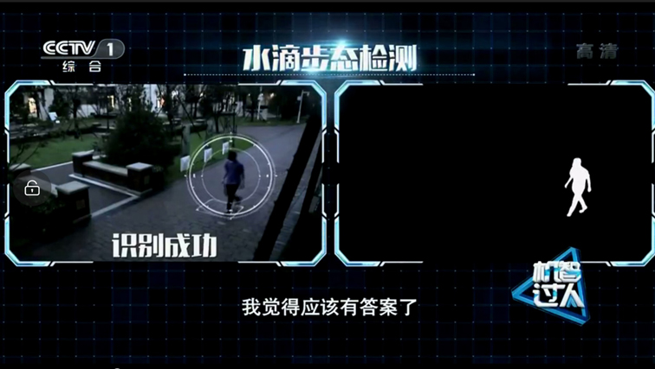
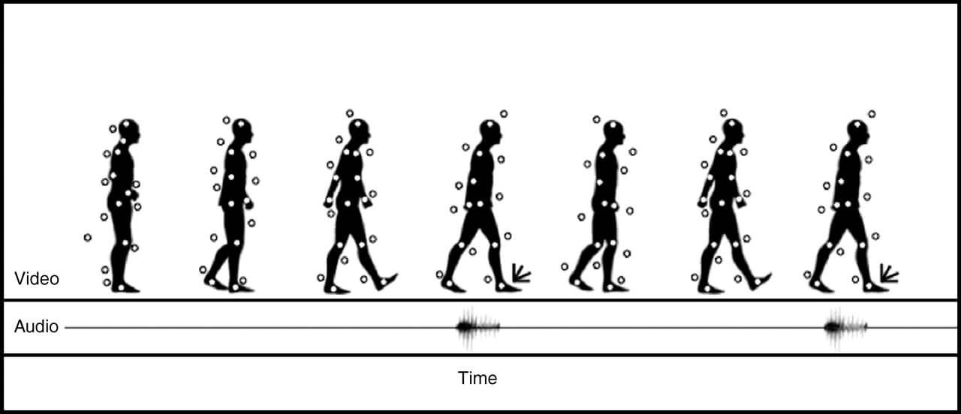
How it works
Extract a person’s silhouette from video and analyzes the silhouette’s movement to create a model of the way the person walks.
Multiple sequential frames are required to processing
Points of reference have to be applied to an initial image
Points of reference have to be tracked across the following frames
After an initial reference is created, a search for matching patterns have to be performed
Downsides:
Significantly more processing power than facial recognition needed
Cannot be performed in real-time yet (10 minutes to sift through a 1h video)
Database needed

Slide 4
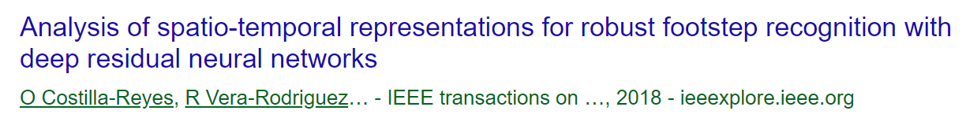
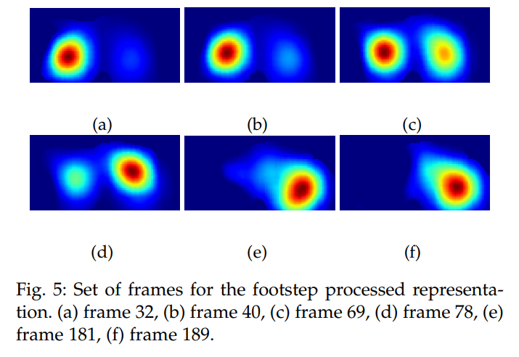

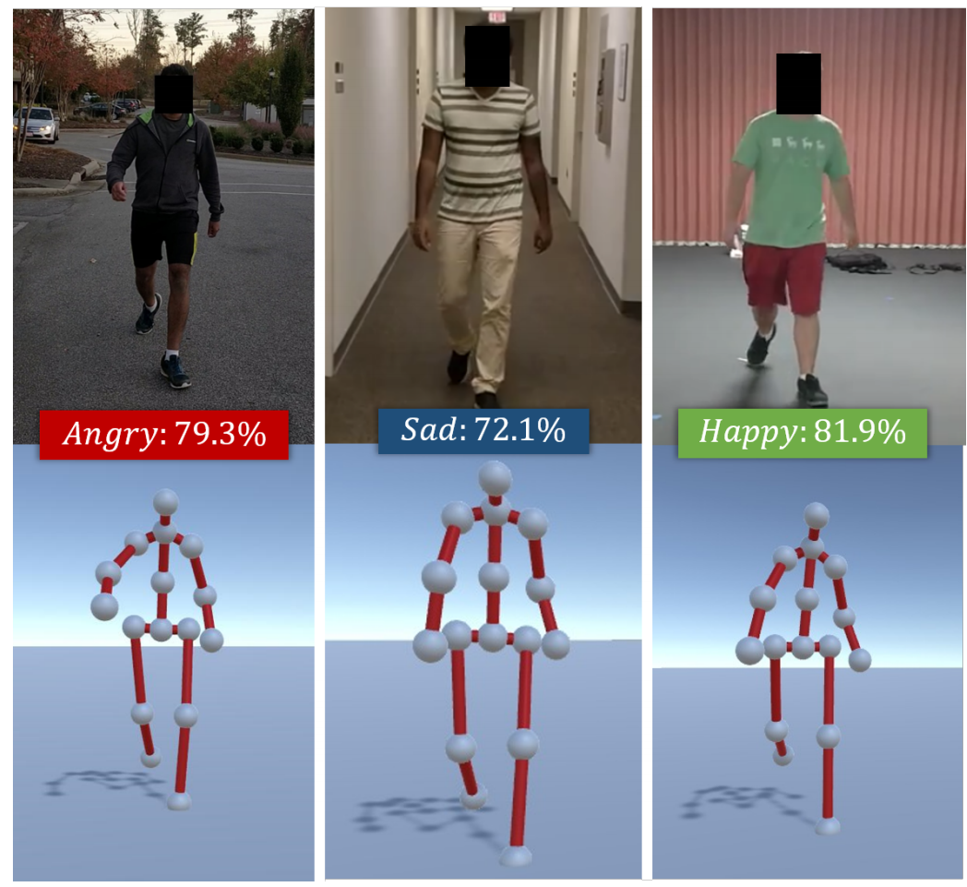
Similar projects
People walk on a special floor pad
Use deep residual neural network to analyze:
Weight distribution
Gait speed
Three-dimensional measures of walking style
Use the combination of
deep convolutional neuronal networks (convolves the input signals in the space domain and is talent in handling two dimensional signals, f.e. images) and
deep recurrent neuronal networks (input signals in a recursive way, and is skilled in handling time-series f.e. voices)
Three-dimension data (x, y & z) of the accelerometer and the gyroscope are put together to form a sixdimension time-series
Use an RGB video of an individual walking
Extract walking gait in the form of a series of 3D poses
Use recurrent neuronal network to exploit the gait features:
Uses labeled emotion datasets to create deep features
Combine these with posture and movement cues computed from gaits

Slide 5


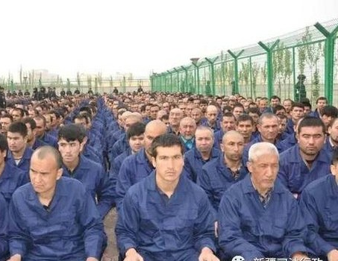
Ethical implications

Slide 6
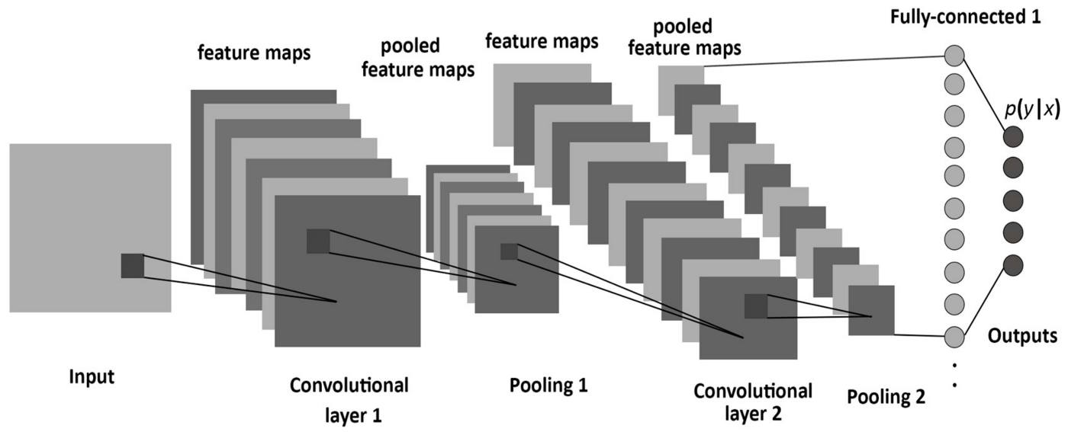
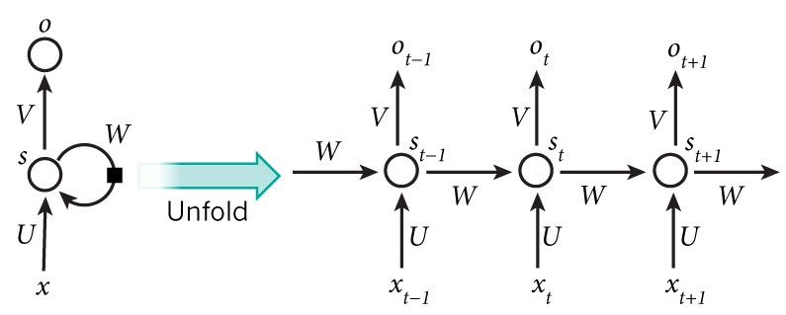
Assumption for the Applied technology
Convolutional Neural Networks (CNN)
Recurrent Neural Networks (RNN)

Slide 7
END

Slide 8
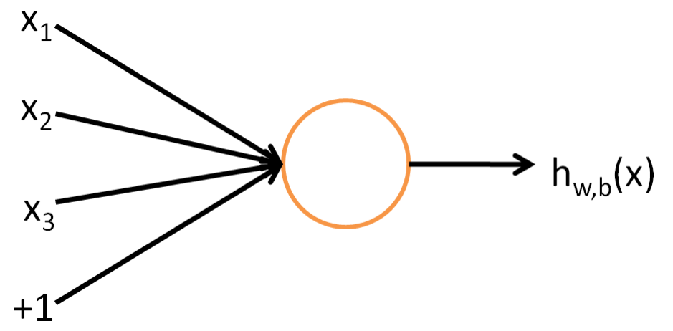
Exkurs: Neuronal network (1/6)
Inspired by the neural architecture of a human brain
Neuron is the basic building block of it
Similar functionality to a human neuron
Takes in some inputs and fires an output
A mathematical function (apply function on the provided inputs)
The functions are called activation function
5 major activation functions (tried to date, step, sigmoid, tanh, and ReLU)

Slide 9
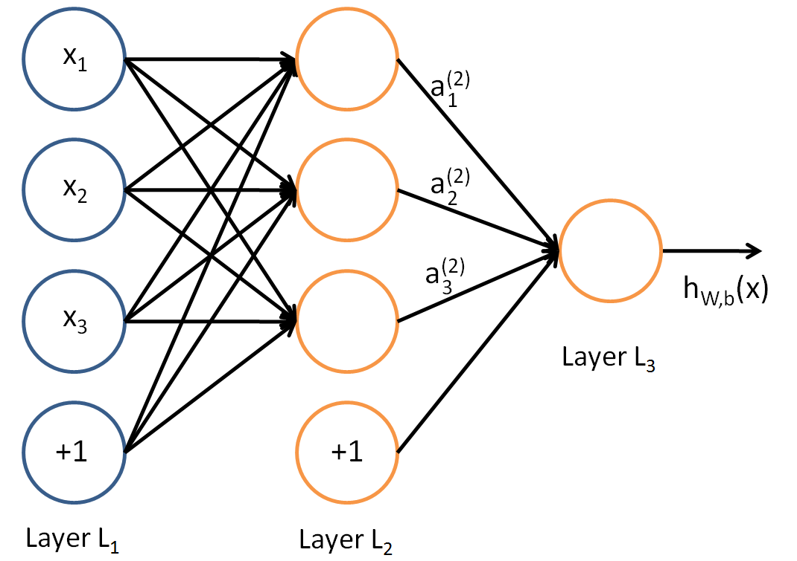
Exkurs: Neuronal network (2/6)
A layer in a neuronal network is a collection of neurons which take in an input and provide an output
Each input to a neuron is processed with a assigned activation function
Layer on the left is the input Layer
Layer on the right is the output layer
Layer in middle is the hidden layer
Values are not observable in training set
Each can apply a different function
The network learns something at every layer to make accurate

Slide 10
Exkurs: Neuronal network (3/6)
Convolutional Neural Networks (CNN) is one of the variants of neural networks
The hidden layers of a CNN typically consist of convolutional layers, pooling layers, fully connected layers, and normalization layers
Instead of normal activation functions, convolution and pooling functions are used as activation functions

Slide 11
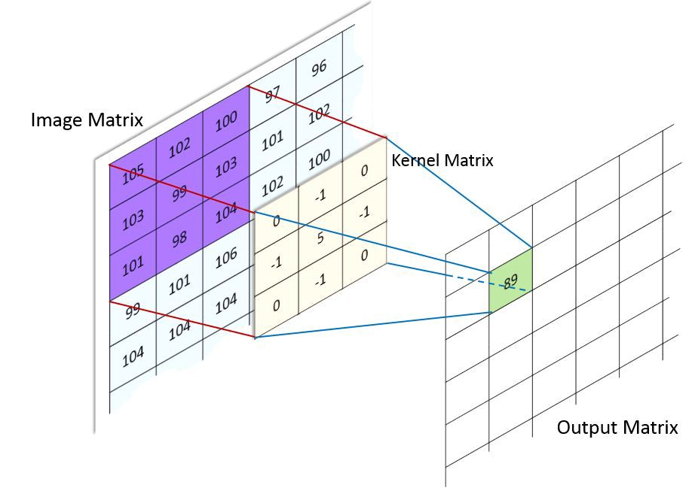

Exkurs: Neuronal network (4/6)
Convolution operates on two images
One as the “input” image and the other (the kernel) as a “filter” on the input image, producing an output image → it takes two images and produces a third as output
Can also described as:
It takes an input and applies a filter over it (multiplies the input signal with the kernel to get the modified signal)

Slide 12
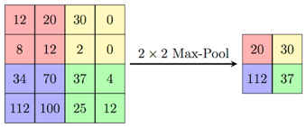
Exkurs: Neuronal network (5/6)
The object of Pooling is to down-sample an input representation (image, hidden-layer output matrix, etc.)
reducing dimensionality and
make assumptions about the featurs in the sub-regions
Two main types of pooling: max and min pooling
Max pooling based on picking up the maximum value…

Slide 13
Exkurs: Neuronal network (6/6)

