Slide 1
VLM-Guided Robot Reaching
Language-conditioned tabletop manipulation with a vision-language model in the loop
A frozen Qwen3-VL detector feeds a behaviour-cloned navigation policy that drives a UR5e arm to touch a named object.
Onuralp Güvercin · Deep Learning in Robotics · Final Project

Slide 2
Objective
▸ Task: a robot arm must reach out and touch a specific object named in natural language - e.g. "the red cube".
• Scene: a tabletop with 2–4 differently coloured boxes and spheres at random positions (6 colours × 2 shapes).
• The robot sees only a top-down camera image; it is never told the target's coordinates.
▸ The central question
• Can a vision-language model act as the "eyes" that localise the target, while a small learned policy acts as the "hands" that move toward it?
▸ Success metric
• An episode succeeds if the end-effector makes contact with - or comes within 5 cm of - the correct target.
• Success rate, final EE-to-object distance, and steps taken are reported.
VLM-Guided Robot Reaching
1

Slide 3
System Architecture
MuJoCo Env
top-down image + ee_pos
Qwen3-VL (frozen)
image + object name → bbox (cx,cy,w,h)
NavigationMLP
[bbox, ee_pos] → H × Δee (metres)
UR5e Arm
apply H deltas → contact?
Closed loop: the policy executes H steps, then re-queries the VLM (H steps = 1 VLM call).
• Perception (VLM): localises the named object as a normalised bounding box - off-the-shelf, weights frozen.
• Control (MLP): 7-D input [bbox(4) + ee_pos(3)] → 3·H deltas, predicting H steps of motion in one shot. Trained purely by behaviour cloning - no RL, no VLM training.
• Horizon H is the same knob in both training and inference.
• Training: each sample regresses H consecutive expert deltas, so the MLP's output head is sized 3·H.
• Inference: those H deltas run before the next VLM call - small H = more re-planning & VLM cost, large H = cheaper but more open-loop drift (H = 1–5 is swept).
VLM-Guided Robot Reaching
2

Slide 4
Data Collection
▸ An automated scripted expert generates every demonstration - no human teleop, no learning here.
• Its only job is to produce the correct answer the policy will later imitate; the intelligence lives in the data, not the controller.
▸ For each random scene (2–4 objects, rejection-sampled ≥ 10 cm apart, unique colour + shape)
• every object in the scene is targeted in turn;
• a straight-line controller drives the end-effector toward the target's (x, y) in 4 cm steps - capped so it never overshoots.
▸ Logged at every step
• top-down RGB image (128×128) and end-effector position ee_pos (xyz);
• the ground-truth bbox - the object's true 3-D position projected through the camera matrix (not a vision model).
▸ What gets saved
• a reach ends on gripper–target contact (MuJoCo geom collision); only successful reaches are stored - one .pt file per trajectory.
• parallelised across seeded worker processes → ~2,700 demonstrations.
▸ Action labels (Δee) are not stored - they are derived in training as ee[t+1] − ee[t]. The VLM is never used during collection.
VLM-Guided Robot Reaching
3

Slide 5
Policy & Behaviour Cloning
▸ NavigationMLP - a residual MLP (width 512, 4 residual blocks, SiLU + LayerNorm).
• Input (7-D): bbox(cx,cy,w,h) + normalised ee_pos(x,y,z).
• Output (3·H): end-effector deltas Δee in metres, H steps ahead.
▸ Trained by behaviour cloning (supervised regression)
• Target = the expert's next H step-to-step Δee (the same horizon used at inference); loss = MSE on the deltas.
• Each training sample regresses a whole H-step block at once, so the policy learns to plan the horizon, not just one step.
• AdamW + warmup→cosine LR; the output head is zero-initialised so the policy starts from gentle, near-zero motions.
▸ Honest evaluation
• Stratified train/val/test split by colour+shape; samples from one trajectory never leak across splits.
• Test RMSE ≈ 0.0007 m - the policy reproduces expert deltas almost exactly.
VLM-Guided Robot Reaching
4

Slide 6
Critical Design Choices
▸ Fixed bounding box per episode.
• The bbox is read once at the start - when the object is clearly visible - and held constant; the loop then closes on ee_pos, not on a re-detected box.
• As the arm moves over the target, the gripper occludes the object, so a fresh detection mid-reach would be unreliable or fail; holding the initial box avoids this.
▸ Delta actions with clamping (±5 cm/step).
• The policy predicts relative motion (Δee), not an absolute target - every command is a small step from the current pose, not a jump to a far point.
• Each delta is clipped to ±5 cm per axis (≈ the expert's 4 cm step), so even a wrong prediction can only nudge the arm - keeping the closed loop stable.
▸ Configurable horizon H (1–5).
• H sets how many predicted steps are executed before the VLM is queried again - directly trading perception cost against open-loop accuracy.
• Small H = frequent re-planning (more VLM calls, tighter tracking); large H = cheaper but more drift between detections.
VLM-Guided Robot Reaching
5

Slide 7
The VLM Was Not Trained
▸ In this project Qwen3-VL-4B is used frozen, off-the-shelf, as the detector.
• Fine-tuning a 4-billion-parameter vision-language model needs multi-GPU memory and long training runs - compute that was not available.
• So the contribution is the end-to-end pipeline + the control policy, with the VLM as a plug-in perception module.
▸ If compute had been available
• The VLM would be fine-tuned with GRPO (Group Relative Policy Optimization).
• Reward = how well the predicted bbox matches the target (IoU / centre error), or even downstream reaching success.
• This adapts the detector to the exact camera, lighting, and object set - directly attacking the VLM-vs-GT gap shown in the results.
VLM-Guided Robot Reaching
6

Slide 8
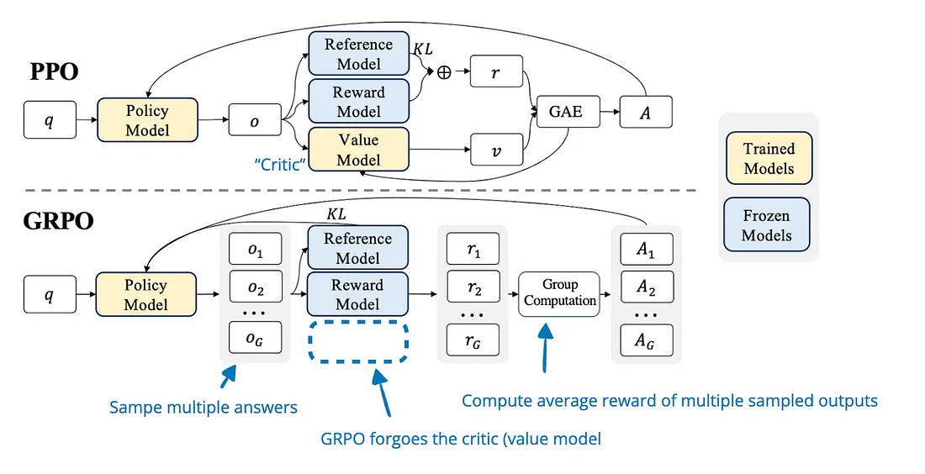
PPO vs GRPO - The Idea
▸ PPO (top)
• needs a separate Value Model to estimate the baseline (advantage via GAE).
• = a second large network to train and store.
▸ GRPO (bottom)
• samples a GROUP of G answers per prompt,
• scores each with the reward model,
• uses the group's mean/std as the baseline - no critic at all.
PPO trains an extra Value Model ("critic"); GRPO replaces it by sampling a group and normalising rewards. (DeepSeekMath, 2024)
VLM-Guided Robot Reaching
7

Slide 9
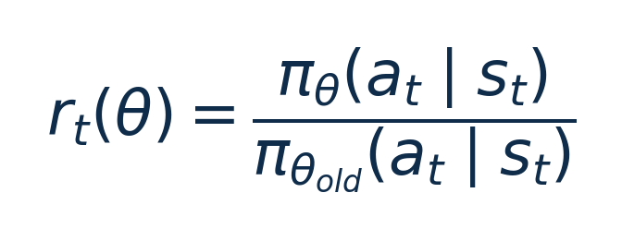
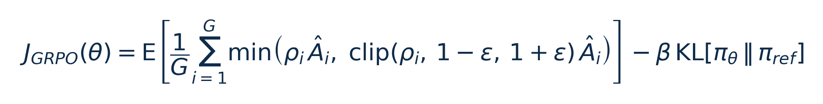
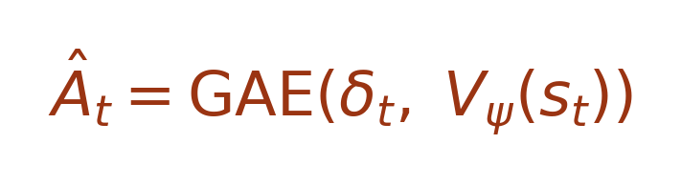
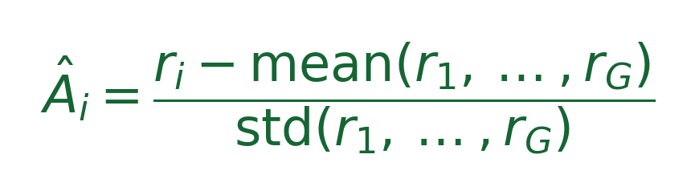
PPO vs GRPO - The Loss Functions
Shared importance ratio:
PPO
GRPO
• Advantage Â comes from a learned critic V (GAE).
• Extra value network → more memory & compute.
• KL penalty keeps the policy near the reference.
• Â = reward normalised within the group (no critic).
• Group mean is the baseline → lighter & simpler.
• Same clipped surrogate + KL to the reference.
VLM-Guided Robot Reaching
8

Slide 10
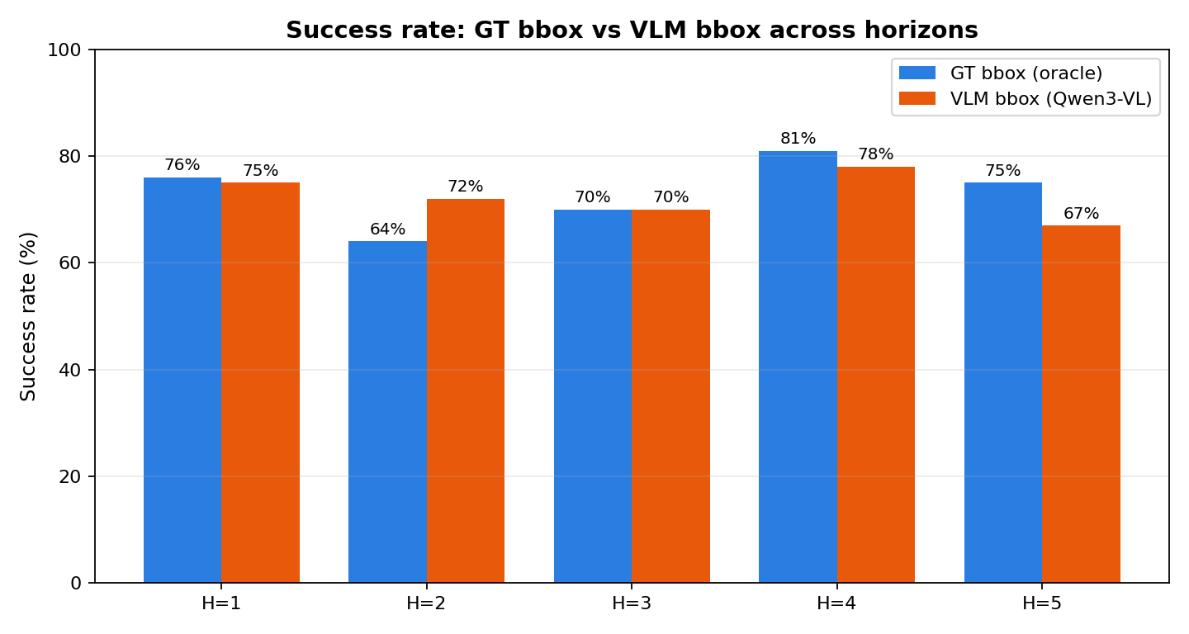
Results · Success Rate
▸ Same policy in both runs - only the bbox source changes.
▸ GT bbox: 64–81% across horizons.
• Best at H=4 (81%); no clear monotonic trend - open-loop drift is not the dominant factor at this scale.
▸ VLM bbox: 67–78%, within ≤9 pp of GT.
• Qwen3-VL bboxes are competitive; the gap closes significantly vs prior expectations.
• H=5 shows the clearest VLM penalty (75% vs 67%).
VLM-Guided Robot Reaching
9

Slide 11
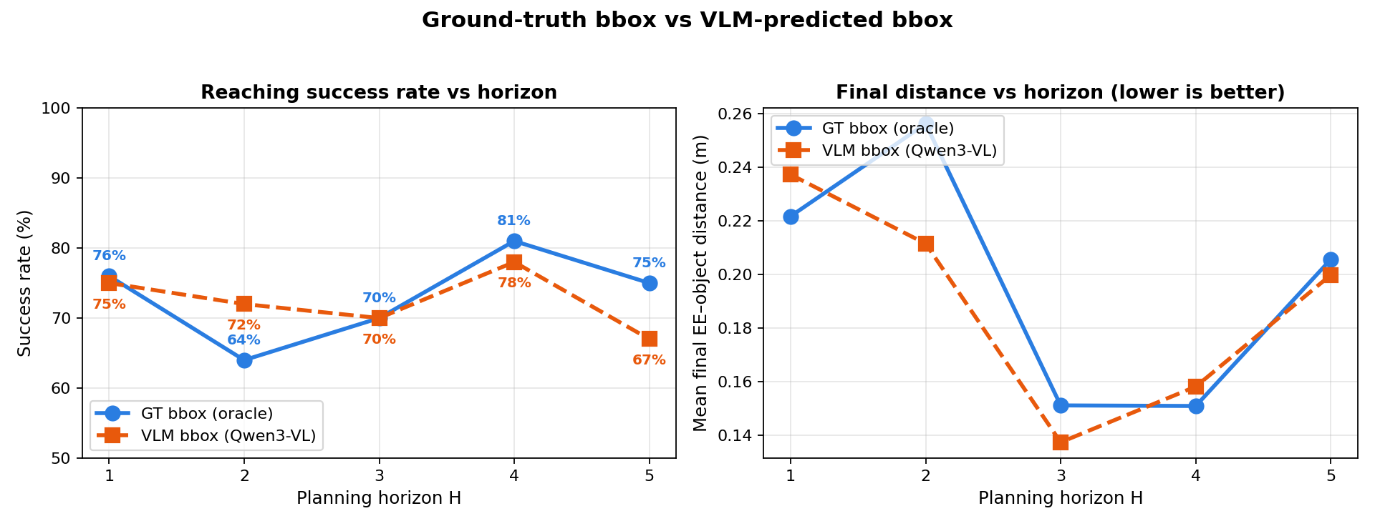
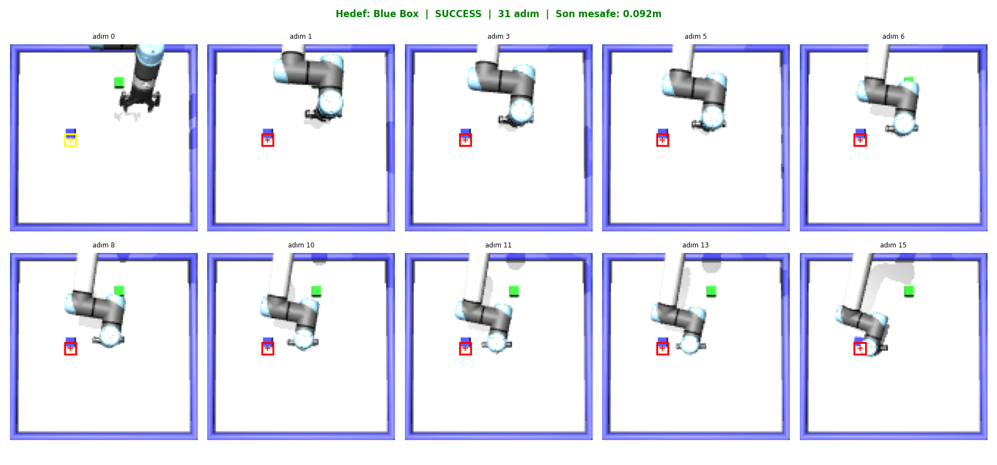
Results · Trends & A Real Episode
▸ Mean final distance
• GT: 15–26 cm (all eps).
• VLM: 14–24 cm - comparable to GT, slight edge at H=3–5.
▸ Sweet spot: H = 3–4
• best balance of replanning frequency and open-loop drift for both bbox sources.
▸ Takeaway
• VLM perception is competitive; GRPO fine-tuning could close the remaining gap.
VLM-bbox episode (H=2): the predicted box (red) tracks the blue cube as the arm reaches it.
VLM-Guided Robot Reaching
10

Slide 12
Results · What the Gap Means
▸ Strong behaviour cloning baseline.
• Test RMSE ≈ 0.0007 m - the MLP reproduces expert deltas almost exactly. The control policy is not the bottleneck.
▸ GT performance: 64–81%, best at H=4.
• No strict monotonic decline - at 100 episodes/horizon, episode variance is large enough that horizon ordering is noisy.
▸ VLM perception is competitive (67–78%).
• Qwen3-VL bboxes keep the arm close to the right target in most episodes; fixed per episode, a good initial box is enough.
• The remaining GT–VLM gap (≤9 pp) represents the cost of imperfect localisation - exactly what GRPO fine-tuning would close.
▸ Implication: a frozen off-the-shelf VLM already reaches 67–78% success; fine-tuning the detector is the clear next lever.
VLM-Guided Robot Reaching
11

Slide 13
Conclusion & Future Work
▸ A frozen VLM + a tiny behaviour-cloned MLP builds a working language-conditioned reaching system.
▸ The learned controller is strong - sub-mm RMSE; the policy is not the limiting factor.
▸ Off-the-shelf Qwen3-VL is surprisingly competitive - 67–78% success, within ≤9 pp of oracle GT bboxes.
▸ The remaining gap is the perception budget: better bbox localisation directly translates to higher success.
▸ Clear next step:
• fine-tune the VLM with GRPO (reward = bbox accuracy / reaching success) to close the localisation gap - the one piece compute prevented here.
• GRPO is the natural fit: reward is cheap to compute, no value network needed.
▸ Practical operating point: H = 3–4 - best success rate for both bbox sources with a reasonable VLM query budget.
VLM-Guided Robot Reaching
12

