Slide 1
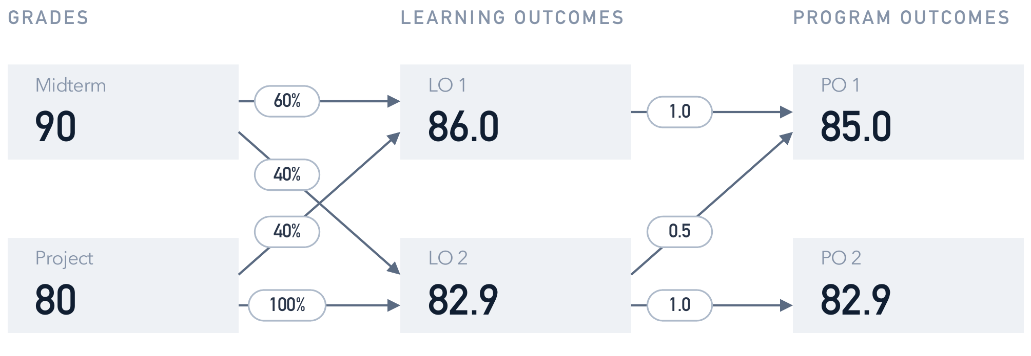
01 The idea
Publish a grade, and every student’s PO profile updates itself
The key ingredient is one small scoring engine that every number goes through. We wrote it test-first. It reproduces the worked example in the brief to the decimal, and 1,162 automated tests guard it.
Live: web-production-153e9.up.railway.app
POlaris · Mid-semester update · Acıbadem University · November 2026
1
Notes:
About 75 seconds. This is the brief's own example, Elif. Her midterm is 90 and her project 80. The course says
the midterm counts 60 percent toward learning outcome 1 and the project 40, so LO 1 is 86.0. LO 2 works the
same way and comes out at 82.9. Then each learning outcome feeds the department's program outcomes with a
weight, and PO 1 lands on 85.0. Every arrow is a weighted average, and nothing else. POlaris does exactly this
for every student, every course and every PO, and the moment an instructor publishes a grade, the profile
updates. The engine was written test-first and reproduces this example exactly. It is live on Railway.

Slide 2
02 How we planned
We turned the brief into 70 user stories and ten weekly sprints
13
1
70
10
design questions in the brief,
answered one by one
project specification,
kept in our repository
user stories, baseline first,
each with an owner and points
one-week sprints, one branch
and pull request per story
where we work
what for
WhatsApp group
day-to-day questions and decisions
After lectures
short in-person syncs
Online calls
planning and reviewing each sprint
GitHub
19 merged pull requests so far, CI on every one, and the project board from Sprint 4
POlaris · Mid-semester update · Acıbadem University · November 2026
2
Notes:
About 80 seconds. We formed the backlog straight from the brief. It ends with thirteen design questions,
who enters grades, who sees what and so on, and we answered each one in a project specification that lives in
the repository. From that we wrote 70 user stories in the "As a ..., I want ..., so that ..." form, put the
baseline the brief asks for first, and spread them over ten one-week sprints. Every story has an owner and a
point estimate. We manage the work through GitHub: one branch and one pull request per story, nineteen merged
so far, and CI runs on every one. Day to day we use a WhatsApp group, we sync after lectures, and we plan and
review sprints on calls.

Slide 3
03 Who did what
Three people, three slices of the product
member
what they have built so far
Onur Mohamed Haniffa
Project specification and build guide, repository, CI and Docker, design system, login and navigation, department pages, course setup and both weight grids, grade sheet, deployment on Railway
Fatmanur Demir
Roles and permissions, publishing grades, student PO profile, instructor course results, department overview, enrollment import from CSV, second version of the demo data
Zeynep Uygun
Data model and migrations, the department’s 11 official program outcomes, scoring engine and data loaders, first demo data
Each item is a user story with an owner. The report lists the story numbers.
POlaris · Mid-semester update · Acıbadem University · November 2026
3
Notes:
About 70 seconds. We split the product into three areas, so each of us owns a vertical slice with its own
screens. Onur set up the project and the platform and built most of the instructor side. Fatmanur built roles
and permissions, publishing and the views students and the department see. Zeynep built the domain core: the
data model, the official program outcomes and the scoring engine. Every item here is a story with an owner on
our backlog, and the report lists the story numbers.

Slide 4
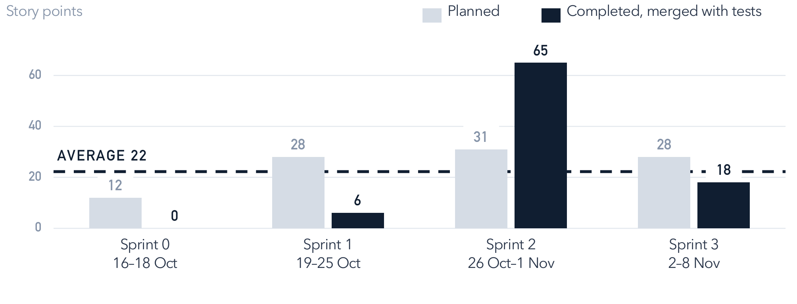
04 How fast
About 22 points a week, once tests shipped with the code
1 week
sprint length,
Monday to Sunday
4 done
sprints completed,
Sprint 4 is running
89 of 99
planned points
completed
We size stories with planning poker on a Fibonacci scale. Sprint 1 looks empty because its code was merged before its tests, so those points only counted in Sprint 2. Now tests go in the same pull request.
POlaris · Mid-semester update · Acıbadem University · November 2026
4
Notes:
About 85 seconds. We estimate in story points, relative size not hours, using planning poker on 1, 2, 3, 5
and 8. Everyone shows a card at once, and if the votes are far apart the highest and lowest explain before we
vote again. Sprints are one week, Monday to Sunday, and we have finished four. A story only counts in the week
it was merged with its tests passing, and half-done work counts zero. That is why Sprint 1 looks empty and
Sprint 2 jumps to 65: the Sprint 1 code went in before its tests. The average is 22 points a week, and since
then tests ship in the same pull request as the code.

Slide 5
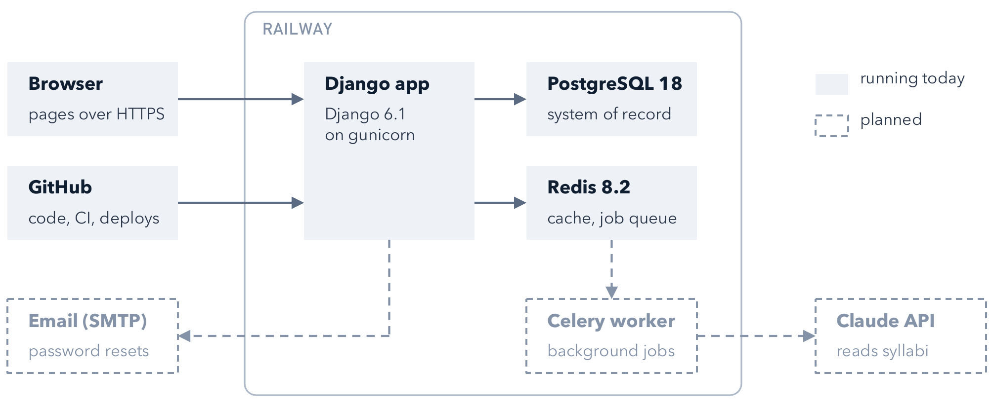
05 How it runs
One Django app on Railway, with PostgreSQL and Redis behind it
Publishing grades is one database transaction, so a student never sees half-published results. The dashed boxes are next: a background worker, the Claude API for reading syllabi, and email.
POlaris · Mid-semester update · Acıbadem University · November 2026
5
Notes:
About 80 seconds. This is the CSE 321 side. The browser talks to one Django application that renders pages
on the server, and HTMX updates single parts of a page, like one cell of a weight grid, without a reload. It
runs on Railway, which also gives us HTTPS. PostgreSQL is the system of record and enforces our constraints;
publishing grades runs as one transaction, so students never see half the grades of an assessment. Redis is
the cache today and becomes the job queue when the worker arrives, so a slow call to the Claude API never holds
up a page. Code reaches Railway from GitHub, where CI runs our 1,162 tests.

Slide 6
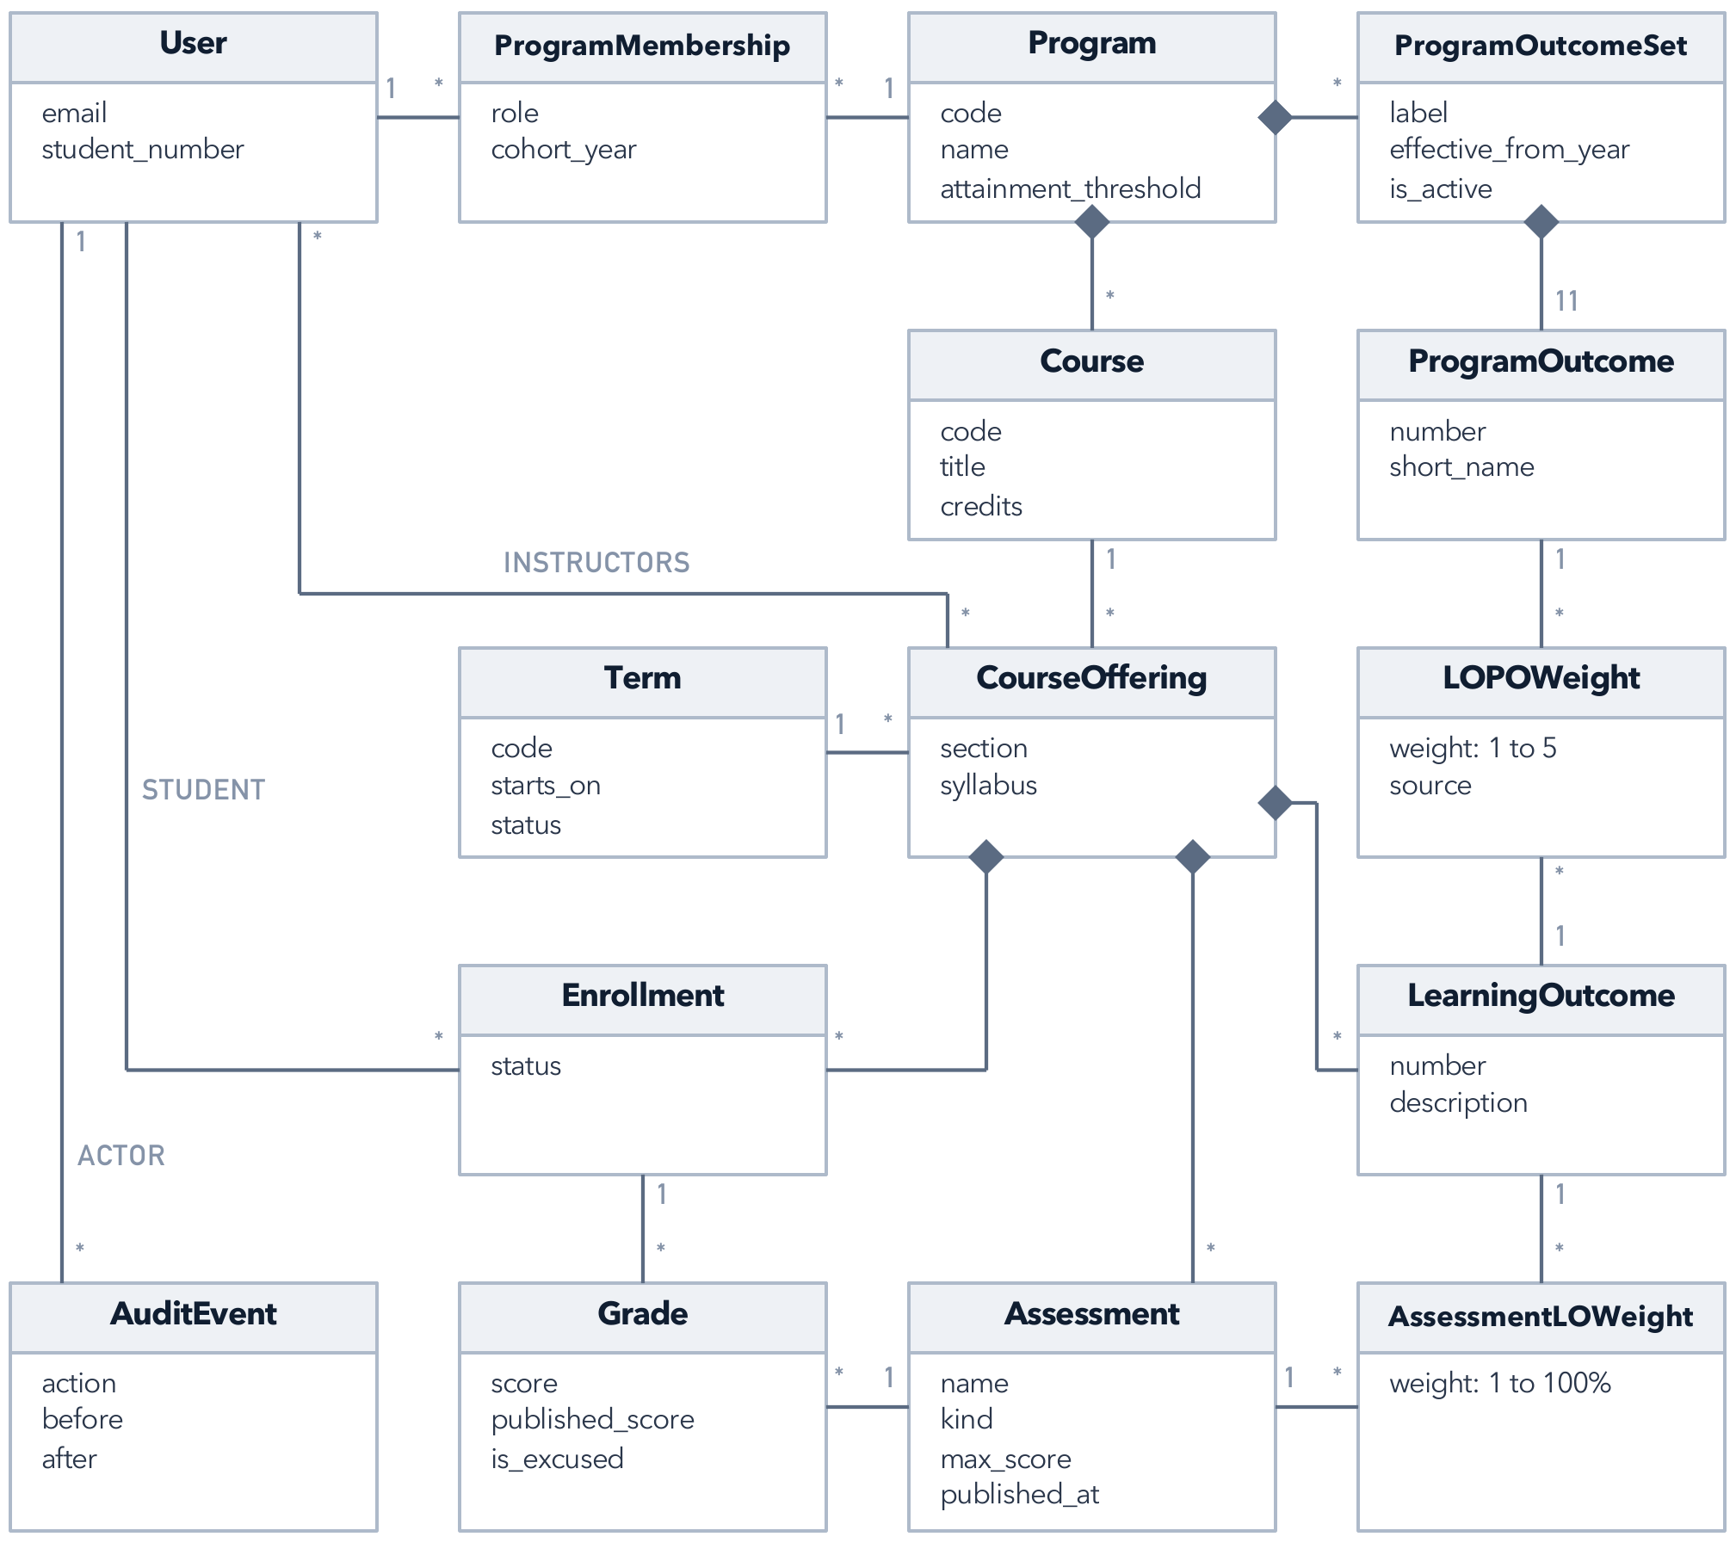
06 The data underneath
Fifteen classes, and two of them carry every weight
AssessmentLOWeight links an assessment to a learning outcome with a percentage.
LOPOWeight links a learning outcome to a program outcome with a weight from 1 to 5.
Grade keeps a draft and a published score, so publishing never loses the draft.
AuditEvent records who changed what, before and after.
Next: upload a syllabus and let the Claude API draft the course setup (Sprint 6), then bulk gradebook upload and PDF reports.
POlaris · Mid-semester update · Acıbadem University · November 2026
6
Notes:
About 75 seconds. Underneath it all are fifteen classes. A program has versioned sets of its eleven program
outcomes. A course runs as an offering in a term, and the offering owns its learning outcomes, assessments
and enrollments. AssessmentLOWeight and LOPOWeight carry every weight in the scoring chain you saw on the first
slide. A grade joins one assessment and one enrollment and keeps a draft and a published score, and every
change is recorded in the audit log. Next, in Sprint 6, an instructor will upload a syllabus and the Claude API
will draft the course setup for them to review. Then bulk gradebook upload and PDF reports. Thank you.

