Slide 1

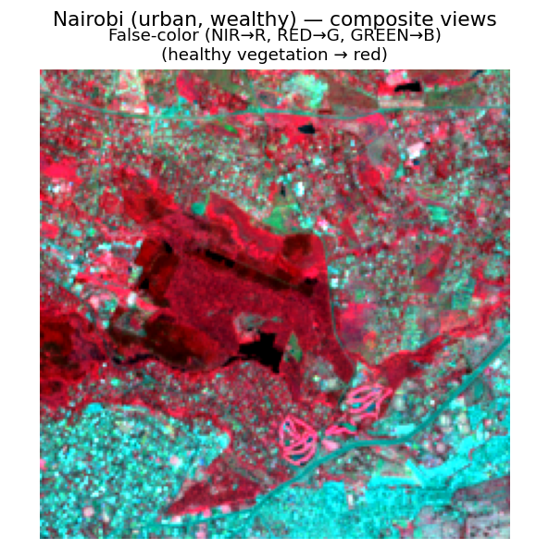
Predicting Village
Wealth from Space
P R E S E N T E D B Y
Onur Haniffa · 231402005
Advisor: Dr. Seda Nilgün Dumlu
ML / DL Internship · Acıbadem MAAÜ · 2026

Slide 2
Does It Work? Yes.
r 0.78
0.55
Pearson r — matches the
WILDS PovertyMap benchmark
worst-group r —
beats their 0.45
Honest, on unseen countries
• Leave-country-out CV — tested on countries the model never saw
• Pooled r² 0.61 on the multi-round (36k-village) data
• A naïve random split would have inflated this to 0.73 (+20%) — we refuse that

