Slide 1
ML / DL INTERNSHIP · ACIBADEM MAAÜ · 2026
Predicting Village Wealth from Space
A modern replication — and fairness & uncertainty audit — of Yeh et al. (2020), Nature Communications
Onur Haniffa · Advisor: Dr. Seda Nilgün Dumlu · June 2026

Slide 2
MOTIVATION
Why Predict Poverty from Space?
THE PROBLEM
THE PROMISE
▸ Reliable poverty data is scarce, expensive, and infrequent
▸ Household surveys cost millions and run every ~5 years
▸ Thinnest exactly where the need is greatest
▸ Satellites image everywhere on Earth — free and repeatedly
▸ Can a neural network read village wealth from imagery?
▸ If yes: a scalable complement to ground surveys
The whole question: can a free satellite image stand in for an expensive survey?
Predicting Village Wealth from Space · Onur Haniffa
01 / 19

Slide 3
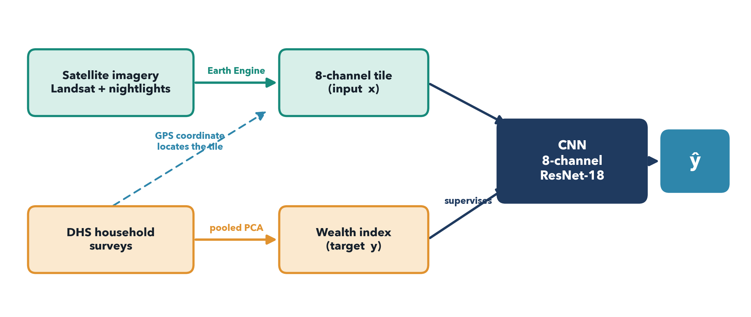
THE IDEA
One Model, Two Inputs
A village's GPS pulls a satellite tile (x); its survey gives a wealth value (y); the network learns x → y.
This talk answers two things: where does the wealth number come from, and does it work — for whom?
Predicting Village Wealth from Space · Onur Haniffa
02 / 19

Slide 4
DATA · GROUND TRUTH
The Answer Key: DHS Surveys
WHAT DHS GIVES US
THE DELIBERATE TWIST
▸ Gold-standard household surveys (USAID-funded)
▸ Unit = a cluster ≈ a village (~25 households)
▸ A GPS coordinate for every cluster
▸ DHS shifts each GPS point for privacy: up to 2 km (urban), 5 km (rural)
▸ So the true village is somewhere nearby — not exactly on the point
▸ That is WHY our tile is a wide 6.72 km box: big enough to still contain it
The survey is our ‘answer key’ — the model is trained and graded against it.
Predicting Village Wealth from Space · Onur Haniffa
03 / 19

Slide 5
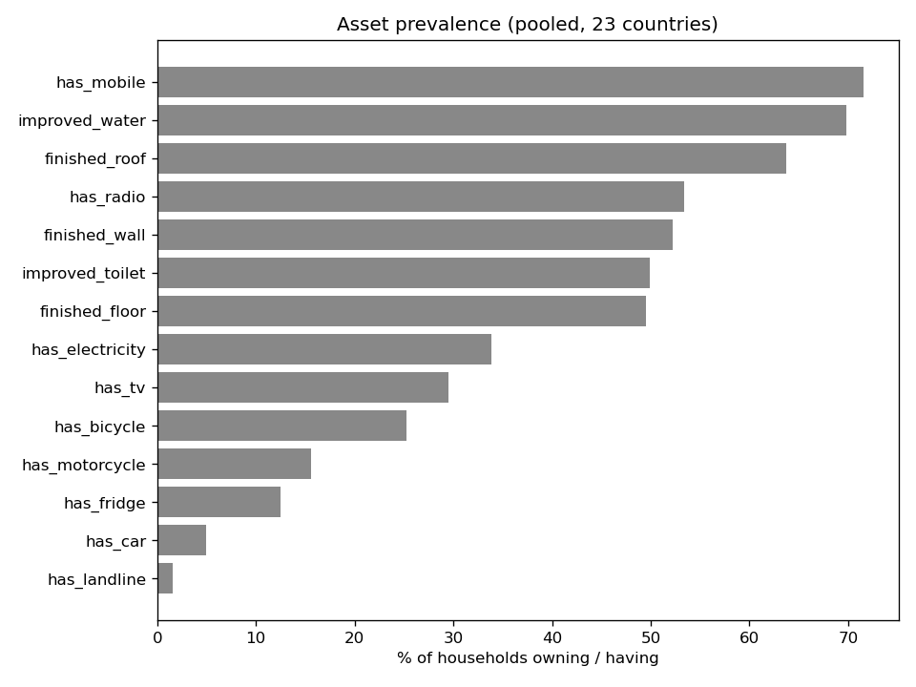
DATA · THE TARGET
There Is No ‘Wealth’ Column
THE PROBLEM
▸ DHS never asks ‘how rich are you?’
▸ It records asset checkboxes: electricity? TV? fridge? car?
▸ Plus finished floor / wall / roof, water, toilet, rooms
▸ We must turn ~15 yes/no answers into ONE wealth number
Asset ownership across our 355,000 households — the raw material for the wealth index.
Predicting Village Wealth from Space · Onur Haniffa
04 / 19

Slide 6
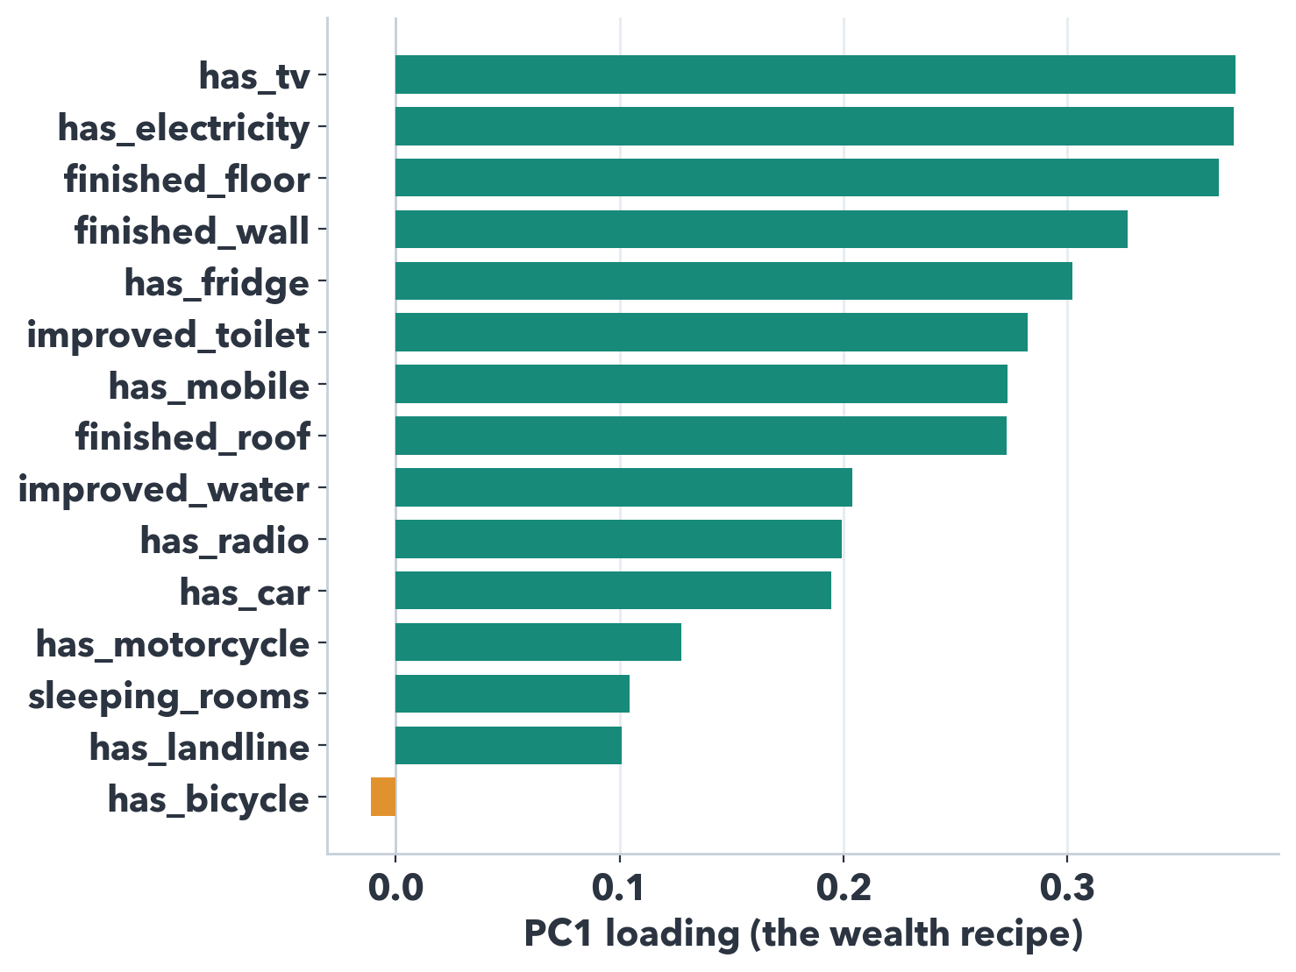
METHOD · WEALTH INDEX
PCA: Finding the Hidden Wealth Axis
THE ONE RULER
▸ PCA finds the single mix of assets that best explains who owns MORE
▸ That axis (PC1) is wealth — every asset loads positive (a ‘more-of-everything’ axis)
▸ Average it to the village = our target y
▸ ‘Only 28%?’ — that is 4× the random floor; validity is in the loadings, not the %
Like a credit-score formula — discovered from the data, not hand-set.
Predicting Village Wealth from Space · Onur Haniffa
05 / 19

Slide 7
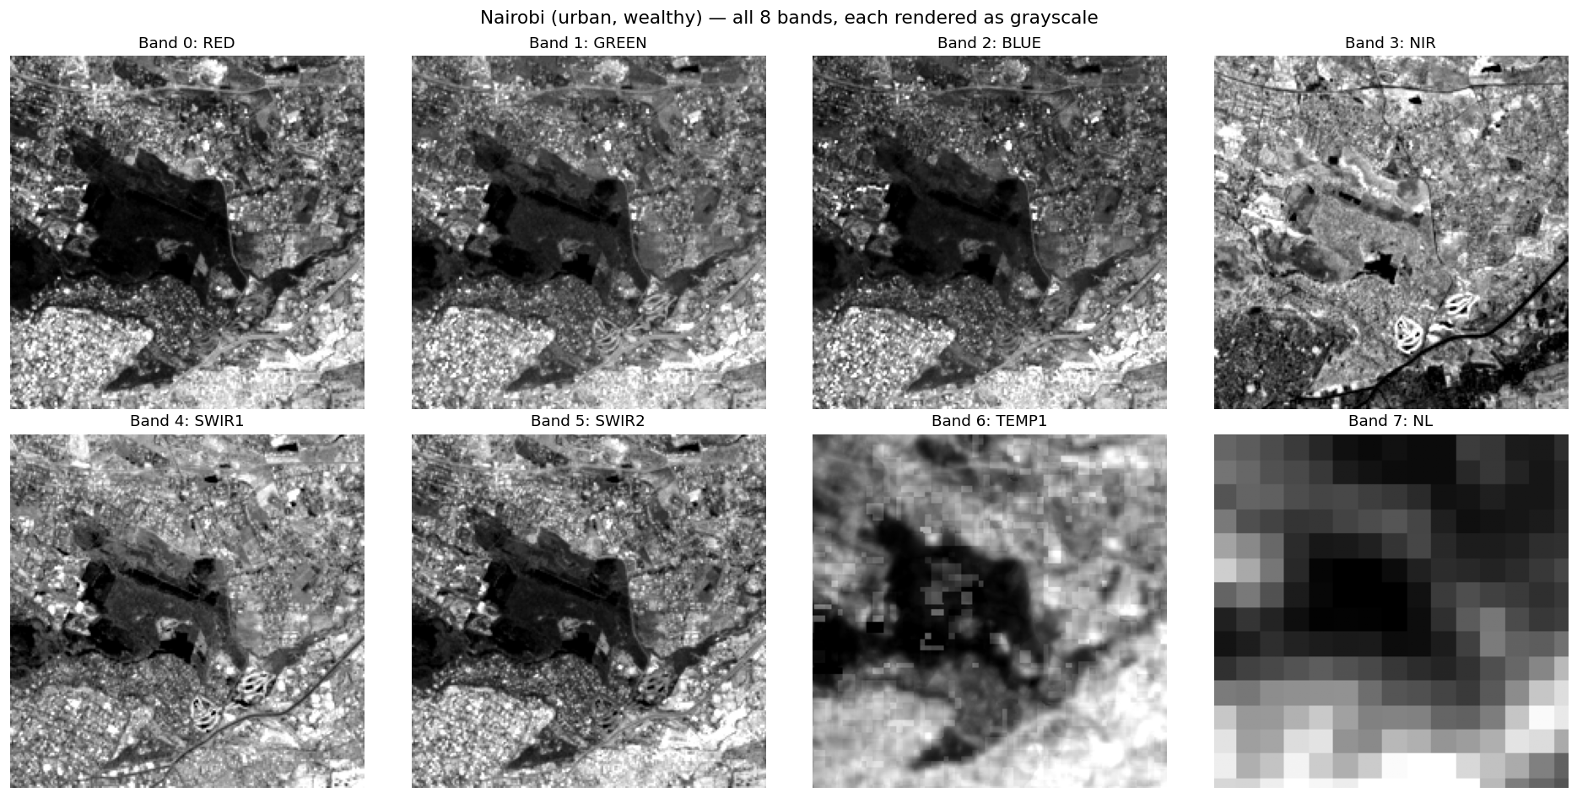
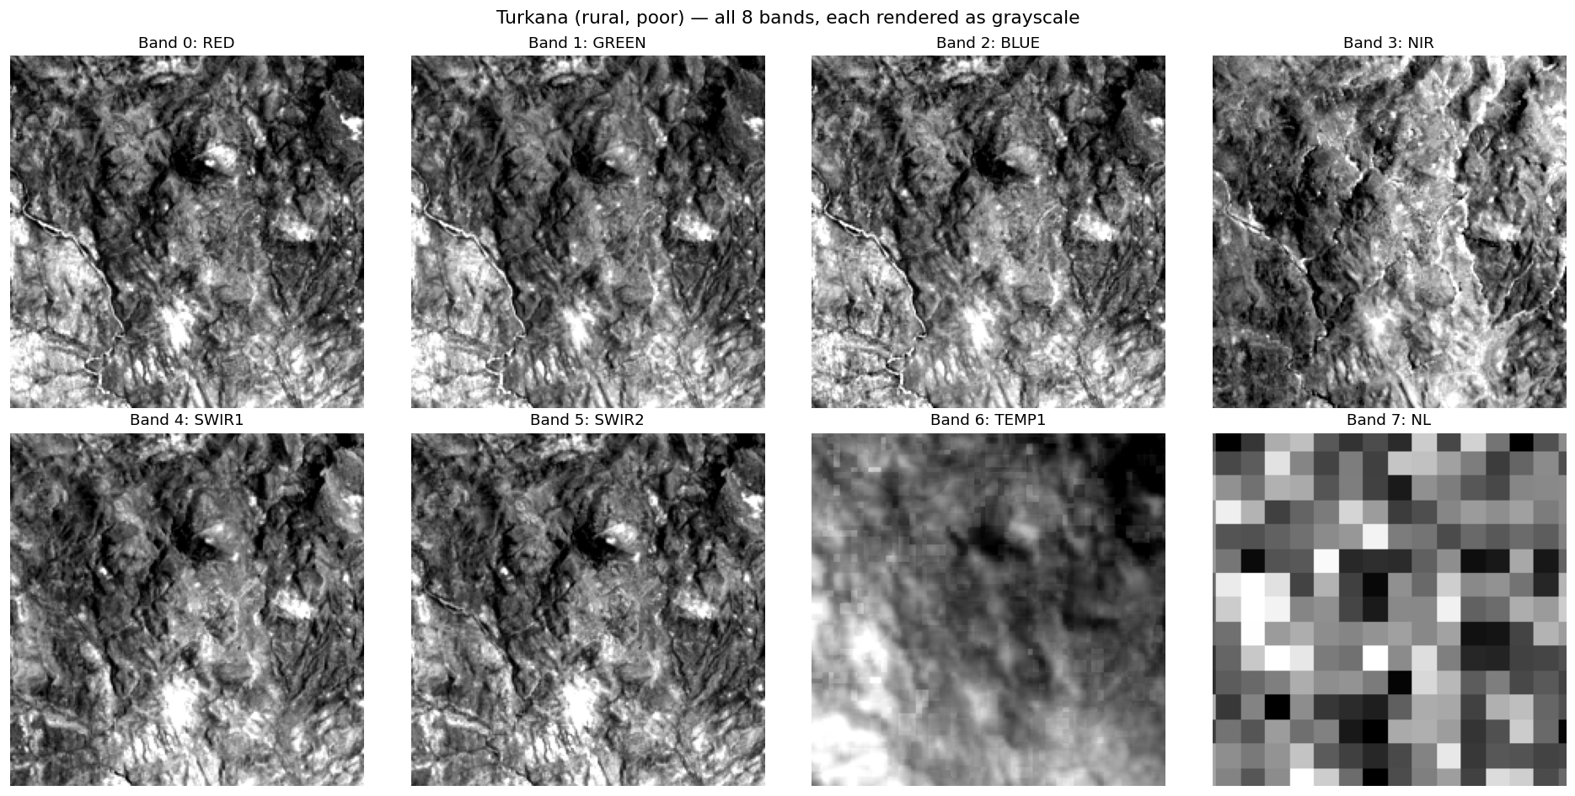
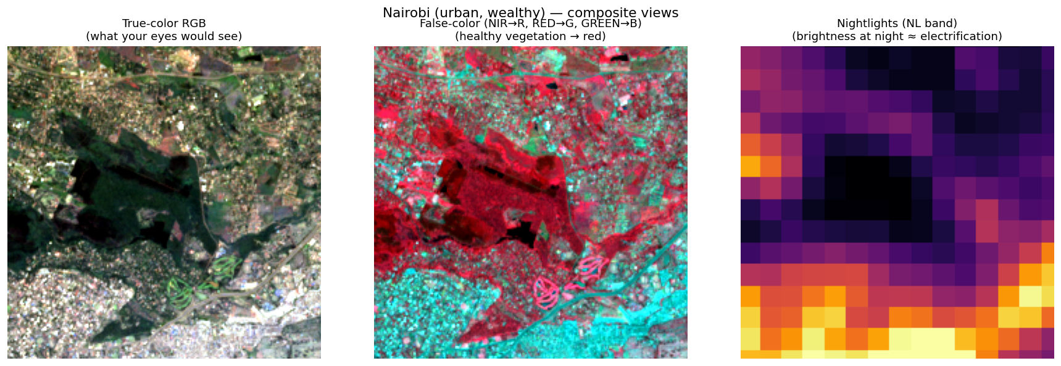
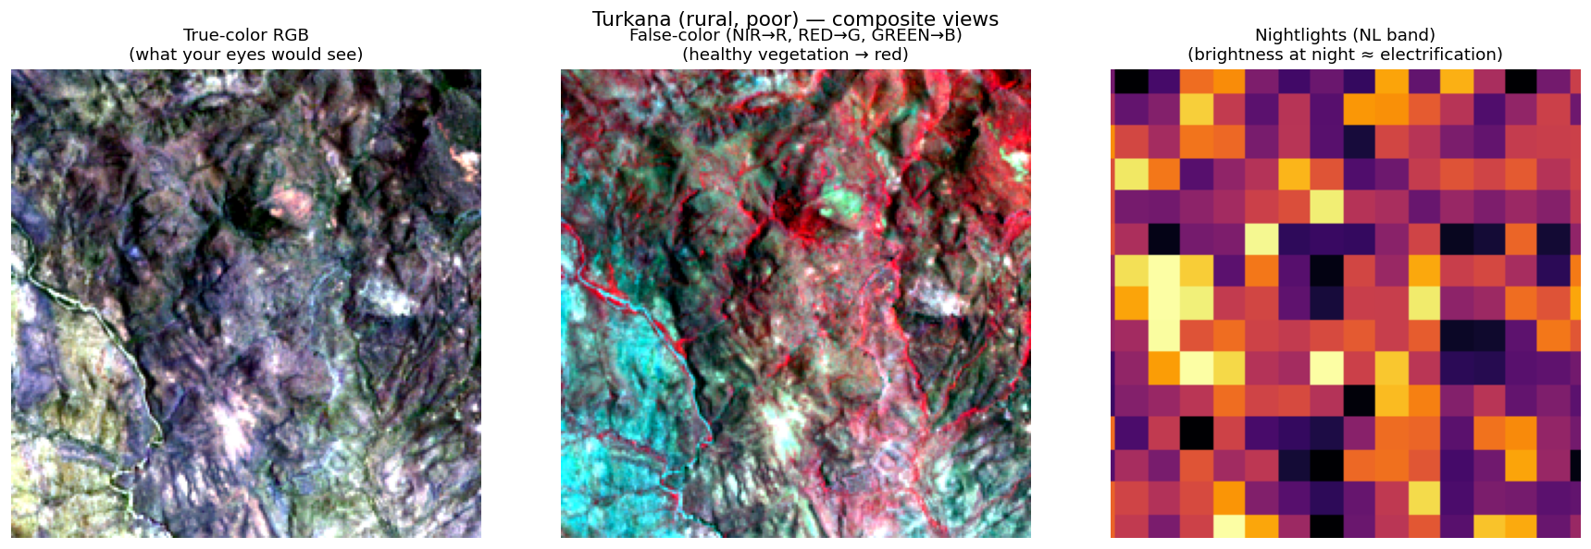
DATA · THE INPUT
Eight Ways to See a Village
URBAN — NAIROBI, KENYA
RURAL — TURKANA, KENYA
8 channels = 8 ‘senses’: visible colour, infrared (vegetation & rooftops), thermal (heat), night-lights (electrification). The CNN reads all 8 together and outputs one wealth number.
Predicting Village Wealth from Space · Onur Haniffa
06 / 19

Slide 8
METHOD · THE MODEL
The Model, in 20 Seconds
▸ A ResNet-18 — a standard, well-understood convolutional network
▸ Two tweaks: the input is rebuilt for 8 channels (not 3), and the output is one number (not categories)
▸ Trained from scratch on the satellite tiles
The science is in the data and the honest evaluation — not the architecture.
Predicting Village Wealth from Space · Onur Haniffa
07 / 19

Slide 9
METHOD · THE HONEST TEST
Testing on Countries It Has Never Seen
WHY NOT A RANDOM SPLIT?
CROSS-COUNTRY VALIDATION
▸ Split villages randomly and the model can MEMORISE a country
▸ Same country in train AND test = it cheats — a flattering but fake score
▸ Useless for the real question: does it generalise to a NEW place?
▸ Train on ~18 countries, test on 5 it has NEVER seen
▸ Rotate so every country is the test set exactly once
▸ Every number we report is on unseen countries
Like an exam with questions you never studied — the only fair test.
Predicting Village Wealth from Space · Onur Haniffa
08 / 19

Slide 10
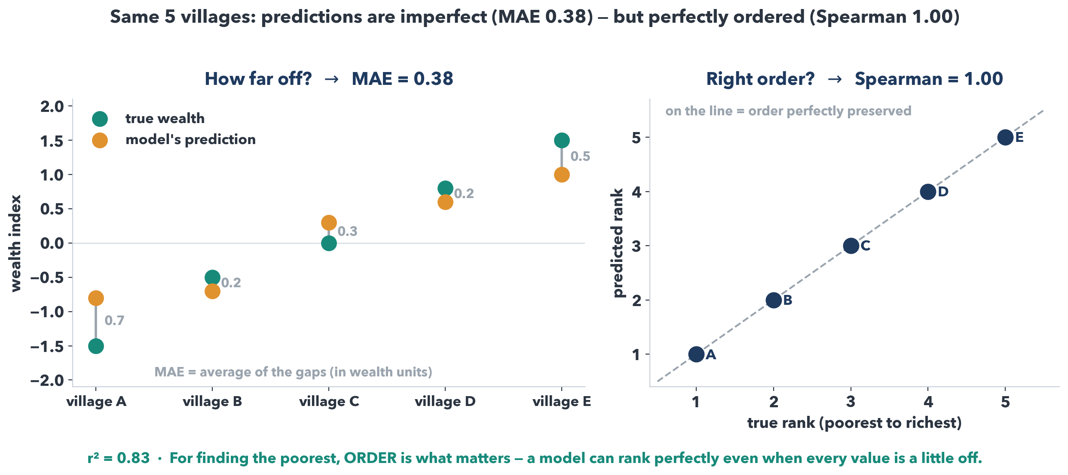
METHOD · MEASURING SUCCESS
How Do We Know If It’s Good?
Three metrics — because they answer different questions.
Predicting Village Wealth from Space · Onur Haniffa
09 / 19

Slide 11
RESULTS · REPLICATION
Does It Work? Yes — at Benchmark Level.
0.78
0.78
0.55
0.45
Pearson r (ours)
= WILDS benchmark
worst-group r
WILDS worst-grp
▸ In Pearson r — the metric WILDS PovertyMap reports — we MATCH the published benchmark (0.78)…
▸ …and BEAT its worst-group score (0.55 vs 0.45), on the same leave-country-out protocol
▸ Pooled r² 0.61 on unseen countries; the ‘gap to Yeh’ was an r²-framing of the from-scratch penalty
▸ Over 2× a naïve floor — it genuinely reads wealth from space, on countries it has never seen
Predicting Village Wealth from Space · Onur Haniffa
10 / 19

Slide 12
RESULTS · WHAT DRIVES IT
What Carries the Signal? Night-lights.
0.58
0.52
0.46
night-lights only
all 8 channels
daytime only
▸ Night-lights ALONE roughly match the full 8-channel model
▸ Lights = electrification = the single strongest village-wealth signal
▸ Daytime imagery adds little here (it is data-hungry, and we are data-limited)
▸ Foreshadows the limit: if the signal is mostly lights, what happens where there are none?
Predicting Village Wealth from Space · Onur Haniffa
11 / 19

Slide 13
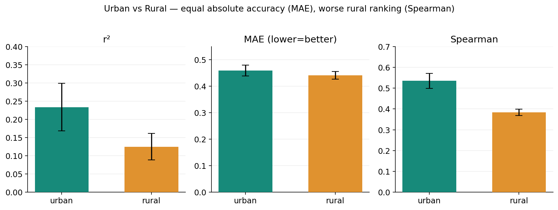
RESULTS · THE AUDIT (1/2)
It Serves Cities Better Than Villages
Remember Nairobi vs Turkana? Equal absolute accuracy (MAE), but the model RANKS rural villages worse (Spearman 0.41 vs 0.54) — in 21 of 23 countries.
Predicting Village Wealth from Space · Onur Haniffa
12 / 19

Slide 14
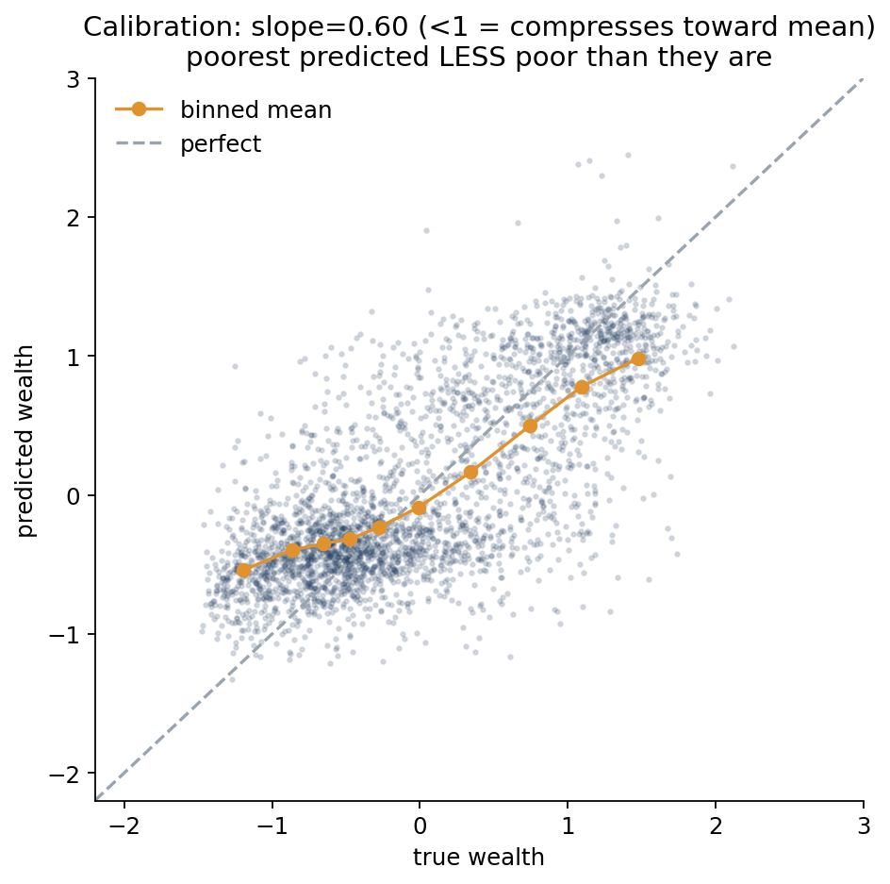
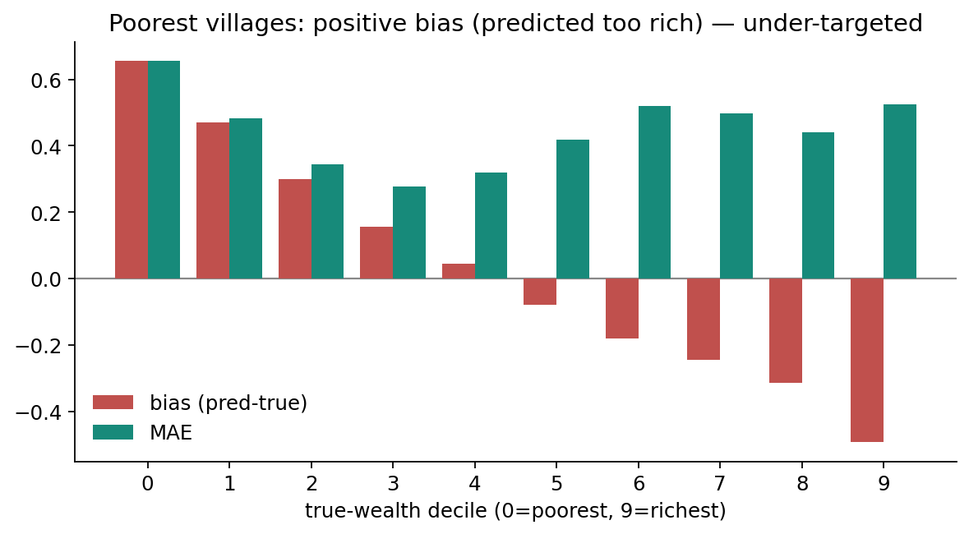
RESULTS · THE AUDIT (2/2)
Confidently Wrong About the Poorest
The model compresses toward the average: it predicts the POOREST as richer than they are, with the biggest errors exactly there. Targeting the poorest 20%, it finds only ~23% of them.
Predicting Village Wealth from Space · Onur Haniffa
13 / 19

Slide 15
THE PUNCHLINE
A Fundamental Limit
CONFIDENTLY WRONG
UNDETECTABLE
UNFIXABLE
The audit: largest, most biased errors fall on the poorest villages
→
No uncertainty method — ensembles, MC-dropout, learned variance — flags it
→
Reweighting the loss toward the poor doesn’t repair it — it just destabilises training
Because the signal isn’t there. Night-lights are uniformly dark below the poverty line — the satellite cannot separate the extreme poor.
Confirmed FIVE ways: confidently-wrong → undetectable → unfixable by reweighting (LDS & Balanced-MSE) → unfixable by 3× data → and it recurs out-of-distribution (next slides).
Predicting Village Wealth from Space · Onur Haniffa
14 / 19

Slide 16
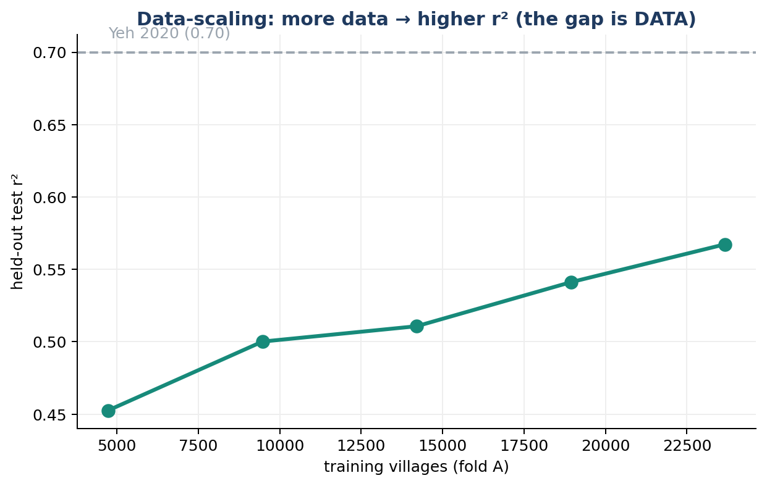
RESULTS · SCALE
The Full Study Confirms It (3× Data)
0.61
+0.59
≈
pooled r² (full)
poorest-bias
fairness unchanged
▸ 3× the data (multi-round): accuracy rises 0.52 → 0.61
▸ But the poorest-bias barely moves (+0.62 → +0.59)
▸ More data helps accuracy — NOT equity
Predicting Village Wealth from Space · Onur Haniffa
15 / 19

Slide 17
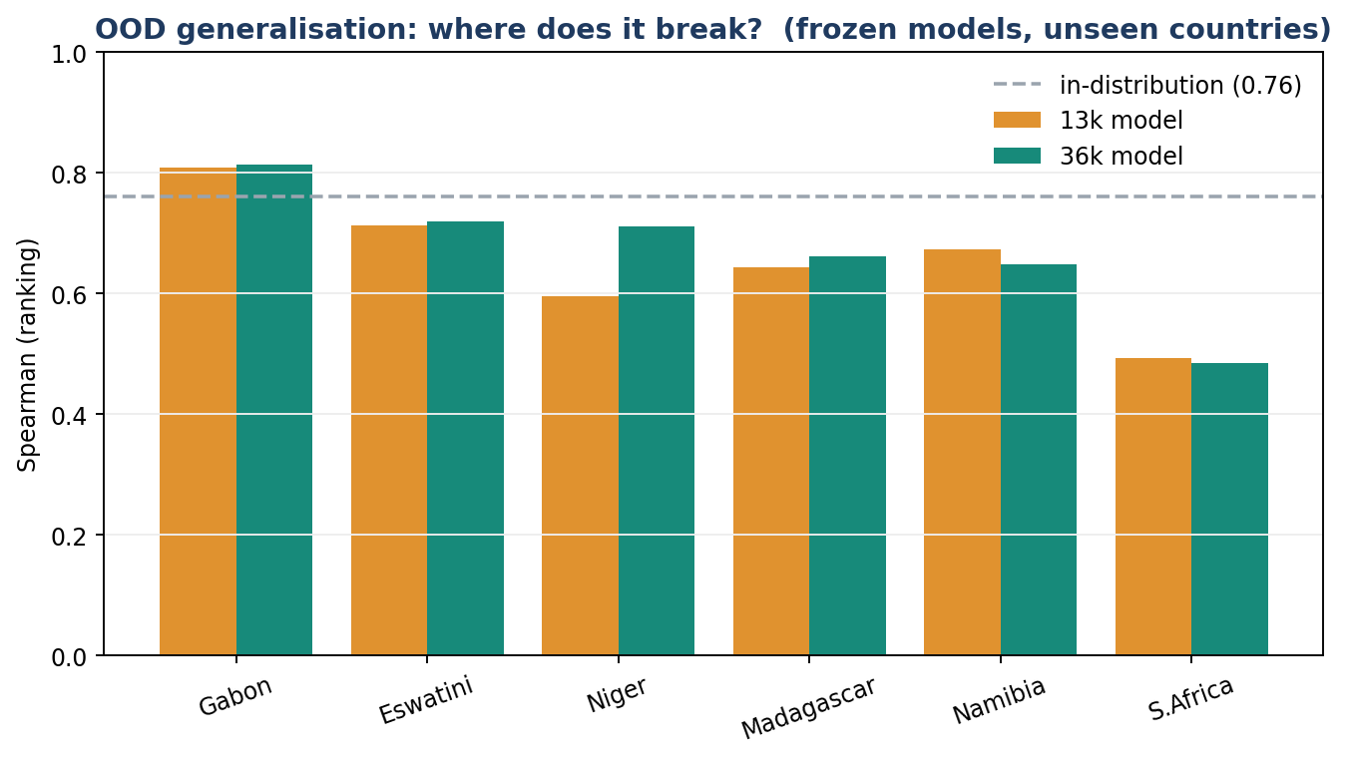
RESULTS · OOD CAPSTONE
Where Does It Break? Unseen Countries.
Frozen model, 6 never-seen countries. Ranking TRANSFERS (Gabon 0.81 beats home) — but it BREAKS on rich South Africa (r² −1.7): the same flatten-the-extremes flaw, now on the rich tail. And more data does NOT help OOD.
Predicting Village Wealth from Space · Onur Haniffa
16 / 19

Slide 18
METHOD · HONESTY
Is Our Evaluation Honest? We Checked.
+20%
23/23
0.61
what naïve CV inflates
survive FDR control
[0.54–0.66] honest CI
▸ Random-split CV scores 0.73 vs our country-blocked 0.61 — a +20% leakage inflation we REFUSE to claim
▸ No memorisation: train r² 0.70–0.80 (not ~1.0); learning curve early-stopped at best validation
▸ Whole-country bootstrap CIs + Benjamini-Hochberg FDR across all 23 per-country tests
▸ Residuals carry local spatial structure — unmodelled signal, NOT leakage (folds are country-disjoint)
Predicting Village Wealth from Space · Onur Haniffa
17 / 19

Slide 19
CONTRIBUTIONS
What’s New Here
SOLID FOUNDATION
MOST NOVEL
▸ Faithful modern replication — matches the WILDS benchmark in Pearson r
▸ The most comprehensive fairness + uncertainty audit on this 23-country data
▸ Adds temporal + out-of-distribution external validity (frozen models, 6 new countries)
▸ Equity-framed uncertainty: even calibrated UQ cannot flag the failure on the poorest
▸ A fundamental-limit thesis confirmed FIVE independent ways — apparently unstated in the literature
Honest positioning: this is a rigorous AUDIT, not a new architecture — and we don’t claim a new state of the art.
Predicting Village Wealth from Space · Onur Haniffa
18 / 19

Slide 20
THE ONE THING TO REMEMBER
Satellite poverty maps are great for ranking regions — not for last-mile targeting of the extreme poor — and standard uncertainty tools can’t warn you when they’re wrong about the neediest.
Thank you · Questions?

