Slide 1
ML/DL INTERNSHIP · SPRING 2026 · ACIBADEM MAAÜ
Predicting Village Wealth from Space
A modern replication & fairness audit of Yeh et al. (2020), Nature Communications
Onur Haniffa · Advisor: Dr. Seda Nilgün Dumlu · 22 May 2026

Slide 2
MOTIVATION
The Problem & the Promise
THE PROBLEM
THE PROMISE
▸ Reliable poverty data is scarce, expensive, and infrequent
▸ Thinnest exactly where the need is greatest
▸ Decisions get made on stale or missing numbers
▸ Satellites image everywhere on Earth, cheaply and repeatedly
▸ Can a neural network read household wealth from imagery?
▸ If yes: a scalable complement to ground surveys
poverty-cnn · Onur Haniffa
01 / 11

Slide 3
BACKGROUND
Where This Comes From
THE LINEAGE
OUR FOUR CONTRIBUTIONS
▸ Jean 2016 (Science): nightlights + transfer learning
▸ Yeh 2020 (Nature Comms): mean r² = 0.70 across 23 countries
▸ Aiken 2023 (IJCAI): fairness gaps — but only 10 countries
▸ Replicate Yeh in modern PyTorch
▸ Fairness audit across ALL 23 countries
▸ Uncertainty-aware fairness (novel)
▸ Temporal fairness drift (novel)
poverty-cnn · Onur Haniffa
02 / 11

Slide 4
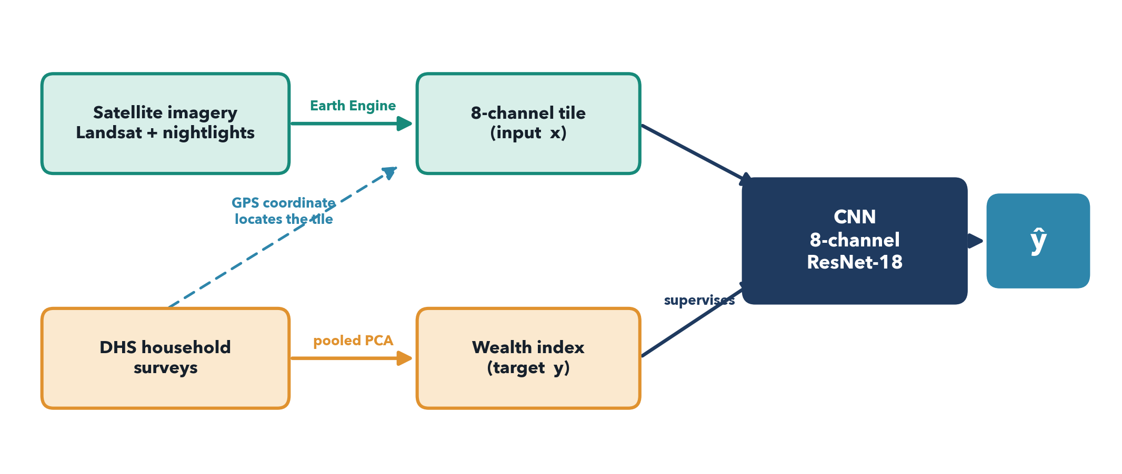
APPROACH
Two Data Sources, One Model
Each village's GPS point pulls a satellite tile (x); its survey gives a wealth value (y); the CNN learns x → y.
poverty-cnn · Onur Haniffa
03 / 11

Slide 5
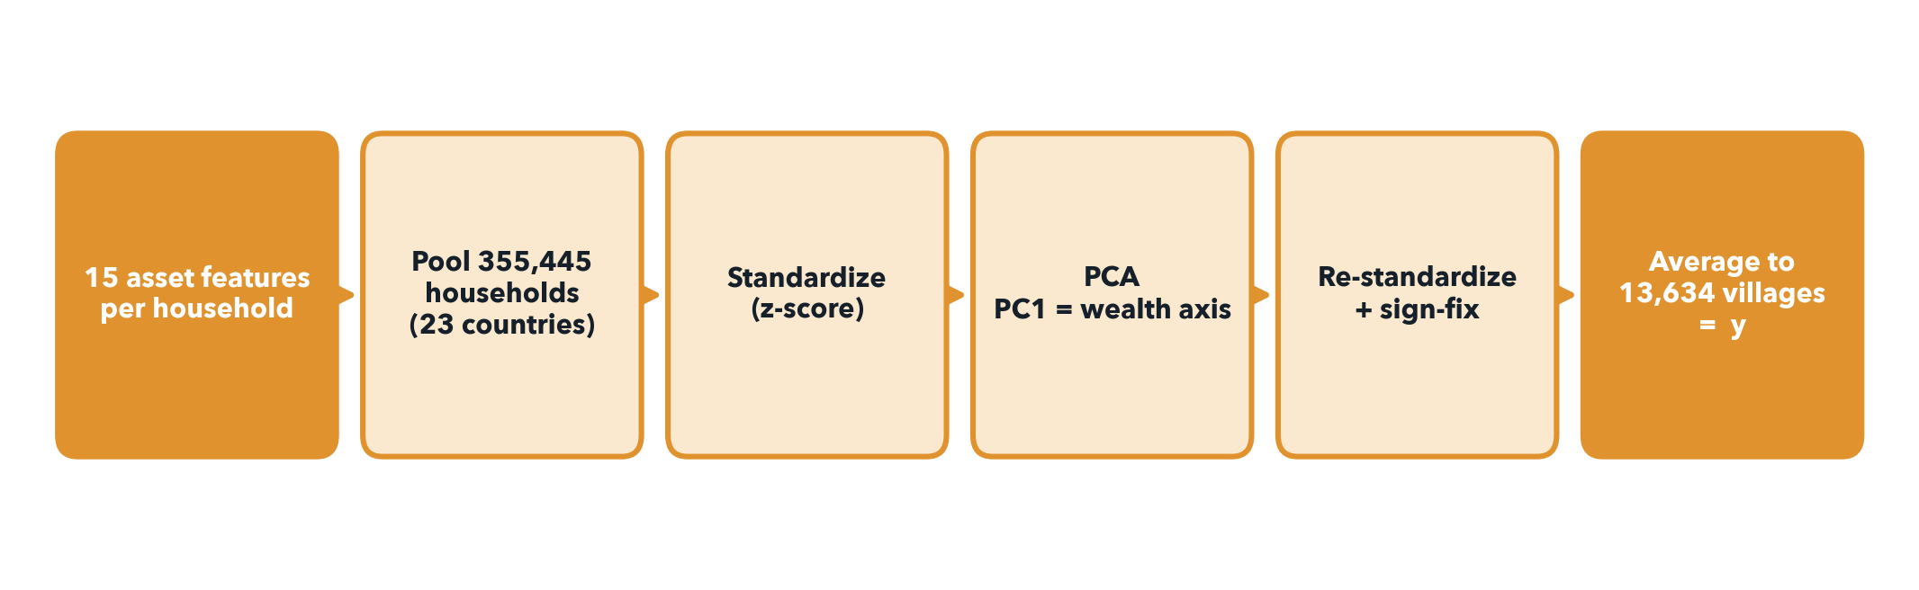
METHOD · WEALTH INDEX
From a Survey to a Wealth Number
Assets, not income. Pool every household across 23 countries, run PCA, take PC1 as the wealth axis, average to the village.
PC1 explains 28.7% of total variance.
poverty-cnn · Onur Haniffa
04 / 11

Slide 6
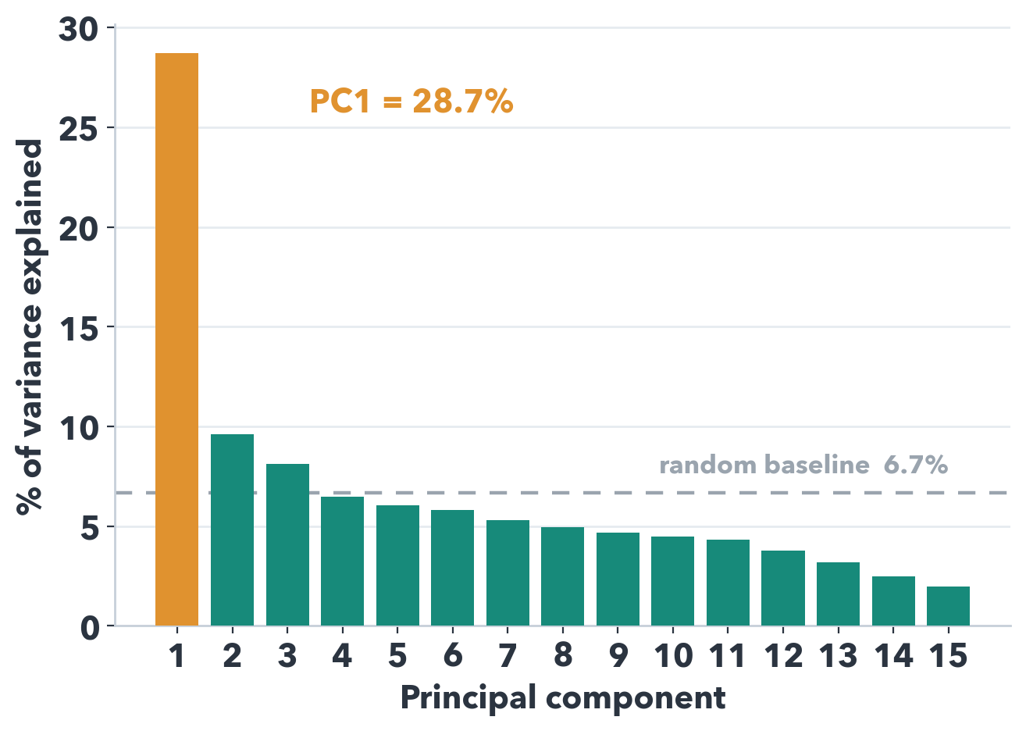
METHOD · VALIDITY
Is PC1 a Valid Wealth Index?
WHY 28% IS PLENTY
▸ PC1 = 28.7% — but the benchmark is the 6.7% random floor, not 50%
▸ That is 4.3× the floor: one strongly dominant factor
▸ Binary survey data caps variance; 20–40% is the norm
▸ Variance = compactness, not validity
▸ Validated by the country ranking + urban/rural gap
poverty-cnn · Onur Haniffa
05 / 11

Slide 7
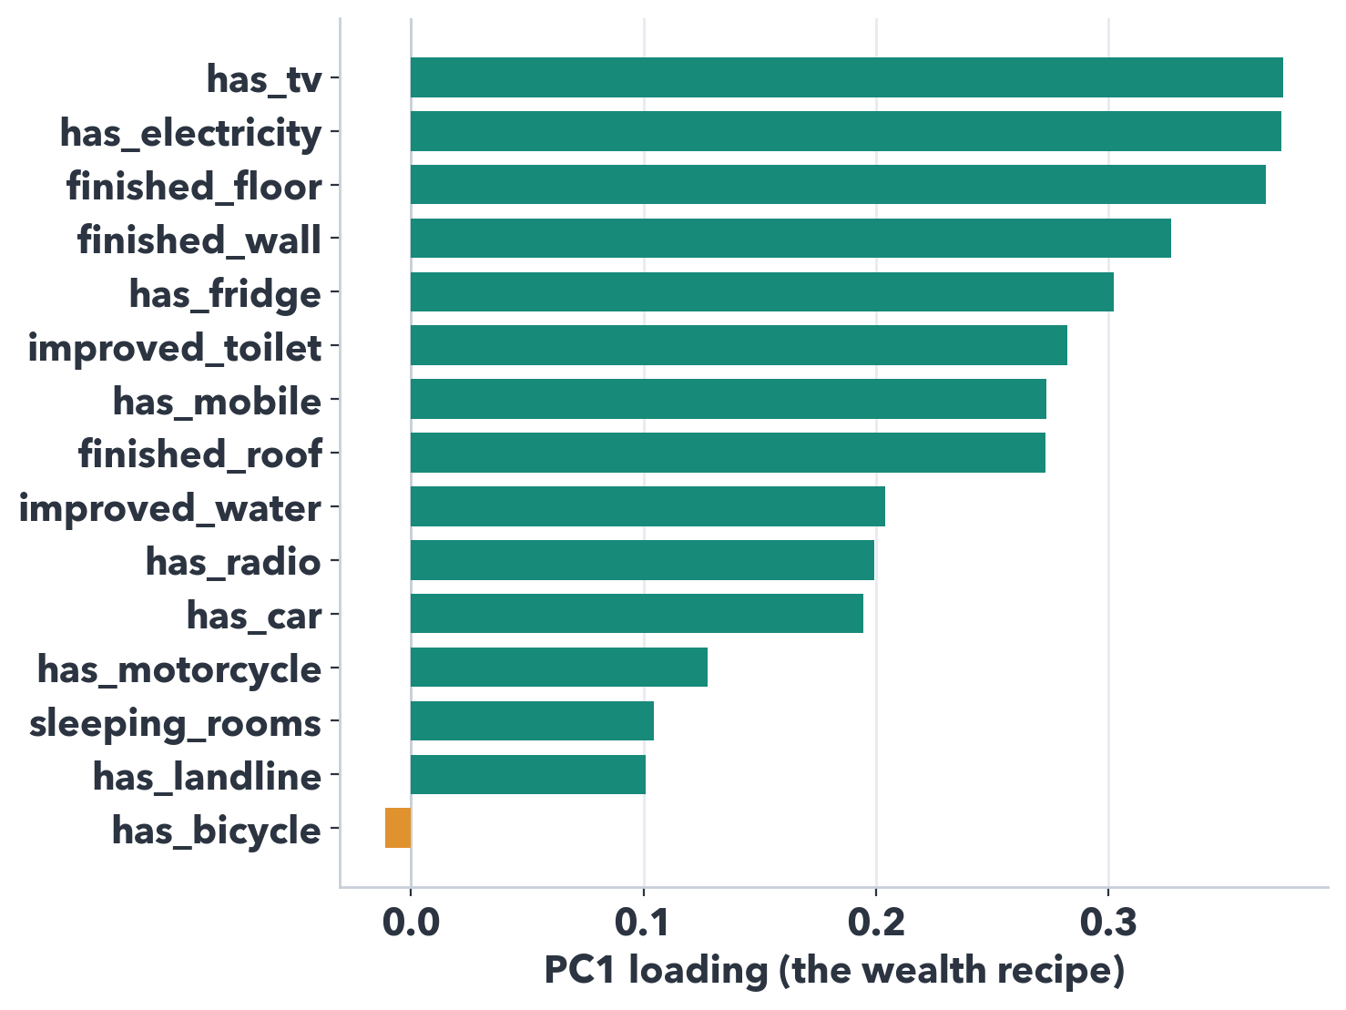
METHOD · INTERPRETATION
Why PC1 Is Wealth, Not PC2/PC3
LEVEL VS CONTRAST
▸ A wealth factor makes ALL assets rise together (a 'level')
▸ PC1 is all-positive → that IS wealth
▸ PC2/PC3 are orthogonal contrasts (mixed signs)
▸ PC2 = rural/traditional vs urban/modern; PC3 = big durables
▸ Wealth is the #1 driver → it lands on PC1 by construction
poverty-cnn · Onur Haniffa
06 / 11

Slide 8
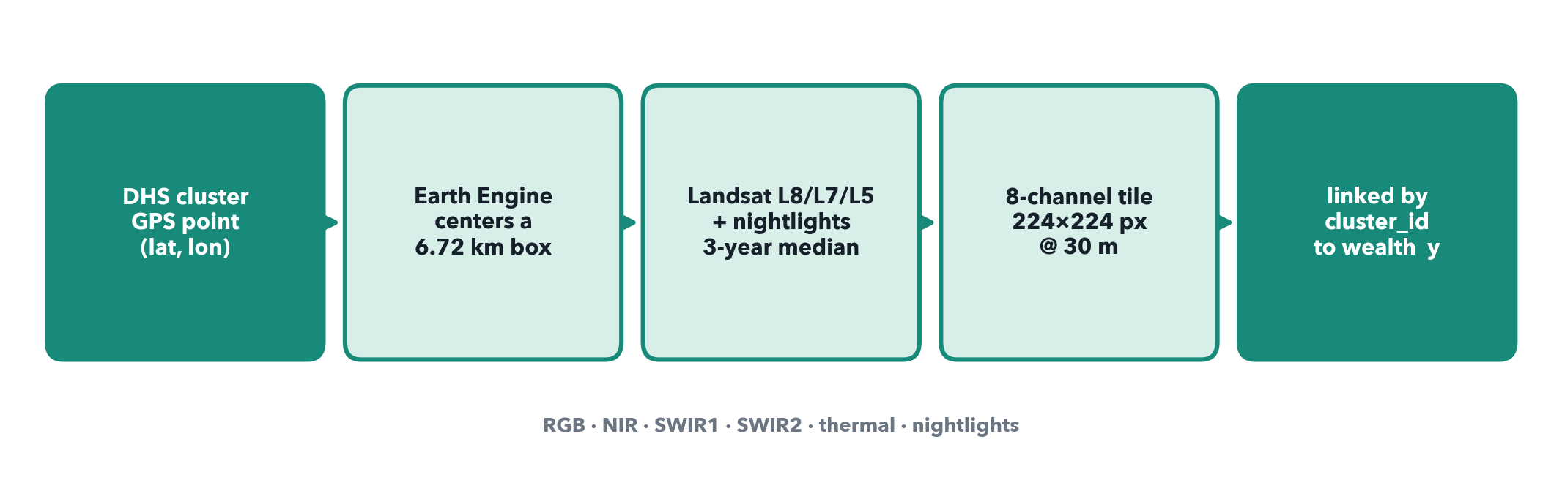
METHOD · IMAGERY
From a GPS Point to a Tile
The GPS coordinate selects the patch; Earth Engine builds a cloud-free 3-year median; 8 bands stack into one 224×224 tile.
poverty-cnn · Onur Haniffa
07 / 11

Slide 9
PREPROCESSING
Decisions & Honest Divergences
▸ Ordinal categoricals (floor/wall/roof, water, toilet) collapsed to a binary 'improved/finished' flag — documented divergence
▸ Quality filter: drop households missing >30% of features — only ~30 of 355,445 dropped (99.99% complete)
▸ Special DHS codes handled (e.g. 'rooms' 96/97/98/99 → missing, not a fake 10-room house)
▸ Nightlights: DMSP-OLS (pre-2012) vs VIIRS (2012+) — different scales, documented
▸ One survey round per country → 13,634 clusters (Yeh pooled multiple rounds → 19,669)
poverty-cnn · Onur Haniffa
08 / 11

Slide 10
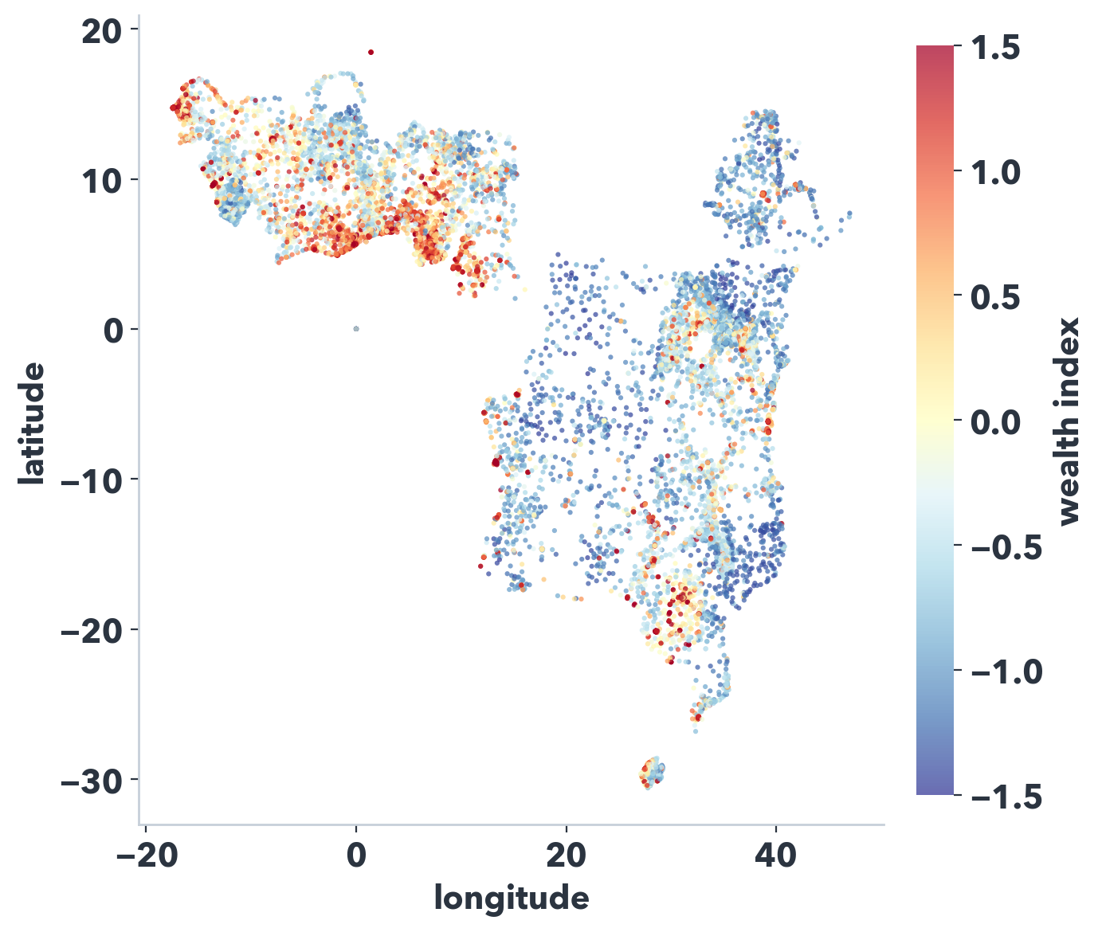
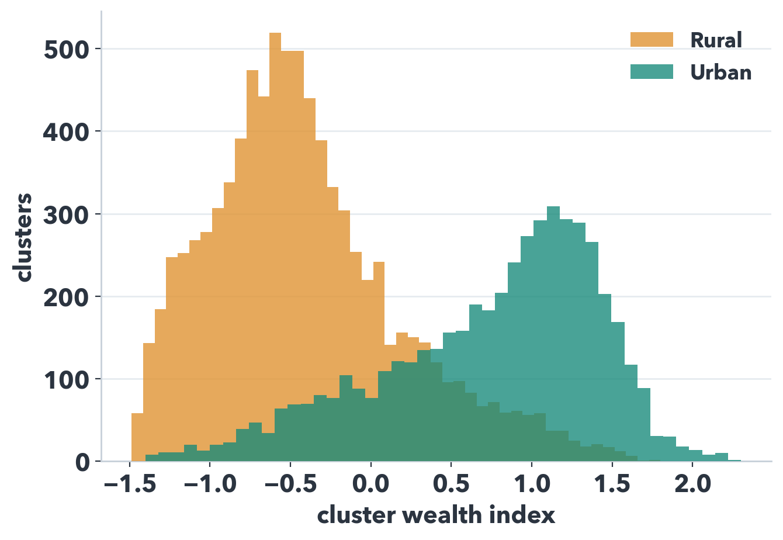
EDA
What the Data Looks Like
13,634
28.7%
1.16σ
georeferenced clusters
PC1 variance
urban/rural gap
poverty-cnn · Onur Haniffa
09 / 11

Slide 11
STATUS
Status & Plan
DONE
IN PROGRESS
NEXT
▸ DHS → wealth index, all 23 countries
▸ 355,445 households → 13,634 villages
▸ Full EDA
▸ Satellite tiles via Earth Engine
▸ ~50% extracted
▸ Finishing in ~1–2 days
▸ Pair tiles ↔ wealth
▸ Train 8-channel ResNet-18
▸ Replication r² → fairness → extensions
Target mean-of-folds r² ≥ 0.60 · Deadline 30 May 2026
poverty-cnn · Onur Haniffa
10 / 11

