Slide 1
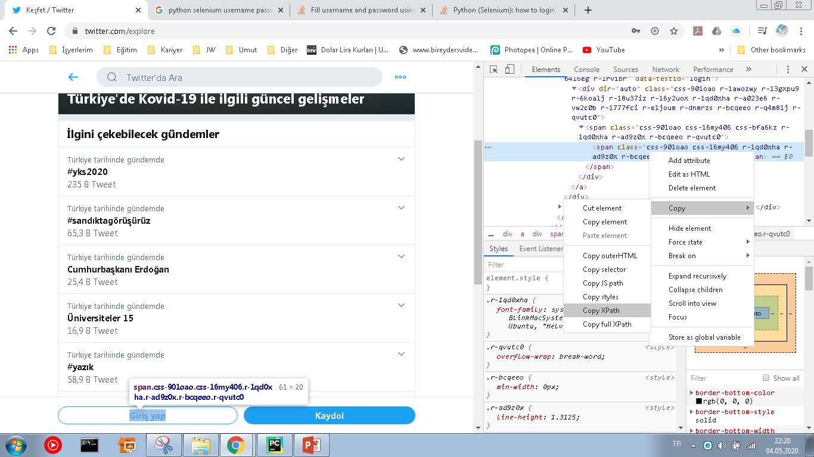
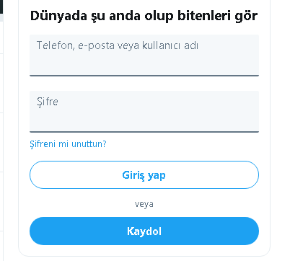
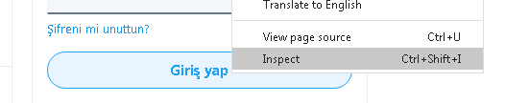
Kullanıcı adı ve şifrenin girilip Giriş Yap butonuna basılması
Sağ tıkla->

Slide 2
from selenium import webdriver import time browser = webdriver.Chrome() browser.get("https://twitter.com/login") time.sleep(3) username = browser.find_element_by_xpath('//*[@id="react-root"]/div/div/div[2]/main/div/div/form/div/div[1]/label/div/div[2]/div/input') password = browser.find_element_by_xpath('//*[@id="react-root"]/div/div/div[2]/main/div/div/form/div/div[2]/label/div/div[2]/div/input') username.send_keys("onurkaraguler@hotmail.com") password.send_keys("onildU8688") girisYap = browser.find_element_by_xpath('//*[@id="react-root"]/div/div/div[2]/main/div/div/form/div/div[3]/div/div/span/span') girisYap.click() time.sleep(5) browser.close()
Username ve password girdikten sonra giriş butonuna basacak

Slide 3
from selenium import webdriver import time from selenium.webdriver.common.keys import Keys browser = webdriver.Chrome() browser.get("https://twitter.com/login") time.sleep(1) username = browser.find_element_by_xpath('//*[@id="react-root"]/div/div/div[2]/main/div/div/form/div/div[1]/label/div/div[2]/div/input') password = browser.find_element_by_xpath('//*[@id="react-root"]/div/div/div[2]/main/div/div/form/div/div[2]/label/div/div[2]/div/input') username.send_keys("onurkaraguler@hotmail.com") password.send_keys("onildU8688") girisYap = browser.find_element_by_xpath('//*[@id="react-root"]/div/div/div[2]/main/div/div/form/div/div[3]/div/div/span/span') girisYap.click() time.sleep(1) searchArea = browser.find_element_by_xpath('//*[@id="react-root"]/div/div/div[2]/main/div/div/div/div[2]/div/div[2]/div/div/div/div[1]/div/div/div/form/div[1]/div/div/div[2]/input') searchArea.send_keys("german") searchArea.send_keys(Keys.ENTER) browser.close()
Arama kısmına «german» yazılır ve ENTER

