Slide 1
Wind Turbune Active Power Prediction
By
ONUR KULA

Slide 2
The Problem
The uncertainty surrounding the amount of energy that will be generated
The challenge of selecting suitable locations for wind farms.

Slide 3
The Solution
Predicting the amount of LV active power based on correlations with other variables.
Modelling

Slide 4
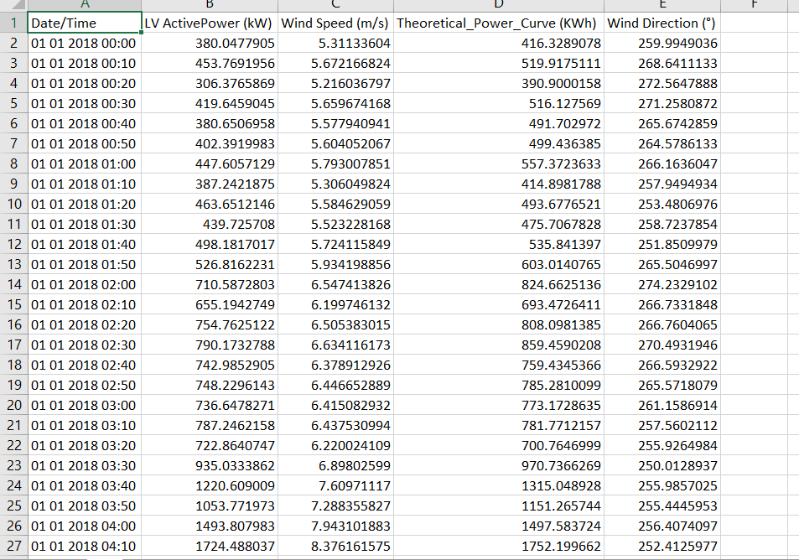
The Data
Data Source: https://www.kaggle.com/datasets/berkerisen/wind-turbine-scada-dataset/data

Slide 5
Data Wrangling
The wind turbine dataset comprises various measurements taken at 10- minute intervals throughout the year 2018.
Target variable: Lv Active Power
Technically, values for wind speed, LV active power, theoretical power, and wind direction cannot be less than 0.
After performing the necessary data wrangling steps, our refined dataset now consists of 50473 rows

Slide 6
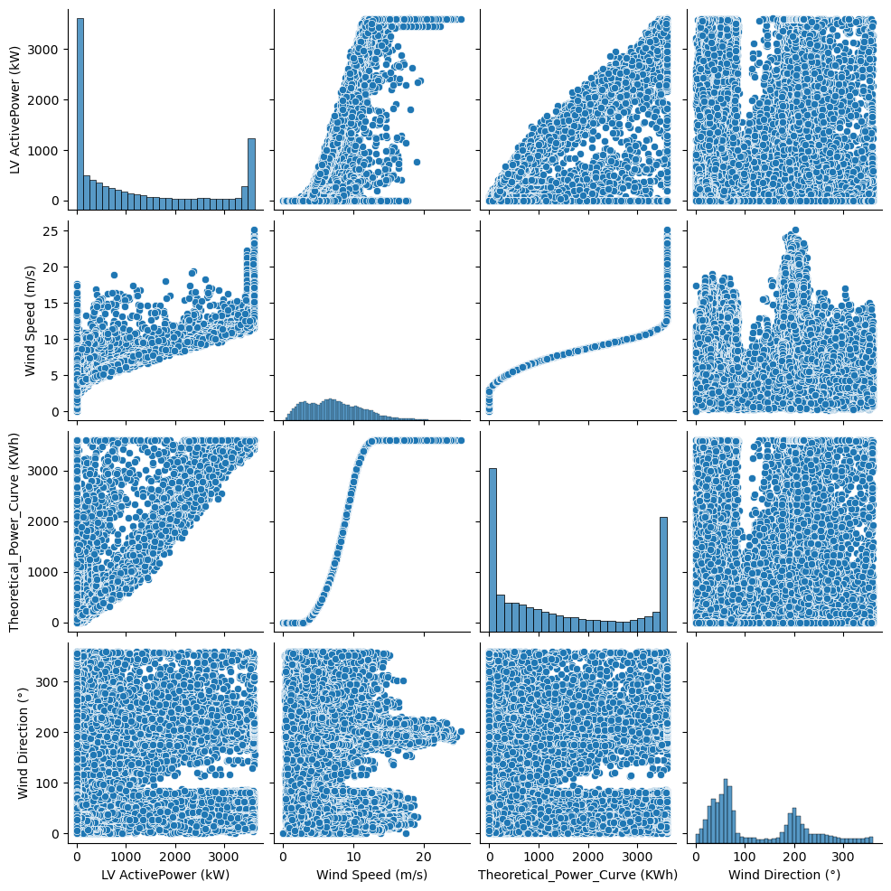
Explaratory Data Analysis

Slide 7
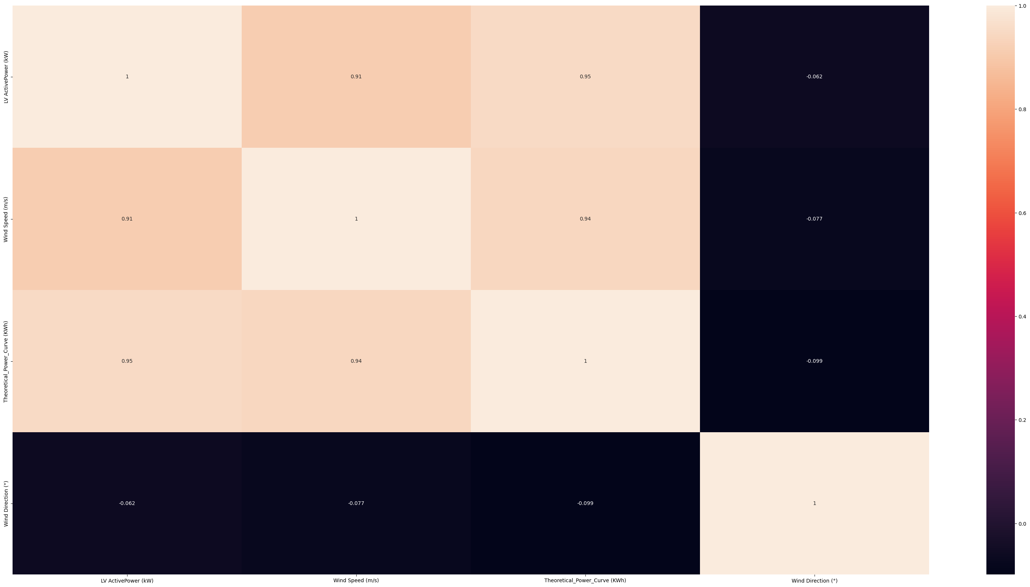

Slide 8
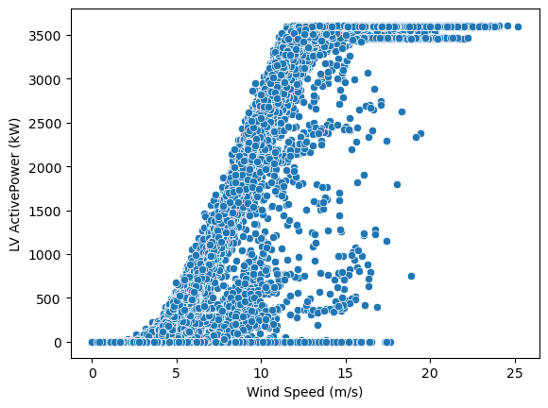

Slide 9
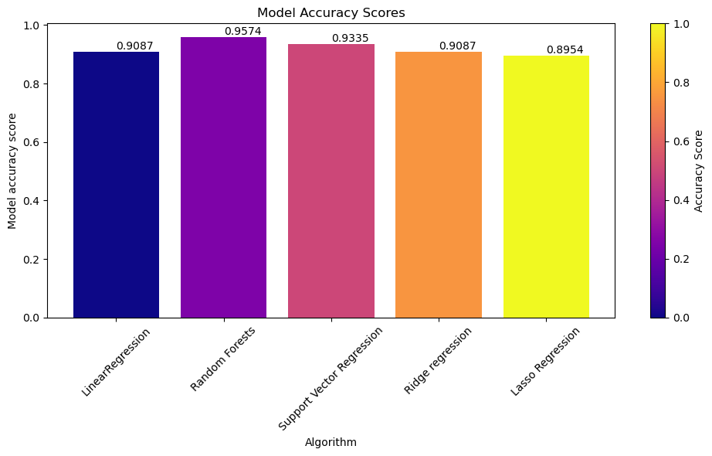
Model Selection

Slide 10
Takeaways
Random Forests is best model
Wind speed measurement matter most
All of the columns are important

Slide 11
Future Research
Expand to more parameters
Incorporating data from additional years
Incorporate external data sources such as weather forecasts, geographical data, or historical energy production data to enrich the feature set and improve model performance

Slide 12
THANK YOU FOR LISTENING

