Slide 1
Heart Disease Prediction
By
ONUR KULA

Slide 2
The Problem
Heart disease is a leading cause of death worldwide.
Traditional diagnostic methods can be time-consuming and costly.
Early detection is crucial for effective treatment and management.

Slide 3
The Solution
To address the problem of predicting heart disease, we propose using machine learning models trained on a comprehensive dataset that includes various health indicators.
By leveraging different machine learning algorithms, we can build models that accurately predict the likelihood of a patient having heart disease.

Slide 4
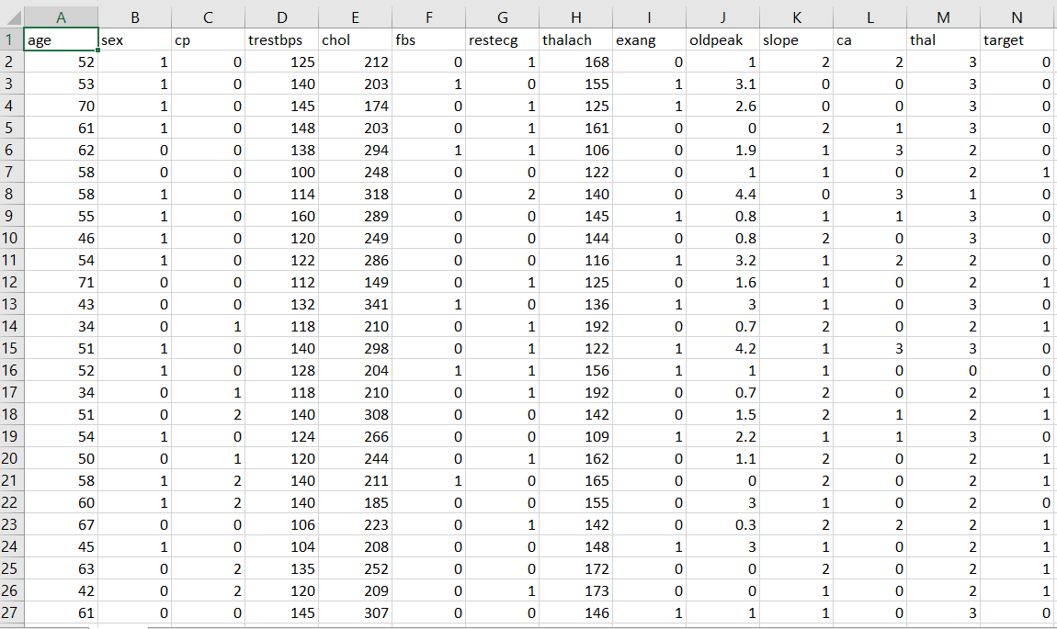
The Data
Data Source: https://www.kaggle.com/datasets/mexwell/heart-disease-dataset

Slide 5
Data Wrangling
The dataset is collected from a combined heart disease dataset, which includes data from five different sources: Cleveland, Hungarian, Switzerland, Long Beach VA, and Statlog.
This combined dataset consists of 1025 instances with 13 features.

Slide 6
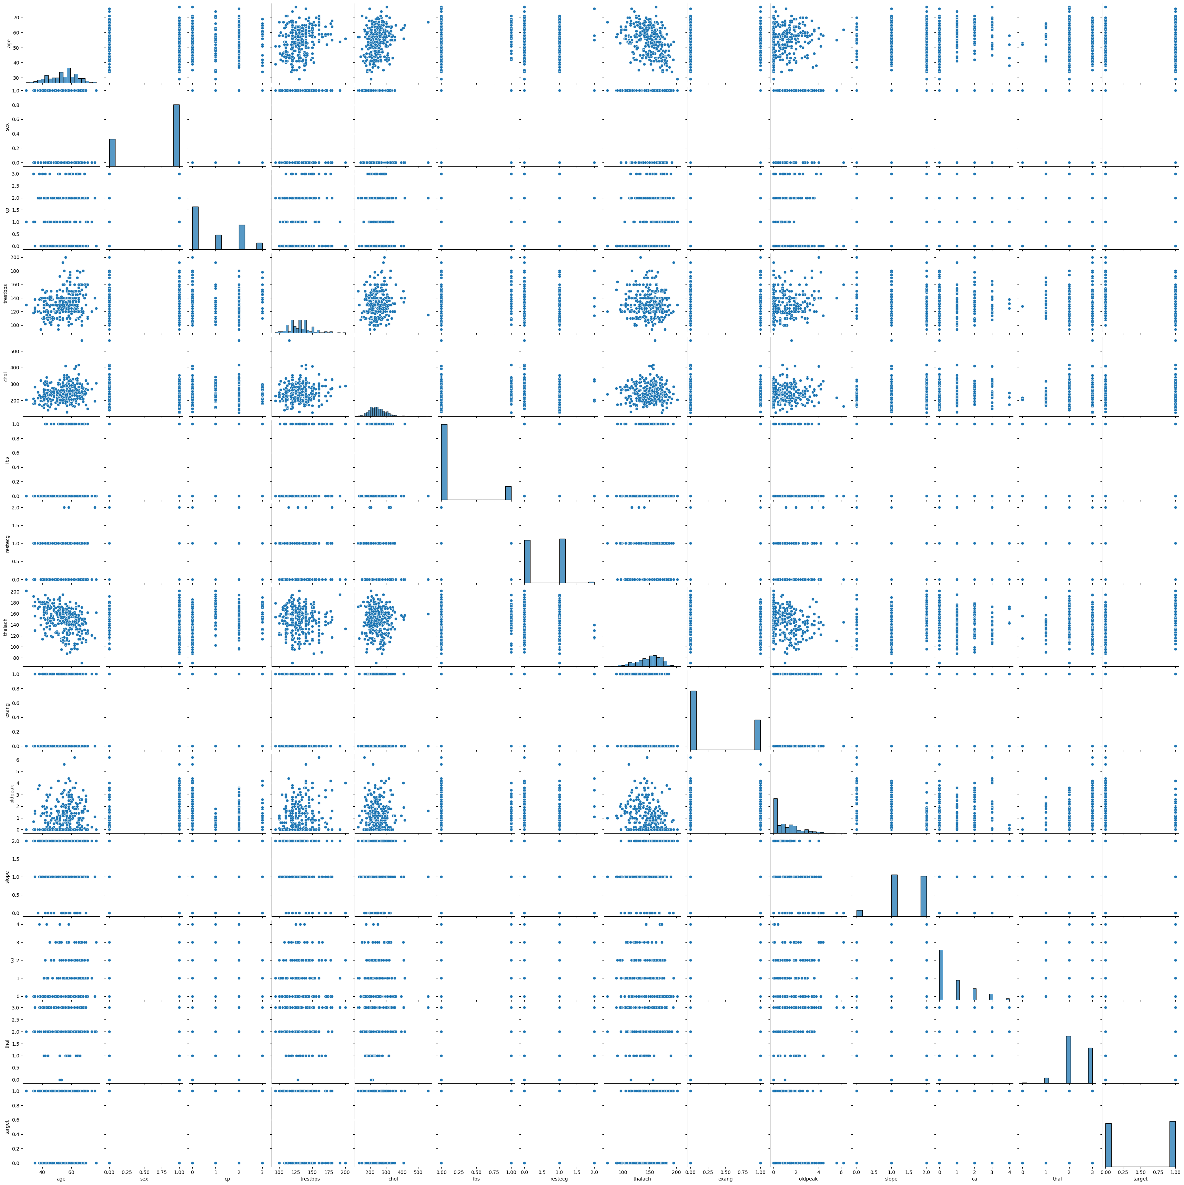
Explaratory Data Analysis

Slide 7
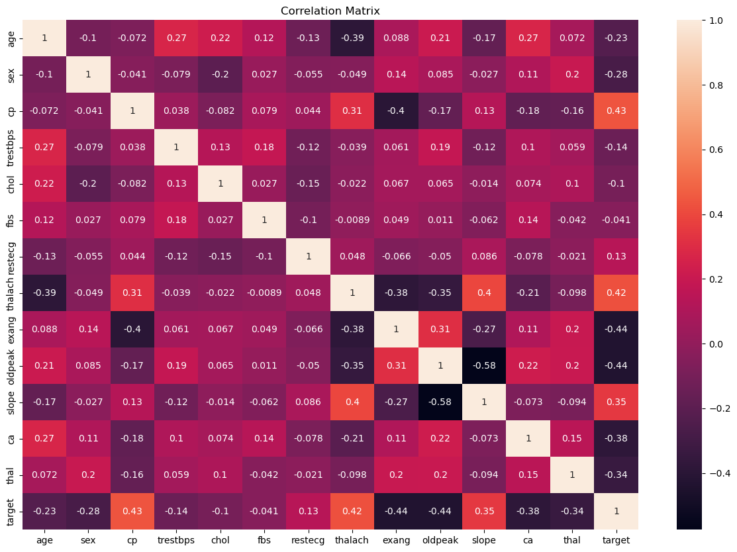

Slide 8
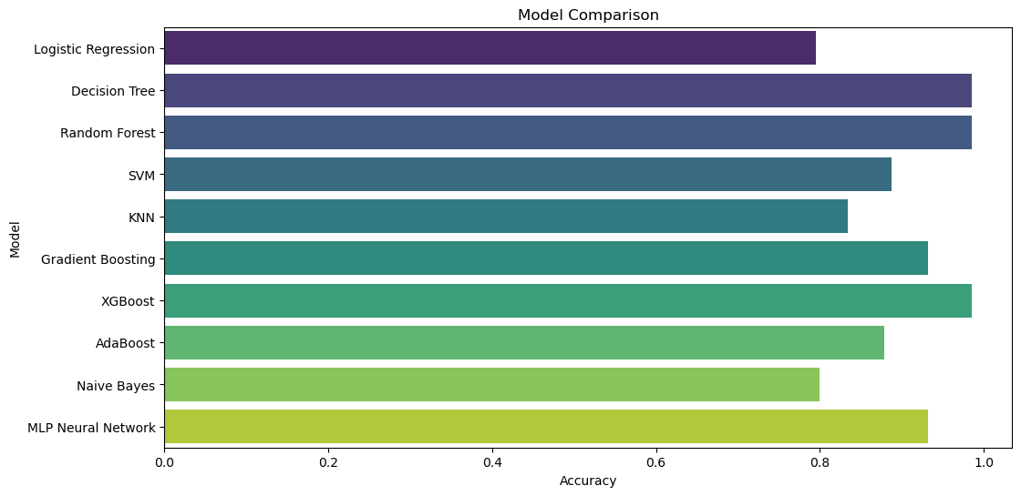
Model Selection

Slide 9
Takeaways
Random Forest Classifier, Decision Tree and XGBoost Classifier performed exceptionally well, achieving higher accuracy compared to others.
On the other hand, models like the Logistic Regression and Naive Bayes had lower accuracy.

Slide 10
Future Research
Expand to more parameters
Incorporating data from additional patients

Slide 11
THANK YOU FOR LISTENING

