Slide 1
CQRS IMPLEMENTATION (WORKSHOP)
Onur SALKAYA
onursalkaya@gmaıl.com

Slide 2

ABOUT ME
Technical Lead @Morhipo.com
10 years experience as a professional
(.net , .net core based architecture)
Code lover
Desiring learner
Fitness, drumming, family guy

Slide 3
agenda
Discussing Traditional and Monolithic Applications
Problems To Faced
Solution Suggestions
What is CQS?
What is CQRS
What Problems Does CQRS Solve?
Commands, Events
Eventually Consistency
CODING...

Slide 4
KEYWORDS
Command, Query, Event, Domain Driven Design, Entity, Aggregate, Microservices, Messaging, Transaction, Distributing, NoSql, Relational Database, Consistency, Concurrency...

Slide 5
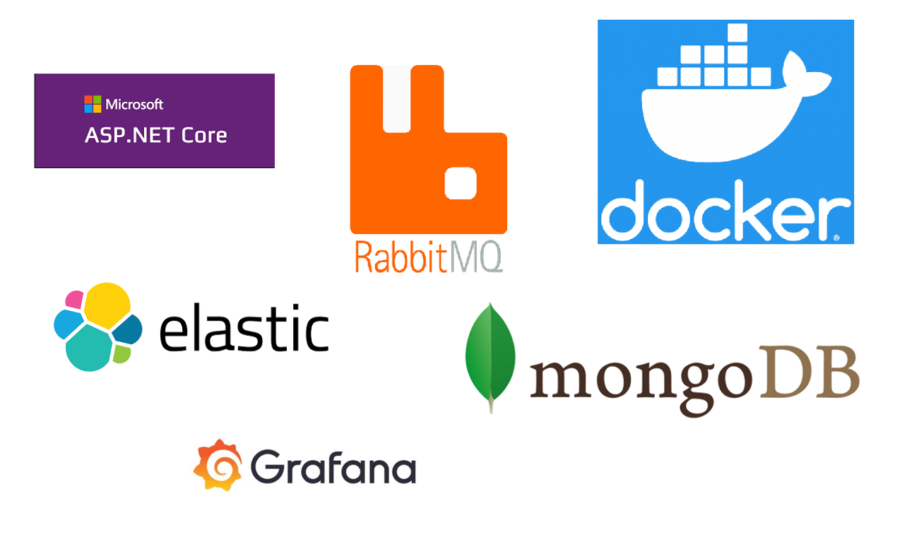

Slide 6
FOR MORE INFORMATION...
Martin Fowler
Greg Young
Udi Dahan
Bertrand Meyer

Slide 7
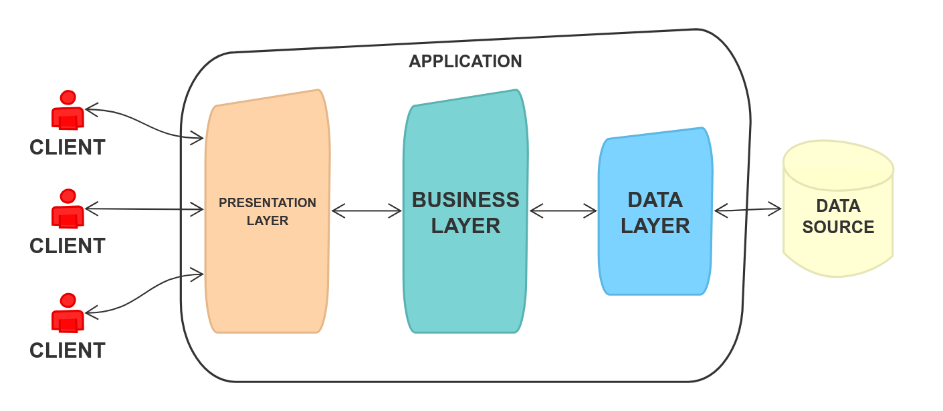
Tradıtıonal Monolıth applıcatıon

Slide 8
LET’S CODE...
(https://github.com/OnurSalkaya/cqrs-workshop/tree/01-Monolith)

Slide 9
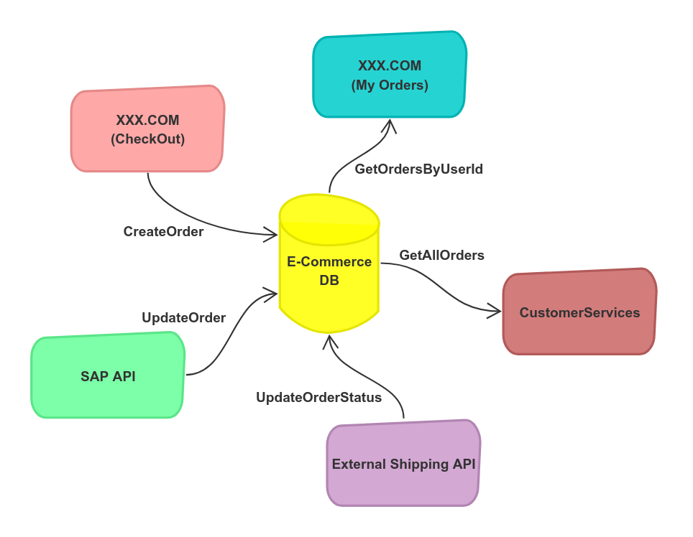
Tradıtıonal Monolıth applıcatıon

Slide 10
BaSIC CRUD OPERATIONS
The ultimate goal when developing software is to (usually) feed a data source and access the information from there when necessary
The complexity grows day by day
Size of data source grows also
After a while, we focus on maintaining rather than improving it

Slide 11
problems
Performance issues
Lots of transactions caused lots of bottleneck
Single of failure (Api, Data Source etc...)
Necessity to scale vertically

Slide 12
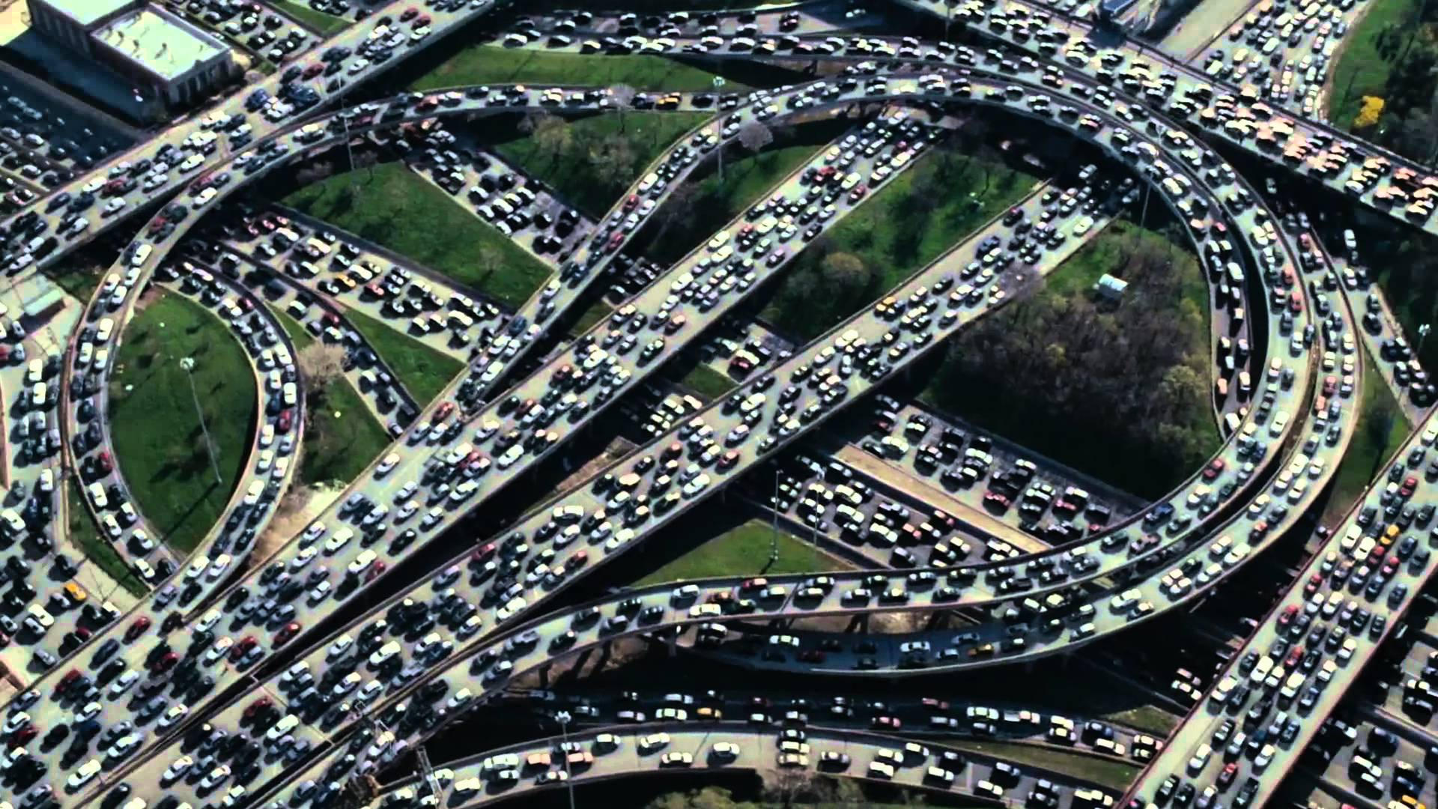

Slide 13
CQS
(Command Query Seperation)
Bertrand Meyer - 1997

Slide 14
Every Method Should Either Be
A Command That Perform An Action Or Change A State
OR
A Query That Returns Data From A Source
NOT BOTH!

Slide 15
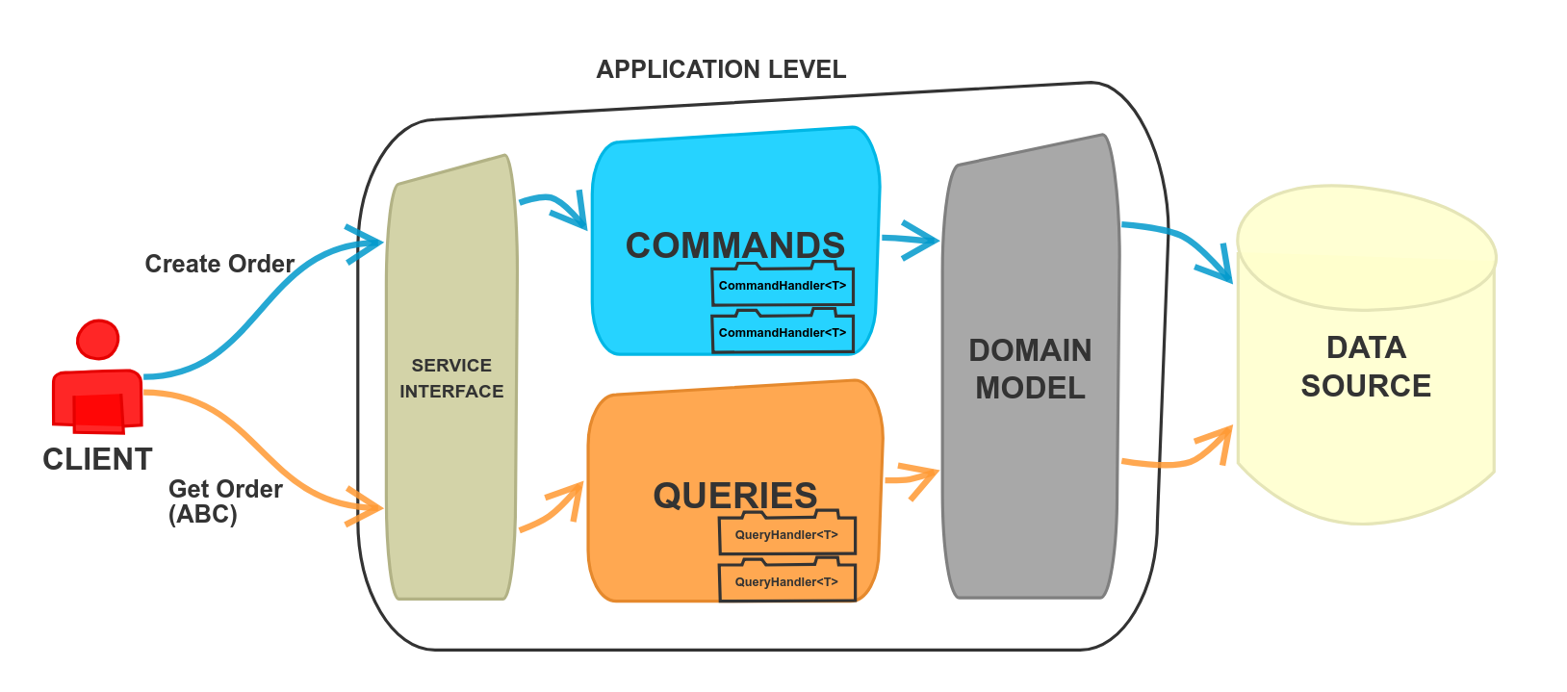

Slide 16
LET’S CODE...
(https://github.com/OnurSalkaya/cqrs-workshop/tree/02-CQS)

Slide 17
What DID We Gain?
Commands and Queries are separated
Getting closer to single of responsibility

Slide 18
CQRS
(Command Query Responsibility Segregation)

Slide 19
Many people have been getting confused over what CQRS is. They look at CQRS as being an architecture; it is not.
CQRS is a very simple pattern that enables many opportunities for architecture that may otherwise not exist.
(Greg Young)

Slide 20
Seperate Domain Objects!

Slide 21
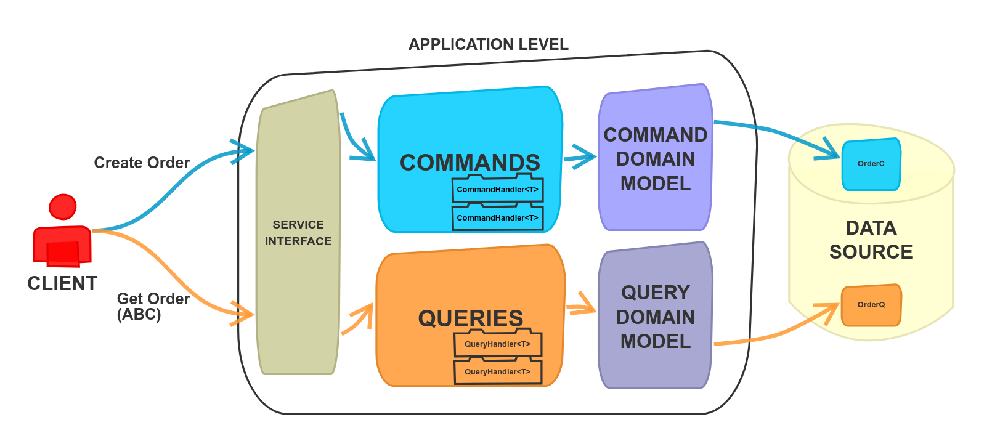

Slide 22
Seperate Applications!

Slide 23
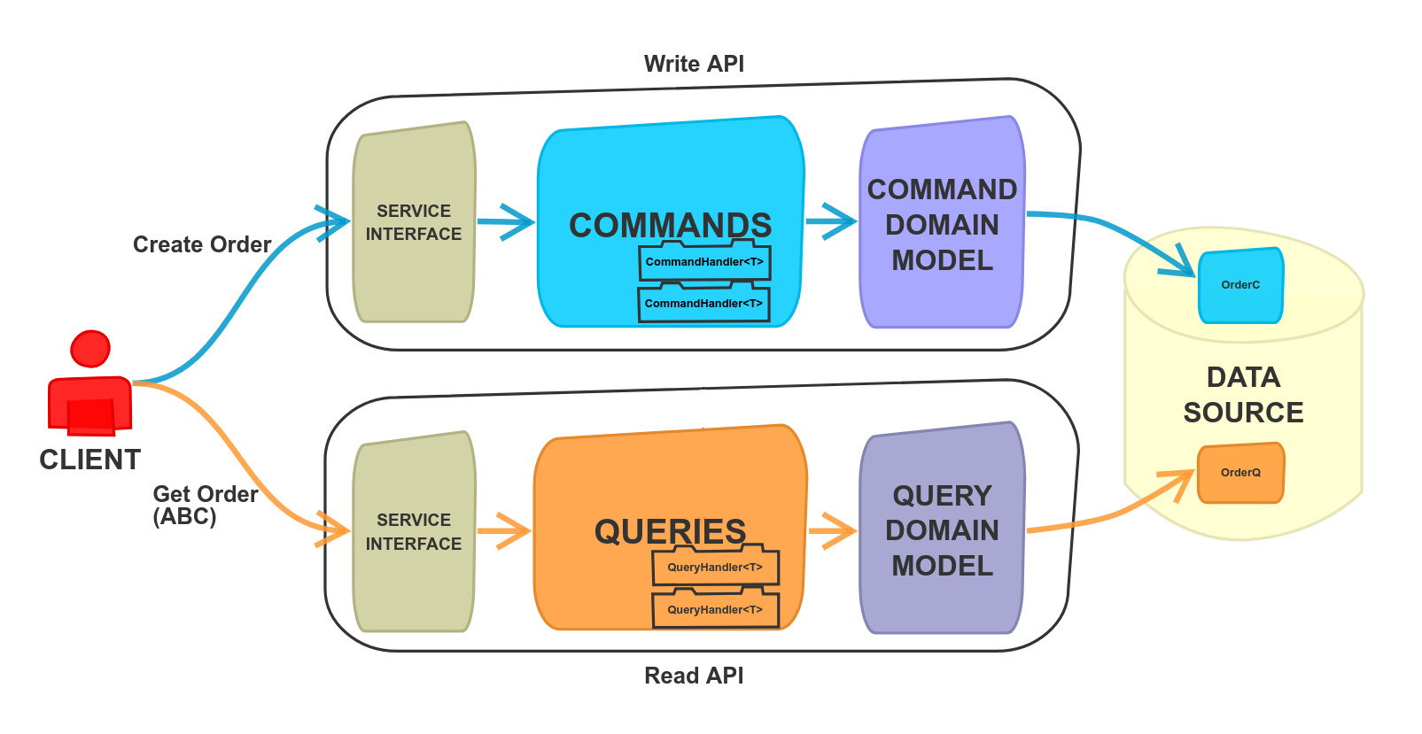

Slide 24
Seperate Data Sources!

Slide 25
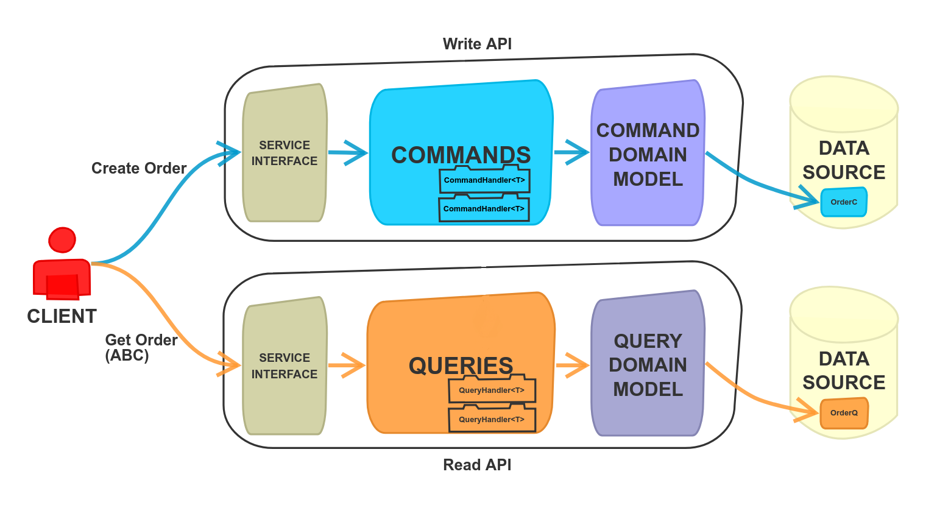

Slide 26

What about
data consistency?

Slide 27
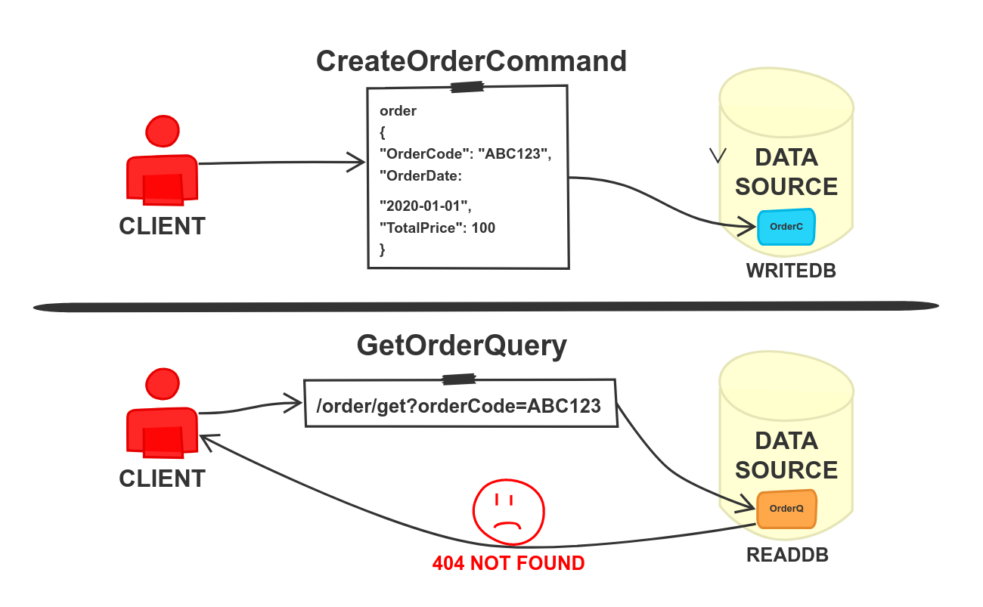

Slide 28
PROJECTIONS!

Slide 29
VIEW
MATERIALIZED VIEW

Slide 30
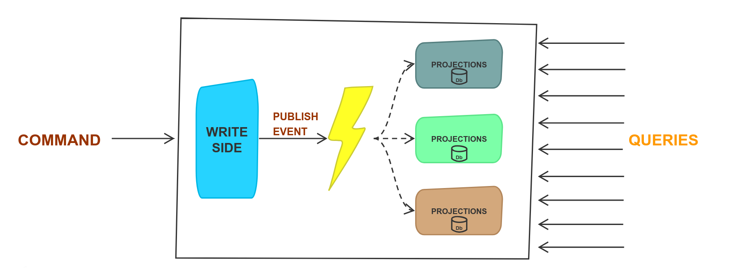

Slide 31
Now we can talk about
Eventually Consistency!

Slide 32
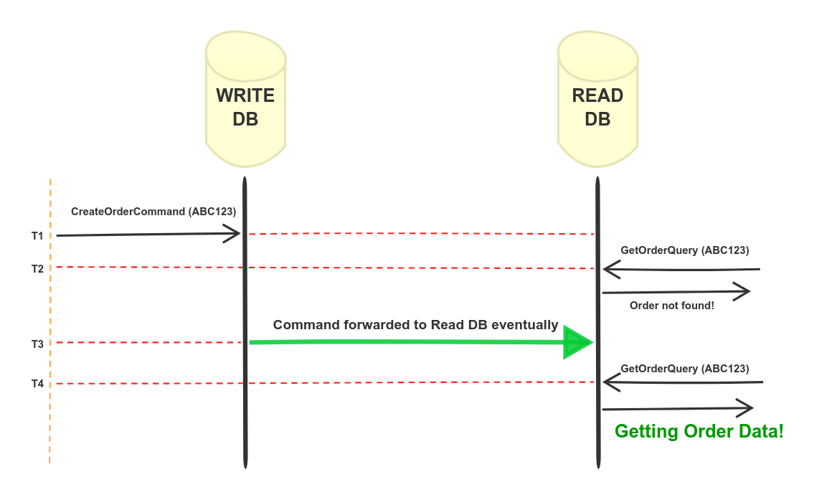

Slide 33
COMMAND
==
EVENT
??

Slide 34
COMMAND
A request named imperative sentence
CreateOrder
CancelOrder
UpdatePrice
May fail

Slide 35
Event
Statement of fact named with past tense
OrderCreated
OrderCancelled
PriceUpdated
Never fails
Immutable

Slide 36
SEND MESSAGE
==
PUBLISH MESSAGE
??

Slide 37
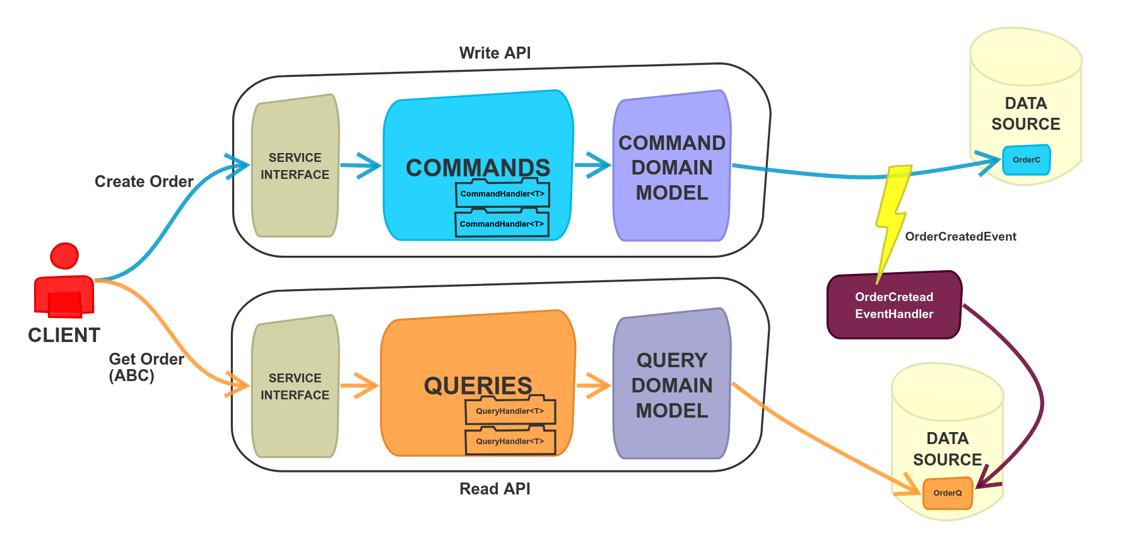

Slide 38
LET’S CODE...
(https://github.com/OnurSalkaya/cqrs-workshop/tree/03-CQRS)

Slide 39
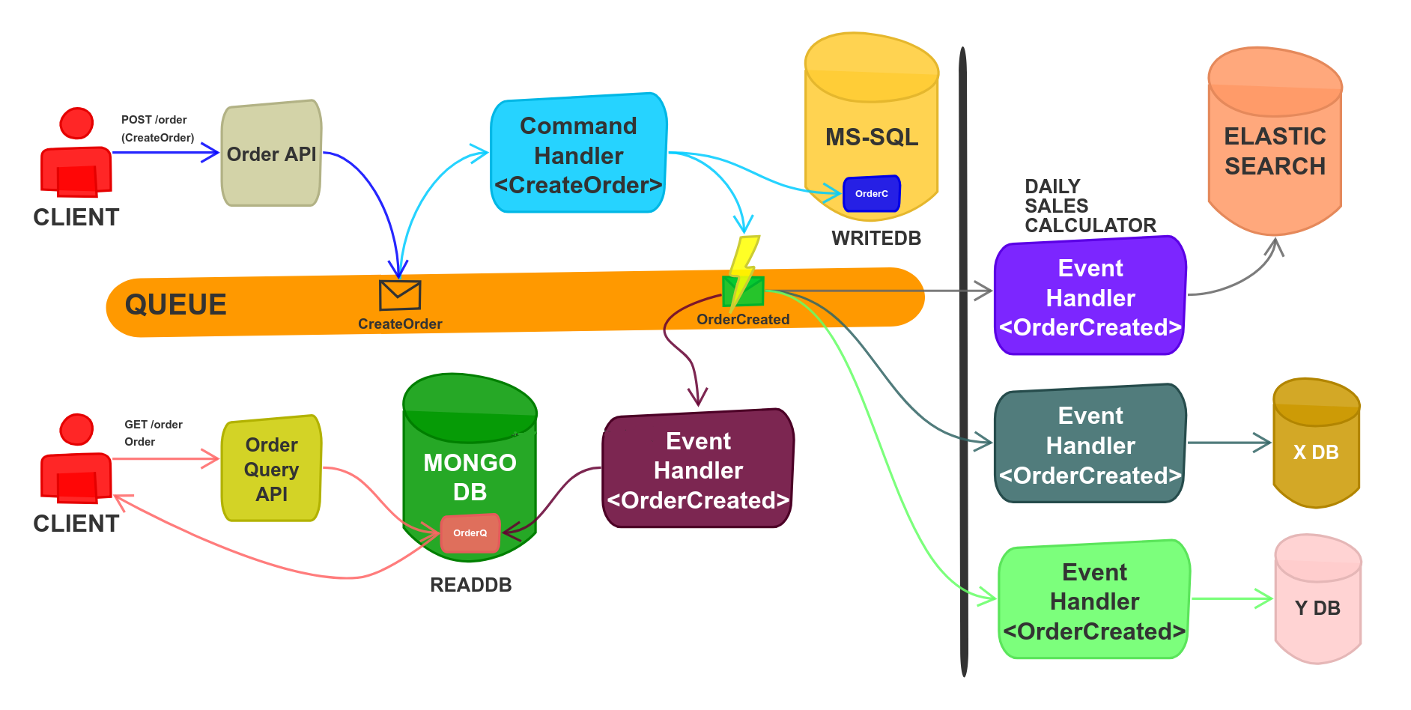

Slide 40
Why CQRS?
To be more scalable
To be able to scale write and read side separately
To be able to process more data synchronously
Increasing performance
To be able to handle complex problems by separating it into smaller pieces
To be able to build autonomous teams
Polygoth Programming

Slide 41
What IS WRONG WITH CQRS ?
Is it necessary? Maybe we do over-engineering
Implementing to whole system
Combining with multiple domain objects
If there is no CI/CD pipelines

Slide 42
CQRS CAN SOLVE LOTS OF PROBLEMS
BUT...

Slide 43
Multıple Domaın object UPDATE?
Why do u need? Is there any way to
avoid from it?
Example: "When a user is deactivated, cancel all
orders of the user"

Slide 44
Command and event versıonıng?
public class OrderCreatedEvent
{
public Guid Id { get; set; }
public string OrderCode { get; set; }
public DateTime OrderDate { get; set; }
public int UserId { get; set; }
public decimal TotalPrice { get; set; }
public string Status { get; set; }
}
public class OrderCreatedEvent_V2
{
public Guid Id { get; set; }
public string OrderCode { get; set; }
public DateTime OrderDate { get; set; }
public int UserId { get; set; }
public decimal TotalPrice { get; set; }
public string Status { get; set; }
//NEW PROPS
}
V3...

Slide 45
Event DUPLICATION?
Block re-handling with unique key
Ensure that events are handled idempotant

Slide 46
Event Orderıng?
ChangePassword (t1) -> PasswordChanged
ChangePassword (t2) -> PasswordChanged
Reordering on bus using delaying
Getting events bulk to consumer
Using event notification

Slide 47
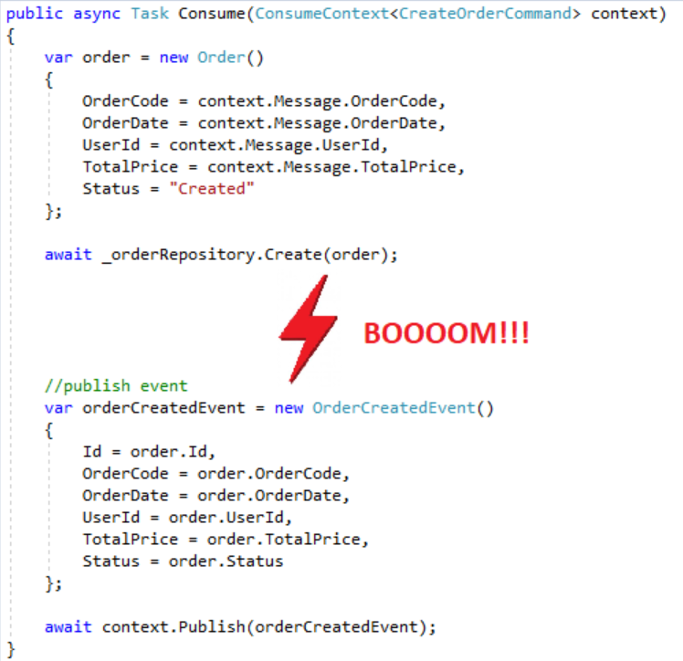
WHAT IF EVENT CAN’T BE PUBLISHED AFTER TRANSACTION COMMIT?
Suggestion : Outbox Pattern

Slide 48
EVENT SOURCING...

Slide 49
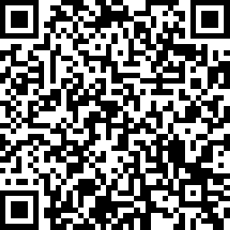
THANK YOU... FEEL FREE TO SEND YOUR FEEDBACK!

