Slide 1
Online Shopping Checkout with Card Validation
Team No
Aanurag - 2620030684
Amlan - 2620040026

Slide 2
Abstract
A console-based Java program where a customer picks a product from an inventory and pays by card.
The card number is checked for length (15 or 16 digits) and verified with the Luhn algorithm.
The card type is detected automatically: VISA, MASTERCARD, AMEX or RUPAY.
A custom exception and try / catch / finally handle wrong inputs without crashing the program.

Slide 3
Understanding Problem Statement
Mistyped or fake card numbers cause failed payments and wasted transactions.
A checkout must validate the card before the payment goes through.
Users may type letters or an item number that does not exist, and the program must not crash.
Goal: a simple, robust checkout with clear error messages for every kind of bad input.

Slide 4
CO 1 Topics
int for choice, price, sum and digit (whole numbers).
String for product name, card input and digits.
boolean flag doubleIt switches on and off while checking the card.
Arrays and objects: Product[] inventory holds the products, and Scanner reads input.
Product[] inventory = {
new Product("Laptop", 60000),
new Product("iPhone", 80000)
// ... 4 products in total
};
int choice = Integer.parseInt(input);
String digits = input.replace(" ", "");
int sum = 0;
boolean doubleIt = false;
int digit = digits.charAt(i) - '0';

Slide 5
Co 2 TOPICS
for loop (forward): prints every item of the inventory with its number.
for loop (backward): walks the card digits from right to left for the Luhn check.
Each pass reads one digit, adds it to sum and flips doubleIt.
// Print the inventory
for (int i = 0; i < inventory.length; i++) {
System.out.println((i + 1) + ") "
+ inventory[i]);
}
// Luhn: digits from right to left
for (int i = digits.length() - 1;
i >= 0; i--) {
// read digit, add to sum
doubleIt = !doubleIt;
}

Slide 6
CO 3 Topics
Nested if: double the digit, then subtract 9 if the result is above 9.
Validation ifs: reject the card if the length is wrong or the Luhn check fails.
if / else if chain: picks the card type from the starting digits.
if (doubleIt) {
digit *= 2;
if (digit > 9) {
digit -= 9;
}
}
if (!isLuhnValid(digits)) {
throw new InvalidCardException(...);
}
if (number.startsWith("4")) {
return "VISA";
} else if (firstTwo >= 51 && firstTwo <= 55) {
return "MASTERCARD";
}

Slide 7
CO 4
Parameterized: isLuhnValid(String digits) takes the card number and returns true or false.
Parameterized: main(String[] args) is the entry point of the program.
Non-parameterized: getCardType() and toString() take no input.
// Parameterized
private boolean isLuhnValid(String digits) {
...
return sum % 10 == 0;
}
// Non-parameterized
public String getCardType() {
...
return "UNKNOWN";
}
// Calling them
isLuhnValid(digits);
card.getCardType();

Slide 8
CO 5
Product(String name, int price): sets the product fields using this.
Card(String input): checks the number and creates no Card if it is bad.
InvalidCardException(String message): passes the message to super().
public Product(String name, int price) {
this.name = name;
this.price = price;
}
public Card(String input)
throws InvalidCardException {
// validate, then store the number
this.number = digits;
}
public InvalidCardException(String message) {
super(message);
}

Slide 9
CO 6
trim() and replace(): clean the typed input and remove spaces.
matches(): checks the card is 15 or 16 digits using a pattern.
charAt(), length(): read each digit of the card number.
substring(), startsWith(): read the first digits to find the card type.
Concatenation: builds the inventory and cart messages.
scanner.nextLine().trim()
input.replace(" ", "")
digits.matches("\\d{15,16}")
digits.length()
digits.charAt(i) - '0'
number.substring(0, 2)
number.startsWith("4")
(i + 1) + ") " + inventory[i]
"Your cart is - " + item

Slide 10
Conclusion
One working program covers variables, loops, if statements, methods, constructors and String handling.
The Luhn check catches mistyped card numbers before the payment is made.
A custom exception with try / catch / finally keeps the program from crashing on bad input.
Future scope: quantity and cart total, more card types, a GUI and a database.

Slide 11
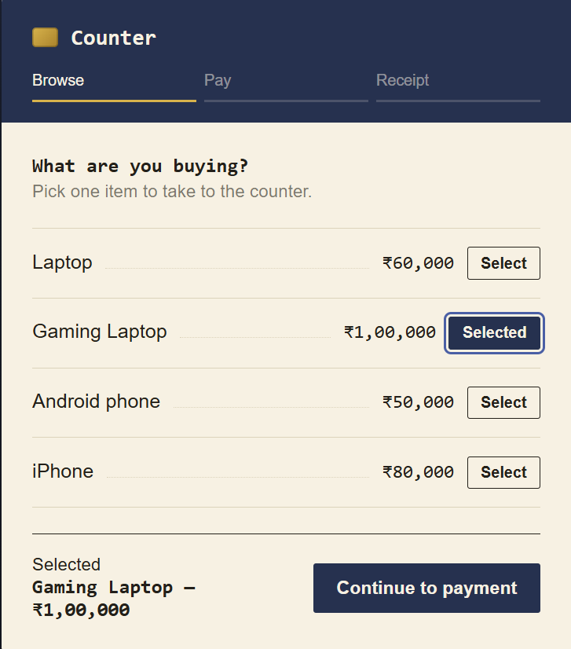
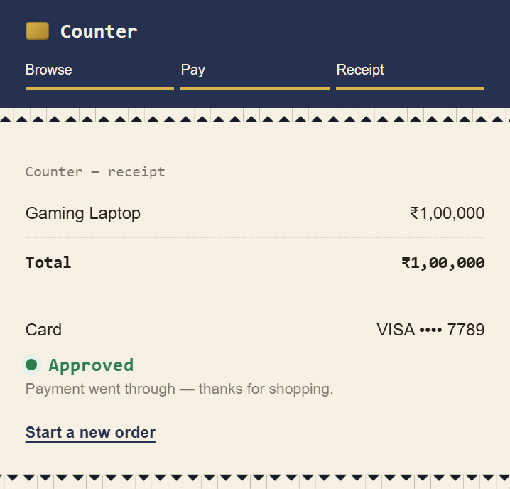
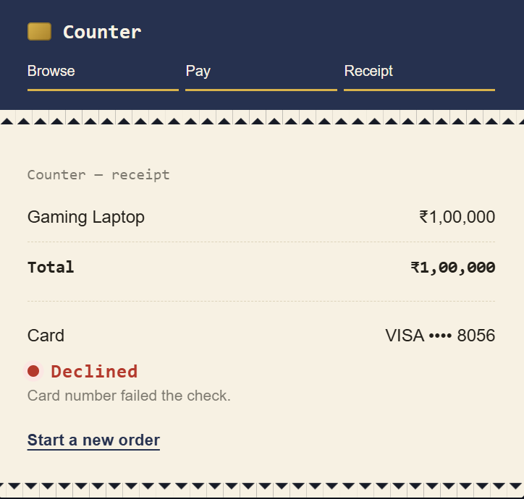
Screen Shots
Inventory and item selection
Successful payment
Invalid card or wrong input

Slide 12
Geo Tag Photo and git hub link
GitHub
Geo Tag Photo

