Slide 1
Final Presentation

Slide 2
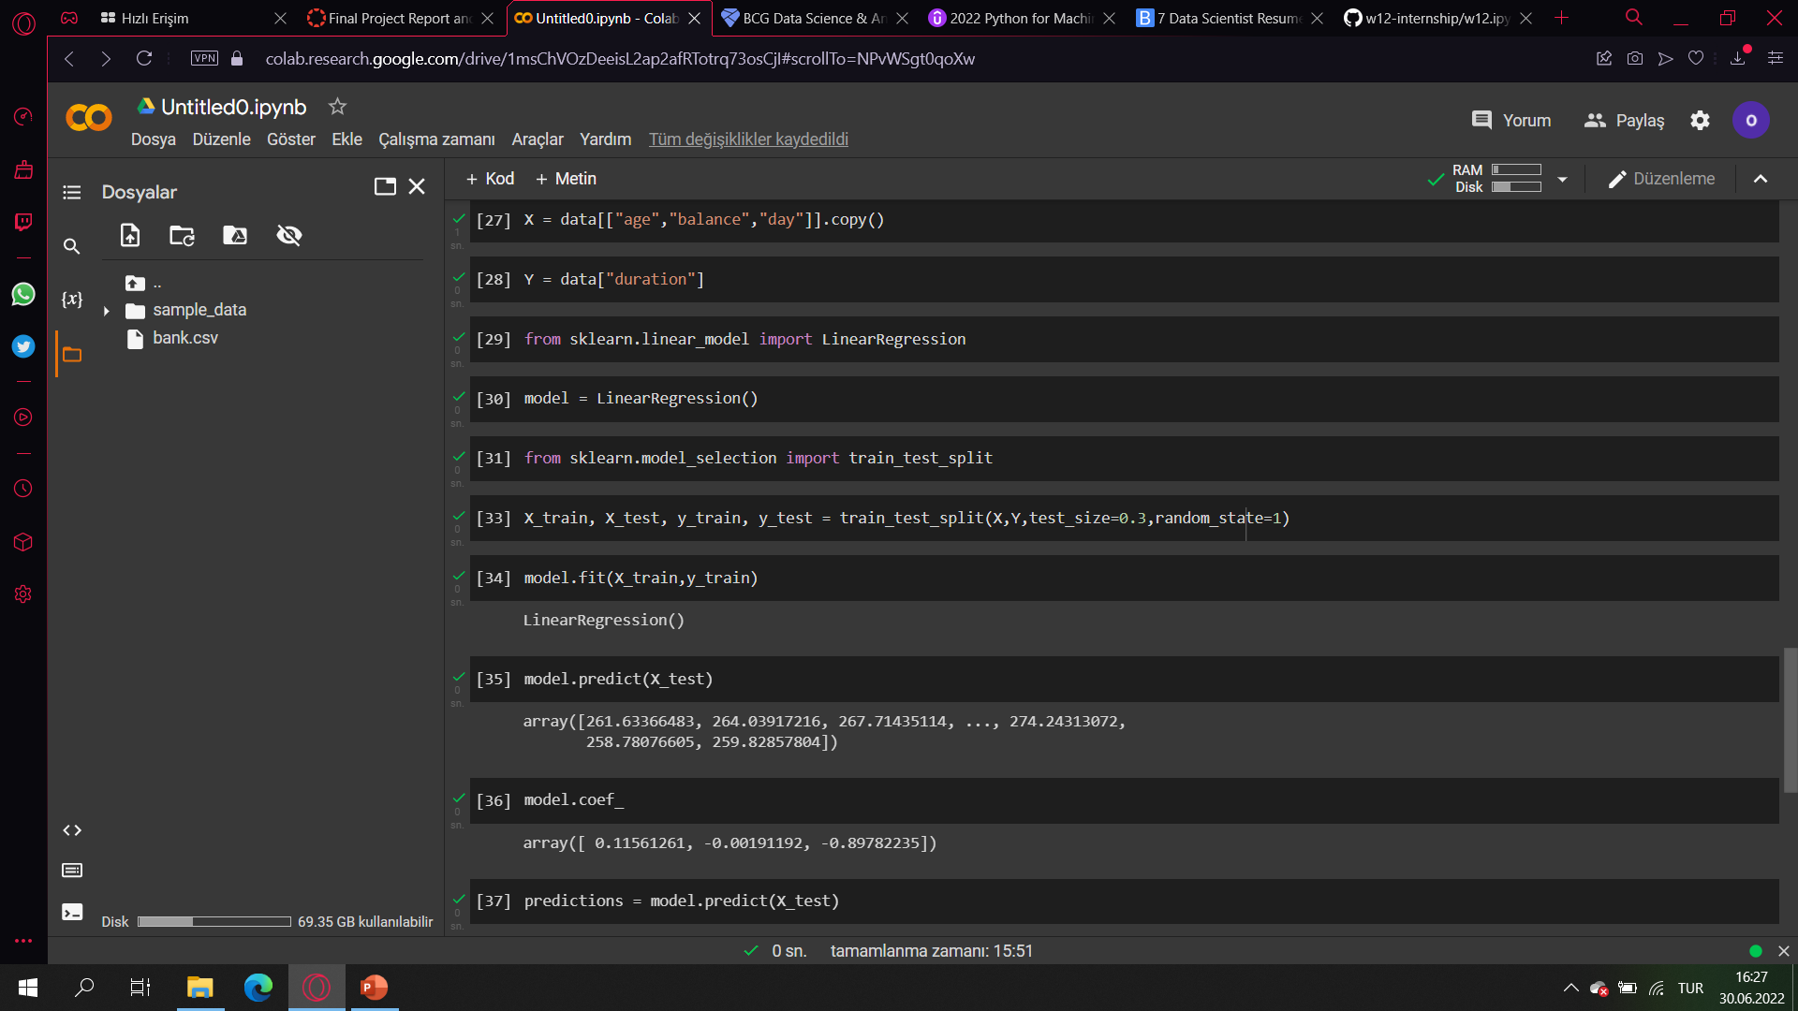
X and Y

Slide 3
Train Test split and model

Slide 4
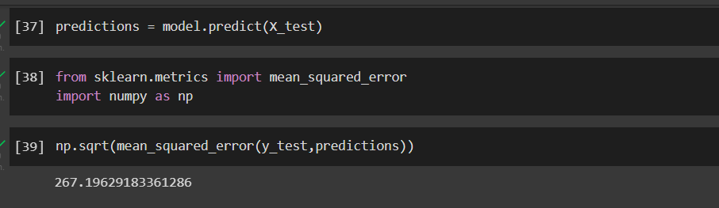
Model Performance

